Slide 1

Coronary heart disease prediction using SVM
Mina NASEH
Oliver JACK

Slide 2
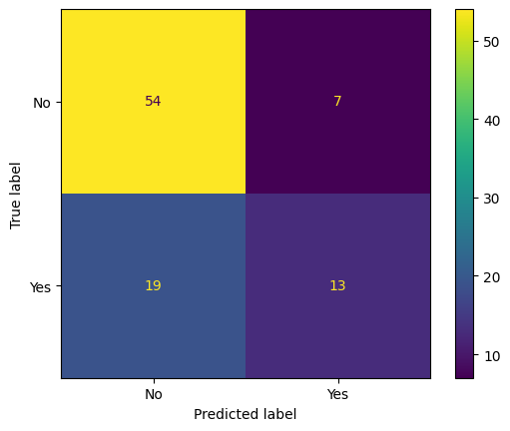
Problem overview
goal = come up with model that predicts coronary heart disease based on certain features
SVM approach
#1 priority = minimize false negatives
#2 priority = minimize false positives

Slide 3

Dataset analysis
9 features + CHD column
462 observations
no missing data
Dataset is unbalanced!
#No 302
#Si 160

Slide 4
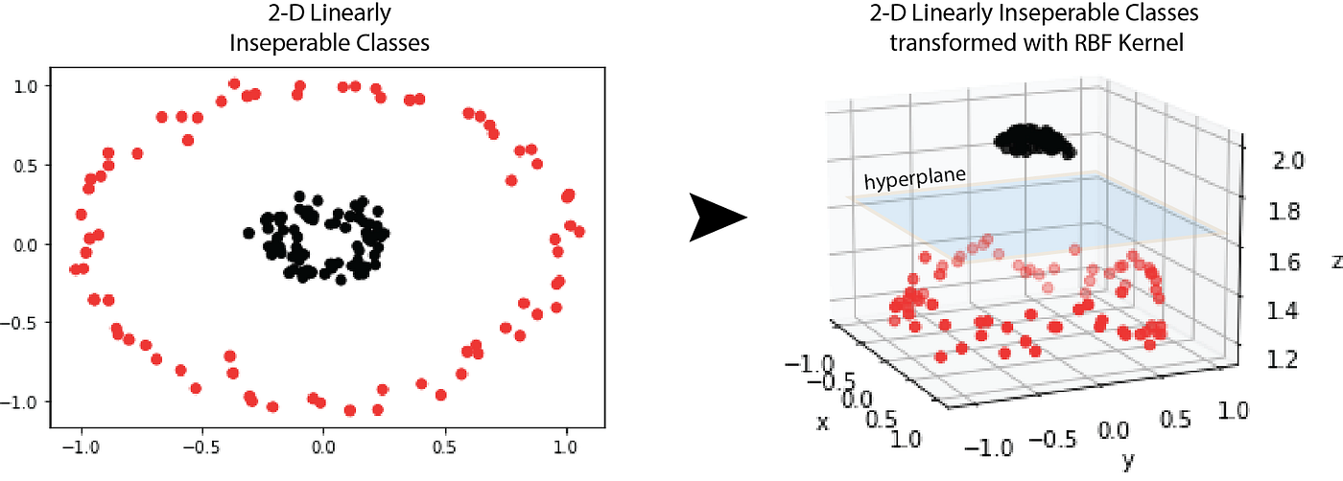
SVM
SVM = supervised learning algorithm used for classification & regression tasks
goal = find the optimal hyperplane that maximizes the margin between different classes
data can be transformed into a higher-dimensional space to simplify separation of classes
hard-margin vs. soft-margin

Slide 5
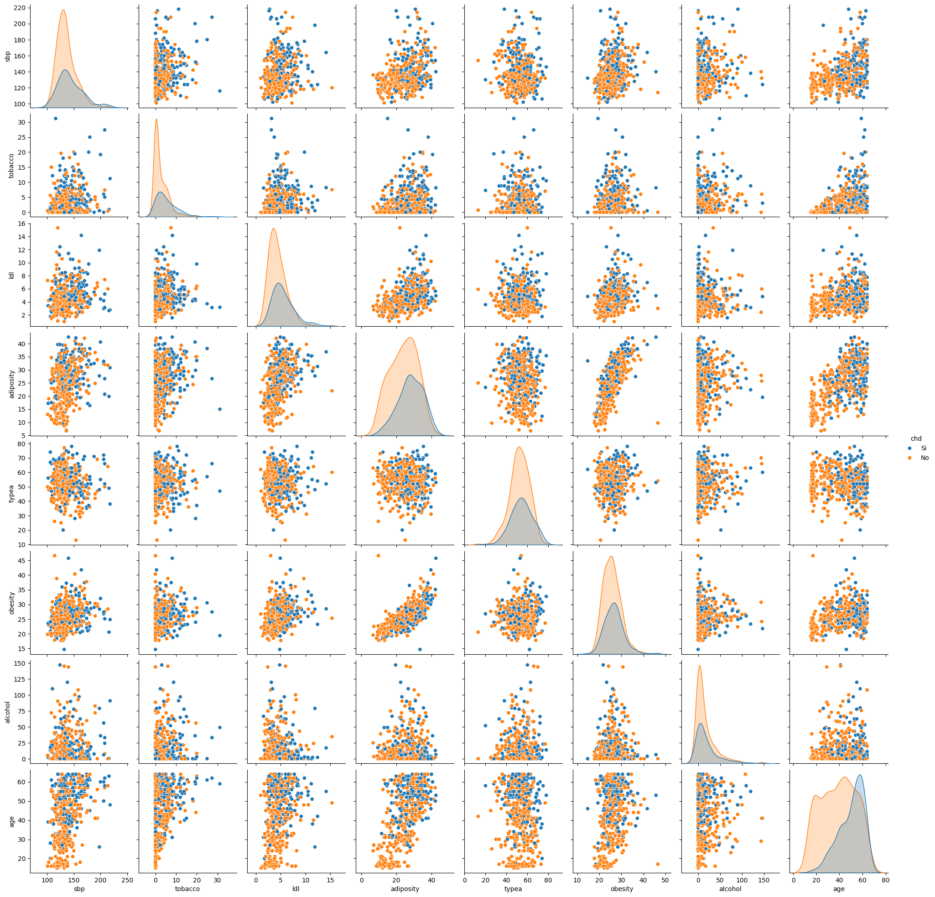
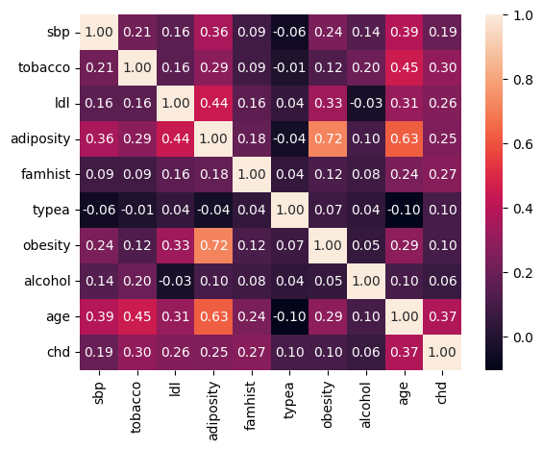
Data preprocessing – 1
Adiposity is a measure of the condition of being severely overweight or obese

Slide 6
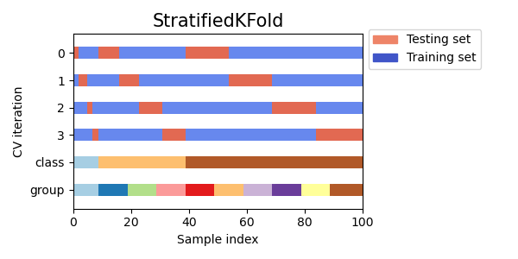
Data preprocessing – 2
X_train, X_test, y_train, y_test = train_test_split(X, y, train_size=0.8, shuffle=True, random_state=42, stratify=y)

Slide 7
Data preprocessing – 2
scaler1 = preprocessing.StandardScaler().fit(X)
X_train = scaler1.transform(X_train)
X_test = scaler1.transform(X_test)
scaler2 = preprocessing.StandardScaler().fit_transform(X_train)
X_test_scaled = scaler2.transform(X_test)
clf = GridSearchCV(svm.SVC(), cv=5, param_grid={"kernel": kernel, "degree": degree, "coef0": coef0, "C": C, "gamma": gamma}, verbose=1, n_jobs=-1, scoring="recall")
The recall is the ratio tp / (tp + fn) where tp is the number of true positives and fn the number of false negatives. The recall is intuitively the ability of the classifier to find all the positive samples.

Slide 8
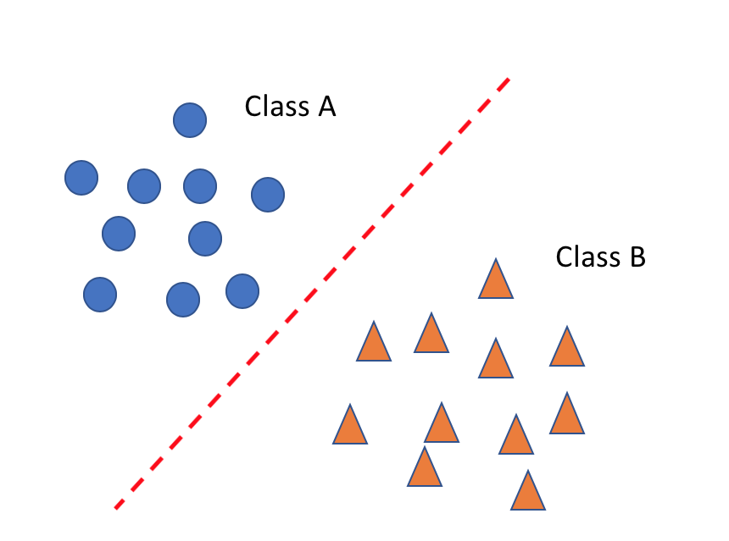
Model training – Linear kernel
formula : K(x,x′) = x⋅x′
x & x′: feature vectors
C: regularization parameter (part of the SVM's objective function that is minimized during training, not part of the kernel function) ( range: [0.1, 1, 10, 100, 1000])

Slide 9
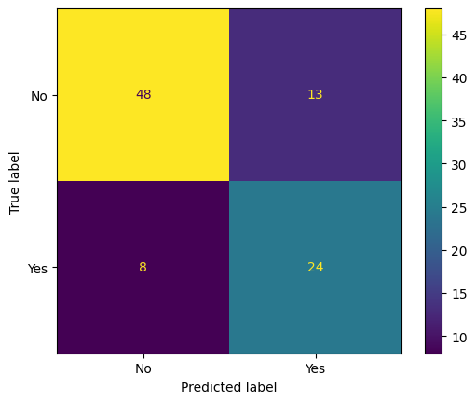
Results – Linear kernel
features = [tobacco, typea, famhist, age]
C = 1

Slide 10
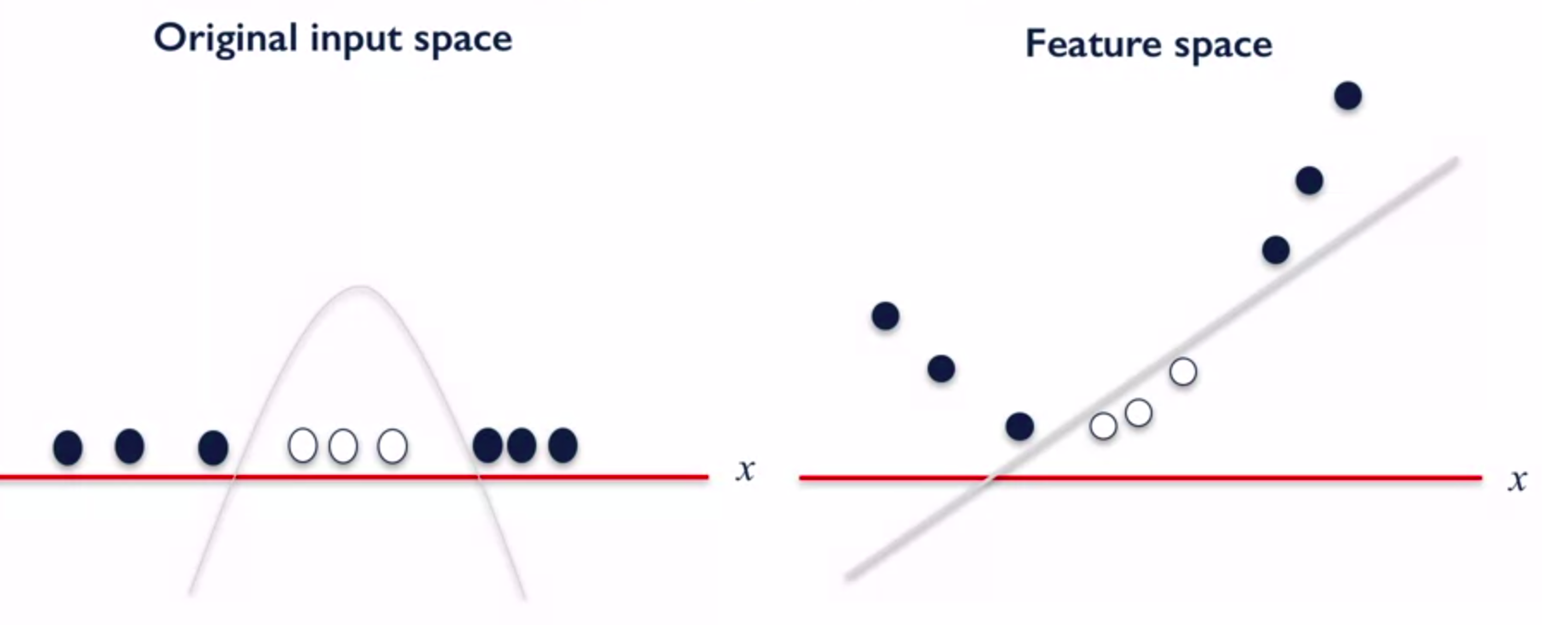
Model training – Polynomial kernel
formula: K(x,x′) = (γ⋅x⋅x′+ c)^d
x & x′: feature vectors
γ (gamma): scale factor for the dot product of x & x′ (range: ['scale', 'auto', 0.0001, 0.001, 0.01, 0.1, 1])
c: constant term (range: [0, 1, 2, 3, 4, 5, 6, 7, 8, 9, 10])
d: degree of the polynomial (range: [1, 2, 3, 4, 5])
C: regularization parameter (range: [0.1, 1, 10, 100, 1000])

Slide 11
Results – Polynomial kernel
features = [tobacco, typea, famhist, age]
C = 1
γ = 1
c = 0
d = 1

Slide 12
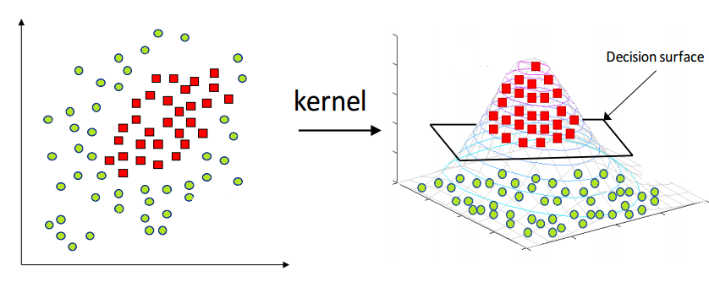
Model training – RBF kernel
formula: K(x,x′) = exp(−γ∥x−x′∥^2)
x & x′: feature vectors
γ (gamma): scale factor for the dot product of x & x′ (range: ['scale', 'auto', 0.0001, 0.001, 0.01, 0.1, 1])
C: regularization parameter (range: [0.1, 1, 10, 100, 1000])

Slide 13

Results – RBF kernel
features = [tobacco, typea, obesity, famhist, age]
C = 100
γ = 0.001

Slide 14
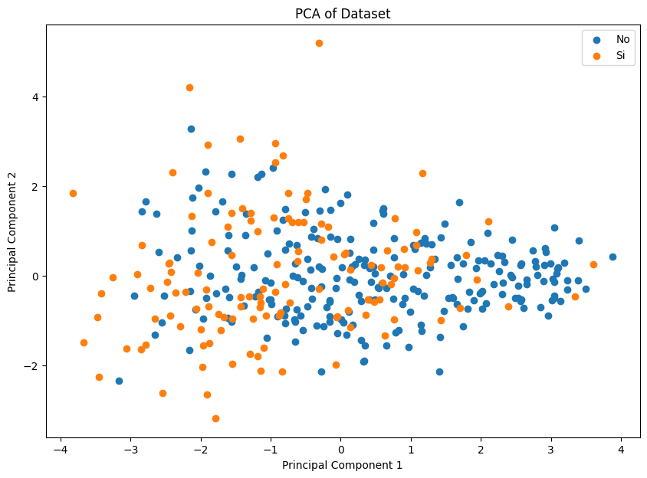
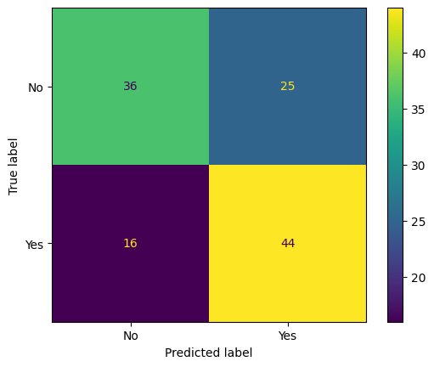
Other tested approaches
reducing the number of features using PCA
modifying train-test split proportion
balancing the two sets by generating new synthetic samples

Slide 15
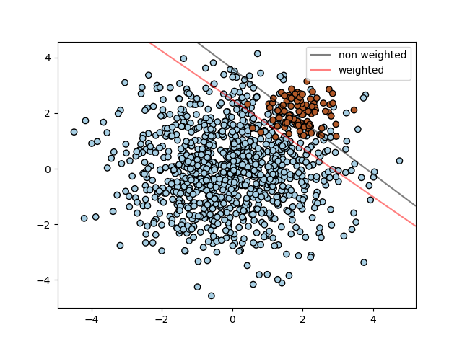
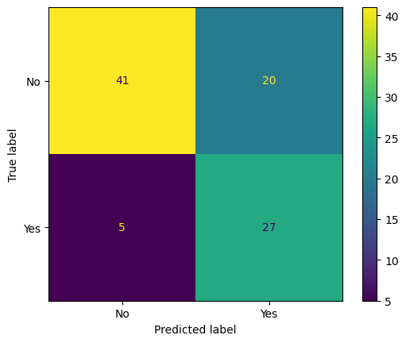
Weighted SVM

Slide 16

Medical advice
our preferred SVM model: linear kernel applied to features age, tobacco consumption, type-A behaviour & family history of heart disease
major computational advantages as opposed to using RBF kernel

Slide 17

Thank you for your attention!

