Slide 1


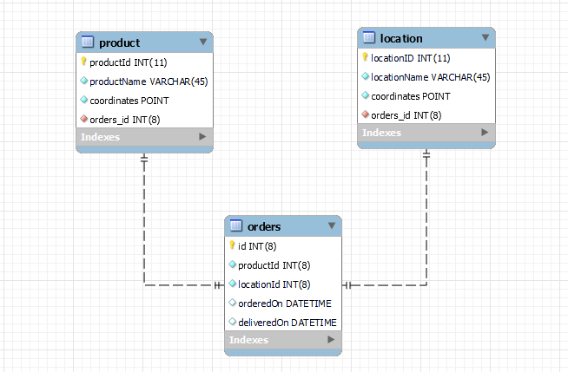
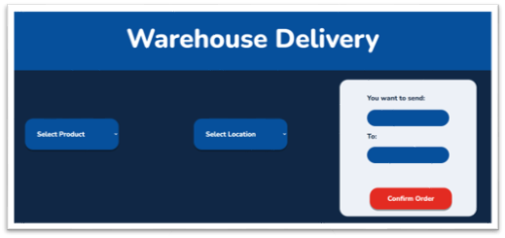
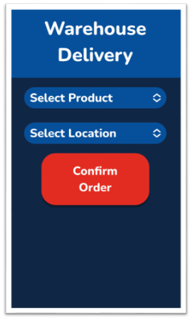
Robot Delivery Database
Mina Campos
Professor Nancy Reddig
OPPORTUNITY/PURPOSE
The purpose of this project was to make an easily accessible order form that will connect to, push, and pull information from a database to a delivery robot
TECHNICAL DESIGN & DATA MODEL
DESIGN SPECIFICATIONS & SYSTEM REQUIREMENTS
We wanted this project to work as an online order form, that would push and pull from the database tables capturing specific ID values, and to then push those values into a new table that would be sent off to the delivery robot. I had planned to keep the webpage simple, for easy access, and focus on the task at hand to work directly with the database values.
PROTOTYPE/PROCESS
A big point in my design process was needing to re-code the entire CSS multiple times as I had originally coded everything to be in a set position and was unaware of the way that would affect different screen sizes. Since most of my code sat in the CSS files, everything I changed would cause a domino effect in altering something else, making it difficult to move forward until I finished a layout.
IMPACT
I aim that this project will provide great efficiency in robot to database communication, for the future of delivery design robotics.
TESTING PROCESS OR LESSONS LEARNED
Doing this project taught me a lot about repetitive feedback, with weekly standup meetings being held with Professor Reddig to ensure the project was on track and the goal was at hand. It also allowed for a lot of learning and testing using SQL commands that I had before been very unfamiliar with, giving me a greater understanding of that side in code.
REFERENCES & ACKNOWLEDGEMENTS
I’d like to thank Professor Reddig for presenting me with the opportunity to work on this project with her and believing in my ability despite not having the desired experience. Along with The School of Engineering and Computer Science for providing endless support and resources to make this project possible.
Software Engineering Project 2023
EDUCATE FOR SERVICE. ENGINEER FOR SOCIETY.
Notes:
Introduction. Include the student name, company name, internship location, internship position, and internship dates. Also note the course rubric and number, course title, and instructor(s). In addition, describe how you secured the internship.
Abstract. The abstract should provide a concise summary of what was done and learned in the internship and the course.
Learning Objectives. List 2 to 5 learning objectives that you had planned to achieve by completing the internship.
Description of Key Responsibilities. Summarize the major responsibilities, activities, and project(s) completed during the internship.
Application of VWU courses to the internship. Explain how your coursework helped with the internship. Link relevant courses, theories, and concepts to their applications within the internship.
Lessons Learned. Explain what you learned about the industry, the company, the career process, and yourself through the internship experience.
Acknowledgements. Recognize the people who helped you, including the internship site supervisor, the course instructor, and mentors. Include full titles in the acknowledgements. In addition, acknowledge funding sources.
Visuals. Incorporate visual aids to illustrate key points. Be sure to label all visuals. Include: names, dates, locations, and photographers. Do not include photographs of children unless you have secured approval from your site supervisor to use the children’s images.

