Slide 1

What is a hyper-heuristic?
Simple Idea: Heuristics to choose heuristics (initial definition)
A hyper-heuristic is a heuristic that operates on a search space of heuristics rather than directly on a search space of solutions

Slide 2
Different Search Spaces
Hyper-heuristic
Operates upon
Low Level Heuristics
Operates upon
Potential Solutions

Slide 3
What is the difference between a hyper-heuristic and a meta-heuristic?
All the term hyper-heuristic says is: “Operate on a search space of heuristics”.
NOTHING ELSE!
We have a high level search method (the hyper-heuristic) - which may (or may not) be a metaheuristic

Slide 4
Properties of Hyperheuristics
Operate on search spaces of heuristics
Easy to implement, practical to deploy (easy, cheap, fast)
Aim is to take advantage of strengths and avoid weaknesses of each heuristic
Existing heuristics can be used within hyperheuristics
No problem specific knowledge is required during the search over heuristics space

Slide 5
Hyperheuristics – Motivation
Automating the heuristic design process
Deeper understanding of how high we can raise the level of generality: What are the limits?
A Grand Challenge
More General
The General Solver
Significant scope for future research
Doesn’t exist….
Problem Specific Solvers

Slide 6
Intellectual Roots
Hyper-heuristic research has many of its roots in the mid-nineties
But can be traced back to the 60’s

Slide 7
Intellectual Roots
Fisher H. and Thompson G.L. Probabilistic Learning Combinations of Local Job-shop Scheduling Rules. In Factory Scheduling Conference, Carnegie Institute of Technology, May 10-12, 1961
Fisher H. and Thompson G.L. Probabilistic Learning Combinations of Local Job-shop Scheduling Rules. Ch 15,:225-251, Prentice Hall, New Jersey, 1963
Crowston W.B., Glover F., Thompson G.L. and Trawick J.D. Probabilistic and Parameter Learning Combinations of Local Job Shop Scheduling Rules. ONR Research Memorandum, GSIA, Carnegie Mellon University, Pittsburgh, (117), 1963
The learning mechanism used probabilistic weightings of low level heuristics which represented scheduling rules

Slide 8
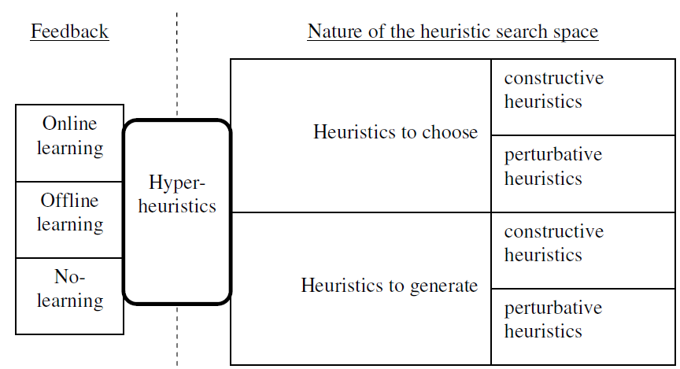
Classification
Choice hyperheuristics
Methodologies
Generational hyperheuristics
Methodologies

Slide 9
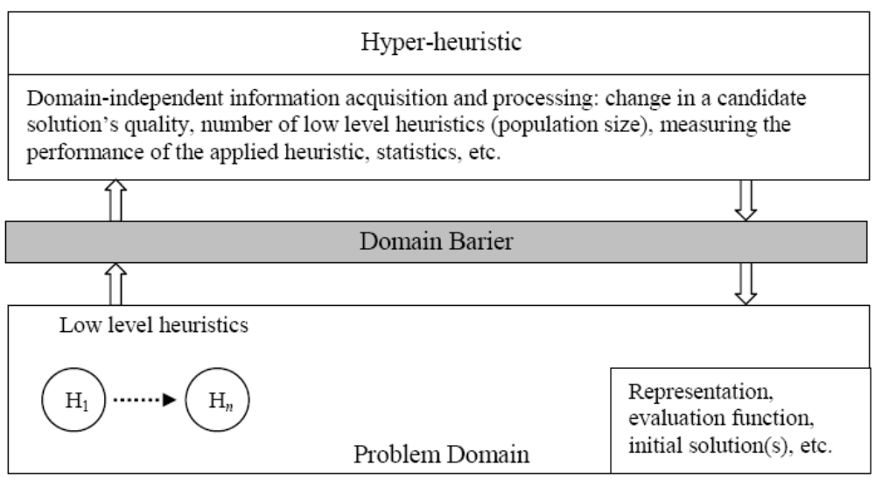
A Hyper-heuristic Framework
Hyper-heuristic
Domain Barrier

Slide 10
A Choice Hyper-heuristic Framework
Heuristic Selection Method
Move Acceptance Criteria
Domain Barrier
Perturbative low level heuristics

Slide 11
A Choice Hyper-heuristic Framework –
Single Point Search
generate initial candidate solution p
while (termination criteria not satisfied){
select a heuristic (or subset of
heuristics) h from {H₁, ..., H_{n}}
generate a new solution (or solutions) s
by applying h to p
decide whether to accept s or not
if (s is accepted) then
p=s }
return p;

Slide 12
Reinforcement Learning
A machine learning technique
Inspired by related psychological theory
  Reward and punishment
Concerned with how an agent ought to take actions in an environment to maximize some notion of long-term reward

Slide 13
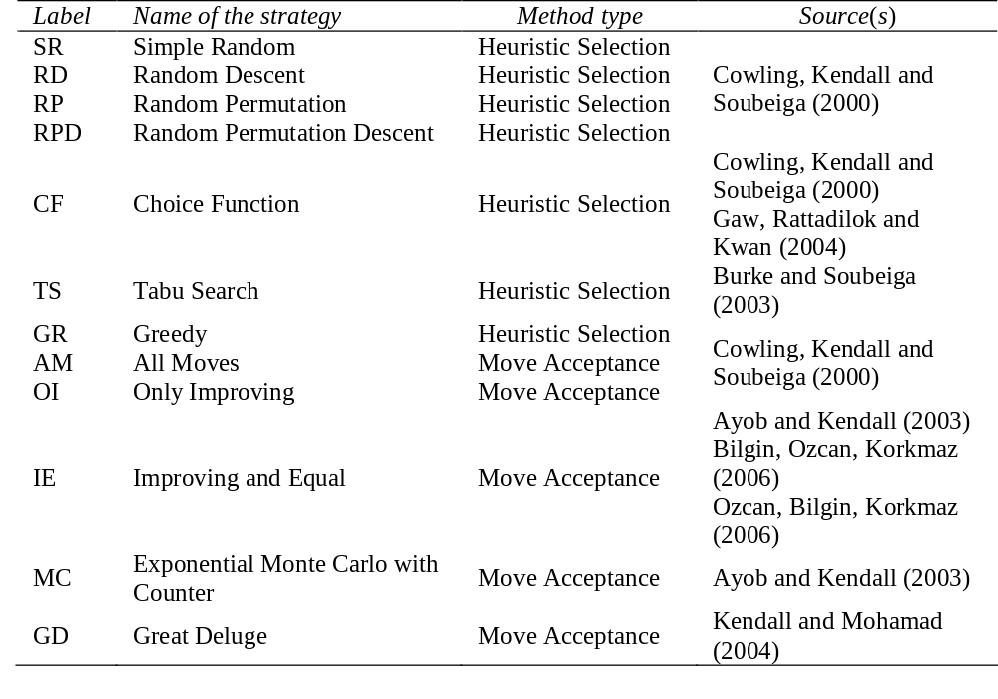
Some Existing Perturbative Hyper-heuristic Components
EMCQ
MC
Simulated Annealing
Move Acceptance
Bai and Kendall (2005) Bilgin, Ozcan, Korkmaz (2006)

Slide 14

Heuristic Selection –
Simple Random (SR)
Select one of the low level heuristics
randomly
SR
H₁
H₂
H₃
H₄
H₅
H₆

Slide 15
Heuristic Selection –
Simple Random (SR)
Select one of the low level heuristics
randomly
SR
H₁
H₂
H₃
H₄
H₅
H₆

Slide 16
Heuristic Selection –
Simple Random (SR)
Select one of the low level heuristics
randomly
SR
H₁
H₂
H₃
H₄
H₅
H₆

Slide 17

Heuristic Selection –
Simple Random (SR)
Select one of the low level heuristics
randomly
SR
H₁
H₂
H₃
H₄
H₅
H₆

Slide 18
Heuristic Selection – Greedy (GR)
Apply each low level heuristic to the candidate solution and choose the one that generates the best change in the objective value
GR
Δf₁
Δf₂
Δf₃
Δf₄
Δf₅
Δf₆
H₁
H₂
H₃
H₄
H₅
H₆
Δf₃ < Δf₁, Δf₂, Δf₄, Δf₅, Δf₆ at step t

Slide 19
Heuristic Selection –
Choice Function (CF)
The choice function maintains a record of the performance of each heuristic. Three criteria are maintained:
1) Its individual performance
2) how well it has performed with other heuristics
3) the elapsed time since the heuristic has been called

Slide 20
Heuristic Selection –
Choice Function (CF)
CF
s₁
s₂
s₃
s₄
s₅
s₆
H₁
H₂
H₃
H₄
H₅
H₆
s₂ > s₁, s₃, s₄, s₅, s₆ at step t

Slide 21
Move Acceptance – Simple Criteria
AM: All Moves Accepted
OI: Only Improving Moves accepted
IE: Improving or Equal moves are accepted.

Slide 22
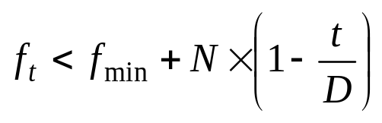
Move Acceptance – Great Deluge (GD)
Improving and equal moves are accepted
Non-improving moves resulting in a fitness value less than a threshold are accepted.
The threshold is decreased to global minimum with time.
  N : initial fitness – minimum fitness
  t : time passed
  D : Duration
current fitness
threshold

Slide 23
Move Acceptance –
Simulated Annealing (MC)
All improving moves are accepted while the non-improving are accepted based on Metropolis criterion (e^{-δ/τ}), where τ represents temperature, being decreased at each iteration using a cooling schedule.
Previous studies show that SA is one of the best move acceptance criterion

