Slide 2
Visualisation Tool for Selection Hyper-Heuristics
gp09-exo

Slide 3
“
Design and implement a Java applet (or application) that demonstrates how a selection hyper-heuristic works on an optimisation problem that requires binary representation.
”

Slide 4
What is a heuristic anyway?

Slide 5
So what’s a hyper-heuristic?

Slide 6
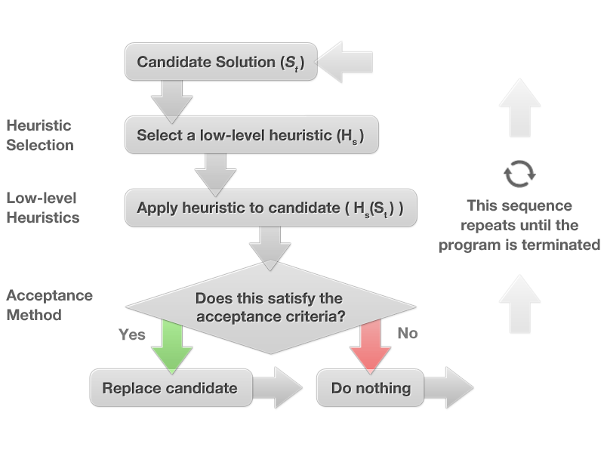

Slide 7
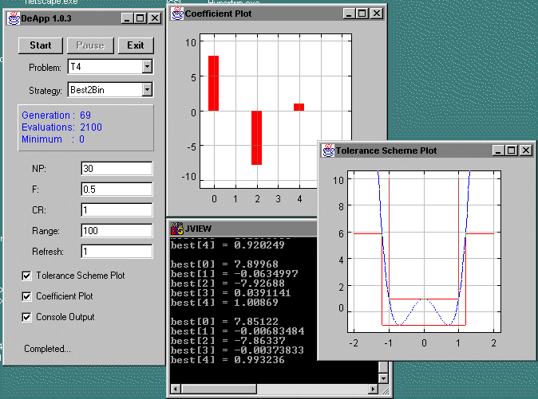
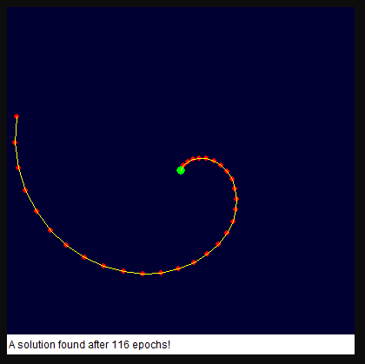
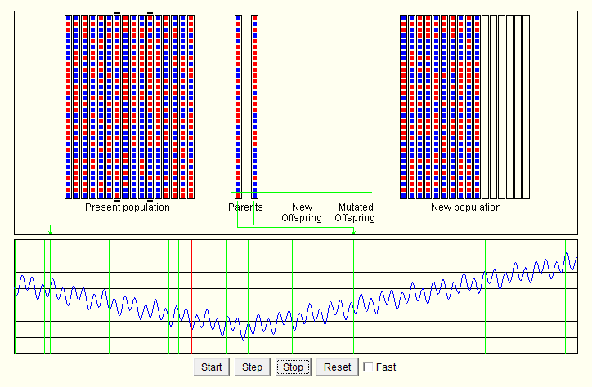
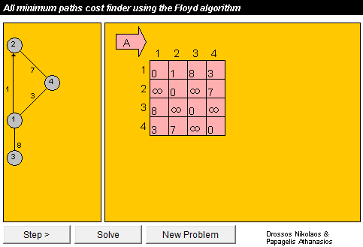
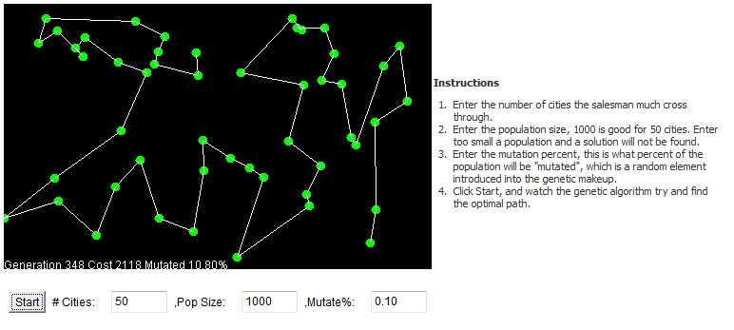
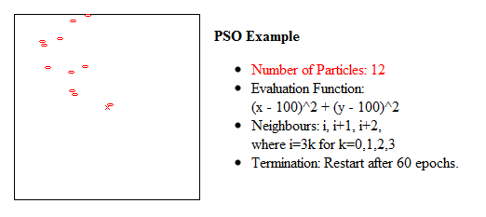

Slide 8
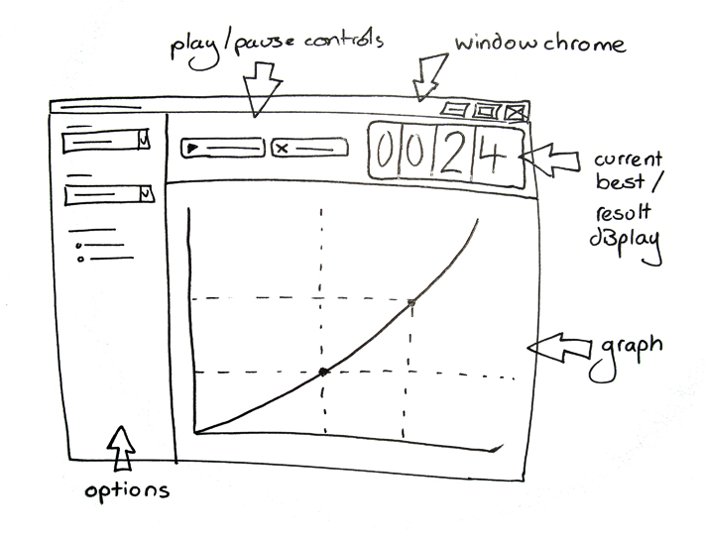
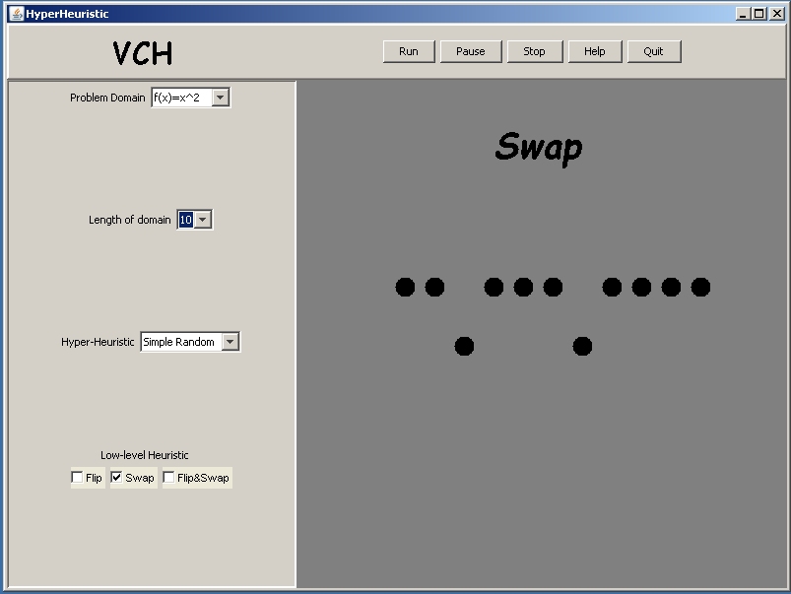
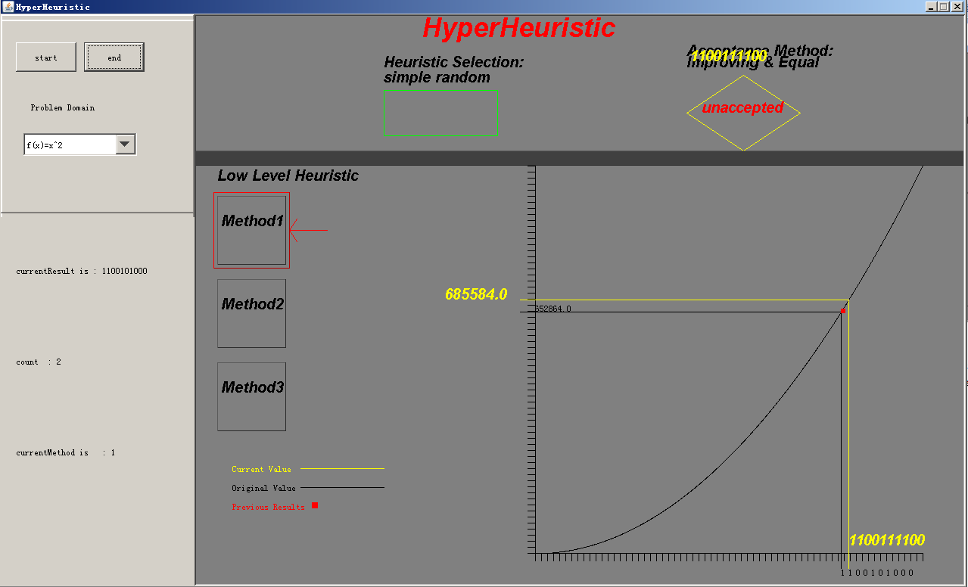

Slide 9
