Slide 1

FLAME Platform
A Simple Walkthrough
What you can see and do — step by step

Slide 2
WELCOME

Slide 3
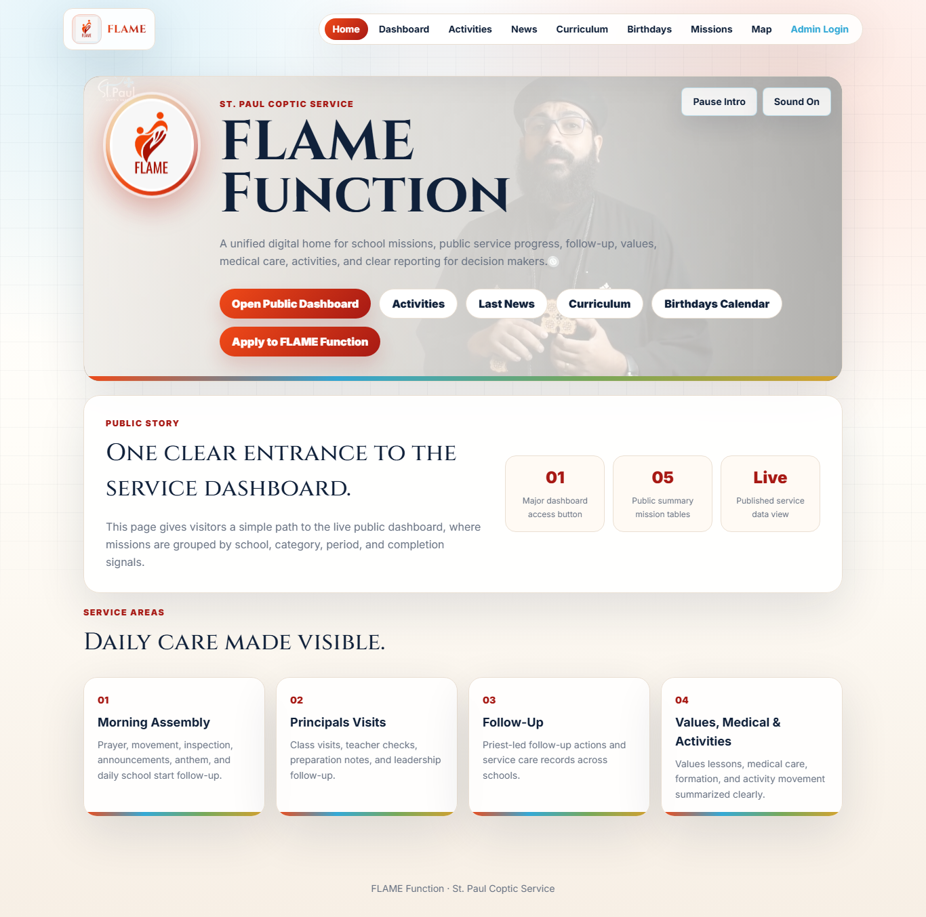
Welcome to FLAME
A simple window into the FLAME educational missions — see the service story and manage everything in one place.
Steps
1 Open the website on any device.
2 Visitors explore the public pages.
3 The team signs in to manage the data.
1

Slide 4
FOR VISITORS

Slide 5
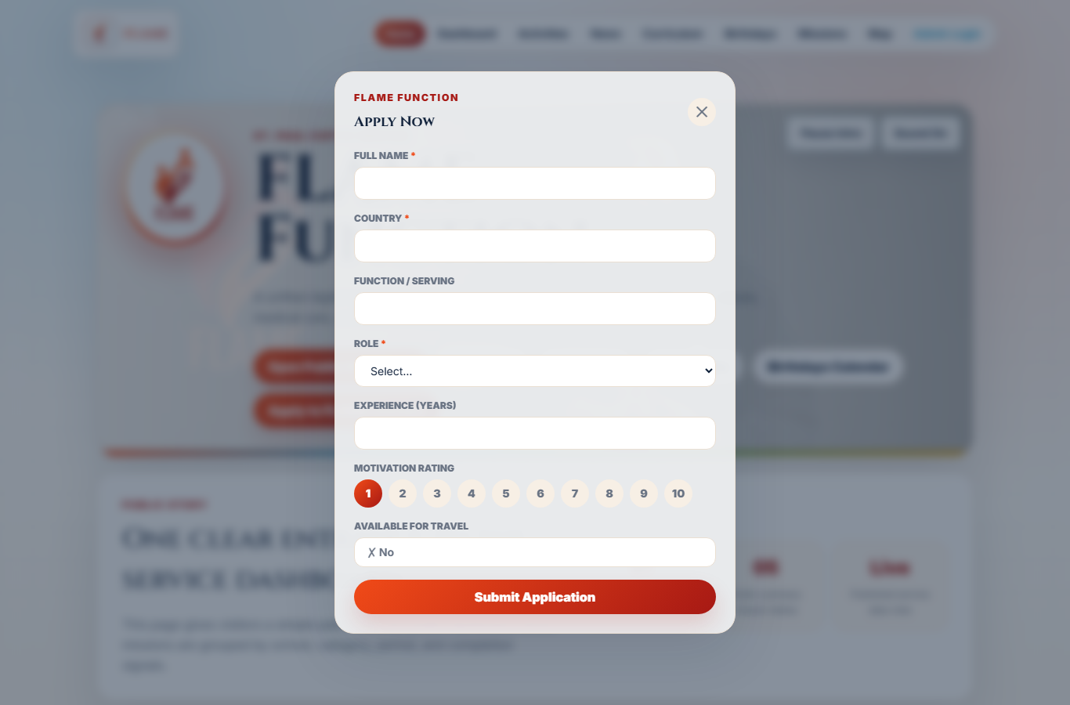
Apply to Join
Anyone can apply to serve, right from the home page.
Steps
1 Click the Apply button.
2 A simple form pops up.
3 Fill it in and submit — the team receives it instantly.
2

Slide 6
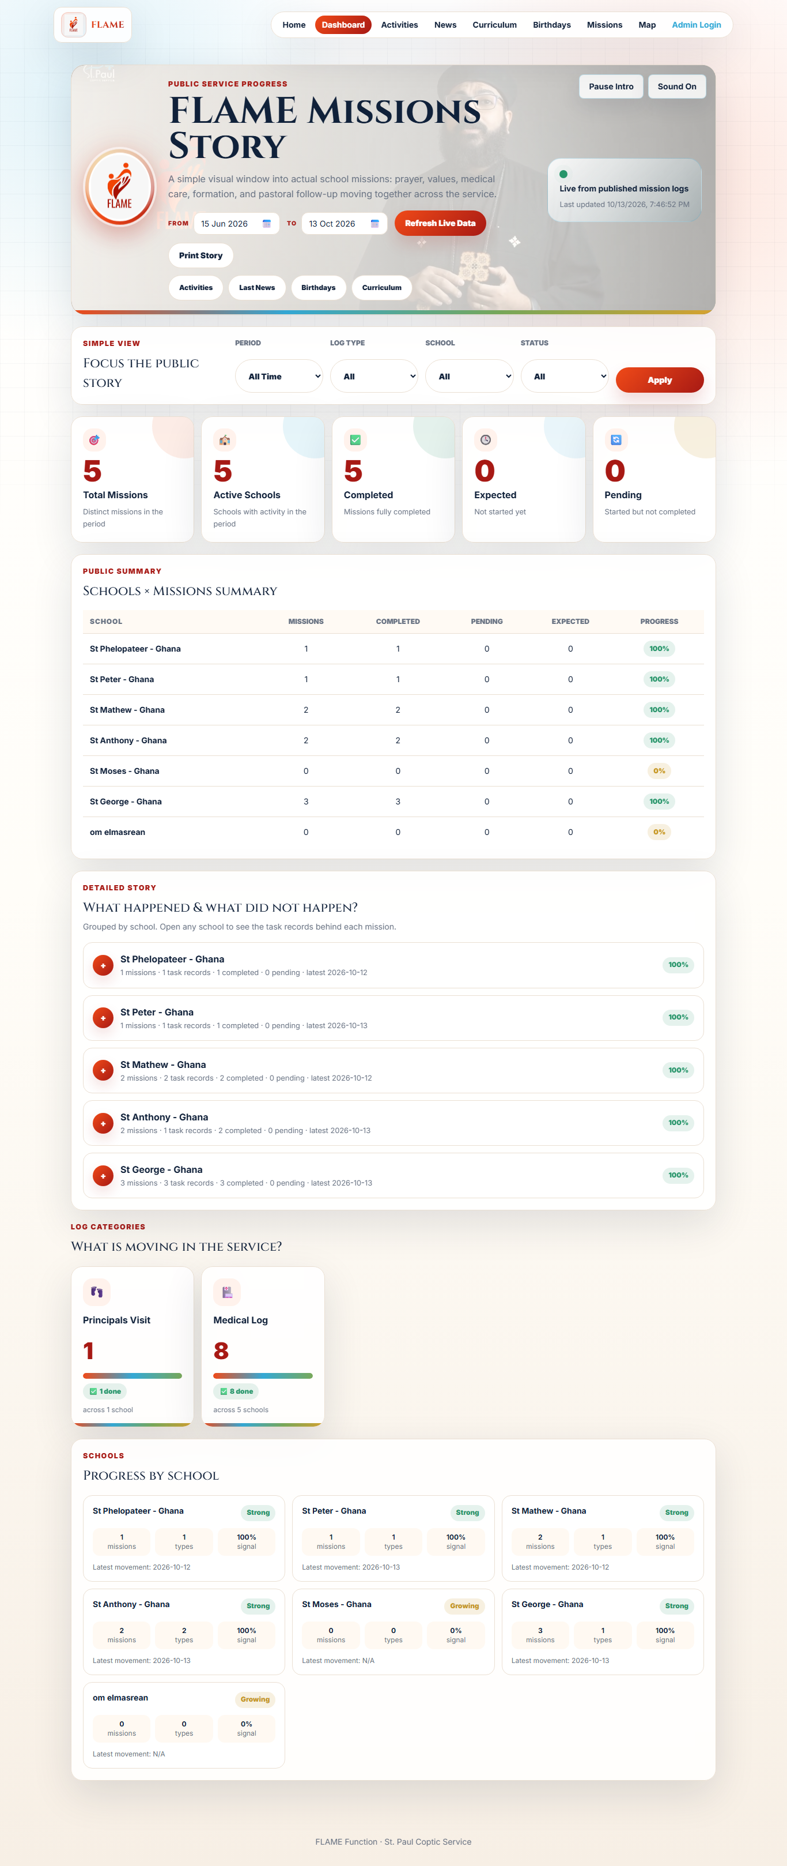
The Missions Story (Dashboard)
A live, colourful summary of what is happening across the schools.
Steps
1 Open the Dashboard.
2 See totals: missions, schools, completed, pending, not started.
3 Scroll to explore each school's progress.
3

Slide 7
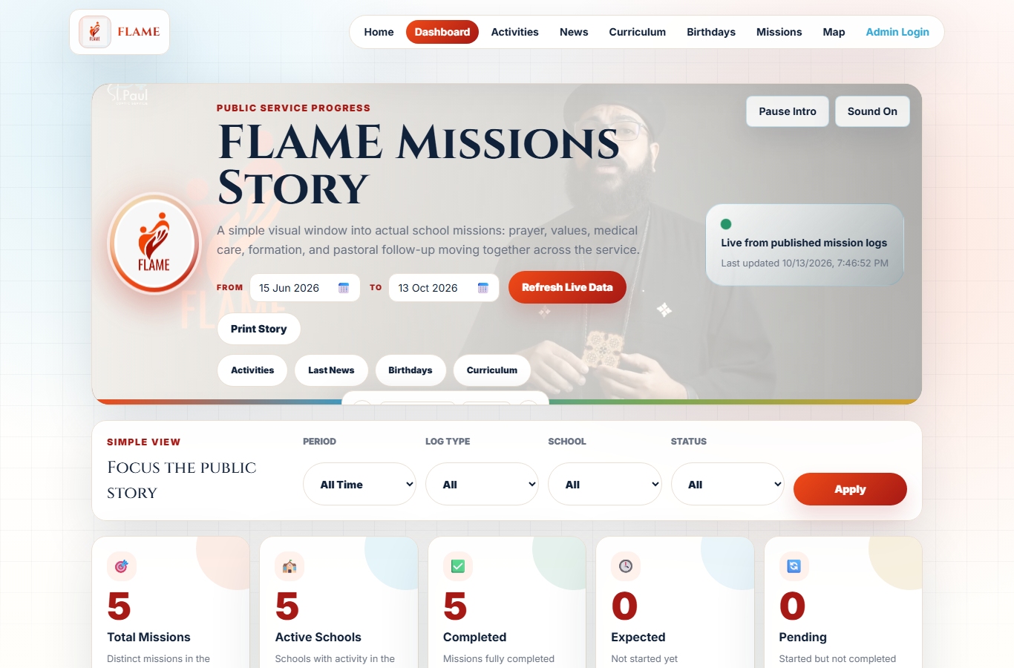
Pick a Date Range Easily
Choose any period with a friendly calendar — no typing dates.
Steps
1 Click a date field.
2 Use the calendar to pick a day, or Today / Clear.
3 The whole dashboard updates to that period.
4

Slide 8
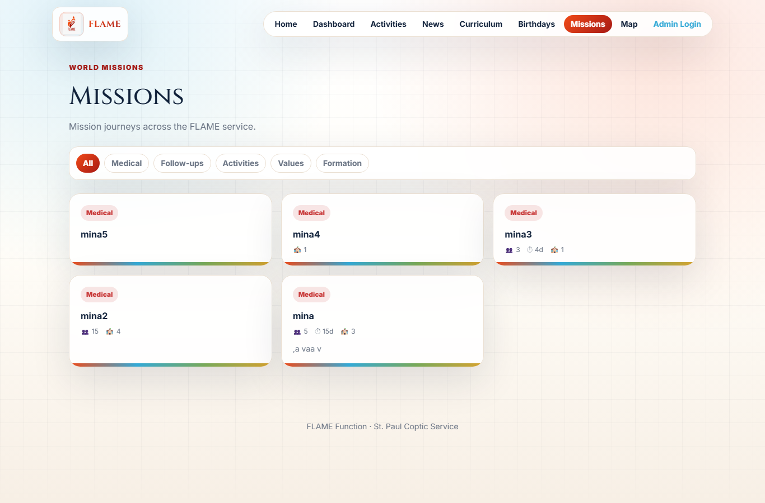
Browse Missions
See every mission with its status and details.
Steps
1 Open the Missions page.
2 Each mission shows where, when and its progress.
3 Status is clearly flagged: completed, in progress, or not started.
5

Slide 9
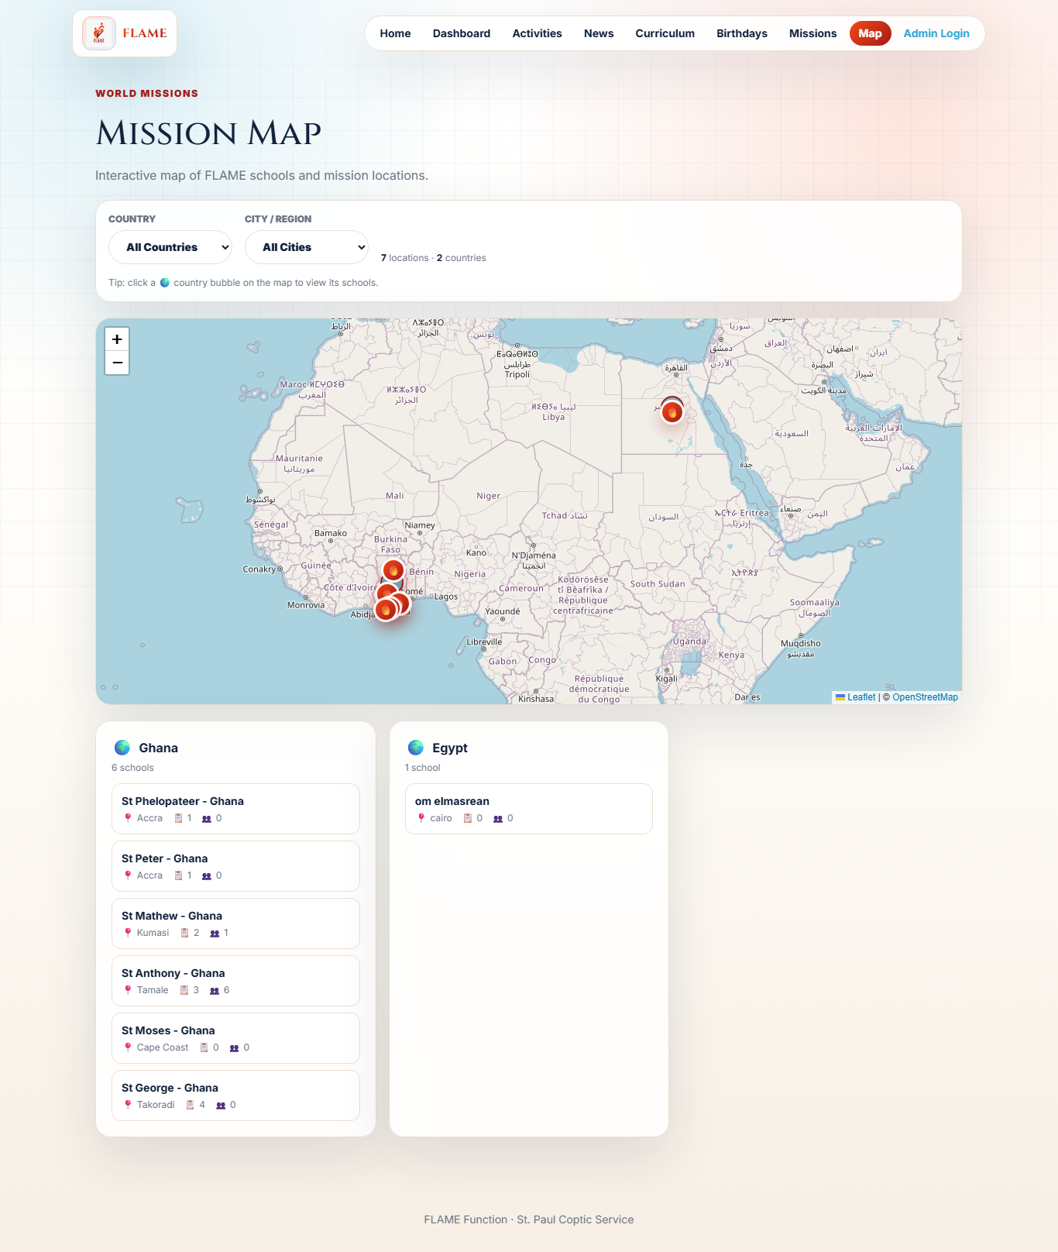
Explore the World Map
See where the service reaches on an interactive map.
Steps
1 Open the Map page.
2 Click a country bubble to focus on it.
3 Click a school pin to see its missions and people.
6

Slide 10
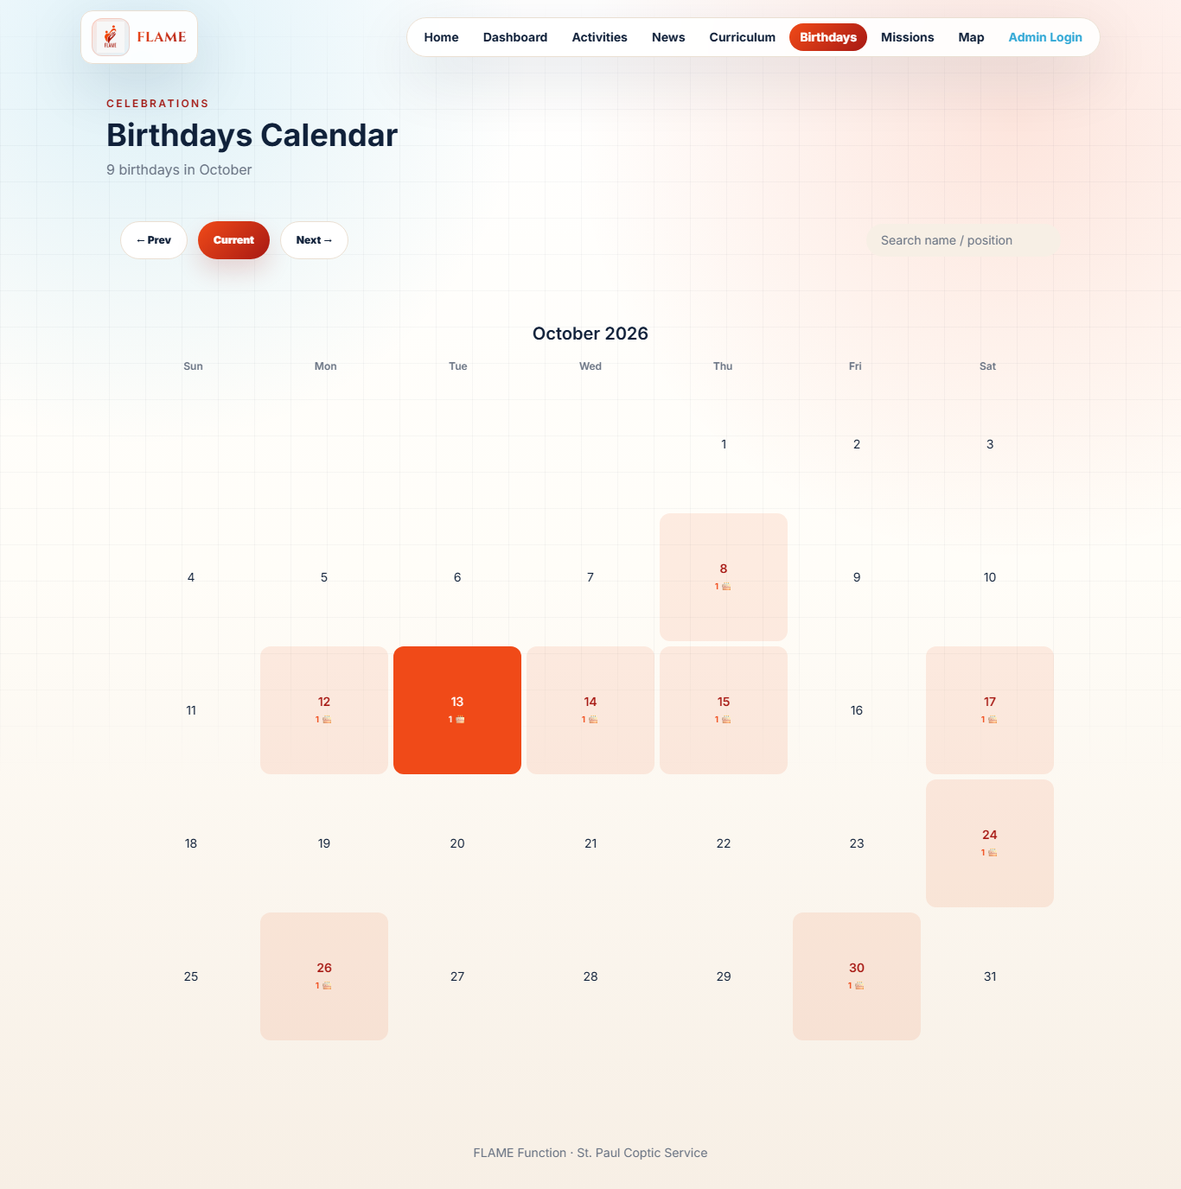
Birthday Calendar
Never miss a celebration — with one-tap contact copying.
Steps
1 Open the Birthdays page.
2 Pick a day to see whose birthday it is.
3 Tap the phone chip to copy the contact number.
7

Slide 11
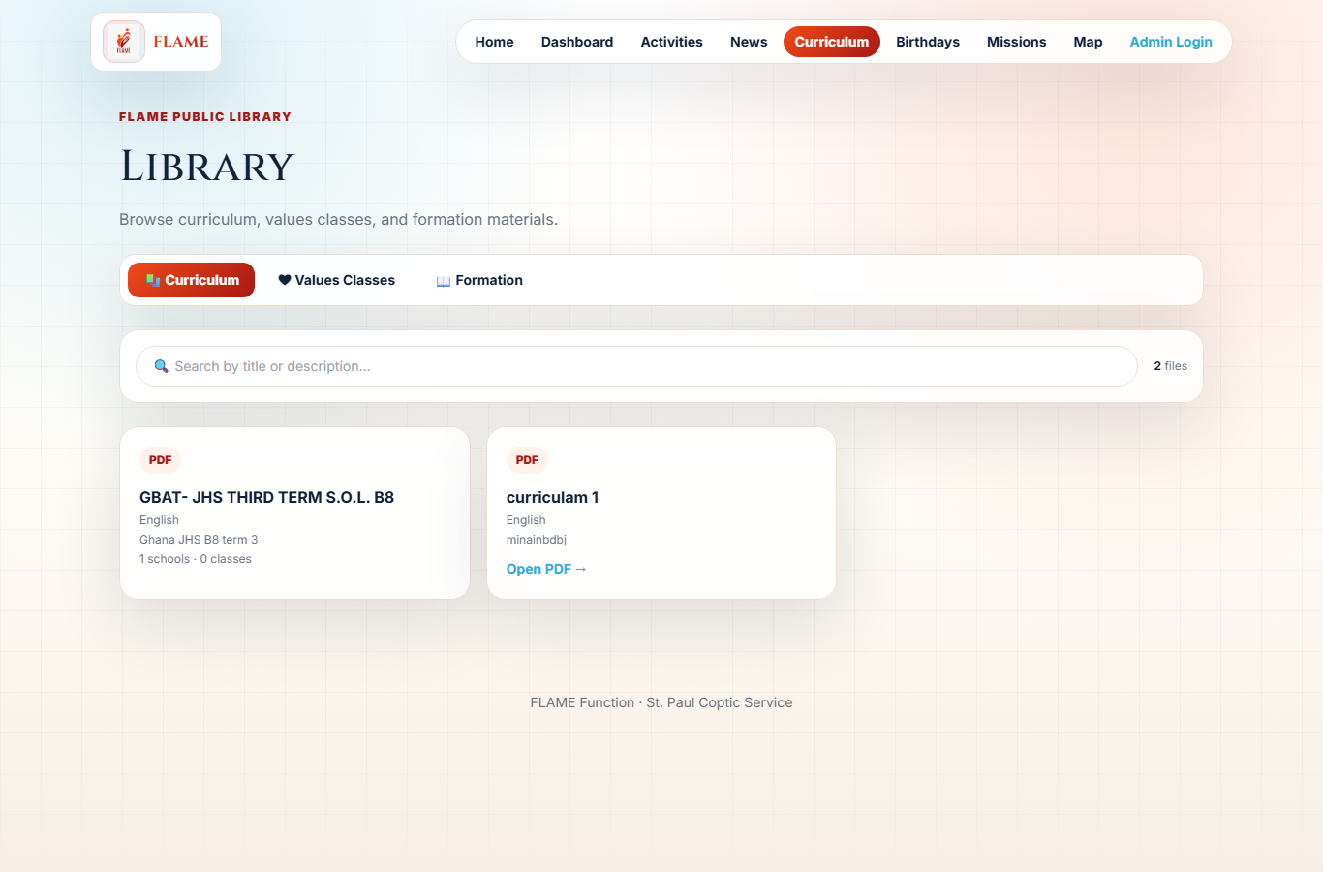
Curriculum Library
Read the shared curriculum, values and formation materials.
Steps
1 Open the Curriculum page.
2 Switch between Curriculum, Values and Formation tabs.
3 Open any document to read it.
8

Slide 12
FOR THE TEAM

Slide 13
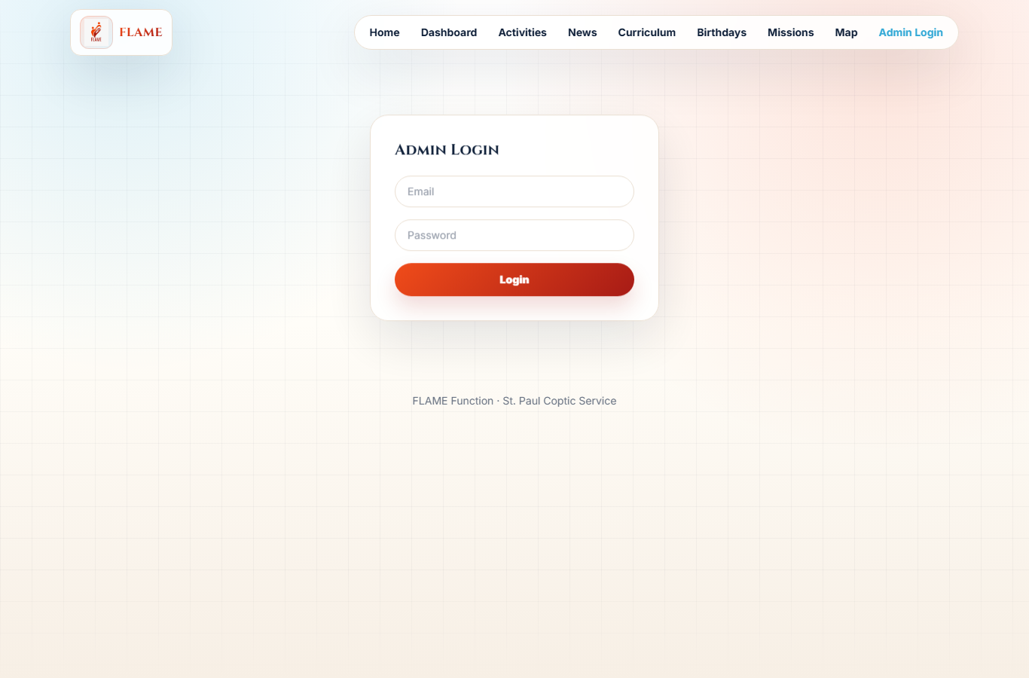
Secure Sign-In
The team signs in to manage everything safely.
Steps
1 Open the Login page.
2 Enter your email and password.
3 You only see what your role allows.
9

Slide 14
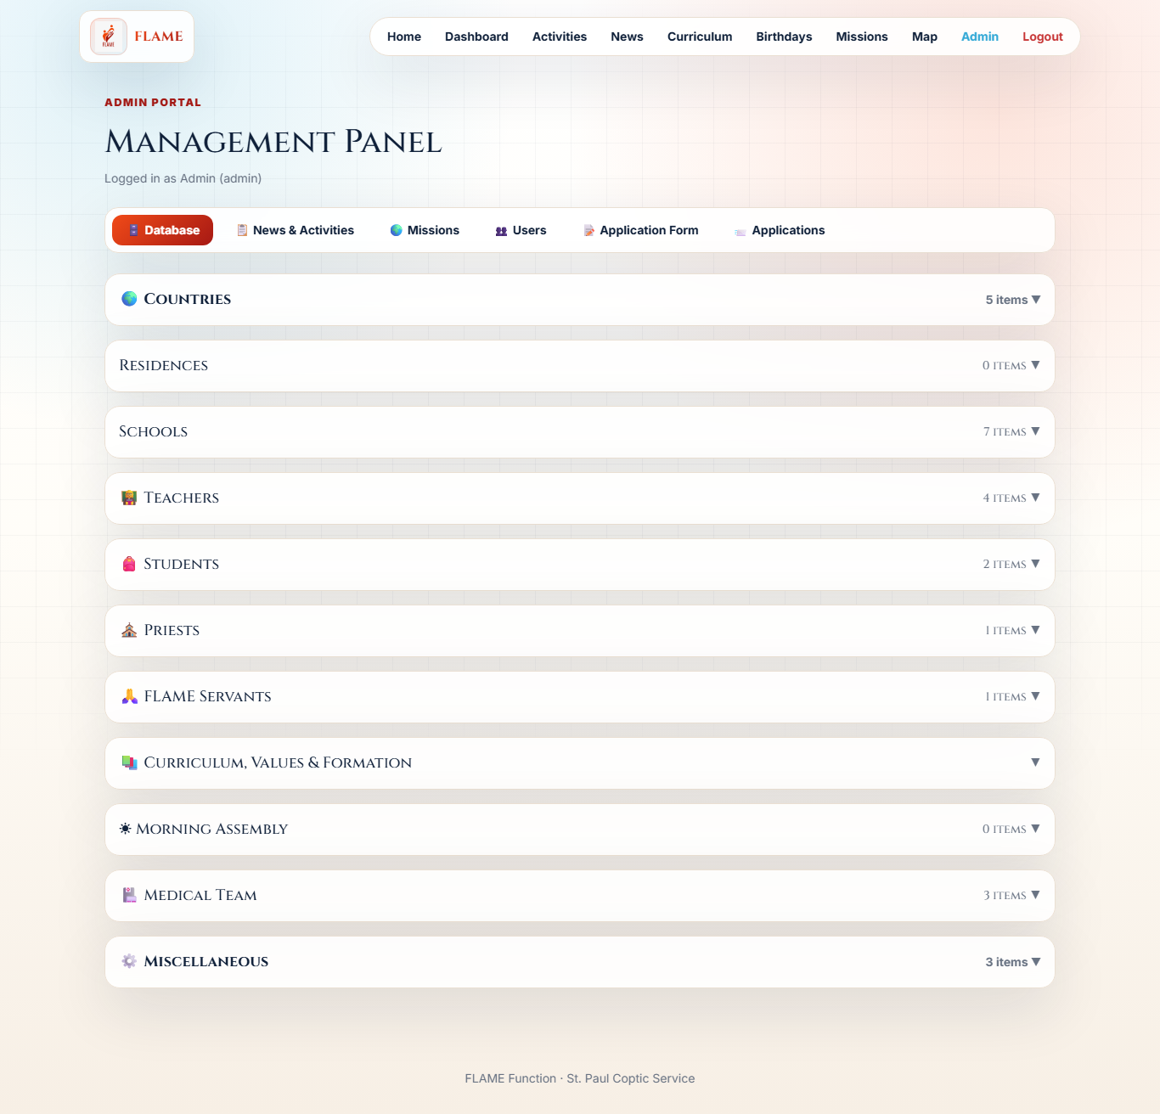
The Admin Home
Everything the team manages, organised into simple tabs.
Steps
1 After signing in, you land on the admin area.
2 Use the tabs: Database, Missions, News, Users, Forms.
3 Each tab holds friendly, collapsible sections.
10

Slide 15
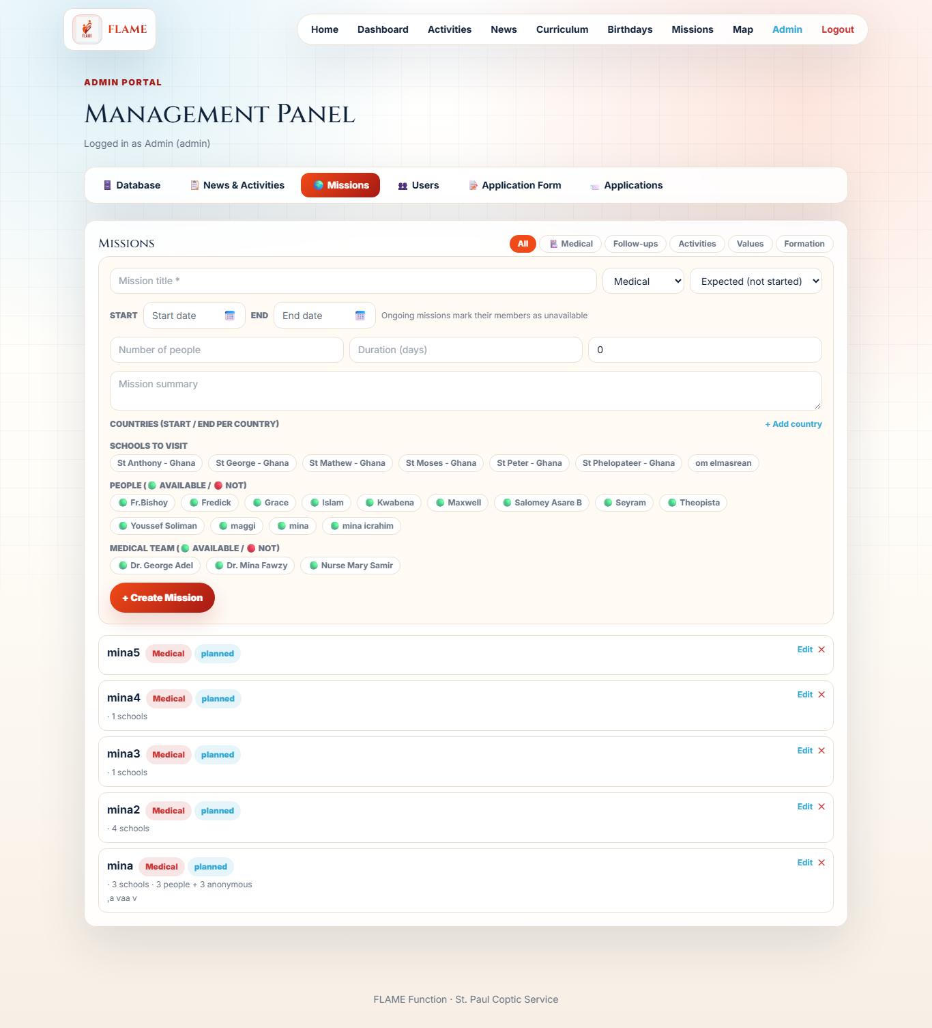
Create & Track Missions
Plan a mission, pick schools and people, and track its status.
Steps
1 Open the Missions tab.
2 Add a title, dates, status and the schools visited.
3 Edit any mission later — its progress shows on the dashboard.
11

Slide 16
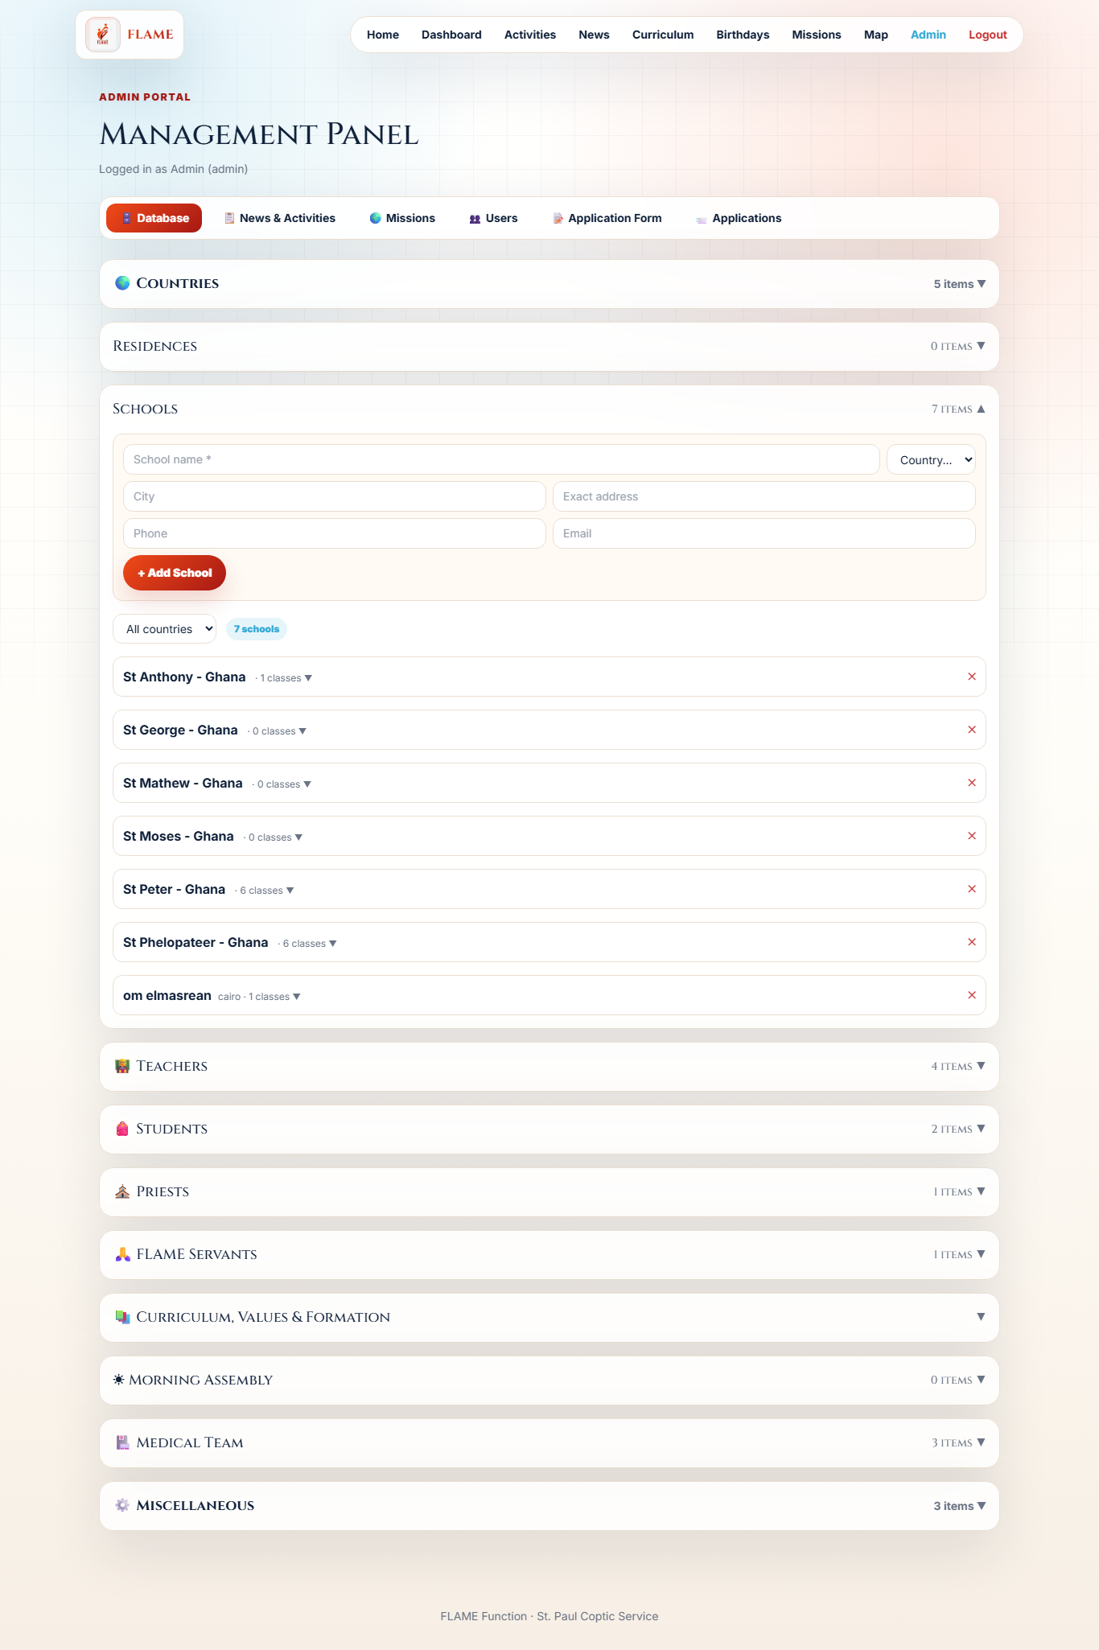
Manage a School
Open a school to add logs, tasks, people and content — all in one place.
Steps
1 Open Database → Schools and expand a school.
2 Add a log or task (medical, principal visit, etc.).
3 Assign principals/teachers and update statuses.
12

Slide 17
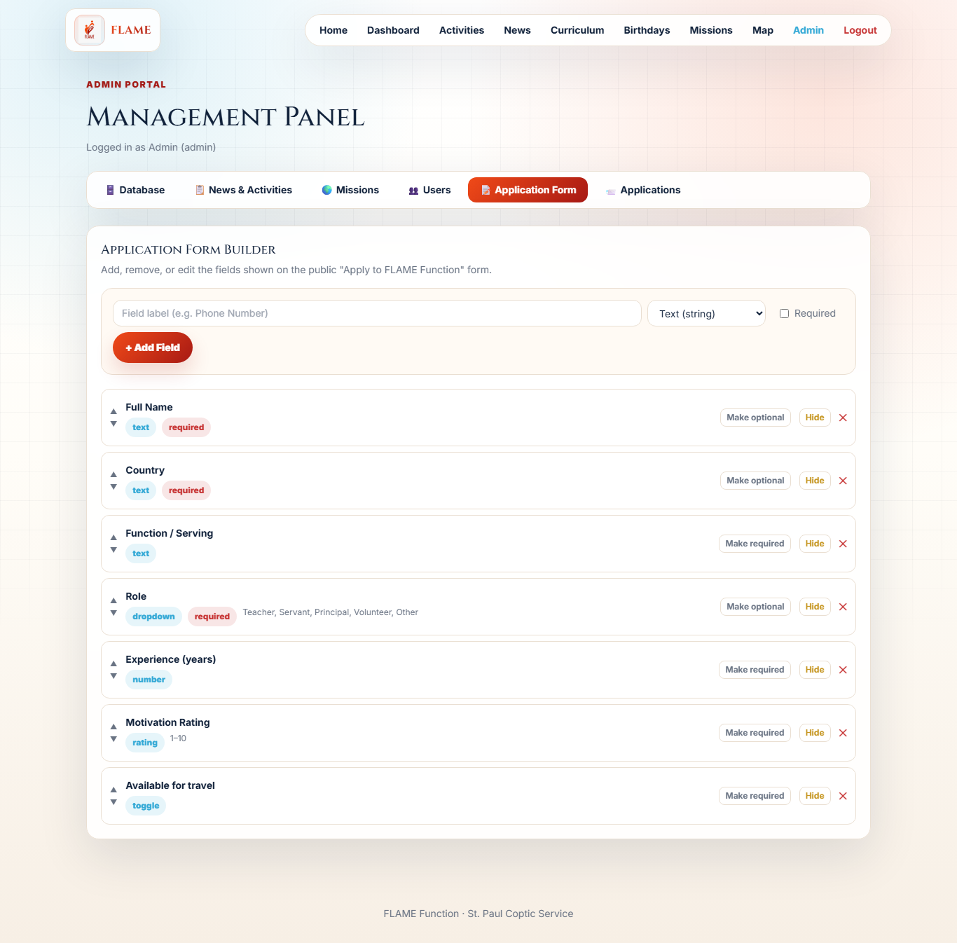
Design the Apply Form
Decide what applicants are asked — no developer needed.
Steps
1 Open the Application Form tab.
2 Add fields: text, number, dropdown, toggle or rating.
3 Changes appear on the public Apply form instantly.
13

Slide 18
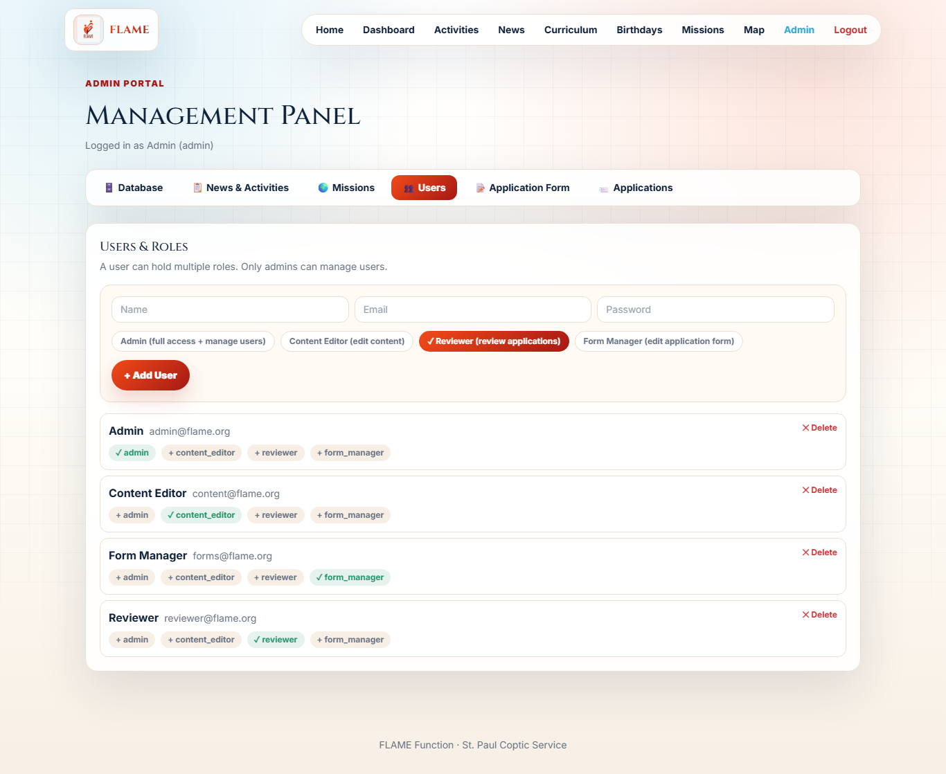
Manage Team Members
Admins add team members and choose what each can do.
Steps
1 Open the Users tab (admin only).
2 Add a member and assign one or more roles.
3 Roles control who edits content, reviews, or manages forms.
14

Slide 19
That's FLAME
Simple for visitors. Powerful for the team.
FLAME Function · St. Paul Coptic Service

