Slide 1
FLAME Platform
Feature Showcase & Walkthrough
React + Vite · Node/Express · Prisma · SQLite · Leaflet

Slide 2
What's inside
🔥 Public Home & Video Hero
🏥 Medical Team & Availability
📊 Public Missions Dashboard
📝 Dynamic Application Form
🚑 Missions (Admin): Status, Dates & Editing
🔐 Users, Roles & Permissions
🏫 School Task Board (Logs, Visits, Content)
🗺️ World Mission Map
📚 Curriculum, Values & Formation
✨ Platform UX: Friendly Date Picker & Brand
👥 People: Teachers, Students, Priests, Servants
🎉 Activities, News & Birthdays

Slide 3
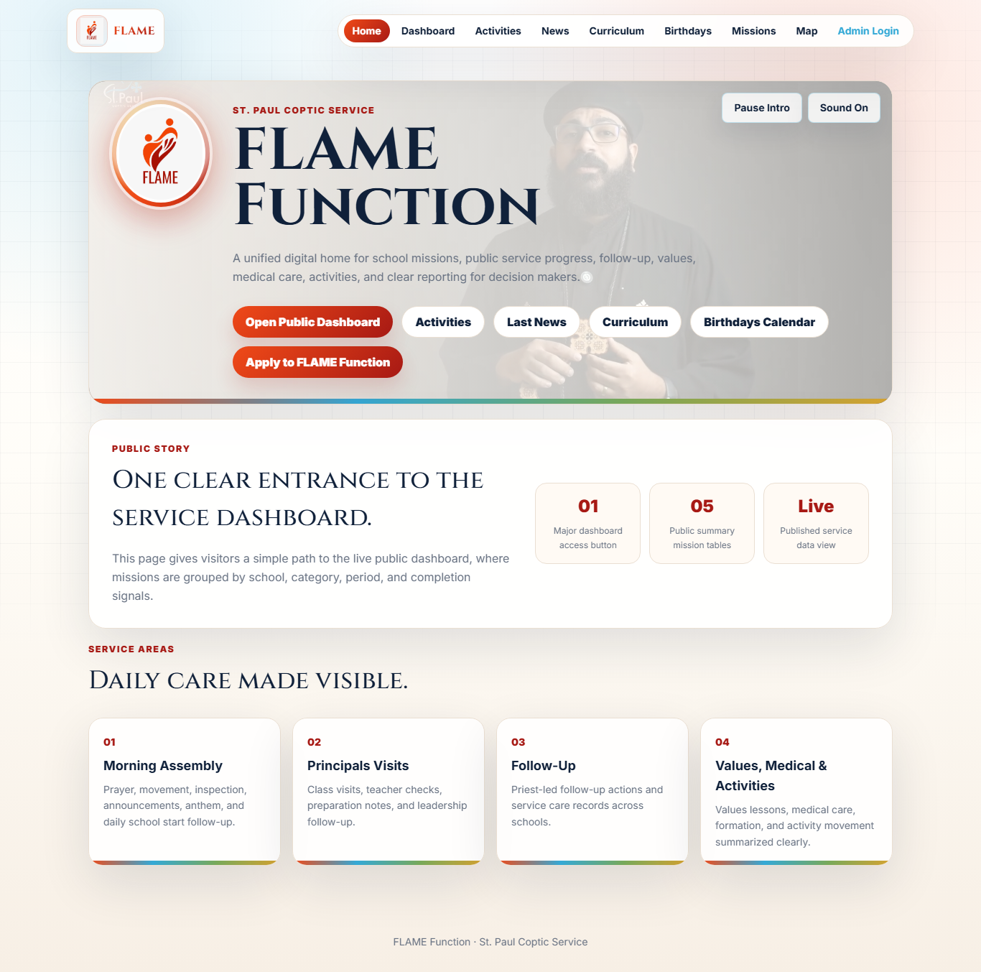
🔥 Public Home & Video Hero
Landing page introducing the FLAME service with an intro video, animated hero, quick links, and an Apply call-to-action.
How to use it
1. Open the site root (/) in a browser.
2. The hero plays intro.mp4 with Pause / Sound controls.
3. Use the navbar to reach Dashboard, Missions, Activities, News, Curriculum, Birthdays, or Map.
4. Click 'Apply' to open the dynamic application form popup.
5. Fill the fields rendered from the admin-defined form and submit.
Key rules
• The Apply form is fully data-driven: fields come from FormField records ordered by `order` where `active = true`.
• A submission stores all answers as a JSON blob in Application.values.
1/12

Slide 4
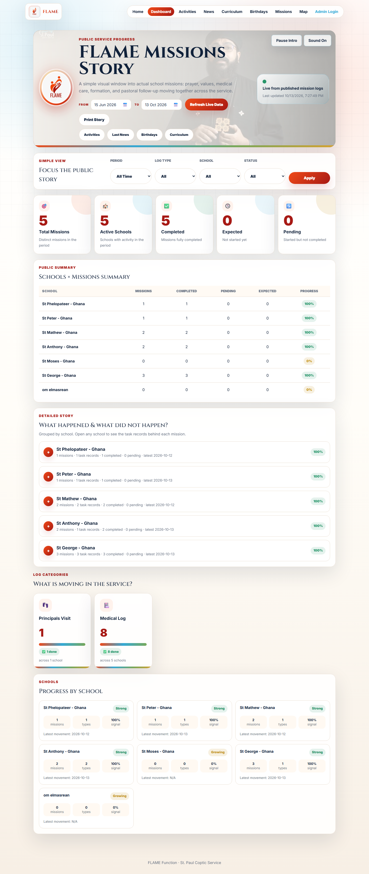
📊 Public Missions Dashboard
Live public story of the service: KPIs, Schools×Missions summary, per-school drill-down of tasks performed vs. not performed, and category totals — all driven by the date range and filters.
How to use it
1. Open /dashboard.
2. Set Period or From/To dates — the whole dashboard reloads automatically.
3. Filter by Log Type, School, or Status (Completed / Expected / Pending).
4. Read the KPI strip: Total Missions, Active Schools, Completed, Expected, Pending.
5. Open any school to drill into task records grouped by log type.
Key rules
• The `to` date is treated as end-of-day (23:59:59.999) so same-day logs are always included.
• Total Missions counts DISTINCT real missions (by the mission id tagged in a log's notes); a mission visiting N schools counts once but shows activity in all N schools.
2/12

Slide 5
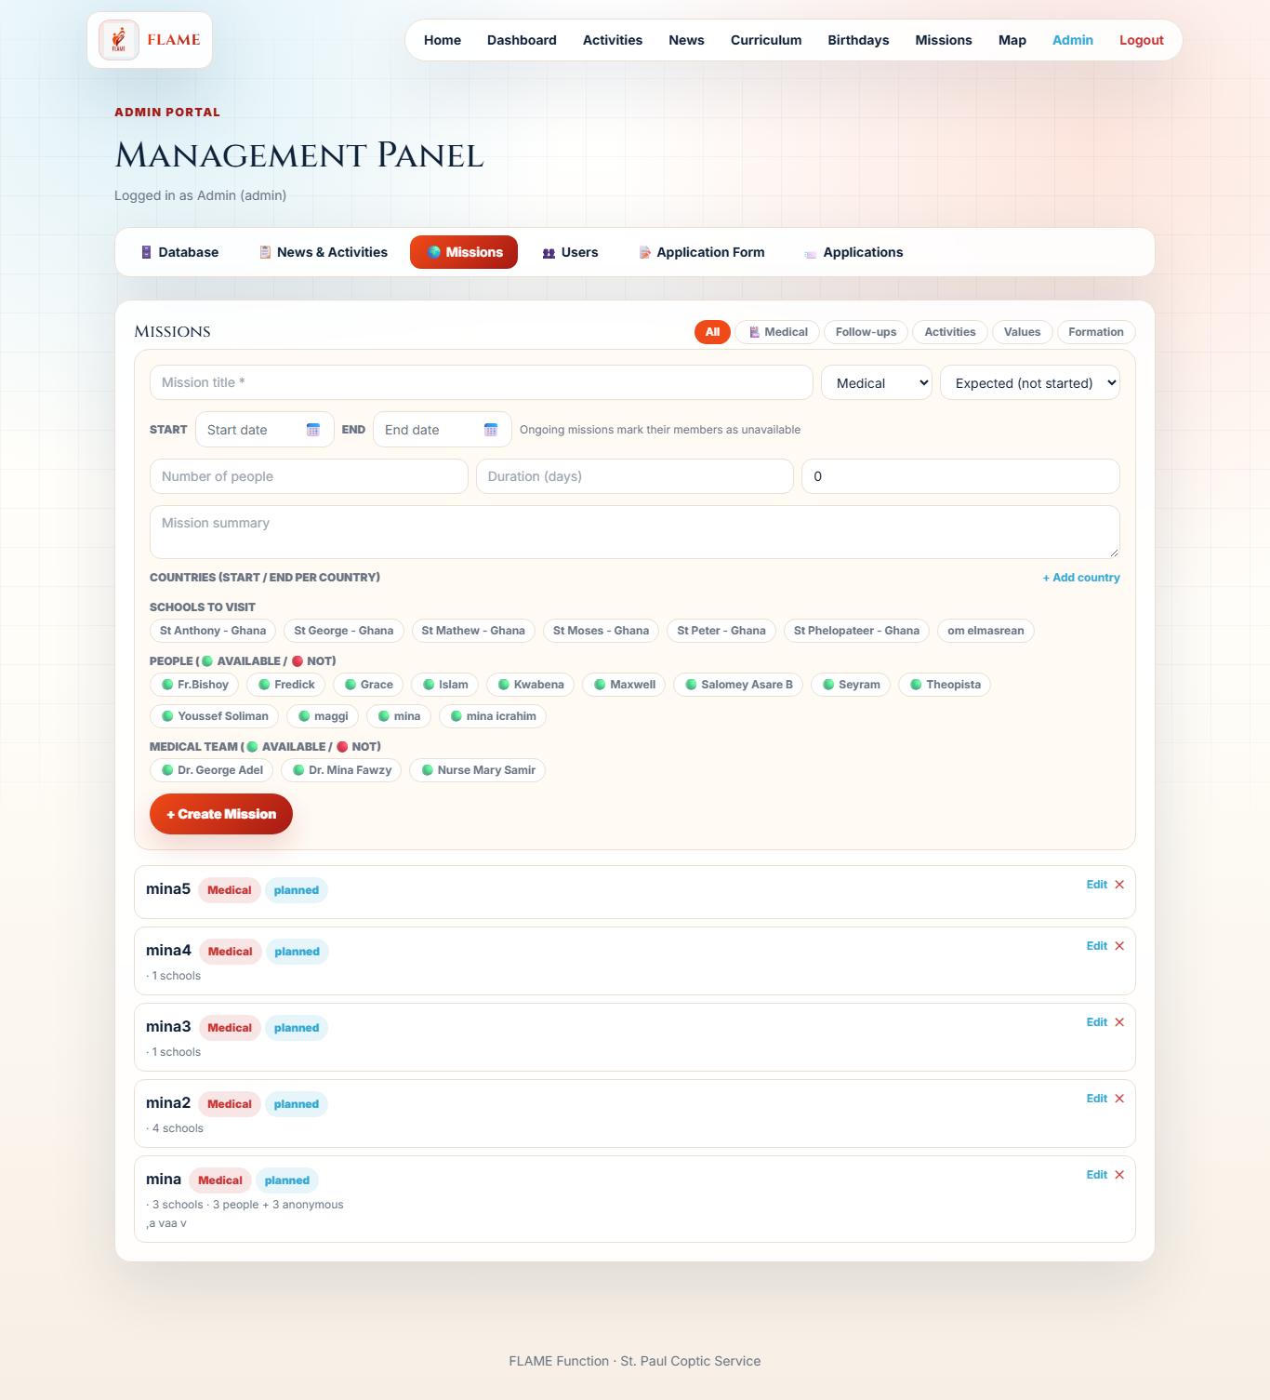
🚑 Missions (Admin): Status, Dates & Editing
Create missions (Medical / Follow-ups / Activities / Values / Formation / Other) with mandatory status, start/end dates and at least one school. Each mission auto-generates dashboard logs and is fully editable.
How to use it
1. Admin → Missions.
2. Enter a title; pick type and status (Expected / Pending / Completed).
3. Set mandatory start and end dates; select at least one school.
4. Add countries (per-country dates), people and medical team — availability is shown.
5. Create — one dashboard log per visited school is generated concurrently.
6. Use Edit to change status/dates/summary; members become unavailable while a mission is Pending and free again when Completed or deleted.
Key rules
• Server-side validation: title, status, startDate, endDate and ≥1 school are required; endDate must be ≥ startDate (HTTP 400 otherwise).
• Generated MissionLog.logDate uses the mission startDate; log status mirrors the mission status.
3/12

Slide 6
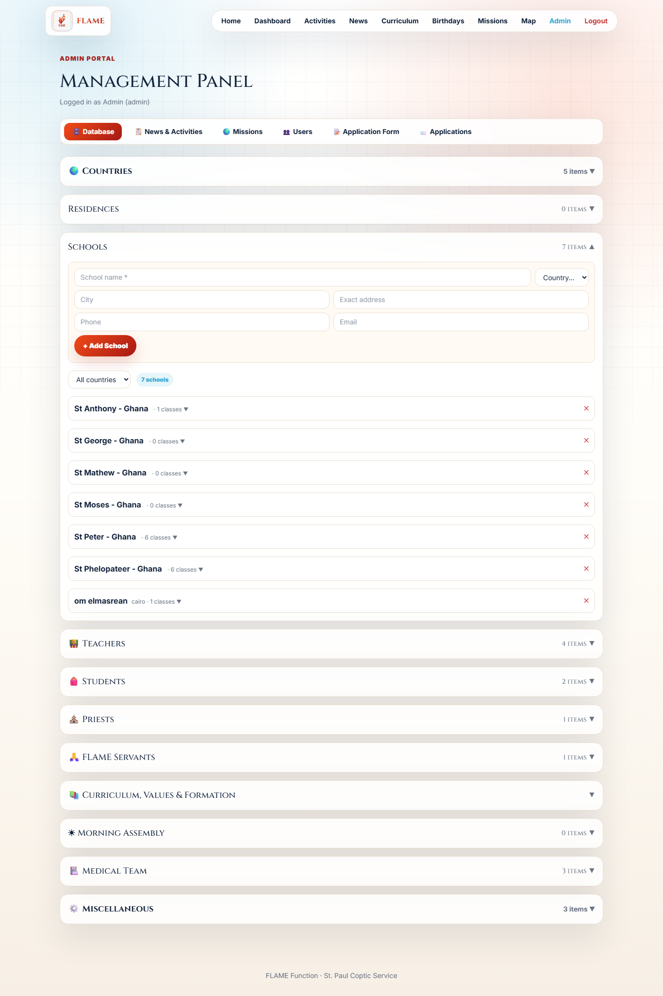
🏫 School Task Board (Logs, Visits, Content)
Per-school hub: create medical logs / principal visits / tasks (summary + date mandatory), assign people with roles, and track assigned curriculum/values/formation with a status.
How to use it
1. Admin → Database → Schools → expand a school.
2. 'Add Log / Task': choose a type, set date, write a summary (both required), pick a status.
3. For a Values Class, select which values class from the extra selector that appears.
4. 'People & Roles': assign an existing person as Principal / Worker / Resident / Teacher / Priest, change a role, or remove from the school.
5. Update any log or assigned-content status (Expected / Pending / Completed) inline.
6. Manage Classes and add Students (linked to a class) in the same panel.
Key rules
• School-level logs require a non-empty summary and a date (HTTP 400 otherwise). The summary is stored in MissionLog.notes and mirrored as a TaskRecord 'Summary: ...'.
• Logging a Values Class also assigns it to the school (if not already) and syncs the per-school status.
4/12

Slide 7
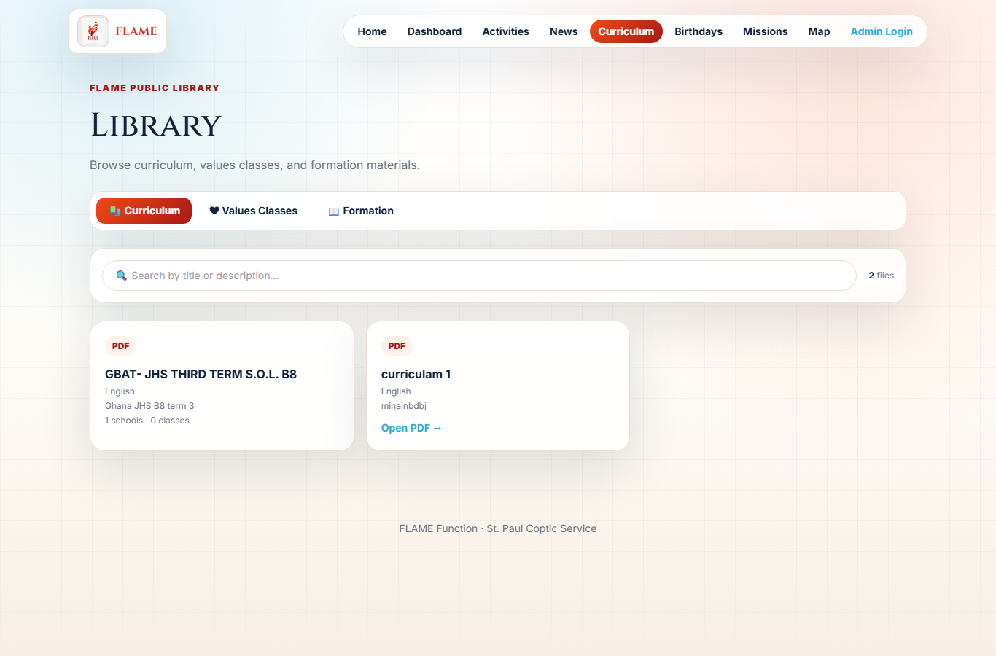
📚 Curriculum, Values & Formation
Upload PDF documents (≤12MB) and assign them to multiple schools and classes (classes scoped to the chosen schools). Public visitors browse them by tab and open the PDFs.
How to use it
1. Admin → Database → Curriculum, Values & Formation.
2. Enter a title + language and upload a PDF.
3. Select schools; the class picker then only lists classes in those schools.
4. Use 'Edit assignments' on an existing item to re-assign schools/classes later.
5. Public users open /curriculum, switch tabs, and open the PDFs.
Key rules
• Uploads are limited to 12MB (PDF) and stored on disk; the public URL is /uploads/<uuid>.pdf (proxied in dev, served statically in prod).
• A school assignment carries a status (expected|pending|completed) updatable per school.
5/12

Slide 8
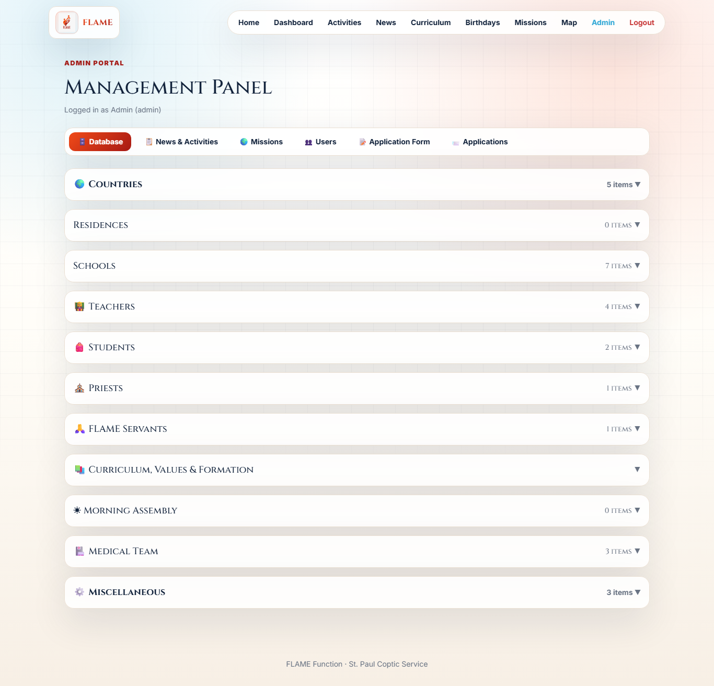
👥 People: Teachers, Students, Priests, Servants
A single reusable Person model powers teachers, priests, servants and school staff; Students are separate and belong to a class. Birthdate cannot be in the future. Country/school filters with live counts and full inline editing.
How to use it
1. Admin → Database → Teachers / Students / Priests / Servants.
2. Create a record (name required; students need a school + class).
3. Filter by country and school; the section header shows the live count.
4. New records appear instantly — filters auto-clear on create.
5. Use Edit on any row to update details; birthdate pickers block future dates.
Key rules
• Person.fullName is the only required field; a Person is reusable across schools, residences and missions.
• Server rejects future birthdate/dob (HTTP 400).
6/12

Slide 9
🏥 Medical Team & Availability
Medical team members with specialty and availability. Availability is surfaced when selecting members for medical missions and flips automatically while a mission is in progress.
How to use it
1. Admin → Database → Medical Team.
2. Add a member (name, specialty, contact, email).
3. Toggle availability or Edit the member inline.
4. When creating a Medical mission, members show a green/red availability marker.
Key rules
• A Medical mission set to Pending marks its selected medics unavailable; Completed/Delete frees them.
• MissionMedical is a composite-key join (missionId + memberId).
7/12

Slide 10
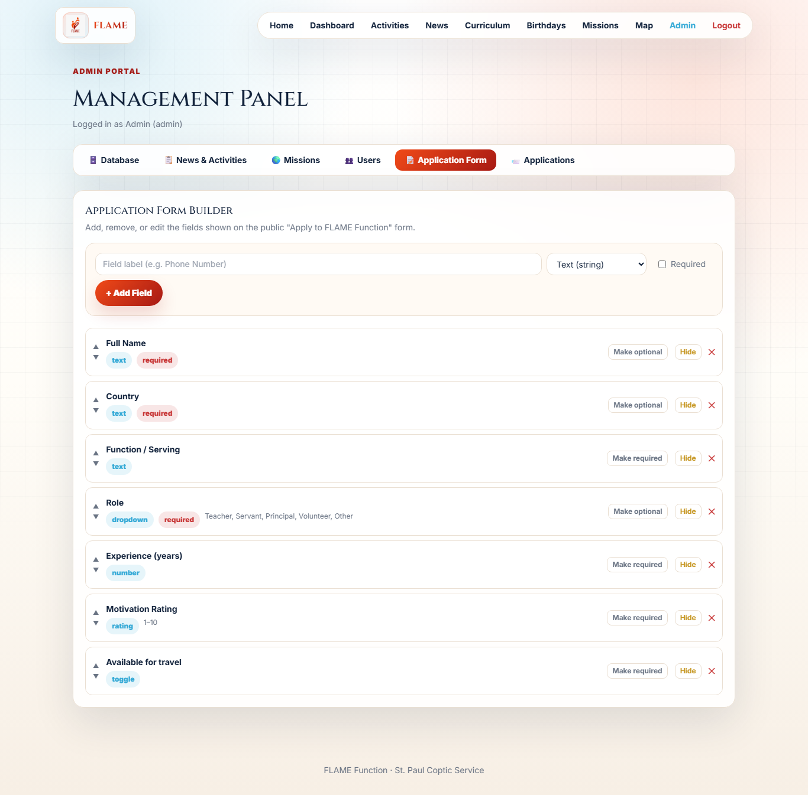
📝 Dynamic Application Form
Admins define the Apply form fields (text / number / dropdown / toggle / rating 1–10). Visitors submit via a popup; admins review all submissions.
How to use it
1. Admin → Application Form.
2. Add fields and pick a type; for dropdown provide the option values.
3. Mark required, set order, or remove fields.
4. Visitors click Apply on Home and submit.
5. Admin → Applications to review every submission.
Key rules
• FormField.key is unique; type ∈ {text, number, dropdown, toggle, rating}; dropdown options stored in `options`.
• Only active fields render on the public form, ordered by `order`.
8/12

Slide 11
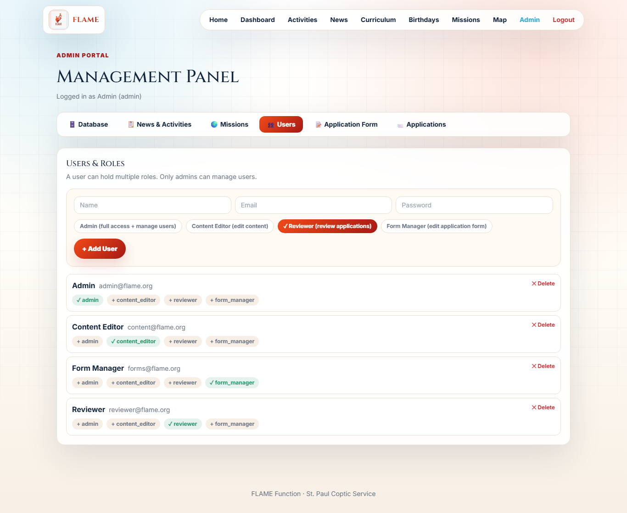
🔐 Users, Roles & Permissions
Multi-role access control via JWT. Admin is the only role that manages users. Roles: admin, content_editor, reviewer, form_manager.
How to use it
1. Log in as admin (POST /api/auth/login returns a JWT).
2. Admin → Users.
3. Create a user and assign one or more roles (stored comma-separated).
4. Each role grants scoped access, enforced by requireRole on the server.
Key rules
• CAN_EDIT_CONTENT = admin, content_editor. CAN_REVIEW_APPLICATIONS = admin, reviewer. CAN_MANAGE_FORM = admin, form_manager. CAN_MANAGE_USERS = admin only.
• requireRole grants access if ANY of the user's roles is permitted.
9/12

Slide 12
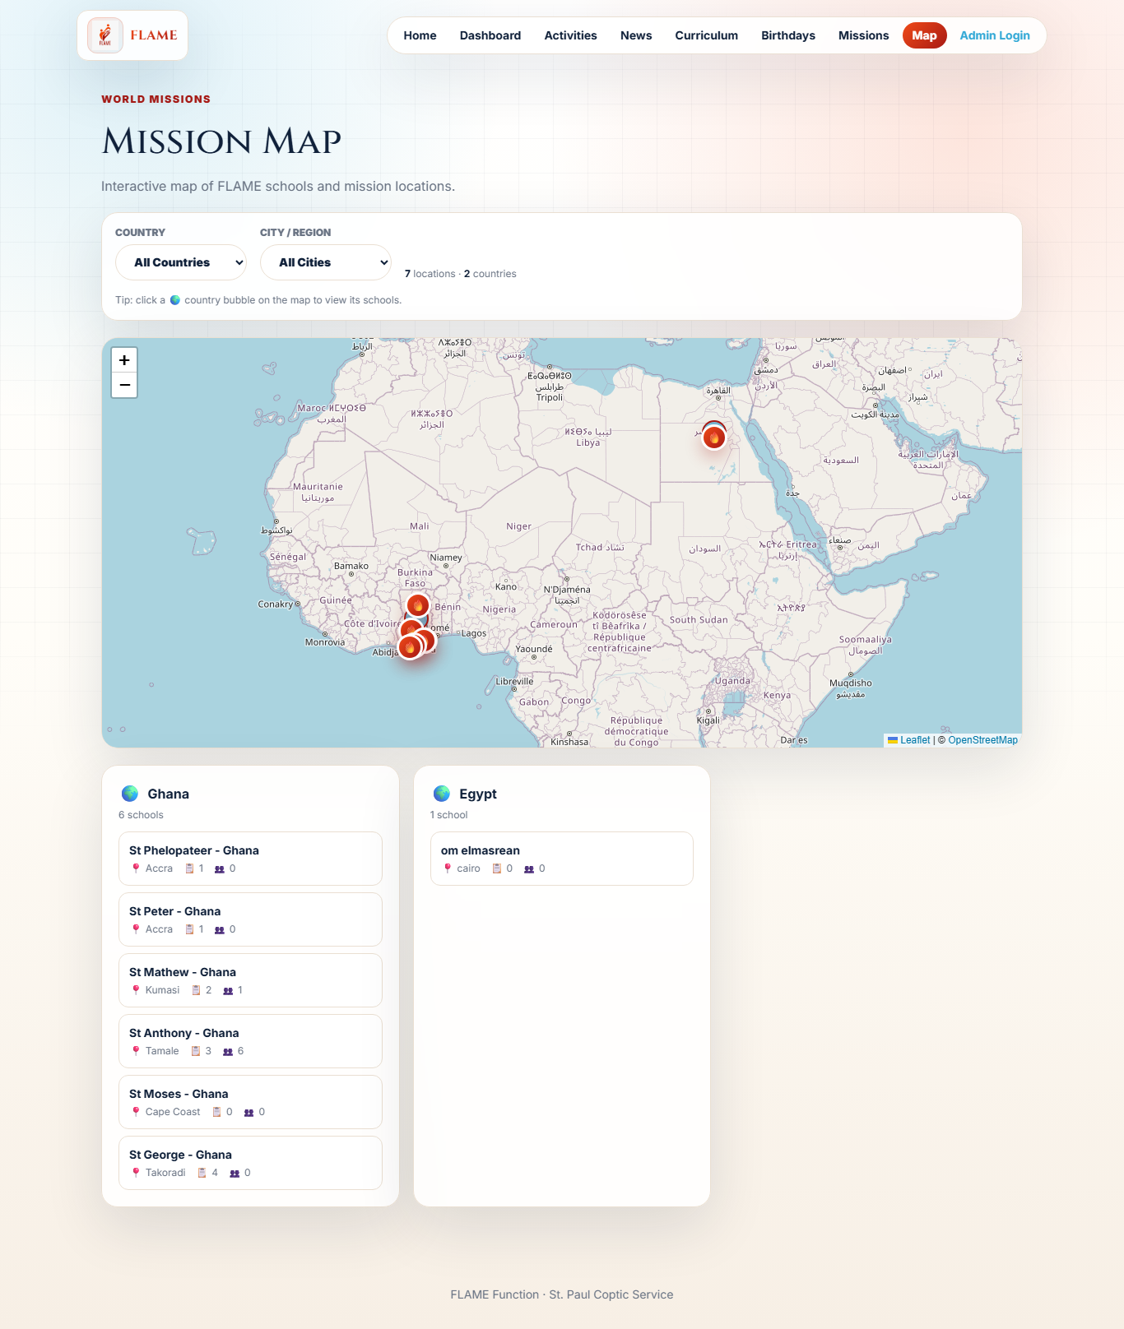
🗺️ World Mission Map
Leaflet map of school locations with mission and people counts, filterable by country and city — filtering handled server-side.
How to use it
1. Open /map.
2. Browse pins for each geolocated school (lat/lng) with mission + people counts.
3. Filter by country or city.
Key rules
• Only schools with latitude and longitude set appear as pins.
• Counts come from Prisma _count on missionLogs and people; results are grouped by country for the sidebar.
10/12

Slide 13
✨ Platform UX: Friendly Date Picker & Brand
A custom, responsive calendar date picker replaces the native input everywhere, and the FLAME logo has an enhanced animated brand treatment.
How to use it
1. Click any date field (dashboard range, mission dates, birthdays, logs).
2. A calendar popover opens with month/year quick-select and ‹ › navigation.
3. Pick a day, or use Today / Clear; disabled days respect min/max.
4. On mobile the picker becomes a centered sheet with a dimmed backdrop.
Key rules
• The picker renders with fixed positioning so it never gets clipped by card overflow, flips above when space is tight, and clamps to the viewport.
• Values use the ISO YYYY-MM-DD format, so it is a drop-in replacement for the native date input across all forms.
11/12

Slide 14
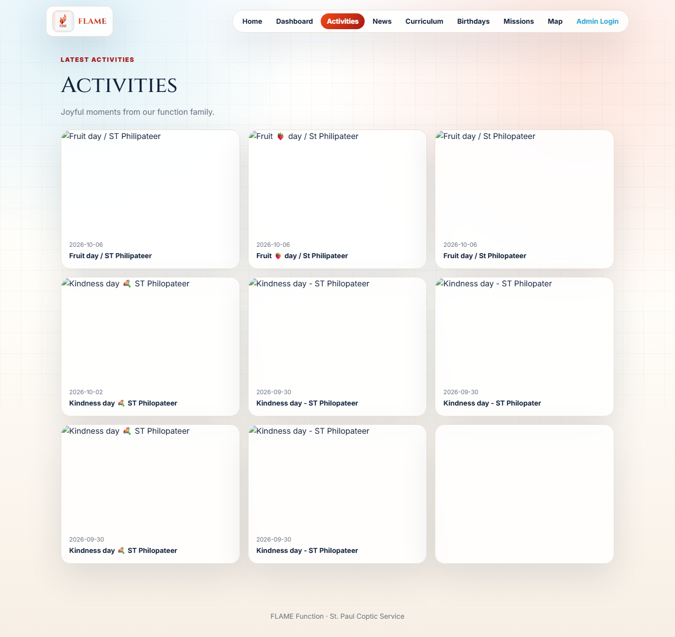
🎉 Activities, News & Birthdays
Admin-managed content surfaced to the public: activities (school / local_flame / other), news posts, and a birthday calendar aggregating people and students — each birthday showing a copyable contact number.
How to use it
1. Admin manages Activities and News under News & Activities.
2. Birthdays are computed from Person.birthdate (or legacy dob) and Student.birthday.
3. Public users open /activities, /news, /birthdays.
4. In Birthdays, click the 📞 contact chip to copy the number to the clipboard.
Key rules
• Activity.scope ∈ {school, local_flame, other}; may link to a school.
• Birthdays endpoint merges Person and Student records and sorts by month/day.
12/12

Slide 15
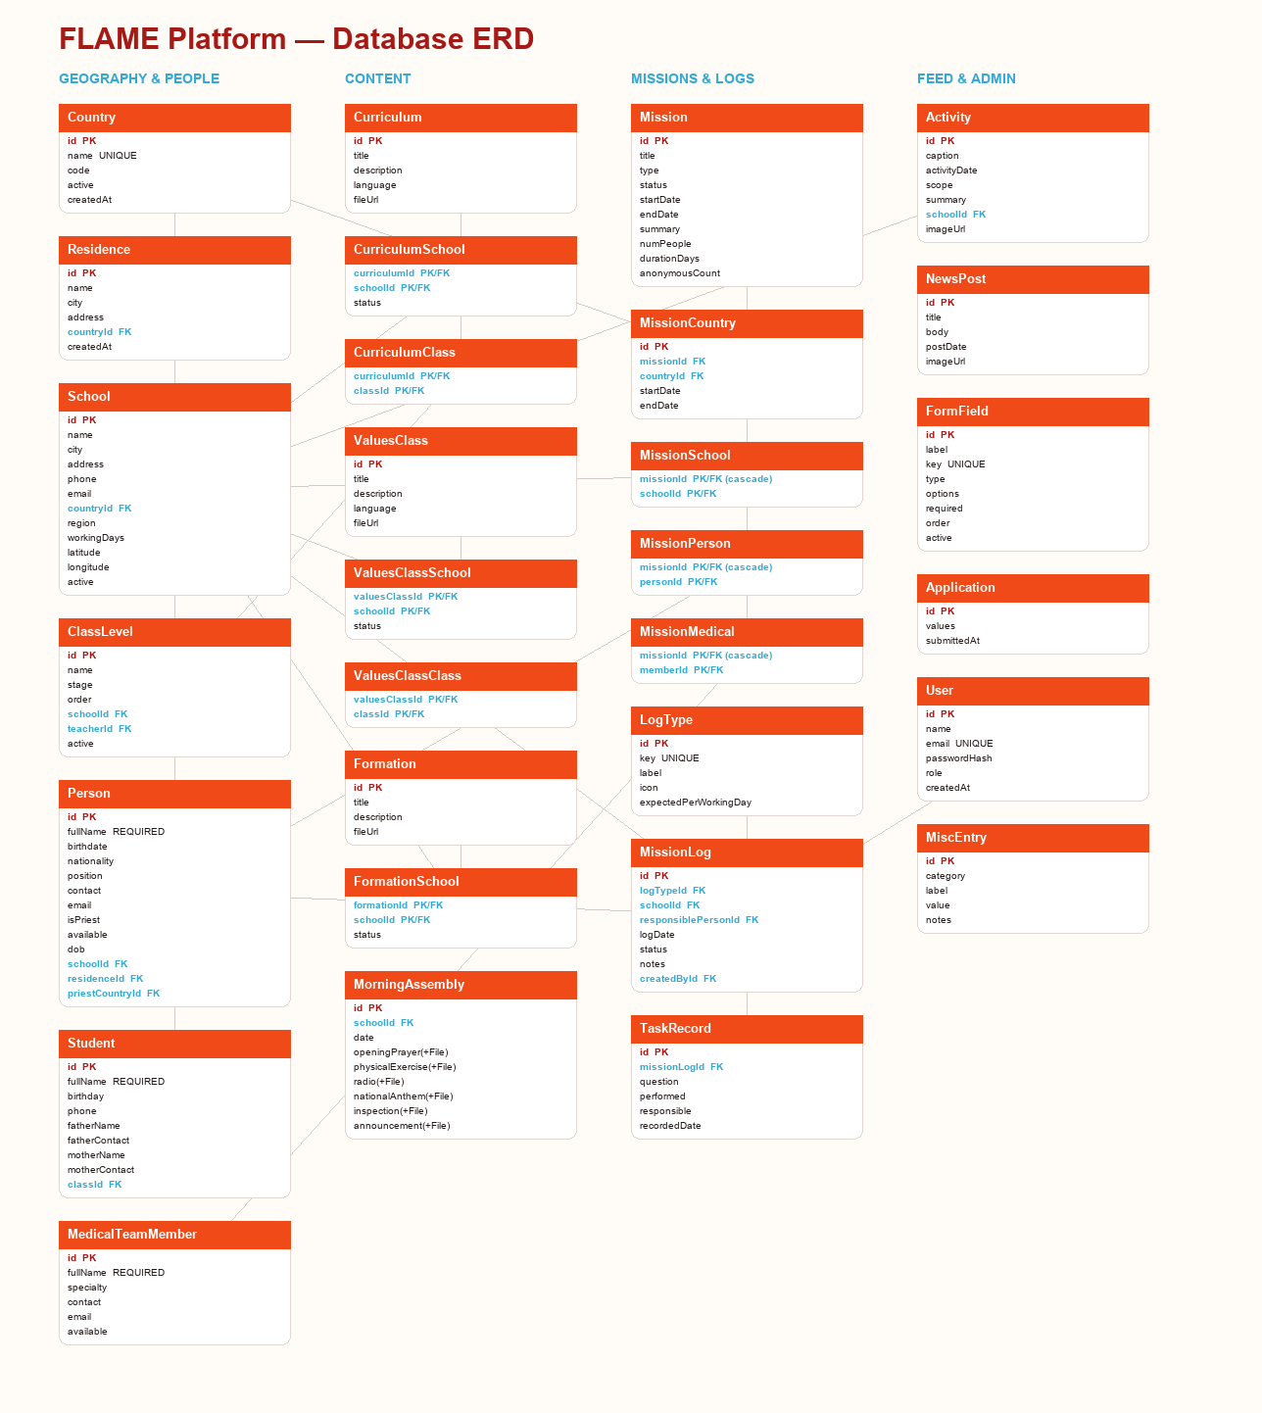
Database ERD

Slide 16
Thank you
FLAME Function · St. Paul Coptic Service

