Slide 1
HSCI 416 Lab 1
Fall 2024

Slide 2

Currently PhD student
MSc in Operation Research
BSc in Mathematics and application
Email: mina_moeini@sfu.ca
Mina Moeini

Slide 3
Objectives before tutorial
Overview of the SAS Program Interface
1
Basic SAS Syntax
2
How to access SAS
3
Use SAS on Demand or SAS program
4
Get SAS running
5

Slide 4
Introduction to SAS
3
SAS stands for Statistical Analysis System.
A powerful software suite for data management and analytics
Data Management:
Efficient handling of large datasets.
Data cleaning and transformation.
Advanced Analytics:
Multivariate analysis
Predictive modeling
Machine learning integration
Reporting and Visualization:
Customizable reports
Interactive dashboards

Slide 5
Learning SAS
Easy-to-learn programming language
Learn through practicing and correcting errors
Book Resources
The Little SAS Book, Delwiche and Slaughter
Learning SAS by example, Cody

Slide 6
Installing SAS:
Option 1: Installing SAS 9.4 locally on your computer (Windows/Linux only).
SFU IT software includes SAS 9.4 and a license (which will need to be renewed during the semester, but we can cover that in lab when necessary).
https://www.sfu.ca/information-systems/services/software/sas-9-4/download-sas-9-4.html
Option 2: SAS on Demand
SAS provides on online web-based server for students to access SAS. See video on canvas called “How to SAS on Demand” for a walkthrough on setting up and how to use. Video is provided by a previous years TA (with permission).
Option 3: Remote connecting to a lab computer at SFU which will have SAS installed.
This option will differ based on your student status (graduate or undergraduate).
Graduate student remote access instructions: https://sfu.teamdynamix.com/TDClient/255/ITServices/KB/ArticleDet?ID=3671
Undergraduate student remote access instructions:
https://sfu.teamdynamix.com/TDClient/255/ITServices/KB/ArticleDet?ID=3670

Slide 7
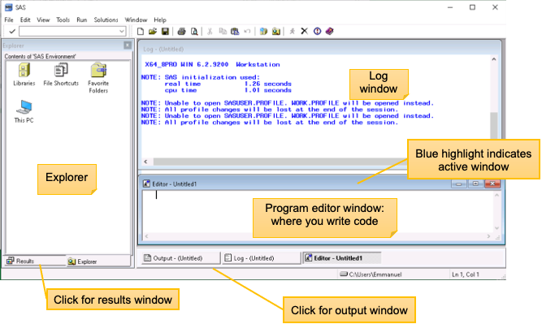
SAS (9.4) Windows environment

Slide 8
Terminology
The actual information within a data field for a specific variable
Database
A comprehensive collection of administrative data. Example: All physician visit records (e.g., MSP billing records).
Data File/Dataset
A specific component of a database, containing either the full set or a subset of data. Example: Hospital discharge records for St-Paul’s Hospital, focusing on male patients aged 12-24 years or stroke admissions.
Data Record/Observation
A single row of data representing one individual or event (e.g., a patient admission).
A specific column in the data file representing a particular attribute.
Data Value
Data Field/Variable

Slide 9
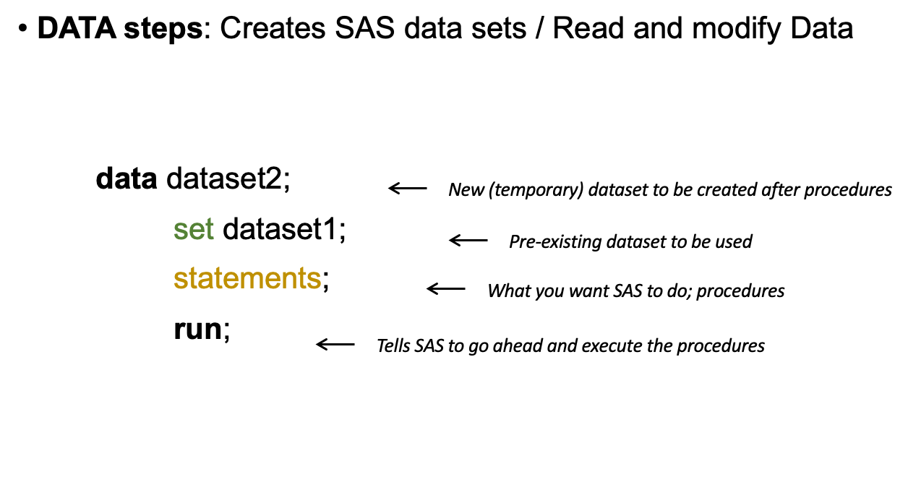
Basics of SAS syntax
•Statements separated by “ ; ”
•SAS: “Semicolon - Always Semicolon"

Slide 10
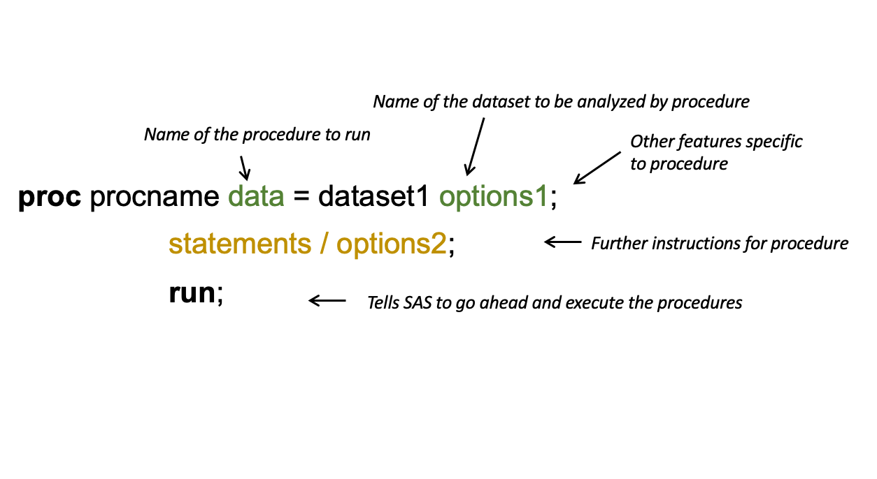
Basics of SAS syntax
Proc: It used to perform various types of data analysis and processing. Each PROC (short for procedure) serves a specific purpose, such as summarizing data, analyzing statistics, or creating graphical reports.
Example:
PROC PRINT
PROC PRINT DATA=work.sales_data;
RUN;

Slide 11
Goals for Today
Reading and Importing Data
Refer to slides and code examples.
Access raw data and code for data reading.
Describing the Data
Use print and contents to understand data structure.
Instructions in slides and code.
Saving Datasets
Guidance provided in slides and code.
Options: Temporary, Permanent, Libraries, Open.
Subsetting Data
Focus on writing code for:
Selecting observations by random sampling, variables, or specific criteria.
Exercises
Refer to the Word document for practice exercises.
Practice Makes Perfect
The best way to improve coding skills is by writing and practicing code.
​

Slide 12
Reading Data in SAS
SAS reads data from various sources and stores it in a unique format called a SAS Dataset, which includes:
Descriptor Portion: Contains metadata about the data, such as variable names and types.
Data Portion: Holds the actual data values.
Rules for SAS Dataset Names:
Length: Must be no longer than 32 characters.
Starting Character: Must begin with a letter or an underscore (_).
Restrictions:
Cannot contain spaces or dashes.
Only letters, numbers, and underscores are allowed.
​

Slide 13
Reading Data in SAS
Reading Data from an Excel File:
proc import datafile='/folders/myfolders/sales_data.xlsx'
out=sales_data
dbms=xlsx
replace;
sheet='Sheet1';
run;
proc print data=sales_data;
run;
The proc import procedure reads data from an Excel file specified in the datafile option.
The out option specifies the name of the output dataset.
The dbms=xlsx option specifies the type of Excel file being read.
The sheet option specifies which sheet to read from.

Slide 14
Saving datasets
Telling SAS where to FIND and STORE data
SAS automatically saves datasets temporarily during a session in a workspace called "Work"
In the output window, these datasets are shown as work.(dataset_name).
To save datasets permanently:
Create a specific folder (e.g., in MYSFUFILES).
Use the libname statement to define the storage location and reference it easily in your SAS programs (e.g., libname saslab2).

Slide 15
Saving datasets
Using the Temporary Work Library:
data work.sales_data;
input CustomerID $ Product $ SalesAmount;
datalines;
C001 Book 20
C002 Pen 5
C003 Notebook 10 ;
run;
proc print data=work.sales_data;
run;
Creating a Permanent Library Using libname:
libname mydata '/folders/myfolders/permanent_data';
data mydata.employee_data;
input EmployeeID $ Name $ Department $ Salary;
datalines;
E001 John HR 60000
E002 Alice IT 75000
E003 Bob Sales 55000 ;
run;
proc print data=mydata.employee_data;
run;

