Slide 1


AGENTIC AI FORECASTING BOOTCAMP
Forecasting U.S. Manufacturing Stress with a Governed Adaptive Agent
What we learned combining a statistical anchor, an LLM analyst and auditable agent memory
Team BMO Two
October 2026
Notes:
Introduce the project as a bootcamp learning exercise. The goal was to learn how to design, evaluate and govern an agentic forecaster, not to ship a production model.

Slide 2





TEAM BMO TWO
Meet the Team
NS
Mina Attari
Nitya Joshi
Pratyush Patodia
Vaibhav K Beohar
Navid Sabbaghi
Senior Manager, Wholesale Credit
Senior Manager, Retail IFRS 9 / CECL Model Development
Senior Manager, IFRS 9 Wholesale Model Development
Senior Manager, Machine Learning
Senior Specialist, IC
Agentic AI Forecasting Bootcamp | Learning proof of concept
2

Slide 3




IN ONE PAGE
Executive Summary
The Opportunity
Early warning of U.S. manufacturing stress could support sector-level portfolio monitoring, but stress is rare (6.25% of months since 2000) and hard to anticipate.
Our Solution
A forecasting workbench where an LLM agent starts from a logistic-regression anchor, adds evidence-based reasoning within a ±0.03 bound, and keeps a versioned, auditable strategy memory.
Results
On 84 monthly backtest origins (6 stress events), no model beat the historical-frequency baseline (Brier 0.0667). The bounded adaptive agent was close (0.0692); the unbounded LLM analyst was far worse (0.0979).
Next Steps
Run a frozen, prospective evaluation with immutable pre-outcome forecasts and more stress events, and add leading indicators before judging whether agents add skill.
Agentic AI Forecasting Bootcamp | Learning proof of concept
3
Notes:
Key message: the main deliverable is learning. The bounded agent stayed close to the statistical anchor, but rare events and coincident signals meant no model beat the base rate in this backtest.

Slide 4
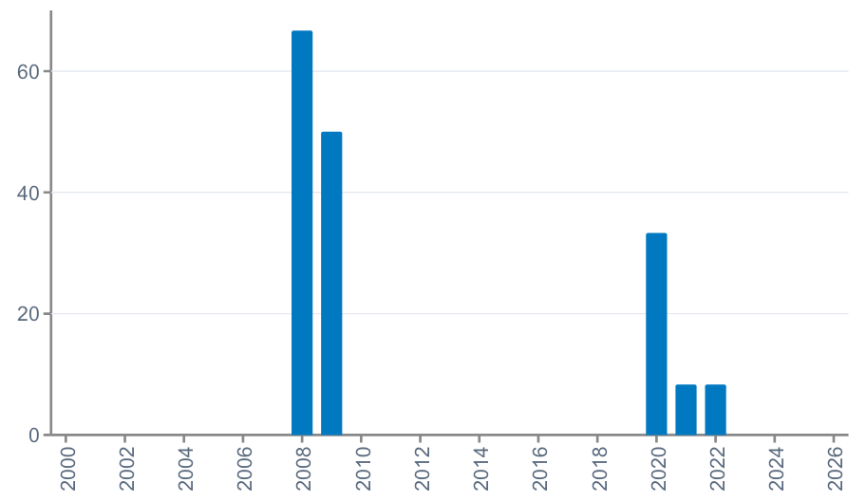
WHY THIS MATTERS
Business Problem & Opportunity
The Challenge
Share of months in manufacturing stress, by year (%)
Credit teams monitor sector exposures and want earlier warning when an industry is heading into stress.
Manufacturing stress is rare: 20 of 320 months (2000-2026) met our definition, clustered in 2008-09, 2020 and brief 2021-22 episodes.
Traditional models struggle with few events, and analyst judgment is hard to make consistent and auditable.
The Opportunity
Agents can read many signals, explain their view, and combine statistics with judgment.
If governed well, they could scale analyst-style monitoring across sectors with a full audit trail.
Target definition: a month is "stressed" when U.S. manufacturing production (FRED IPMAN) has fallen by 2% or more over the previous 3 months. We forecast this 3 months ahead.
Agentic AI Forecasting Bootcamp | Source figure, non-editable
4
Notes:
Base rate 6.25% (20 of 320 months). No dollar impact is claimed; the value case is earlier, more consistent warning.

Slide 5



BOOTCAMP INTENT
What We Set Out to Learn
The goal was not a production model. We used a real, hard forecasting problem to learn how agentic forecasting systems should be built, tested and governed.
Can an LLM agent improve on a statistical forecast?
How do we keep an LLM forecaster safe?
Compare agents against baselines on identical, leakage-safe backtests.
Anchor the agent to a numerical model and bound how far it can move.
Can an agent learn from experience, transparently?
How should we evaluate rare-event forecasts?
Give it a versioned strategy memory with gated updates and an audit log.
Use probability scoring, baselines, calibration and regime slices, and be honest about sample size.
Agentic AI Forecasting Bootcamp | Learning proof of concept
5

Slide 6

HIGH-LEVEL APPROACH
Our Solution
A forecasting workbench that pairs a transparent statistical model with an LLM analyst. The model provides the starting probability; the agent reviews current evidence, explains its view, and can nudge the forecast only within a fixed bound. Every durable change to the agent's strategy is versioned and logged.
Key Capabilities
Leakage-safe numerical anchor
Bounded LLM reasoning
Governed adaptive memory
Logistic regression refit at each forecast date, using only data released by that date (FRED and Yahoo Finance).
The agent returns a probability, rationale, supporting and opposing evidence, and a risk direction. Its change to the anchor is capped at ±0.03.
Typed tools record observations and hypotheses. A hypothesis needs 3 confirmations from distinct origins before it changes the strategy; every change is hash-linked.
Agentic AI Forecasting Bootcamp | Learning proof of concept
6

Slide 7
ARCHITECTURE
How the Workbench Fits Together
Leakage-safe data
Logistic anchor
LLM agent
±0.03 guardrail
Forecast record
IPMAN, macro and market series, filtered by release date
Statistical probability (C = 0.001)
Reviews evidence and proposes a probability with rationale
Final = anchor + bounded adjustment
Scored in backtest with Brier score
Strategy memory (enabled for the adaptive agent)
Typed tools save observations and hypotheses to a versioned state that later prompts read. Every change writes a redacted audit event with before/after hashes.
What the agent CAN change
What it CANNOT change
Observability
Its proposed probability (within ±0.03) and the prompt-level strategy it reads next time.
Data, features, target, model parameters or the anchor code. No retraining happens through the agent.
Optional Langfuse traces for each call, plus a local redacted audit log of strategy changes.
Agentic AI Forecasting Bootcamp | Learning proof of concept
7

Slide 8
DATA, MODELS AND EVALUATION
Technical Approach
Data & Models
Experiments & Evaluation
Dataset
15 monthly inputs from public sources: IPMAN 1/3/6-month changes; Fed funds, 10y-2y spread, CPI, unemployment, jobless claims, VIX, Baa credit spread (FRED); SPY and XLI 3/12-month returns (Yahoo Finance).
Leakage control
Each forecast only sees data released by its date. IPMAN uses a conservative 1-month release lag.
Models compared (7)
Historical frequency (baseline), logistic regression, XGBoost, hybrid anchor, LLM analyst agent, hybrid agent and adaptive agent.
1
Parameter sweep 15 candidates, 3 chronological folds (2000-2017)
2
2018-2024 diagnostic Sweep candidates re-scored on an already-inspected window
3
All-model comparison 7 models, 84 monthly origins (2018-2024), 6 stress events
4
LLM model choice comparison Gemini Lite vs Gemini Advanced, read-only, same 84 origins
5
Governance demo One full hypothesis lifecycle with audited memory changes
Evaluation metrics
Brier score = mean of (forecast probability - actual 0/1)². Lower is better. Brier skill = 1 - model score / baseline score; positive means better than the historical base rate. Plus calibration and regime slices.
Agentic AI Forecasting Bootcamp | Learning proof of concept
8

Slide 9
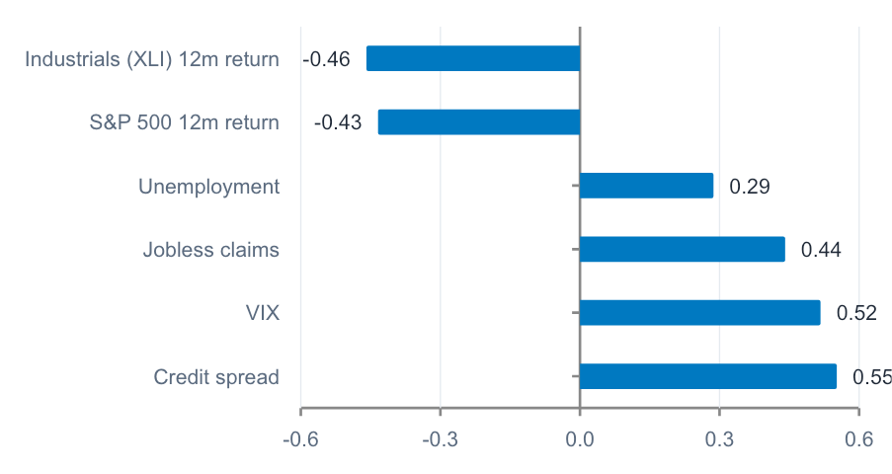
DATA UNDERSTANDING
What the Data Told Us
Correlation with the stress label (same month)
Stress months look very different...
Signal (average) | Normal months | Stress months
VIX | 18.8 | 35.3
Credit spread (pp) | 2.34 | 4.04
Unemployment (%) | 5.5 | 7.7
XLI 12m return (%) | +12.9 | -22.6
...but mostly at the same time, not before
Lagged correlations peak near zero lag: stress signals are largely coincident, not leading. That is the core reason a 3-month-ahead forecast is hard, whichever model is used.
All six signs held under bootstrap and leave-one-out checks.
Data quality: no missing values in any series. Market series start in 1998-99, so the modelling window is 2000 onward (320 months, 20 stress months).
Agentic AI Forecasting Bootcamp | Source figure, non-editable
9

Slide 10
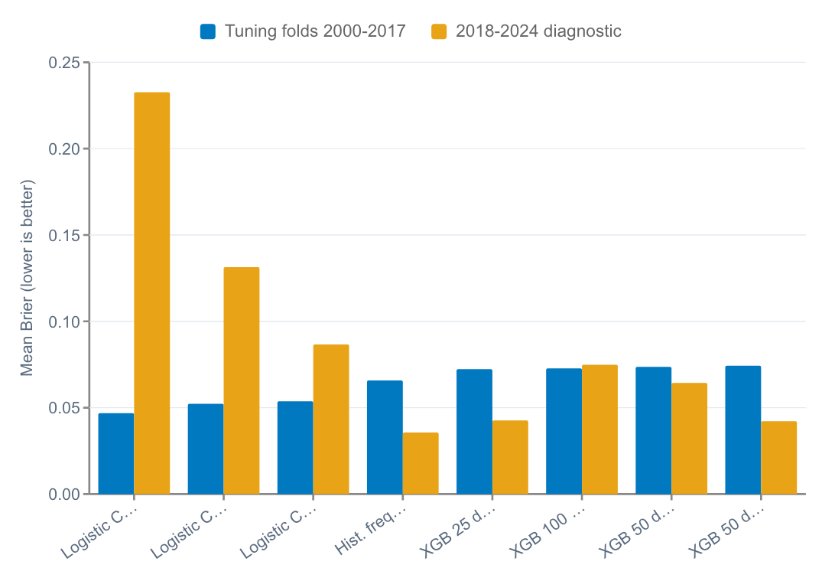
PARAMETER SWEEP
Results 1: The Tuning Winner Did Not Hold Up
1st → last
Logistic C=1.0 ranked first in tuning (+28.8% skill) and last on 2018-2024 (-554% skill).
Only 5 stress events in the tuning period, all in one fold (2006-2011).
No XGBoost setting beat the baseline in tuning; extra regularization did not help.
Lesson: with rare events, tuning can reward confident models that happen to fit one episode.
Action: we froze conservative choices (logistic C=0.001, regularized XGBoost) and did not retune on 2018-2024.
Agentic AI Forecasting Bootcamp | Source figure, non-editable
10
Notes:
Only the 8 candidates with both scores reported are shown. 2018-2024 is a historical diagnostic, not a protected holdout.

Slide 11
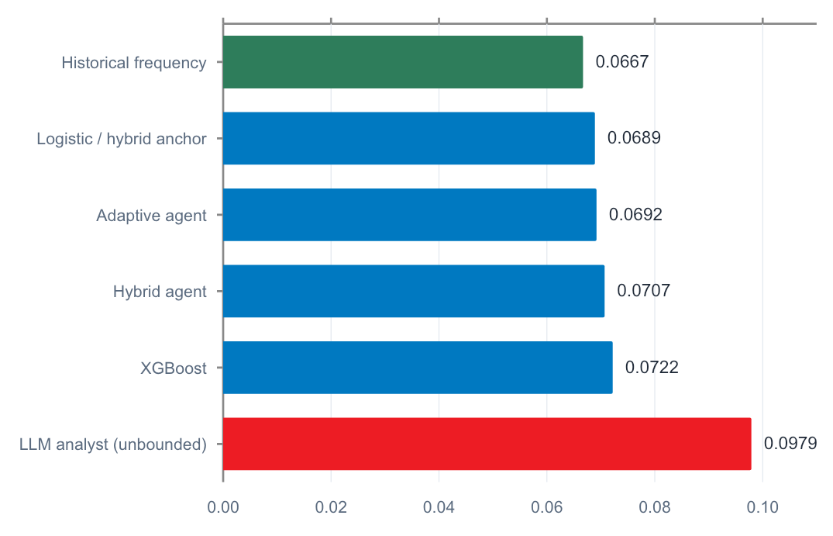
ALL-MODEL COMPARISON, 84 ORIGINS
Results 2: No Model Beat the Base Rate
-3.8%
-46.8%
Adaptive agent skill vs baseline
Unbounded LLM analyst skill vs baseline
The base rate won because events were rare and signals were coincident.
Agents tied to the anchor stayed close to it; the free-standing analyst was much worse.
Blending logistic with XGBoost never helped: the best of 11 tested weights was 100% logistic.
Six events is too few to call any gap statistically meaningful.
Mean Brier score, lower is better. 2018-01 to 2024-12 origins; 6 stress events (7.1%).
Agentic AI Forecasting Bootcamp | Source figure, non-editable
11

Slide 12
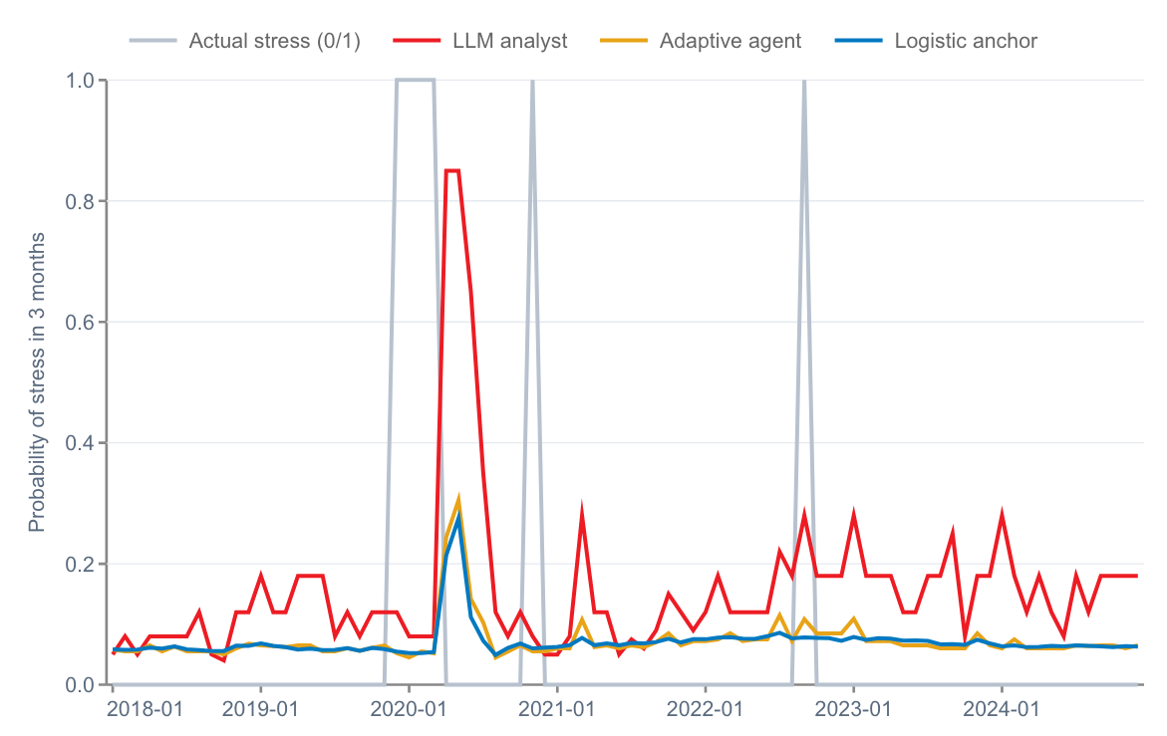
FORECASTS VS OUTCOMES
Results 3: Models Reacted Too Late
All 6 stress events were missed
At the origins that preceded actual stress, the anchor and adaptive agent forecast 0.05-0.11 and the analyst 0.08-0.28.
Peaks came too late
Probabilities spiked at Apr-Jun 2020 origins, after the COVID drop was visible. By the forecast date production was recovering, so the outcome was 0.
X-axis: forecast origin (monthly, 2018-2024). Grey line = actual outcome at the forecast date.
Agentic AI Forecasting Bootcamp | Source figure, non-editable
12

Slide 13
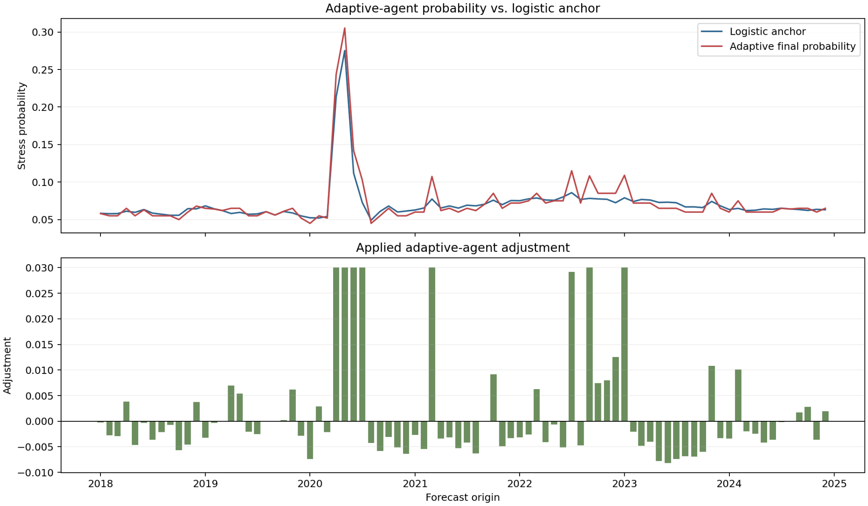
BOUNDED AGENT ADJUSTMENTS
Results 4: The Guardrail Did Its Job
0.094
0.071
0.072
Average agent proposal
Average anchor
Average final forecast
The adaptive agent ran with memory updates enabled.
It wanted higher probabilities on average; the ±0.03 cap kept the final close to the anchor.
7 of 84 proposals hit the cap, including Apr-Jun 2020 when the agent proposed up to 0.85.
26 adjustments up, 58 down. Bounded agents: -3.8% to -6.0% skill vs -46.8% for the unbounded analyst.
Top: logistic anchor vs adaptive agent final probability. Bottom: applied adjustment per origin (capped at ±0.03).
Agentic AI Forecasting Bootcamp | Learning proof of concept
13
Notes:
The guardrail limited harm; it did not create skill.

Slide 14
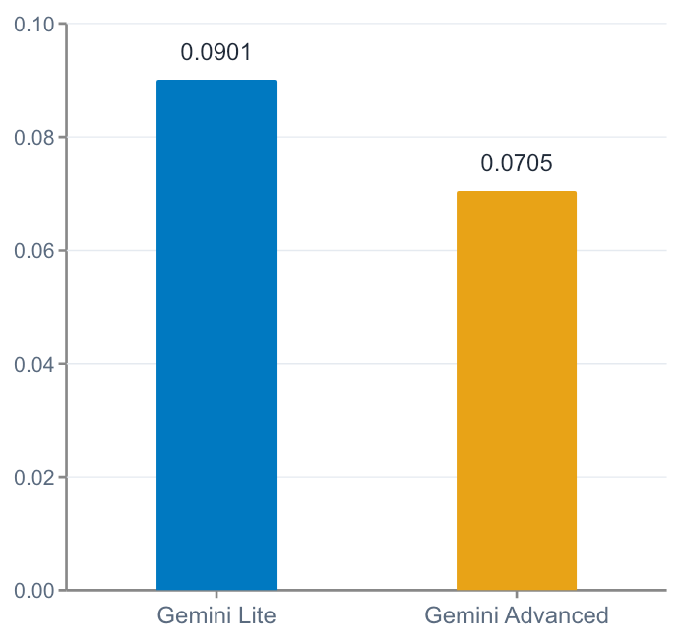
LLM MODEL CHOICE (READ-ONLY)
Results 5: A Stronger LLM Overreacted Less
Where the gap came from
Origin | Lite | Advanced | Outcome
2020-04 | 0.65 | 0.45 | 0
2020-05 | 0.85 | 0.15 | 0
2020-06 | 0.85 | 0.12 | 0
~98%
of the 0.0197 Brier gap came from these 3 post-COVID origins
Gemini Advanced was not better at spotting stress: both models missed all 6 events.
It was more willing to expect a rebound after the April 2020 trough.
Risk directions agreed on only 50 of 84 origins (59.5%).
Rationales sometimes quoted inconsistent inputs for the same month (e.g., 3-month IPMAN -4.05% vs -0.04% in Aug 2018); root cause still to be investigated.
Mean Brier, 84 paired origins, memory updates disabled. Separate experiment from the 7-model comparison.
Agentic AI Forecasting Bootcamp | Source figure, non-editable
14

Slide 15
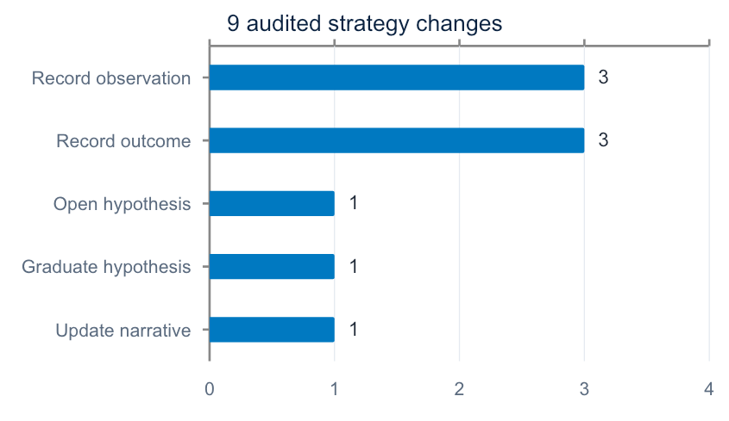
GOVERNANCE DEMONSTRATION
Results 6: Auditable Memory Works
1
2
3
4
5
6
Open
Observe
Confirm
Gate
Graduate
Update
hyp-001 + initial evidence
3 observations
3 distinct origins
≥3 confirmations?
Calibration correction
Approach narrative
What it shows
Each change has a timestamp, tool, version and before/after hash. The gate stopped a hypothesis from becoming guidance until 3 confirmations were recorded. Example outcome: adjust anchor 0.066 to 0.060.
Agentic AI Forecasting Bootcamp | Source figure, non-editable
15

Slide 16





DISCUSSION
Challenges and How We Addressed Them
Rare events (6 in the 84-origin backtest)
Look-ahead leakage
Scored against a base-rate benchmark, used chronological folds, and avoided claims of statistical significance.
Filtered every input by release date; applied a 1-month lag to IPMAN; audited what was visible at the latest origin.
Overfitting during tuning
LLM overconfidence
Froze conservative settings and did not retune on the inspected 2018-2024 window.
Anchored agents to the logistic model and capped adjustments at ±0.03.
Unreliable explanations
Reproducibility and cost
Logged rationale and evidence per forecast; flagged inconsistent quoted values for follow-up.
Cached agent runs; report builds make zero LLM calls and reproduce every chart from saved tables.
Agentic AI Forecasting Bootcamp | Learning proof of concept
16

Slide 17
WHAT WE TAKE AWAY
Key Learnings
01
Start with the base rate
For rare events, a simple historical frequency is a demanding benchmark. Beat it before adding complexity.
02
Anchor and bound the LLM
Unbounded LLM probabilities overreacted. A statistical anchor plus a small cap kept agents close to sound forecasts.
03
Signals matter more than models
Our inputs describe stress as it happens. Better leading indicators will matter more than a bigger model.
04
Governance can come first
Versioned memory, gated updates and audit logs can be built before accuracy is proven and make later evaluation credible.
05
Be careful with explanations
Agent rationales are useful for review but are not causal evidence and can quote inconsistent numbers.
Agentic AI Forecasting Bootcamp | Learning proof of concept
17

Slide 18
NEXT STEPS
Future Work & Opportunities
Next steps to mature the proof of concept
Potential value
1
Prospective test
Freeze the configuration and log immutable forecasts before outcomes are known.
A reusable pattern for sector early-warning monitoring: statistical anchor + bounded agent + audit trail.
Analyst-style commentary at scale, with every forecast traceable to evidence and model version.
A governance template for agentic models in regulated settings: what the agent may change, how changes are gated, and how they are logged.
The same workbench can be pointed at other industries or targets.
2
Prospective test of memory
Run memory-less hybrid agent with an adaptive agent going forward, with memory updated only from forecasts that have actually resolved, and over enough stress events to tell them apart.
3
Leading indicators
Add forward-looking inputs (for example, new orders or surveys) and longer histories to capture more events.
4
Fix explanation quality
Investigate inconsistent quoted inputs and validate rationales against the actual feature snapshot.
Agentic AI Forecasting Bootcamp | Learning proof of concept
18

Slide 19
ADAPTIVE LEARNING CONTROL
Outcome-grounded Adaptive Learning
Saved forecast
Outcome pending
Resolution ledger
Strategy review
Next forecast
Immutable probability, anchor and stable origin ID
Target remains hidden until its release date
Only published outcomes become review evidence
A dedicated reviewer evaluates newly resolved origins
Reads the latest versioned strategy
skill_state.yaml: versioned strategy memory
Stores observations, hypotheses and calibration rules. Typed tools control every change; the audit log records before/after hashes.
Hard refusal
Promotion gate
Auditability
An unresolved or unknown origin cannot confirm or refute a hypothesis.
A calibration rule needs 3 confirmations from distinct resolved origins.
Each update records the review origin, tool, timestamp and before/after hashes.
Agentic AI Forecasting Bootcamp | Learning proof of concept
19
Notes:
Branch addition: cutoff-aware OutcomeLedger and separate periodic strategy review.
The key control is temporal: an outcome cannot enter memory until its publication date is at or before the current forecast origin.
Source: adaptive_agent/ledger.py, adaptive_agent/review.py and adaptive_agent/tools.py.

Slide 20
IMPLEMENTATION ADDITIONS
What Changed in the Branch
01
Outcome ledger
A cutoff-aware ledger hides every label until its release date and exposes stable origin IDs.
02
Separate strategy reviewer
Forecast calls read memory. A dedicated reviewer updates it only after outcomes resolve.
03
Enforced evidence gates
Tools reject unresolved IDs. Graduation needs confirmations from 3 distinct resolved origins.
04
Statistical evaluation
Added 264-origin history, block-bootstrap intervals, HAC DM tests and Murphy decomposition.
05
Reproducible validation
Saved forecasts, reviews and hash-linked audit events. Four targeted learning tests pass.
Agentic AI Forecasting Bootcamp | Learning proof of concept
20
Notes:
These changes make the adaptive process testable. Memory writes now have a resolvable evidence chain rather than narrative references to the current forecast.
Source: branch commits 5bd7ce1, aef3a51 and 0e6c584; test_adaptive_learning.py; reports/full_history.

Slide 21
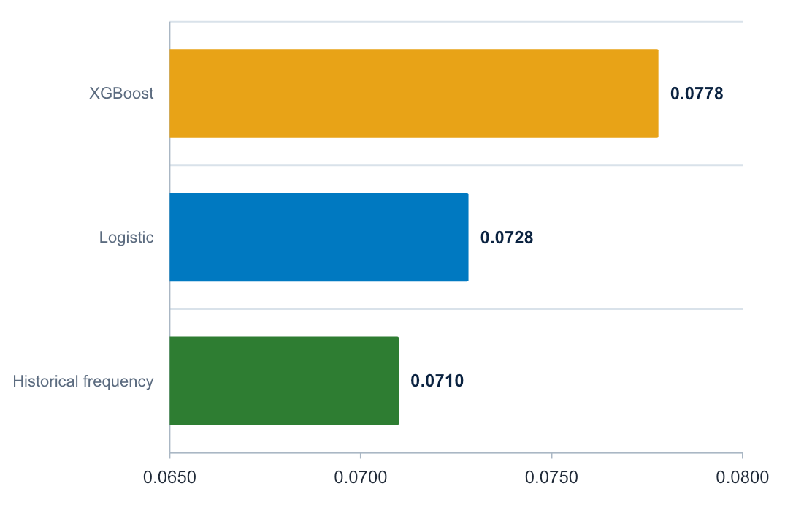
FULL-HISTORY EVALUATION
Results 7: Base Rate Still Leads
-2.6%
-9.6%
Logistic skill vs historical frequency
XGBoost skill vs historical frequency
Historical frequency scored 0.0710.
Logistic scored 0.0728; its +0.0018 gap had a 90% interval of -0.0008 to +0.0043 (p = 0.207).
XGBoost scored 0.0778; its +0.0068 gap was reliably worse (p = 0.0006).
The longer history strengthens the conclusion that these inputs add little forward-looking separation.
Mean Brier score, lower is better. 264 monthly origins, 2003-2024; 20 stress outcomes.
Agentic AI Forecasting Bootcamp | Source figure, non-editable
21
Notes:
Source: reports/full_history/executive_report.md and tables/model_comparison.csv.
The interval uses a six-month circular block bootstrap. The DM test uses HAC variance for overlapping three-month forecast horizons.
The result concerns the evaluated feature set and retrospective sample; it does not prove that manufacturing stress is inherently unpredictable.

Slide 22
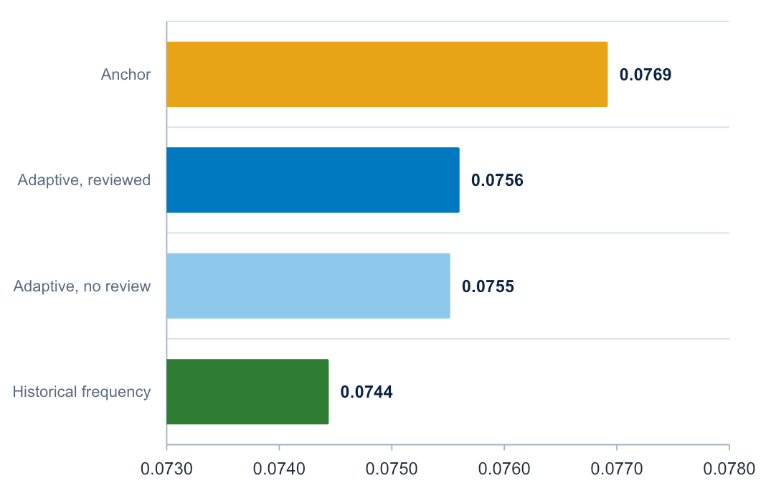
OUTCOME-GROUNDED WALK-FORWARD
Results 8: Governance Improved, Skill Did Not
-1.6%
p = 0.396
Reviewed adaptive skill vs baseline
Reviewed adaptive agent vs anchor
The reviewer ran 24 times and created 35 audited mutations.
Reviewed and no-review agents were nearly identical: 0.0756 vs 0.0755.
The reviewed agent beat its anchor by 0.0013, but the gap was not significant.
Late-period performance was worse than the anchor, so the run does not show learning. It does show a valid, auditable test design.
Mean Brier score, lower is better. 76 resolved origins, 2006-2024; 6 stress outcomes.
Agentic AI Forecasting Bootcamp | Source figure, non-editable
22
Notes:
Source: reports/adaptive_walk_forward/lite and reports/adaptive_walk_forward/lite_no_review.
The reviewed adaptive-versus-anchor mean Brier difference was -0.00132 with DM p = 0.396. Negative favors the adaptive agent.
Reviews occurred every four origins and after a newly resolved stress event. The saved run contains 76 forecasts, 24 reviews and 35 strategy mutations.

Slide 23

Thank You!
Team BMO Two | Agentic AI Forecasting Bootcamp
Questions and feedback welcome
Mina Attari · Nitya Joshi · Pratyush Patodia · Vaibhav K Beohar · Navid Sabbaghi

