Slide 1


AGENTIC AI FORECASTING BOOTCAMP
Forecasting U.S. Manufacturing Stress with a Governed Adaptive Agent
What we learned combining a statistical anchor, an LLM analyst and auditable agent memory
Team BMO Two
October 2026
Notes:
Introduce the project as a bootcamp learning exercise. The goal was to learn how to design, evaluate and govern an agentic forecaster, not to ship a production model.

Slide 2

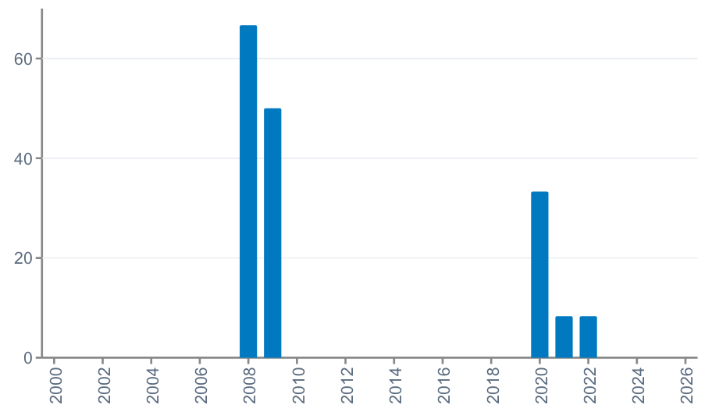
WHY THIS MATTERS
Business Problem & Opportunity
The Challenge
Share of months in manufacturing stress, by year (%)
Credit teams monitor sector exposures and want earlier warning when an industry is heading into stress.
Manufacturing stress is rare: 20 of 320 months (2000-2026) met our definition, clustered in 2008-09, 2020 and brief 2021-22 episodes.
Traditional models struggle with few events, and analyst judgment is hard to make consistent and auditable.
The Opportunity
Agents can read many signals, explain their view, and combine statistics with judgment.
If governed well, they could scale analyst-style monitoring across sectors with a full audit trail.
Target definition: a month is "stressed" when U.S. manufacturing production (FRED IPMAN) has fallen by 2% or more over the previous 3 months. We forecast this 3 months ahead.
Agentic AI Forecasting Bootcamp | Source figure, non-editable
2
Notes:
Base rate 6.25% (20 of 320 months). No dollar impact is claimed; the value case is earlier, more consistent warning.

Slide 3



HIGH-LEVEL APPROACH
Our Solution
A forecasting workbench that pairs a transparent statistical model with an LLM analyst. The model provides the starting probability; the agent reviews current evidence, explains its view, and can nudge the forecast only within a fixed bound. Every durable change to the agent's strategy is versioned and logged.
Key Capabilities
Leakage-safe numerical anchor
Bounded LLM reasoning
Governed adaptive memory
Logistic regression refit at each forecast date, using only data released by that date (FRED and Yahoo Finance).
The agent returns a probability, rationale, supporting and opposing evidence, and a risk direction. Its change to the anchor is capped at ±0.03.
Typed tools record observations and hypotheses. A hypothesis needs 3 confirmations from distinct origins before it changes the strategy; every change is hash-linked.
Agentic AI Forecasting Bootcamp | Learning proof of concept
3

Slide 4
ARCHITECTURE
How the Workbench Fits Together
Leakage-safe data
Logistic anchor
LLM agent
±0.03 guardrail
Forecast record
IPMAN, macro and market series, filtered by release date
Statistical probability (C = 0.001)
Reviews evidence and proposes a probability with rationale
Final = anchor + bounded adjustment
Scored in backtest with Brier score
Strategy memory (enabled for the adaptive agent)
Typed tools save observations and hypotheses to a versioned state that later prompts read. Every change writes a redacted audit event with before/after hashes.
What the agent CAN change
What it CANNOT change
Observability
Its proposed probability (within ±0.03) and the prompt-level strategy it reads next time.
Data, features, target, model parameters or the anchor code. No retraining happens through the agent.
Optional Langfuse traces for each call, plus a local redacted audit log of strategy changes.
Agentic AI Forecasting Bootcamp | Learning proof of concept
4

Slide 5
DATA, MODELS AND EVALUATION
Technical Approach
Data & Models
Experiments & Evaluation
Dataset
15 monthly inputs from public sources: IPMAN 1/3/6-month changes; Fed funds, 10y-2y spread, CPI, unemployment, jobless claims, VIX, Baa credit spread (FRED); SPY and XLI 3/12-month returns (Yahoo Finance).
Leakage control
Each forecast only sees data released by its date. IPMAN uses a conservative 1-month release lag.
Models compared (7)
Historical frequency (baseline), logistic regression, XGBoost, hybrid anchor, LLM analyst agent, hybrid agent and adaptive agent.
1
Parameter sweep 15 candidates, 3 chronological folds (2000-2017)
2
2018-2024 diagnostic Sweep candidates re-scored on an already-inspected window
3
All-model comparison 7 models, 84 monthly origins (2018-2024), 6 stress events
4
LLM model choice comparison Gemini Lite vs Gemini Advanced, read-only, same 84 origins
5
Governance demo One full hypothesis lifecycle with audited memory changes
Evaluation metrics
Brier score = mean of (forecast probability - actual 0/1)². Lower is better. Brier skill = 1 - model score / baseline score; positive means better than the historical base rate. Plus calibration and regime slices.
Agentic AI Forecasting Bootcamp | Learning proof of concept
5

Slide 6
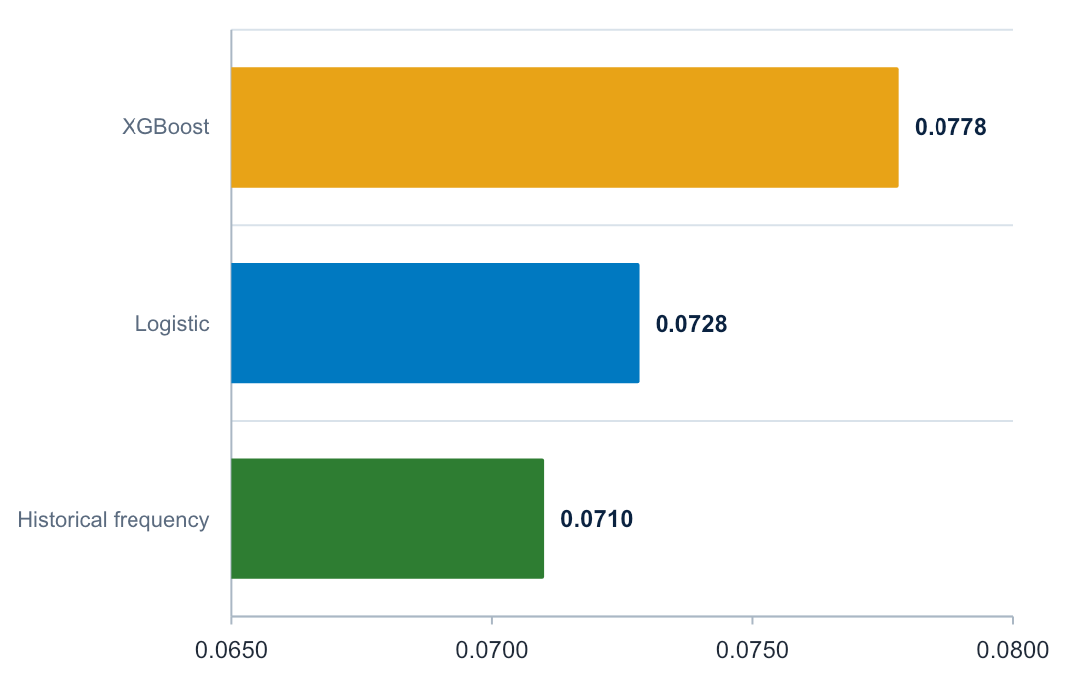
FULL-HISTORY EVALUATION
The Base Rate Still Leads
-2.6%
-9.6%
Logistic skill vs historical frequency
XGBoost skill vs historical frequency
Historical frequency scored 0.0710.
Logistic scored 0.0728; its +0.0018 gap had a 90% interval of -0.0008 to +0.0043 (p = 0.207).
XGBoost scored 0.0778; its +0.0068 gap was reliably worse (p = 0.0006).
The longer history strengthens the conclusion that these inputs add little forward-looking separation.
Mean Brier score, lower is better. 264 monthly origins, 2003-2024; 20 stress outcomes.
Agentic AI Forecasting Bootcamp | Source figure, non-editable
6
Notes:
Source: reports/full_history/executive_report.md and tables/model_comparison.csv.
The interval uses a six-month circular block bootstrap. The DM test uses HAC variance for overlapping three-month forecast horizons.
The result concerns the evaluated feature set and retrospective sample; it does not prove that manufacturing stress is inherently unpredictable.
Showcase cue: lower Brier score is better. The base-rate forecast remains the benchmark to beat.

Slide 7
ADAPTIVE LEARNING CONTROL
Outcome-grounded Adaptive Learning
Saved forecast
Outcome pending
Resolution ledger
Strategy review
Next forecast
Immutable probability, anchor and stable origin ID
Target remains hidden until its release date
Only published outcomes become review evidence
A dedicated reviewer evaluates newly resolved origins
Reads the latest versioned strategy
skill_state.yaml: versioned strategy memory
Stores observations, hypotheses and calibration rules. Typed tools control every change; the audit log records before/after hashes.
Hard refusal
Promotion gate
Auditability
An unresolved or unknown origin cannot confirm or refute a hypothesis.
A calibration rule needs 3 confirmations from distinct resolved origins.
Each update records the review origin, tool, timestamp and before/after hashes.
Agentic AI Forecasting Bootcamp | Learning proof of concept
7
Notes:
Branch addition: cutoff-aware OutcomeLedger and separate periodic strategy review.
The key control is temporal: an outcome cannot enter memory until its publication date is at or before the current forecast origin.
Source: adaptive_agent/ledger.py, adaptive_agent/review.py and adaptive_agent/tools.py.

Slide 8
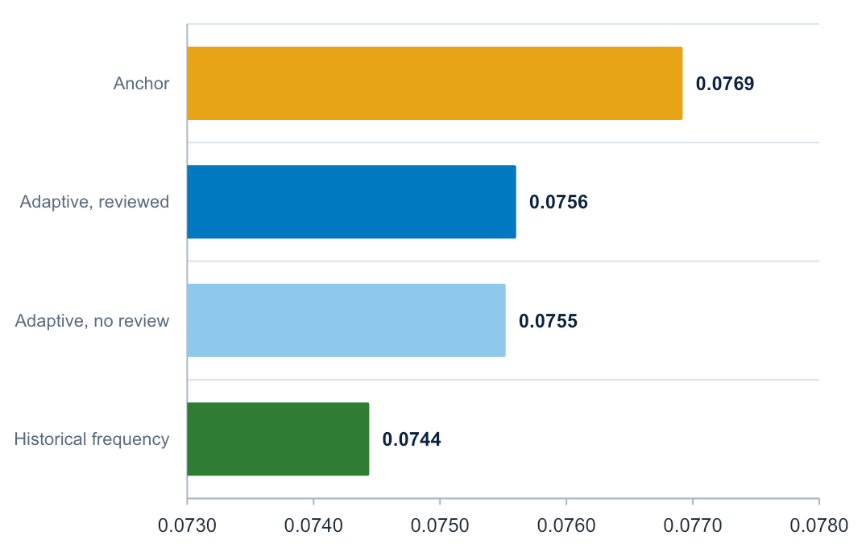
OUTCOME-GROUNDED WALK-FORWARD
Governance Improved, Forecast Skill Did Not
-1.6%
p = 0.396
Reviewed adaptive skill vs baseline
Reviewed adaptive agent vs anchor
The reviewer ran 24 times and created 35 audited mutations.
Reviewed and no-review agents were nearly identical: 0.0756 vs 0.0755.
The reviewed agent beat its anchor by 0.0013, but the gap was not significant.
Late-period performance was worse than the anchor, so the run does not show learning. It does show a valid, auditable test design.
Mean Brier score, lower is better. 76 resolved origins, 2006-2024; 6 stress outcomes.
Agentic AI Forecasting Bootcamp | Source figure, non-editable
8
Notes:
Source: reports/adaptive_walk_forward/lite and reports/adaptive_walk_forward/lite_no_review.
The reviewed adaptive-versus-anchor mean Brier difference was -0.00132 with DM p = 0.396. Negative favors the adaptive agent.
Reviews occurred every four origins and after a newly resolved stress event. The saved run contains 76 forecasts, 24 reviews and 35 strategy mutations.
Showcase cue: the branch fixed the evaluation design. The current evidence does not yet show forecast learning.

Slide 9
NEXT STEPS
Next Steps and Opportunities
Next steps to mature the proof of concept
Potential value
1
Prospective test
Freeze the configuration and log immutable forecasts before outcomes are known.
A reusable pattern for sector early-warning monitoring: statistical anchor + bounded agent + audit trail.
Analyst-style commentary at scale, with every forecast traceable to evidence and model version.
A governance template for agentic models in regulated settings: what the agent may change, how changes are gated, and how they are logged.
The same workbench can be pointed at other industries or targets.
2
Prospective test of memory
Run memory-less hybrid agent with an adaptive agent going forward, with memory updated only from forecasts that have actually resolved, and over enough stress events to tell them apart.
3
Leading indicators
Add forward-looking inputs (for example, new orders or surveys) and longer histories to capture more events.
4
Fix explanation quality
Investigate inconsistent quoted inputs and validate rationales against the actual feature snapshot.
Agentic AI Forecasting Bootcamp | Learning proof of concept
9

Slide 10

Thank You!
Team BMO Two | Agentic AI Forecasting Bootcamp
Questions and feedback welcome
Mina Attari · Nitya Joshi · Pratyush Patodia · Vaibhav K Beohar · Navid Sabbaghi

