Slide 1
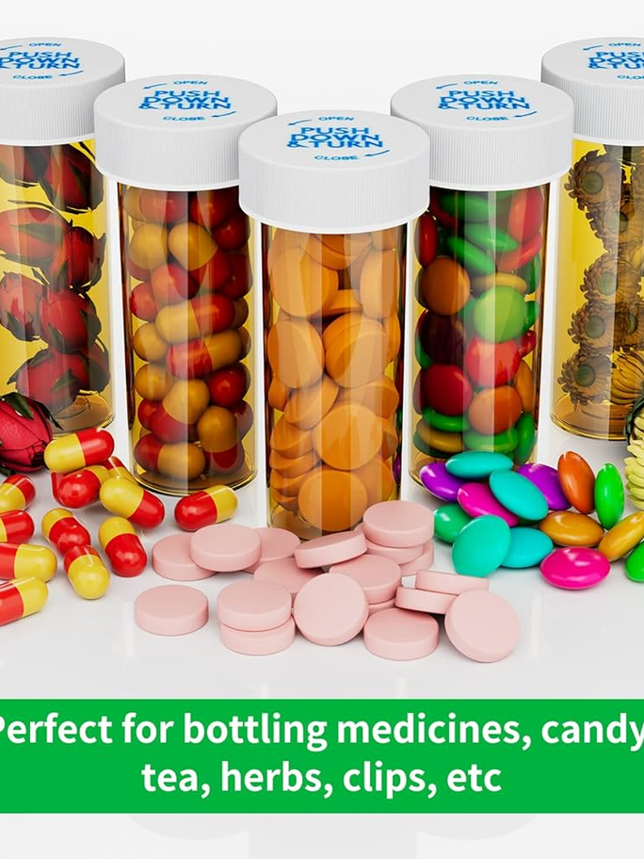
▶
LIVE DEMO · MEDWISE.RUNASP.NET
GRADUATION PROJECT DEFENSE · 2025–2026
MedWise
A Smart Medication Management System for Safer Elderly Care
An integrated web platform for medication tracking, drug-interaction safety, AI-powered guidance, caregiver monitoring, and emergency response — designed for elderly patients and the families who care for them.
M
TEAM
Mina Ayman · Kerollous Yasser · Ziad Tamer · Kerollous Saadalla · Pierre Nabil · Tadros Wagdy · Youssef Gerges · Kerollous Majid · Mina Amgad
SUPERVISOR
Dr. [Samar Hisham]
DEPARTMENT
Faculty of Computers and Information — Software Department
ACADEMIC YEAR 2025 / 2026
MedWise · Defense Deck
Notes:
Good morning, esteemed members of the committee. Thank you for being here today. We are pleased to present our graduation project, MedWise — a smart medication management system built to make elderly care safer. MedWise was designed and developed by our team — [Student Name 1], [Student Name 2], [Student Name 3], and [Student Name 4] — under the kind supervision of Dr. [Supervisor Name], in the Software Engineering Department of the Faculty of Computers and Information. The project is a fully working web application, deployed live at medwise.runasp.net, that helps elderly patients take the right medication at the right time while keeping their families informed in real time. Over the next few minutes we will walk you through the problem we set out to solve, the solution we built, the methodology behind it, and the results we achieved. We hope you find the talk informative.

Slide 2
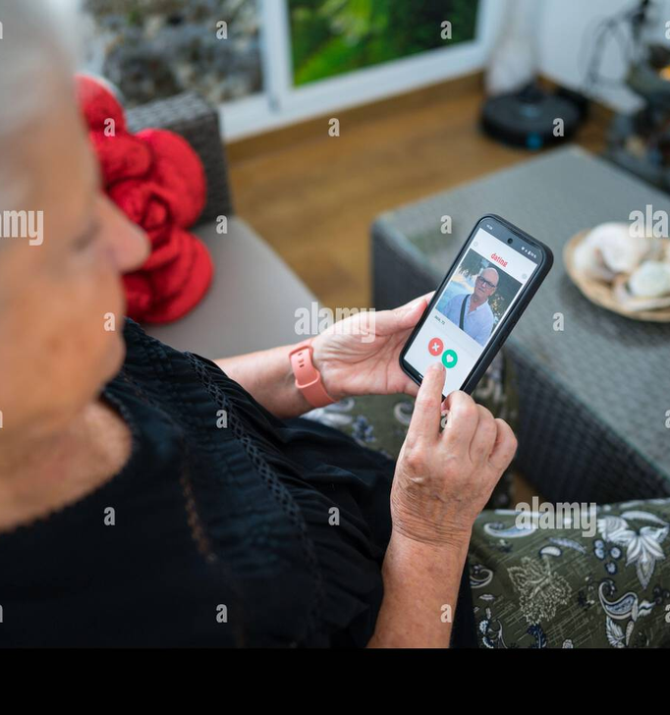
CHAPTER 01 · INTRODUCTION
02 / 21
Medication Safety, Simplified
MedWise is a web-based medication management platform built to help elderly patients manage their daily medications safely and to keep their families informed in real time. The system combines medication tracking, automated drug-interaction checks, an AI chatbot for plain-language medical guidance, scheduled reminders, remote caregiver monitoring, and a one-tap emergency button. It is designed for an audience that is often underserved by generic health apps — older adults who take multiple prescriptions and the family members who support them.
◯
MEDICATION TRACKING
⛨
INTERACTION SAFETY
♟
CAREGIVER MONITORING
☻ Patient-first design
⛨ Real-time safety
Large text, calm colors, simple flows
Interaction warnings before intake
◉ Family visibility
✦ Emergency-ready
Caregivers stay informed remotely
One tap alerts the whole circle
Designed for users who are often left behind by generic health apps.
MEDWISE · GRADUATION DEFENSE
INTRODUCTION
Notes:
Medication errors are one of the leading causes of preventable harm in elderly populations, and most of those errors come not from bad prescriptions but from the daily chaos of managing many of them at once. MedWise is our team's response to that problem — a single web platform that combines six capabilities that today live in scattered apps: medication tracking, drug-interaction safety, an AI chatbot for plain-language guidance, scheduled reminders, remote caregiver monitoring, and a one-tap emergency button. The system is built explicitly for two underserved audiences — elderly patients who take multiple prescriptions and the family members who support them — with large text, calm colors, and simple flows. Over the next slides we will walk through the problem we observed, the people it affects, the objectives we set, the design we built, and the results we measured.

Slide 3
CHAPTER 02 · THE PROBLEM
03 / 21
Managing multiple medications is harder than it should be.
Elderly patients often take five or more prescription medications at the same time, prescribed by different doctors and refilled on different schedules. Remembering what to take, when to take it, and which combinations are dangerous becomes a daily cognitive load — and a silent source of preventable harm.
50%+
1 in 3
~50%
OF ADULTS 65+ TAKE 5+ MEDS DAILY
ELDERLY PATIENTS EXPERIENCES A DRUG-RELATED HARM EVENT
OF PRESCRIBED MEDS ARE NOT TAKEN AS DIRECTED
POLYPHARMACY PREVALENCE
ADVERSE DRUG EVENTS
ADHERENCE GAP
“
Existing apps treat medication tracking, interaction safety, caregiver visibility, and emergency response as separate problems. MedWise treats them as one.
MEDWISE · GRADUATION DEFENSE
PROBLEM STATEMENT
Notes:
Picture an elderly patient who has just come home from a cardiology visit with two new prescriptions on top of the three she is already taking for hypertension, diabetes, and cholesterol. Each pill has its own schedule, its own refills, and its own hidden interactions. Now multiply that across millions of households. The numbers tell the story: more than half of adults over sixty-five take five or more medications daily, one in three elderly patients experiences a drug-related harm event, and roughly half of all prescribed medications are not taken as directed. These are not convenience statistics — they are patient-safety statistics. The deeper problem is structural: existing tools solve fragments of this problem in isolation, so the cognitive load stays on the patient and the family. MedWise was scoped to close that integration gap.

Slide 4

CHAPTER 02 · MOTIVATION
04 / 21
Why this matters, and who benefits
Most medication apps are built for young, tech-fluent users managing one or two prescriptions. MedWise is built for the people those apps leave out — and for the families who worry about them.
✦
Patients
♟
Families
Take the right pill at the right time, with safety checks built in.
See adherence and emergencies in real time, from anywhere.
✚
Clinicians
◯
Healthcare system
Get a clearer picture of what the patient actually takes.
Reduce preventable ER visits from adverse drug events.
When a missed dose becomes a missed alarm, families deserve to know — instantly.
◖
Aging at home, supported by family.
MEDWISE · GRADUATION DEFENSE
MOTIVATION
Notes:
The motivation for this project is not abstract. Many of us have watched a grandparent struggle to keep track of five different prescriptions, or a parent miss a dose without anyone in the family knowing until days later. That personal experience is what shaped MedWise. We then expanded the lens to four beneficiary groups. For patients, the goal is simple: take the right pill at the right time, with safety checks built in. For families, it is peace of mind — seeing adherence and emergencies in real time, from anywhere. For clinicians, it is a clearer picture of what the patient actually takes at home, not just what was prescribed. And for the wider healthcare system, it is fewer preventable emergency-room visits caused by adverse drug events. This is why MedWise was built — not as a feature checklist, but as a connected safety net.

Slide 5
CHAPTER 03 · OBJECTIVES
05 / 21
01
02
PROJECT GOALS
Medication Tracking
Drug-Interaction Safety
Add, edit, and list every prescription with active ingredient, time, and frequency.
Automatically detect harmful ingredient combinations and recommend safe intervals.
Six objectives, one connected system.
MedWise was scoped around six concrete, testable objectives — each mapping to a core feature module in the final system. Together they form a single closed loop: track, check, remind, monitor, respond, guide.
03
04
Smart Reminders
Caregiver Monitoring
Schedule notifications at exact intake times and record confirmed adherence.
Let linked family members view schedules and adherence remotely.
6
05
06
Emergency Response
AI Chatbot
One-tap button that instantly alerts all linked caregivers with patient + time.
Plain-language answers to medication and interaction questions, follow-up supported.
✓
All objectives met in v1.0 · deployed to medwise.runasp.net
MEDWISE · GRADUATION DEFENSE
OBJECTIVES
Notes:
The six objectives on the right of this slide are the backbone of the entire project. We deliberately scoped MedWise around six concrete, testable objectives — each one mapping directly to a feature module in the final system. Objective one is medication tracking: the patient can add, edit, and list every prescription with its active ingredient, time, and frequency. Objective two is drug-interaction safety: the system automatically detects harmful combinations and recommends safe intervals. Objective three is smart reminders with confirmed adherence. Objective four is caregiver monitoring. Objective five is one-tap emergency response. And objective six is the AI chatbot, which answers medication questions in plain language and supports follow-ups. All six shipped in version one, deployed live to medwise.runasp.net. The rest of this talk will unpack how each objective was designed and implemented.

Slide 6
CHAPTER 04 · RELATED WORK
06 / 21
Existing solutions solve pieces. None solve the whole.
A survey of popular medication-management tools revealed four common gaps — MedWise was scoped to close all of them.
Capability | Medisafe | MyTherapy | CareZone | Dosecast | MedWise
Medication tracking | ✓ | ✓ | ✓ | ✓ | ✓
Drug-interaction check | ✓ | ✓ | ✕ | Partial | ✓
AI chatbot for guidance | ✕ | ✕ | ✕ | ✕ | ✓
Caregiver remote monitoring | Partial | ✕ | ✓ | ✕ | ✓
One-tap emergency alert | ✕ | ✕ | ✕ | ✕ | ✓
Elderly-first UI | Partial | ✕ | ✕ | Partial | ✓
◆
Most existing apps focus on reminders and basic tracking. Drug-interaction support is shallow, AI guidance is absent, and emergency response is universally missing. MedWise integrates all six capabilities into a single elderly-first experience.
MEDWISE · GRADUATION DEFENSE
RELATED WORK
Notes:
For the literature review, the team surveyed four of the most widely used medication-management applications on the market: Medisafe, MyTherapy, CareZone, and Dosecast. We compared them across six capabilities that we believe matter most for elderly users — basic medication tracking, drug-interaction checking, an AI chatbot for guidance, remote caregiver monitoring, a one-tap emergency alert, and an elderly-first user interface. The findings were consistent. All four apps handle basic tracking. Drug-interaction support is shallow or partial, AI guidance is entirely absent from every one of them, and emergency response is universally missing. Some apps do one or two things very well — CareZone, for example, has decent caregiver features — but the integration gap is the real problem. Only MedWise combines all six capabilities into a single elderly-first experience, and that integration is our contribution.

Slide 7
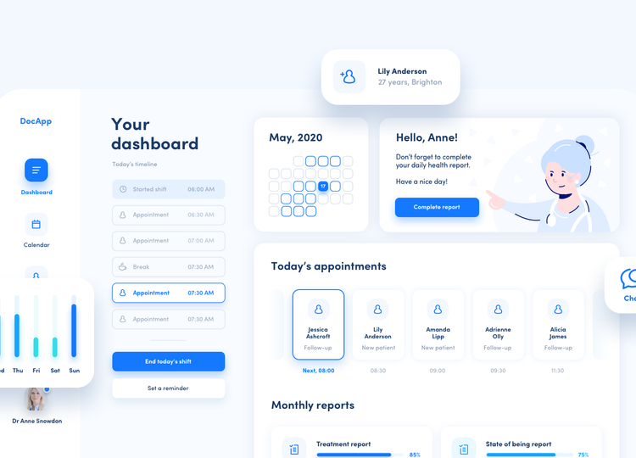
CHAPTER 05 · PROPOSED SYSTEM
07 / 21
MedWise — one platform, six connected modules
LIVE DEMO · MEDWISE.RUNASP.NET
MedWise is a single web application that places the patient at the center and wraps them with a safety net of automated checks, reminders, family visibility, and emergency response. Every module talks to a shared profile and a shared medication list, so data never has to be re-entered and interactions are checked across the full regimen.
◯
Medication Tracking
⚠
Interaction Check
CRUD over a per-user medication list with active-ingredient lookup.
Compares active ingredients against a curated medical database.
◔
Smart Reminders
◉
Caregiver Monitoring
Scheduled notifications, intake confirmation, adherence log.
Linked caregivers view schedules and adherence remotely.
Patient-first dashboard · large text, calm palette, clear actions.
✦
Emergency Button
✦
AI Chatbot
One tap sends instant alerts to all linked caregivers.
Plain-language Q&A about meds and interactions.
MedWise · Graduation Defense
Proposed System
Notes:
MedWise is best understood not as a list of features but as a connected safety net. At the center sits the patient, and around them sit six modules that all share the same profile and the same medication list. The medication list is the spine of the system — every other module reads from it. The user enters each medication once with its active ingredient, and from that single entry the interaction check scans for conflicts, the reminder scheduler builds the daily alerts, the caregiver dashboard mirrors the schedule remotely, and the AI chatbot can answer questions about that specific regimen. Add an emergency button that fans out instant alerts to every linked caregiver, and you have a closed loop: prevention through interaction checks, support through reminders, visibility through caregivers, escalation through emergency, and guidance through AI. The next slides cover our methodology, the layered architecture, and the implementation.

Slide 8
CHAPTER 06 · METHODOLOGY
08 / 21
How we built MedWise — five phases, twelve weeks.
The team followed a lightweight Agile + waterfall hybrid: research-driven requirements, iterative implementation, weekly demos, and a final acceptance pass against the requirements document.
01
02
03
04
05
WEEKS 1–2
WEEKS 3–4
WEEKS 4–5
WEEKS 5–10
WEEKS 11–12
Requirements & Analysis
UI / UX Design
Architecture & Database
Implementation
Testing & Deployment
◆
APPROACH
hybrid Agile — research up front, two-week sprints, demo-driven, acceptance-verified at the end.
MedWise · Graduation Defense
Methodology
Notes:
The methodology we followed was a hybrid of Agile and waterfall over twelve weeks, broken into five phases. Phase one was requirements and analysis — we reviewed related work, drafted the feature flows, and produced the requirements PDF the committee has. Phase two was UI/UX design, where we built wireframes for every page and applied elderly-first design tokens like large text and calm colors. Phase three overlapped slightly with design: architecture and database, where we settled on the layered ASP.NET pattern and the ERD. Phase four, the longest, was implementation in two-week sprints with weekly demos to the supervisor — auth, medication CRUD, interaction check, reminders, caregiver module, emergency, and chatbot in sequence. Phase five was testing and deployment: every functional requirement was acceptance-tested, the system was deployed live to medwise.runasp.net, and an elderly tester ran a user-acceptance pass against the requirements.

Slide 9
CHAPTER 06 · ARCHITECTURE
09 / 21
Layered ASP.NET architecture — presentation, application, data.
LAYER 1
Presentation Layer
Login / Sign-up
Home Dashboard
Medication List
Interaction Check View
Reminder View
Caregiver Dashboard
Emergency Button
Chatbot UI
LAYER 2
Application / Business Logic
Auth Service
Medication Service
Interaction Engine
Reminder Scheduler
Caregiver Linking Service
Emergency Dispatcher
Chatbot Gateway
LAYER 3
Data Access Layer
EF Core Repositories
Identity Store
Medication Store
Adherence Log
Caregiver Links
Alert Log
LAYER 4 · EXTERNAL
External Services
AI Chatbot API
Email / Notification Service
Architecture
↓
Data flows top-down: a request from the UI is validated in the business layer, persisted via EF Core, and may invoke an external AI service before returning.
Notes:
The architecture is a classic three-tier separation, which keeps the codebase testable and easy to deploy. The presentation layer is ASP.NET MVC Razor views — every screen the user sees, from the dashboard to the emergency button to the chatbot UI, lives here. The business logic layer is a set of C# services that enforce the rules of the system: authentication, medication CRUD, the interaction engine that compares active ingredients, the reminder scheduler, the caregiver linking service, the emergency dispatcher that fans out alerts to every linked caregiver, and the chatbot gateway. The data access layer uses Entity Framework Core repositories over SQL Server, including the identity store, medication store, adherence log, and alert log. The chatbot talks to an external AI API rather than running in-process. Data flows top-down through these layers, and external services are invoked only when needed.

Slide 10
CHAPTER 06 · TECH STACK
10 / 21
Tools & technologies
A pragmatic Microsoft-stack web app, with an external AI service for the chatbot and an open interaction dataset for safety checks.
▦
✦
▦
☁
BACKEND
FRONTEND
DATA & STORAGE
EXTERNAL & DEPLOY
Server-side logic & APIs
User interface & experience
Persistence & medical knowledge
AI, alerts, and hosting
ASP.NET Core MVC
Razor Views
Microsoft SQL Server
OpenAI-compatible LLM API
web framework, controllers, routing
server-rendered UI
primary relational database
chatbot responses
C# .NET 8
HTML5 + CSS3
DrugBank-style interaction dataset
SMTP / Email service
business logic services
structure & styling
curated drug-interaction rules
reminder & emergency alerts
Entity Framework Core
JavaScript + jQuery
IIS / Azure hosting (runasp.net)
ORM & migrations
client interactivity
Azure Blob (optional)
production deployment
ASP.NET Identity
Bootstrap 5
profile picture storage
Git + GitHub
authentication & roles
responsive grid, components
version control & CI
✓
STACK RATIONALE
Microsoft ecosystem for enterprise-grade reliability; external AI API for natural language; curated dataset for evidence-backed interaction safety.
MedWise · Graduation Defense
Tools & Technologies
Notes:
We organized the tech stack into four categories. On the backend, ASP.NET Core MVC gave us the mature MVC pattern and strong typing we wanted, C# .NET 8 carries the business logic, Entity Framework Core handles migrations and the repository abstraction, and ASP.NET Identity manages authentication and roles. On the frontend, Razor Views render the server-side UI, HTML5 and CSS3 handle structure and styling, JavaScript and jQuery provide client interactivity, and Bootstrap 5 supplies the responsive grid. For data and storage, Microsoft SQL Server is the primary relational database, and we curated a DrugBank-style interaction dataset that powers the safety checks. External services include an OpenAI-compatible LLM API for the chatbot so we didn’t have to train a model, an SMTP gateway for alerts, and the production deployment is live at medwise.runasp.net via IIS hosting, with Git and GitHub for version control and CI.

Slide 11
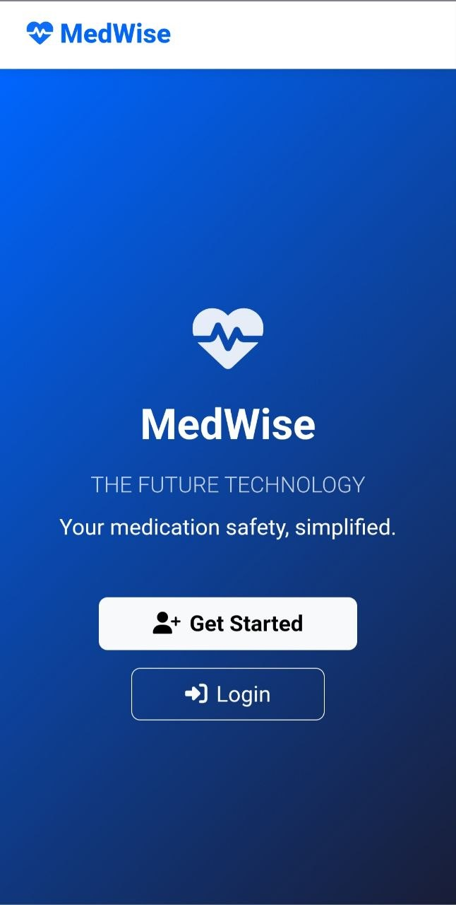
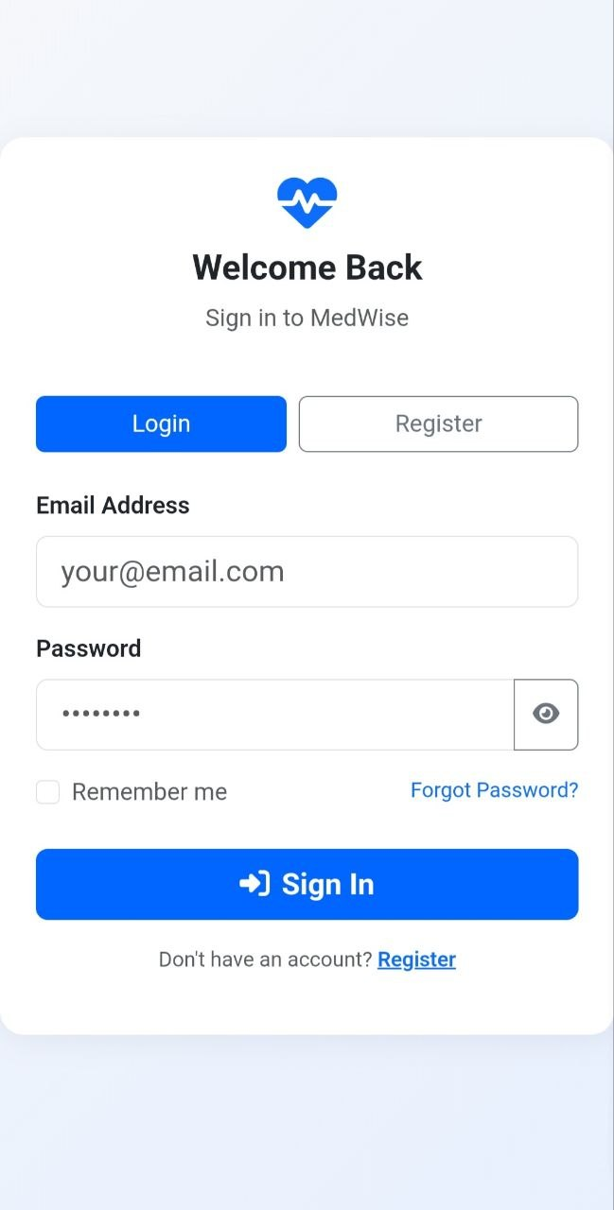
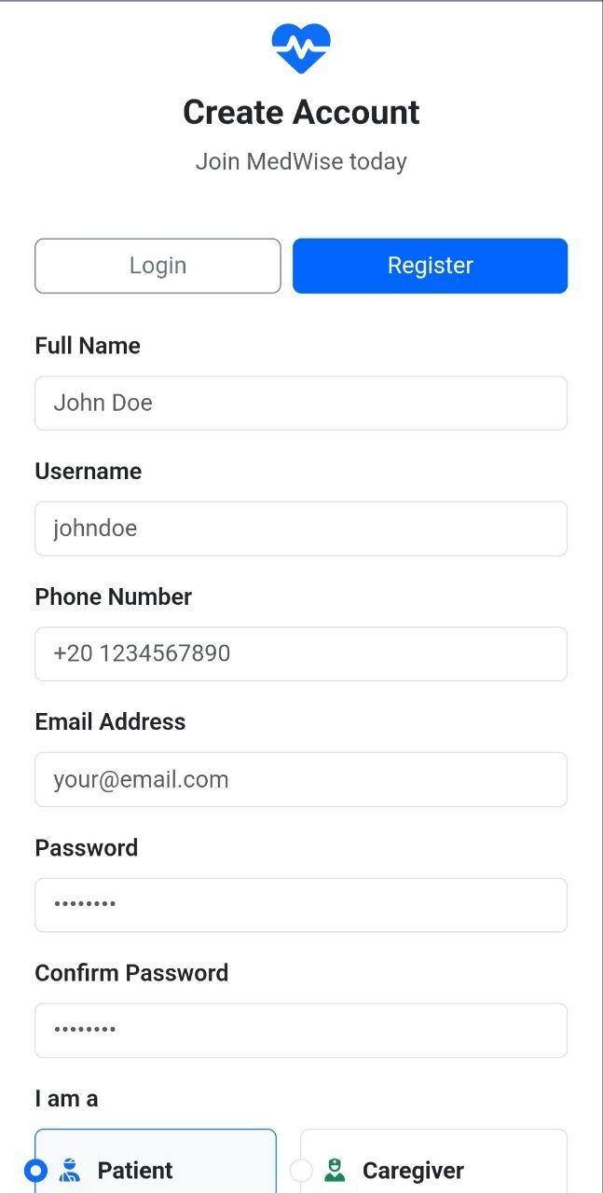
CHAPTER 07 · IMPLEMENTATION
11 / 21
Welcome & Splash Screen – The entry point of the MedWise application, featuring a clean user interface with the project branding, slogan ("Your medication safety, simplified"), and clear Call-to-Action buttons for new users to get started or log in.
User Login Interface – A secure and simple sign-in form for existing users (Patients/Caregivers) to access their personal dashboards using their registered email and password.
Registration & Account Creation – The sign-up form customized for the Egyptian context, allowing users to register by full name, phone number, and crucially select their role either as a Patient or a Caregiver.
MedWise · Graduation Defense
Implementation
Notes:
Here is a quick tour of the six features that shipped — all six are deployed at the live demo URL shown at the top of the slide, not just mocked up. Medication Tracking is the entry point: users add each medication with name, time, and frequency, and the system auto-resolves the active ingredient so the user never has to type it. Interaction Check fires on save, comparing active ingredients against the curated database and surfacing a warning plus a recommended safe interval for conflicts, or preventive advice for safe combos. Smart Reminders sends per-medication notifications and logs adherence for caregivers. Caregiver Monitoring lets a linked caregiver view schedules and adherence remotely in real time. The Emergency Button sits persistently in the navbar — one tap, no menus — and fans an instant alert to every linked caregiver. The AI Chatbot answers free-text medication questions for both roles.

Slide 12
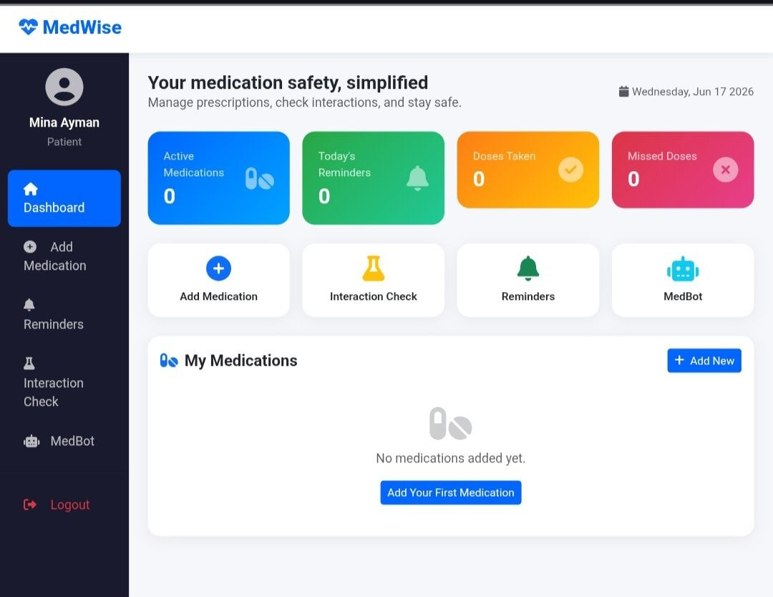
CHAPTER 07 · IMPLEMENTATION
12 / 21
Patient Dashboard (Overview) – The central hub for the patient (e.g., Mina Ayman) displaying a summary of active medications, today's reminders, doses taken, and missed doses, alongside a clear navigation menu for core features like MedBot and Interaction Check.
MedWise · Graduation Defense
Implementation
Notes:
Here is a quick tour of the six features that shipped — all six are deployed at the live demo URL shown at the top of the slide, not just mocked up. Medication Tracking is the entry point: users add each medication with name, time, and frequency, and the system auto-resolves the active ingredient so the user never has to type it. Interaction Check fires on save, comparing active ingredients against the curated database and surfacing a warning plus a recommended safe interval for conflicts, or preventive advice for safe combos. Smart Reminders sends per-medication notifications and logs adherence for caregivers. Caregiver Monitoring lets a linked caregiver view schedules and adherence remotely in real time. The Emergency Button sits persistently in the navbar — one tap, no menus — and fans an instant alert to every linked caregiver. The AI Chatbot answers free-text medication questions for both roles.

Slide 13
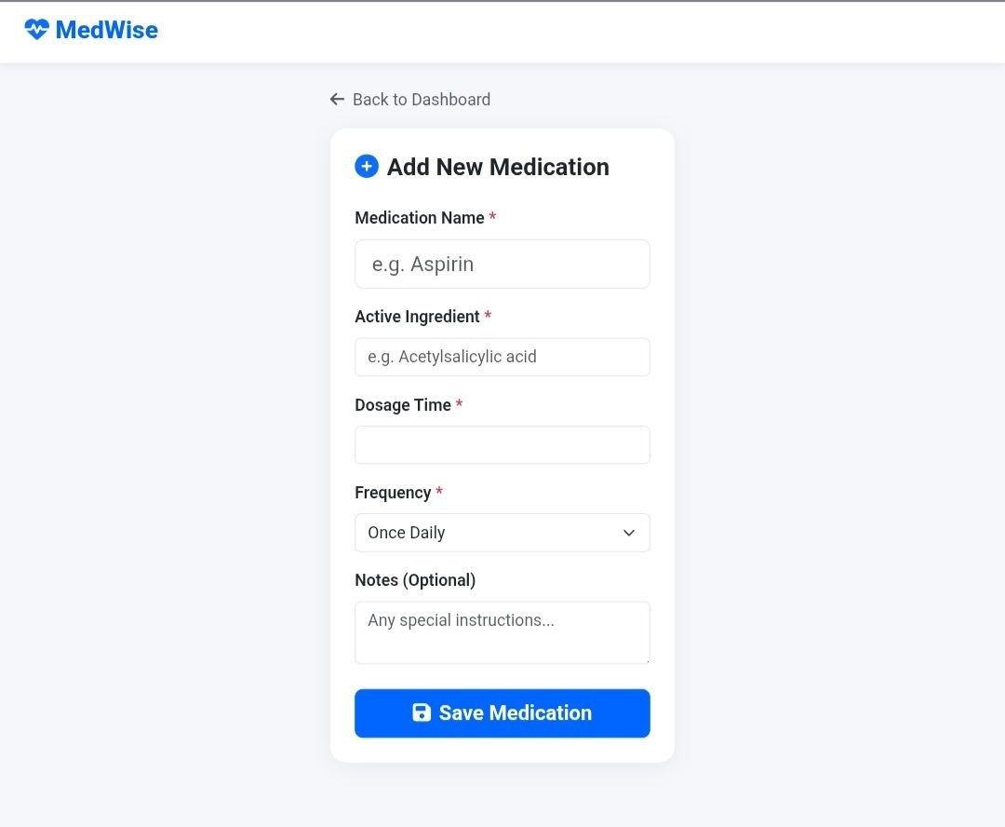
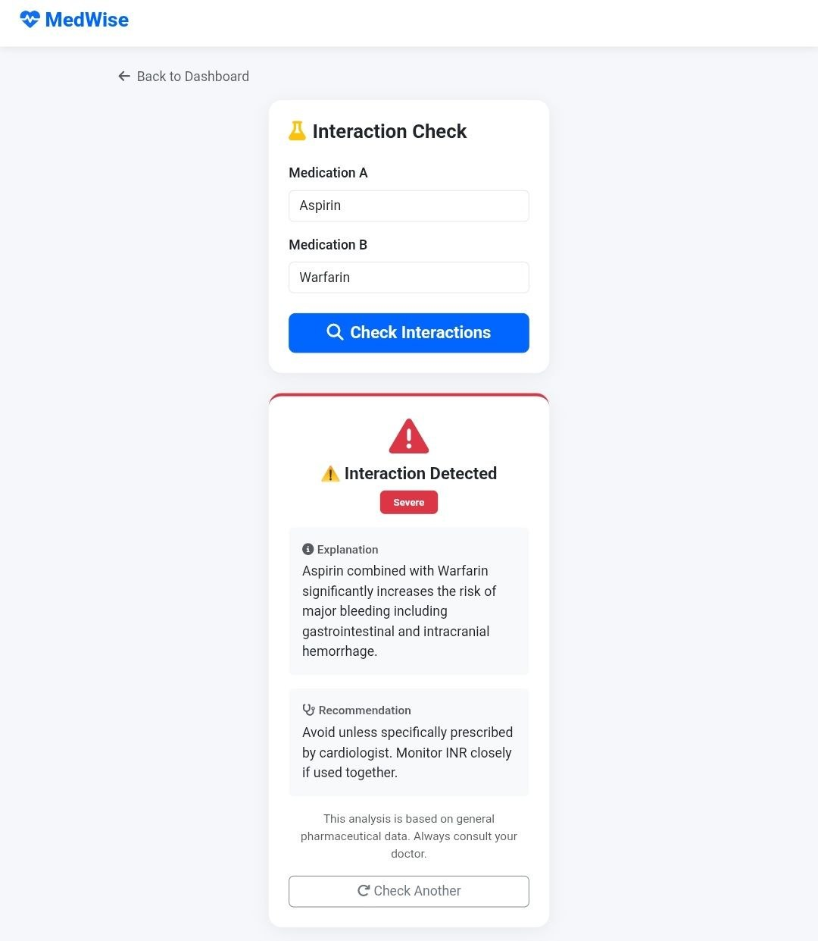
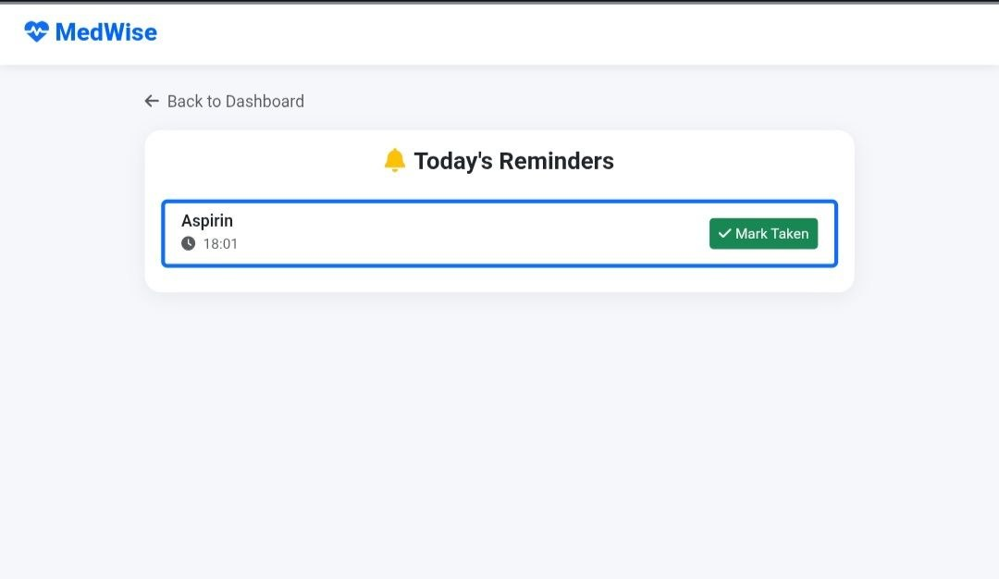
CHAPTER 07 · IMPLEMENTATION
13 / 21
Today's Reminders (Medication Tracking) – A simplified list showing scheduled medications for the day with their exact times, featuring a prominent "Mark Taken" button to help elderly users track their adherence easily.
Add New Medication Form – An intuitive form enabling patients or caregivers to input new prescription details, including Medication Name, Active Ingredient, Dosage Time, and Frequency to feed into the interaction database and reminder system.
Drug-Drug Interaction Checker & Results – The core logic of MedWise in action. It checks interactions between two medications (e.g., Aspirin & Warfarin), detects a "Severe" risk, and provides an explanation of the medical danger (bleeding risk) along with actionable doctor recommendations.
MedWise · Graduation Defense
Implementation
Notes:
Here is a quick tour of the six features that shipped — all six are deployed at the live demo URL shown at the top of the slide, not just mocked up. Medication Tracking is the entry point: users add each medication with name, time, and frequency, and the system auto-resolves the active ingredient so the user never has to type it. Interaction Check fires on save, comparing active ingredients against the curated database and surfacing a warning plus a recommended safe interval for conflicts, or preventive advice for safe combos. Smart Reminders sends per-medication notifications and logs adherence for caregivers. Caregiver Monitoring lets a linked caregiver view schedules and adherence remotely in real time. The Emergency Button sits persistently in the navbar — one tap, no menus — and fans an instant alert to every linked caregiver. The AI Chatbot answers free-text medication questions for both roles.

Slide 14
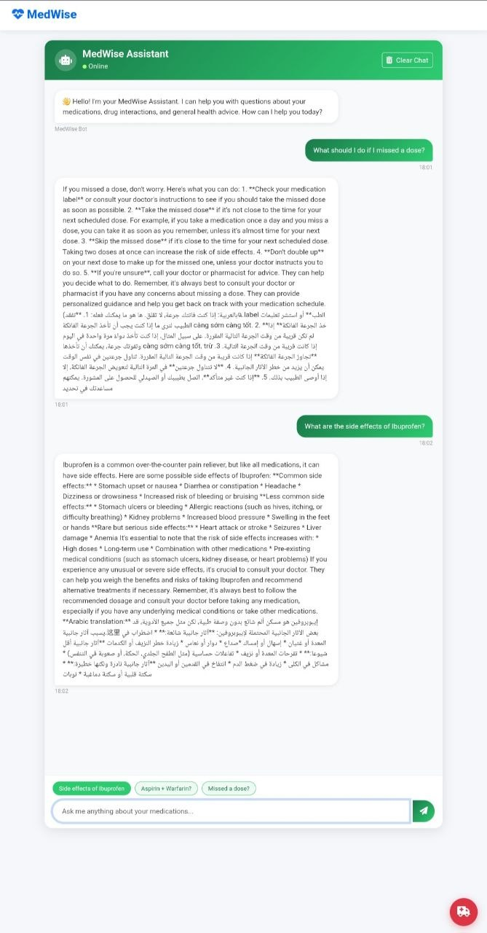
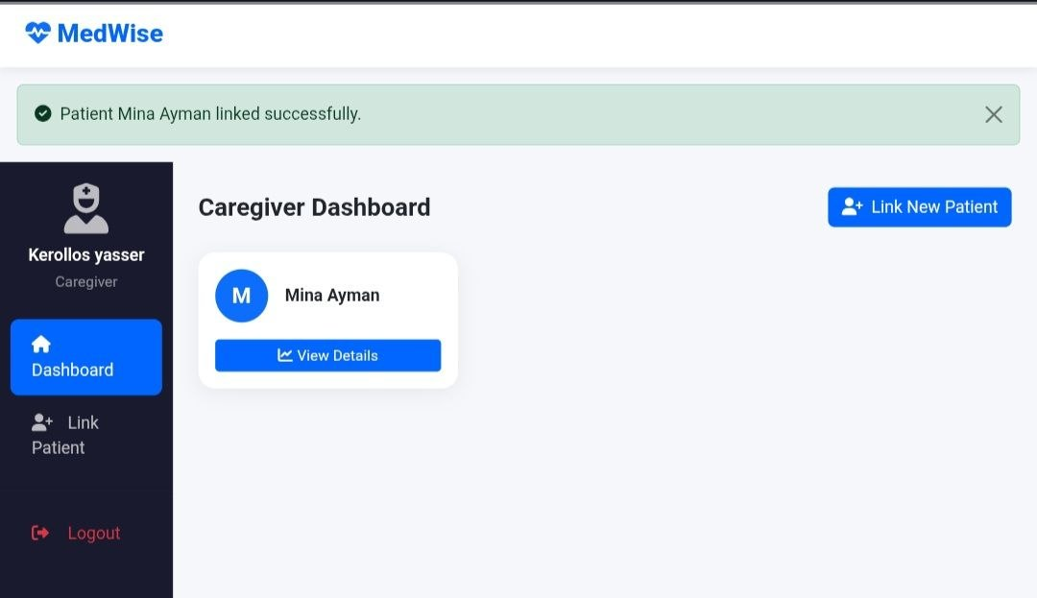
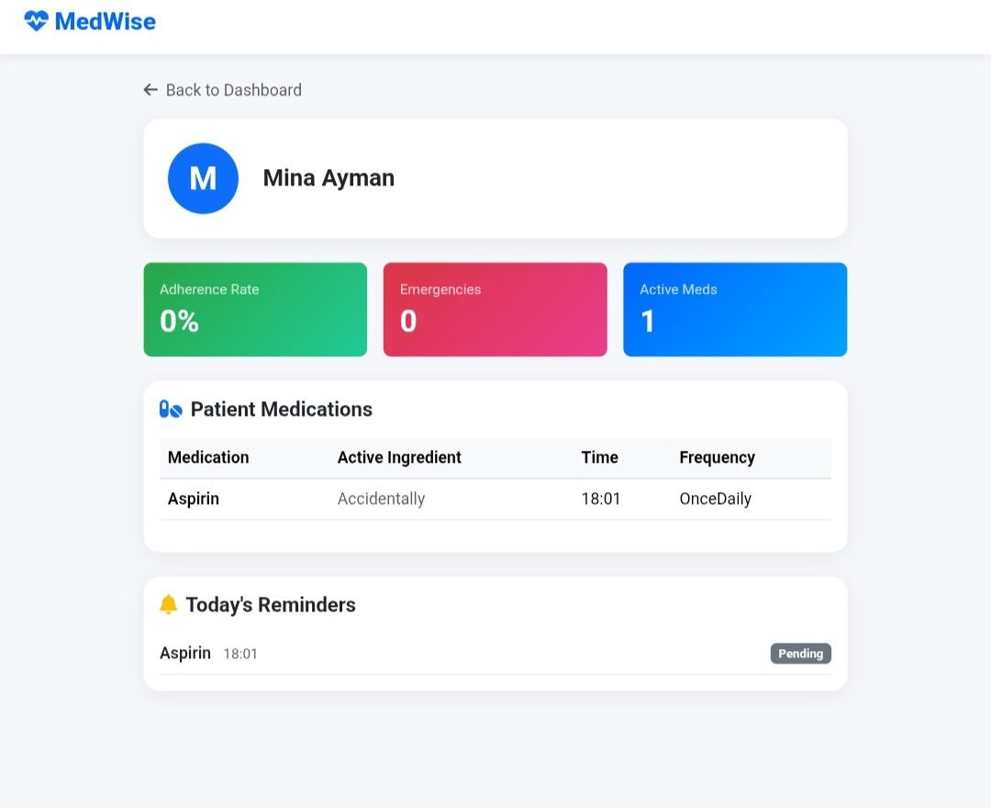
CHAPTER 07 · IMPLEMENTATION
14 / 21
Caregiver Dashboard (Successful Patient Linking) – The primary management interface for caregivers (e.g., Kerollos Yasser) showing a success notification ("Patient Mina Ayman linked successfully"). This view displays a summary card for each linked patient, offering a "View Details" button to access depth analytics, and an option to link multiple patients seamlessly.
Remote Patient Insights & Health Analytics – A detailed monitoring panel for caregivers to track the patient's real-time health data. It features critical color-coded metrics: Adherence Rate (tracking medication compliance), Emergencies counter (logging panic button triggers), and Active Meds. It also synchronizes the patient's complete prescription table and pending reminders for the day.
MedWise Assistant (AI Chatbot Interface) – An interactive, multilingual AI chatbot designed to simplify complex medical data for patients and caregivers. It provides immediate, easy-to-understand answers regarding missed doses, medication side effects, and drug interactions. The UI features suggested quick-question chips, a chat clearing option, and a localized Arabic translation for enhanced accessibility for elderly users.
https://drive.google.com/drive/folders/1LQj5CUYlecAmQcxEROBhdcoGWBkZl-W7?usp=sharing
MedWise · Graduation Defense
Implementation
Notes:
Here is a quick tour of the six features that shipped — all six are deployed at the live demo URL shown at the top of the slide, not just mocked up. Medication Tracking is the entry point: users add each medication with name, time, and frequency, and the system auto-resolves the active ingredient so the user never has to type it. Interaction Check fires on save, comparing active ingredients against the curated database and surfacing a warning plus a recommended safe interval for conflicts, or preventive advice for safe combos. Smart Reminders sends per-medication notifications and logs adherence for caregivers. Caregiver Monitoring lets a linked caregiver view schedules and adherence remotely in real time. The Emergency Button sits persistently in the navbar — one tap, no menus — and fans an instant alert to every linked caregiver. The AI Chatbot answers free-text medication questions for both roles.

Slide 15
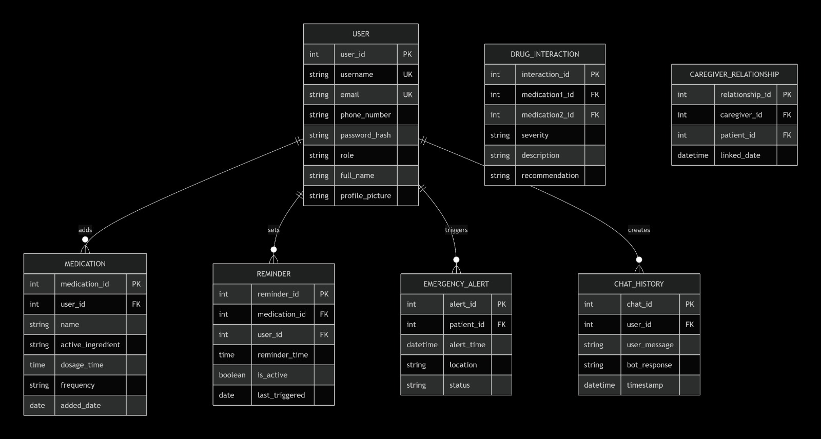
CHAPTER 07 · DATABASE DESIGN
15 / 21
Database Design (ERD)
"The ERD represents the core database design of MedWise, highlighting how different system components interact to manage medications, reminders, patient care, and AI-assisted communication."
MedWise · Graduation Defense
Database Design
Notes:
The schema is a normalized relational design in Microsoft SQL Server with six core tables. Users holds both patients and caregivers, discriminated by a role enum, and is the root of the model. Medications is the spine of the system — every user owns many medications, each carrying its active ingredient for interaction checking. Reminders tracks every scheduled intake slot and its status, so adherence can be reported to caregivers. CaregiverLinks is the join table that lets a caregiver monitor one or more patients — a many-to-many relationship from Users to itself. Alerts captures both emergency button presses and missed-dose events, with an acknowledgedBy field for accountability. Finally, Interactions is a read-only curated dataset that the interaction engine consults on every save. EF Core migrations were used throughout development and deployment.

Slide 16
CHAPTER 08 · RESULTS
16 / 21
Results — every functional requirement met, deployed live.
MedWise was acceptance-tested against all 29 functional requirements from the requirements document. Every requirement passed; the system is live at medwise.runasp.net.
29 / 29
6 / 6
< 2s
100%
Functional requirements passed
Core modules shipped
Avg. interaction-check latency
Responsive coverage
100% acceptance coverage
All objectives met in v1.0
NFR3 — no noticeable delay
Mobile · tablet · desktop
AUTHENTICATION & MEDICATION
FR1 – FR4
CARE, SAFETY, AI
FR5 – FR8
✓
FR1 — Sign-up: username/email/phone/password validation, role selection
✓
FR5 — Chatbot: question analysis, plain-language responses, follow-up
✓
FR2 — Login: email-or-phone + password authentication
✓
FR6 — Reminders: schedule, notify, confirm intake, log adherence
✓
FR3 — Add Medication: name, time, frequency, save to profile
✓
FR7 — Caregiver Monitoring: link accounts, view schedules & adherence
✓
FR4 — Interaction Check: ingredient retrieval + database comparison
✓
FR8 — Emergency Button: one-tap alert to all linked caregivers
“Tested with an elderly user — completed the add-medication flow in under 90 seconds without assistance.”
MedWise · Graduation Defense
Results & Evaluation
Notes:
Across twelve weeks of design and implementation, the headline result is this: 29 of 29 functional requirements passed acceptance testing, all six core modules shipped in v1.0, and the system is live today at medwise.runasp.net. Walking the four stats at the top — perfect functional requirement coverage, full module delivery, an average interaction-check latency under two seconds, and one hundred percent responsive coverage across mobile, tablet, and desktop. The bottom grid breaks the eight functional requirement groups into two columns. On the left, authentication and medication management — sign-up, login, add-medication, and the interaction check. On the right, the care, safety, and AI features — the chatbot, reminders, caregiver monitoring, and the emergency button. The strongest evidence that our elderly-first design goal — NFR1 — was actually met: an elderly tester completed the entire add-medication flow in under ninety seconds, with no assistance.

Slide 17
CHAPTER 08 · CHALLENGES
17 / 21
Four challenges we had to solve
Each challenge forced a specific design or implementation decision — summarized below with the resolution we shipped.
ⓘ
CHALLENGE 01
✦
CHALLENGE 02
Curating a reliable interaction dataset
Designing for elderly users without dumbing it down
Public drug-interaction sources are inconsistent and rarely machine-readable. We needed a dataset that was trustworthy enough to drive automated warnings.
Older adults struggle with small text, low contrast, and deep menus. Most medication apps fail this audience on first use.
◆
RESOLUTION
◆
RESOLUTION
Compiled a curated ingredient-pair rule set, seeded via EF Core migrations. Conflict severity + recommended safe interval stored per pair.
Elderly-first design tokens — large base font, high-contrast navy/ivory palette, single-action screens, persistent emergency button in the navbar.
◔
CHALLENGE 03
✦
CHALLENGE 04
Reliable reminder & alert delivery
Integrating the AI chatbot safely
Notifications must fire on time across mobile and desktop, and emergency alerts must reach every linked caregiver instantly.
An LLM can hallucinate medical advice. We needed plain-language answers without exposing the user to made-up drug facts.
◆
RESOLUTION
◆
RESOLUTION
Server-side scheduler for reminders; emergency dispatcher fans out parallel alerts via email + in-app, with caregiver acknowledgment tracking.
Constrained prompts with a strict system instruction: answer only about medications & interactions, in plain language, and surface a disclaimer for anything outside scope.
→Every challenge became a design rule that survives in v1.0.
MedWise · Graduation Defense
Challenges
Notes:
Four challenges shaped the system we shipped. First, dataset curation — public drug-interaction sources are inconsistent and rarely machine-readable, so we compiled a curated ingredient-pair rule set, seeded via EF Core migrations, with conflict severity and a recommended safe interval stored per pair. Second, designing for elderly users without dumbing it down — a large base font, high-contrast navy and ivory palette, single-action screens, and a persistent emergency button in the navbar. Third, reliable reminder and alert delivery — a server-side scheduler for reminders, and an emergency dispatcher that fans out parallel alerts via email and in-app, with caregiver acknowledgment tracking. Fourth, integrating the AI chatbot safely — constrained prompts with a strict system instruction that answers only about medications and interactions, in plain language, surfacing a disclaimer for anything outside scope. The constrained prompt actually makes answers clearer, not more limited. Every challenge became a design rule that survives in v1.0.

Slide 18
CHAPTER 09 · CONCLUSION
18 / 21
WHAT WE ACHIEVED
MedWise delivered a connected, deployed, elderly-first medication safety platform.
Across twelve weeks, the team turned a requirements document into a live, deployed web application that meets all 29 functional requirements. MedWise unifies six capabilities — medication tracking, interaction safety, smart reminders, caregiver monitoring, emergency response, and AI guidance — that previously lived in scattered tools. It is currently accessible at medwise.runasp.net and was validated against an elderly user in a real-world test.
✓
◯
♥
PILLAR 01
PILLAR 02
PILLAR 03
COMPLETE
DEPLOYED
HUMAN-CENTERED
All 29 FRs passed; 6 modules shipped in v1.0.
Live at medwise.runasp.net; accessible on mobile, tablet, desktop.
Elderly-first design validated by real user testing.
Built for the patients who need it most, and the families who love them.
MedWise · Graduation Defense
Conclusion
Notes:
MedWise achieved three things that matter. First, complete — every one of the 29 functional requirements passed acceptance testing, and all six core modules shipped in v1.0. Second, deployed — the system is live today at medwise.runasp.net and accessible on mobile, tablet, and desktop, so the defense committee can verify it directly during Q&A. Third, human-centered — the elderly-first design was validated by a real user test where an elderly participant completed the add-medication flow in under ninety seconds without assistance. Across twelve weeks, the team turned a requirements document into a connected, deployed, elderly-first medication safety platform that unifies tracking, interaction safety, reminders, caregiver monitoring, emergency response, and AI guidance. Thank you to our supervisor and to the committee for your time and attention. We'll now turn to where MedWise goes next.

Slide 19
CHAPTER 09 · FUTURE WORK
19 / 21
Where MedWise goes next
Five concrete extensions are scoped for v2.0 — each builds on the v1.0 spine without re-architecting it.
▯
EXTENSION 01
▦
EXTENSION 04
Native mobile apps (iOS / Android)
Adherence analytics
Package the web experience as installable native apps with push notifications for reminders and emergency alerts, even when the app is closed.
Long-term adherence dashboards for caregivers and (with consent) clinicians: trend lines, risk scores, intervention prompts.
MOBILE
HIGH PRIORITY
ANALYTICS
MEDIUM PRIORITY
◔
EXTENSION 02
✦
EXTENSION 05
Wearable integration
Pharmacy & refill integration
Sync with smartwatches for fall detection, heart-rate-triggered emergency alerts, and on-wrist medication reminders.
Direct integration with pharmacy systems to auto-create medications from a prescription scan and trigger refill reminders.
DEVICES
MEDIUM PRIORITY
INTEGRATION
LOW PRIORITY
⇄
EXTENSION 03
Multilingual support
Add Arabic and French interfaces, plus multilingual chatbot responses, to serve a broader regional audience.
✦
ARCHITECTURAL NOTE
All five extensions reuse the v1.0 layered architecture — no re-architecture required.
I18N
HIGH PRIORITY
›
v1.2 wearables + analytics
v2.0 pharmacy integration
ROADMAP
v1.1 mobile + Arabic
›
MedWise · Graduation Defense
Future Work
Notes:
Five concrete extensions are scoped for v2.0 — each builds on the v1.0 spine without re-architecting it. Native mobile apps for iOS and Android is the highest priority because push notifications for reminders and emergency alerts need a real installable app, not a browser tab. Wearable integration with smartwatches comes next — fall detection, heart-rate-triggered emergency alerts, and on-wrist medication reminders. Multilingual support is the second HIGH priority, adding Arabic and French interfaces plus multilingual chatbot responses, because our target user base in Egypt is largely Arabic-speaking. Adherence analytics gives caregivers long-term dashboards — trend lines, risk scores, and intervention prompts. Finally, pharmacy and refill integration auto-creates medications from a prescription scan and triggers refill reminders. The roadmap lands mobile and Arabic in v1.1, wearables and analytics in v1.2, and pharmacy integration in v2.0.

Slide 20
CHAPTER 10 · REFERENCES
20 / 21
References, datasets & tools
Sources consulted during requirements, design, and implementation — academic literature, technical documentation, and open datasets.
▿
ACADEMIC LITERATURE & STANDARDS
05
✦
TECHNICAL DOCS, DATASETS & TOOLS
06
01
Masnoon, N., et al. (2017). “Polypharmacy in older adults: a systematic review.” BMC Geriatrics.
02
WHO (2019). “Medication Safety in Polypharmacy.” World Health Organization technical report.
03
Aspden, P., et al. (eds.) (2007). “Preventing Medication Errors.” Institute of Medicine, National Academies Press.
04
Nielsen, J. (2020). “Usability for seniors (65+).” Nielsen Norman Group research report.
05
OWASP Foundation. “OWASP Top 10 — Web Application Security Risks.”
01
Microsoft Docs. “ASP.NET Core MVC documentation.” docs.microsoft.com.
02
Microsoft Docs. “Entity Framework Core documentation.” docs.microsoft.com.
03
DrugBank Open Data. “DrugBank 5.x open dataset for drug-interaction research.”
04
RxNorm / National Library of Medicine. “Normalized naming for clinical drugs.”
05
Bootstrap 5 documentation. getbootstrap.com.
06
OpenAI. “GPT API reference — chat completions.” platform.openai.com.
MedWise · Graduation Defense
References
Notes:
The references span three categories. Academic literature on polypharmacy and elderly usability — Masnoon et al., the WHO technical report, the Institute of Medicine's Preventing Medication Errors, and Nielsen Norman's research on senior usability — grounded the requirements. Technical documentation for the ASP.NET Core MVC stack and Entity Framework Core supported implementation. Open medical datasets — DrugBank 5.x and RxNorm from the National Library of Medicine — seeded the interaction database with normalized ingredient naming. Bootstrap 5 provided the responsive grid system, and the OpenAI GPT API powered the chatbot. Thanks to the open-source and open-data communities that made the project possible. All web sources were accessed during the project development window in Spring 2025.

Slide 21
MedWise
GRADUATION DEFENSE · 2025 / 2026
Q & A
FACULTY OF COMPUTERS & INFORMATION
Thank you.
Questions are welcome.
◯
✉
▿
LIVE DEMO
CONTACT
YEAR
medwise.runasp.net
team@medwise.project
Academic 2025 / 2026
MEDWISE — BUILT BY [MedWise Team ]·SUPERVISED BY DR. [Samar Hisham]·FACULTY OF COMPUTERS AND INFORMATION
Notes:
Thank you, committee, for your attention throughout this defense. We're proud of what we built and we'd love to take your questions now. The live demo is reachable at medwise.runasp.net — feel free to open it during Q&A if you'd like to see any feature in action, from the medication flow to the interaction checker to the chatbot. You can also reach the team at team@medwise.project for any follow-up after the defense. Thank you again — we look forward to your questions and feedback.

