Slide 1
Часть 2

Slide 2
Вводные замечания и подготовка учебной среды

Slide 3
Сокращения и условные обозначения
ctor — конструктор
parens — круглые скобки
comperr — ошибка компиляции
ternop — тернарный оператор
initer — блок инициализации
inca — внутренний класс-член
stinca — статический вложенный класс
meloca — локальный внутренний класс
anonca — анонимный внутренний класс
∃ — существует
∄ — не существует
∴ или →— следовательно
≝ — формулировка определения
∀ — любой
[…) — кортеж без прав.границы

Slide 4
«Разогревающие» вопросы
Для самостоятельной проработки после видеолекций по теорчасти
и перед видеоразбором конкретных задач
К тематической группе 01 — Java Class Design:
http://igor.host/index.php/2017/09/25/ocp-flashcards-1-java-class-design/
К тематической группе 02 — Advanced Class Design:
http://igor.host/index.php/2017/09/27/ocp-flashcards-2-advanced-java-class-design/

Slide 5
Упражнения
http://igor.host/index.php/ocp-exam-preparation-1z0-809/
Разобраны в видеолекциях, относящихся к практикуму
К тематической группе 01 — Java Class Design (16 Qs):
2 13 16 20 34 55 58 60 62 63 67 68 69 79 92 96
К тематической группе 02 — Advanced Class Design (7 Qs):
14 28 37 41 53 71 90

Slide 6
Симлинки
Прописать в РАТН путь к папке с нужным бинарником:
С:\Program Files\Java\jdk-11.0.4\bin
С:\Program Files\Java\jdk1.8.0_151\bin
C:\Program Files\Notepad++
Поднять терминал в режиме админа и в каждой из вышеуказанных папок создать соответствующий симлинк:
mklink javac11.exe .\java.exe
mklink java11.exe .\java.exe
mklink javac8.exe .\java.exe
mklink java8.exe .\java.exe
mklink np.exe .\notepad++.exe

Slide 7
Теорчасть

Slide 8
01 — Java Class Design 02 — Advanced Java Class Design

Slide 9
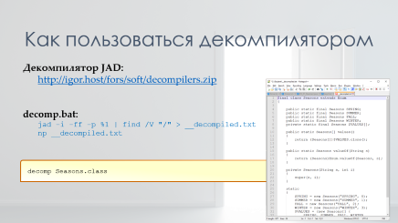
The final keyword
implicitly final are enum and interface constants:
check interface constants by decompiling:
String TEST = "";
turned into public static final String TEST = "";
enum constants:
ONE defined in the Enumer enum turned into public static final Enumer ONE;

Slide 10
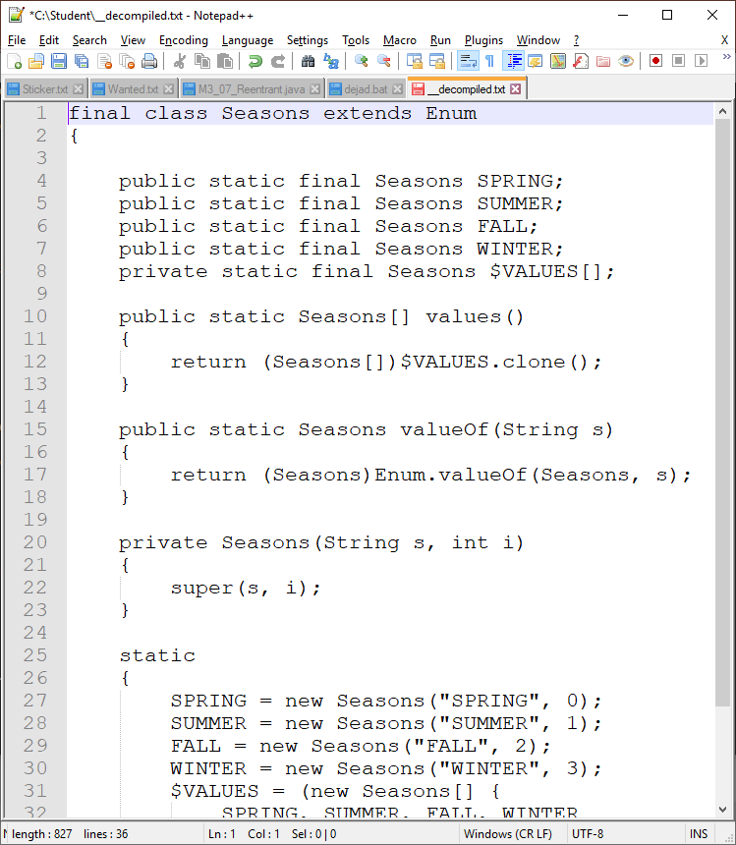
Как пользоваться декомпилятором
Декомпилятор JAD:
http://igor.host/fors/soft/decompilers.zip
decomp.bat:
jad -i -ff -p %1 | find /V "/" > __decompiled.txt
np __decompiled.txt
decomp Seasons.class

Slide 11
The final keyword, cont’d
effectively final:
a class whose ctors are private → can't be extended
a non-final method in a final class → can't be overridden
a local var (including method args) that hasn’t been reassigned → can be used by melocas + anoncas
explicitly final field must be inited:
if non-static: in one of the THREE places (declaration — ctor — instance initer)
if static: in either of the TWO places (declaration — static initer)

Slide 12

Inheritance & Polymorphism
Мнемоническое правило для нашего экзамена:
полиморфизм ≡ поведение
Что в 1-ю очередь имеется в виду:
методы
объекты
наследники

Slide 13

Inheritance & Polymorphism, cont’d
Reftype says what's available, actype says which version of the method will run

Slide 14

Inheritance & Polymorphism, cont’d
An object of type T outside the T-containing package can't access T's protected members
Combat Rule:
diff packs? and protected members? → Red alert!
JLS, §6.6.2, Details on protected access
A protected member or constructor of an object may be accessed from outside the package in which it is declared only by code that is responsible for the implementation of that object.

Slide 15
Inheritance & Polymorphism, cont’d
Fields aren't overridden, they are hidden
marking a hidden field final has no effect
Interfaces cannot extend classes (partly) because they cannot contain instance fields

Slide 16

T = (T)U
Casting
interface Pet
class Dog
class Cat
final
Pet cat = new Cat();
Dog dog = new Dog();
class Husky
dog = (Dog) cat;

Slide 17
instanceof
instanceof checks against a TYPE (interface, class, or enum), not an object
cat instanceof Pet
cat instanceof dog

Slide 18
equals() hashCode()
Contract for hashCode():
if equals() == true → hashCode() must be the same
if equals() != true → hashCode() may be the same
consistency: same value for the same object for the entire application's life

Slide 19
equals() hashCode()
Contract for equals():
reflexivity: x.equals(x) == true
symmetry: x.equals(y) == y.equals(x)
transitivity: if x.equals(y) == true AND y.equals(z) == true
→ x.equals(z) == true
consistency: x.equals(y) must be the same for the entire
application's life
if x != null → x.equals(null) == false

Slide 20

Possible traps
Touch both equals() and hashCode() or none at all
hashCode()'s set of criteria must not be wider than that of equals()
Pay attention to whether Object's equals() is overridden

Slide 21

enums
enums cannot be extended because all enums already implicitly extends abstract java.lang.Enum
enums define implicit methods such as
name()
ordinal()
switch case accept simple (‘unqualified’, as the compiler puts it) enum constant names only
enum.docx

Slide 22
Внутренние классы
статические вложенные (static nested)
не понимают нестатику
внутренние классы-члены (inner member)
могут объявлять статические члены,
если те константы времени компиляции
локальные внутренние (local inner)
inner_classes.docx
анонимные внутренние (anonymous inner)
могут трогать локальные переменные,
если те как минимум эффективно финальные

Slide 23

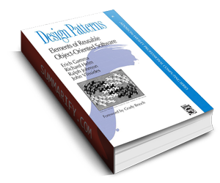
Singleton Design Pattern
Use cases:
app config data
reusable data caches
file write access coordinators
in general: shared resources such as printer job pools, DB access portals, etc.
Make sure of THREE things:
all fields and ctors are private
all instance methods are synchronized
eager pattern: make the instance field final
Class itself can be final, as well

Slide 24
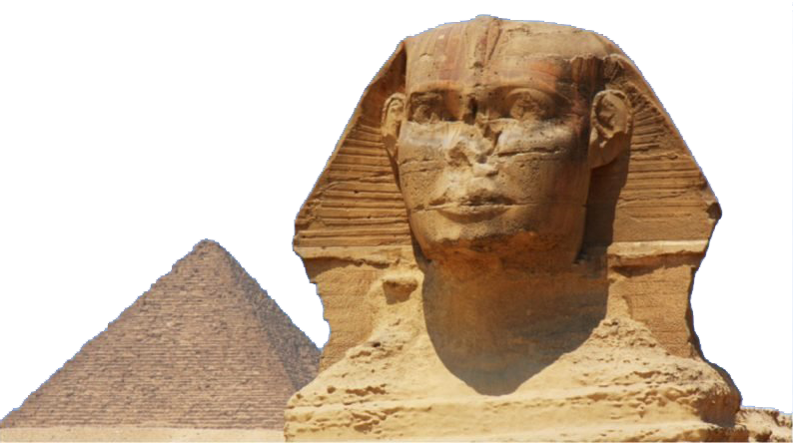
Immutable Class Design Pattern
Rules:
don’t provide mutators such as setters
make all fields final and private
don’t allow overriding
make class/methods final, OR
use private ctors with static factories
when using mutable fields, don’t provide mutators for theses fields, either
create defensive copies to your internal mutable objects to avoid returning the originals

Slide 25
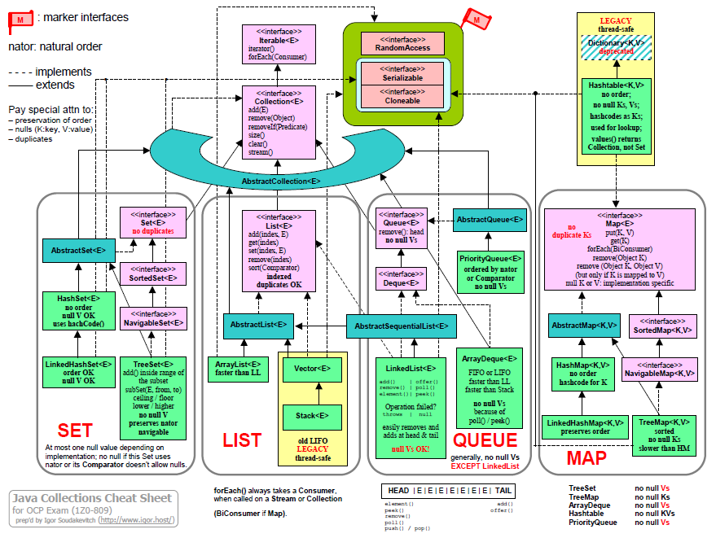
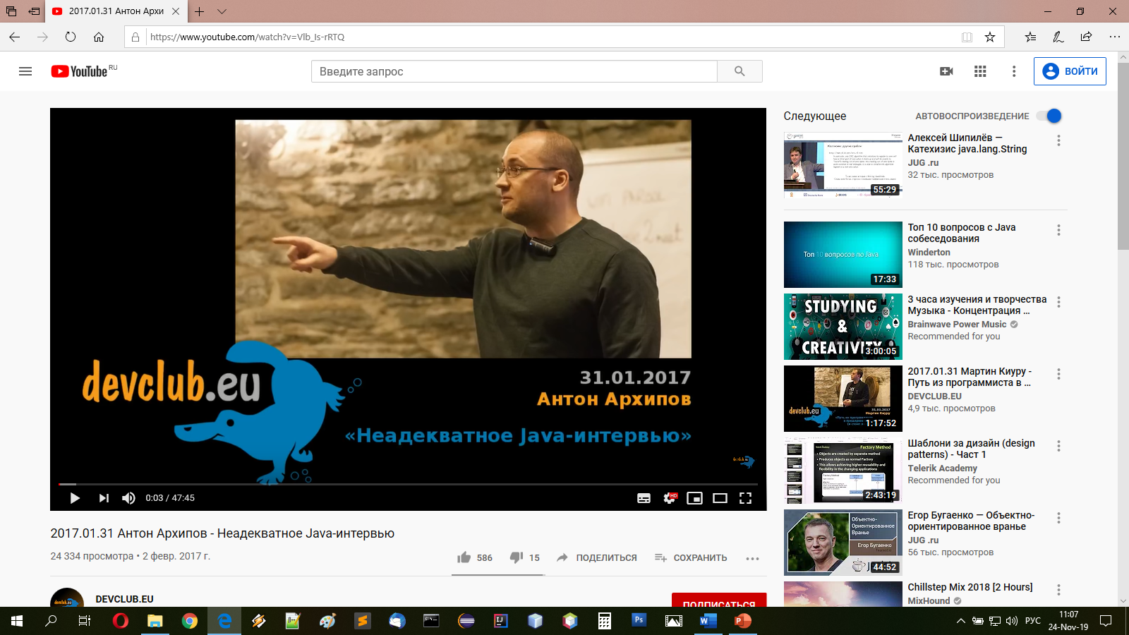
Interfaces
Abstract classes vs interfaces:
interfaces are all about behavior;
abcas are mostly about state;

Slide 26
What to use: abstract classes or interfaces?
Consider using abstract classes if any of these statements apply to your situation:
You want to share code among several closely related classes.
You expect that classes that extend your abstract class have many common methods or fields, or require access modifiers other than public (such as protected and private).
You want to declare non-static or non-final fields. This enables you to define methods that can access and modify the state of the object to which they belong.
Consider using interfaces if any of these statements apply to your situation:
You expect that unrelated classes would implement your interface. For example, the interfaces Comparable and Cloneable are implemented by many unrelated classes.
You want to specify the behavior of a particular data type, but not concerned about who implements its behavior.
You want to take advantage of multiple inheritance of type.
https://docs.oracle.com/javase/tutorial/java/IandI/abstract.html

Slide 27
Default methods override abstract methods without problem:
interface Inter extends Predicate<String>{
@Override // VALID
default boolean test(String str){ return false; }
}
Inheriting same var from a class and an interface / from two interfaces is OK as long as no one uses this var:
interface Floatable{
int airbags = 1;
}
class Inflatable {
int airbags = 4;
}
class Zodiac extends Inflatable implements Floatable{
{
System.out.println(airbags); // INVALID: the ref to airbags is ambigous
}
}
BTW, airbags from Floatable isn't inherited; the ability to have unqualified access to interface constants is considered to be a design flaw.
Cannot use the super keyword to call a method defined in the superinterface.
Superinterface's methods are called by using InterfaceName.super.methodName() notation.

Slide 28
abstract and default methods are inheritable and can be overridden.
static methods aren't inheritable and can be invoked using the interface name instead of a reference variable:
interface Inter {
static void run(){}
}
class Test implements Inter {
public static void main(String[] args) {
Inter inter = new Test();
inter.run(); // INVALID: 'illegal static interface method call'...
// ... should be replaced with type qualifier Inter
Inter.run();
}
}
The reason: static interface methods are not inherited so they do not exist within an instance.
Can't inherit two default methods with the same signature as they clash → must override them with a default or abstract method
EXTRA: default methods cannot be marked as final or synchronized ( http://stackoverflow.com/questions/23453568/what-is-the-reason-why-synchronized-is-not-allowed-in-java-8-interface-methods ) + they cannot override toString(), hashCode() and equals()

Slide 29
Lambda Expressions
Syntax:
<Functional_Interface> <name> = <formal_parameters_list> → <body> ;
Examples:
Predicate<String> predContBrief = str → str.contains(“!”) ;
Predicate<String> predContFull = (String str) → {
return str.contains(“!”) ;
};
Consumer<String> cons = x → System.out.println(x);
Function<String, Integer> funcLen = x → x.length();

