Slide 1
03 — Generics & Collections

Slide 2
Generics
— rationale for having Generics
— parameterization in static vs non-static context
— restrictions, i.e.:
<T extends …>
<? extends …>
<? super …>
— interface intersections
— limitations in usage

Slide 3
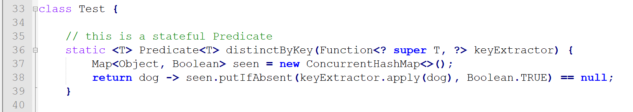
Goal: proficiency in practice

Slide 4
Collections
Main topics:
Collection types
List interface + its implementations
Set interface + its implementations
Map interface + its implementations
Deque interface + its implementations
Ordering collections
Comparable interface
Comparator interface

Slide 5
What's a collection
A collection is a single object designed to manage a group of objects:
Objects in a collection are called elements
Primitives are not allowed in a collection
Various collection types implement many common DSs:
Dynamic array, linked list, stack, queue, hash table, etc.
The Java Collections API relies heavily on generics for its implementation.

Slide 6
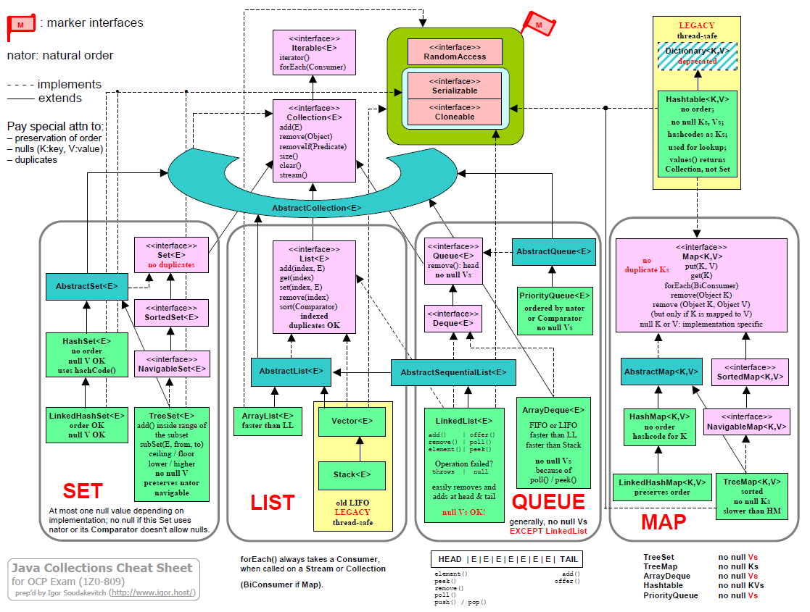
Java Collections Framework

Slide 7
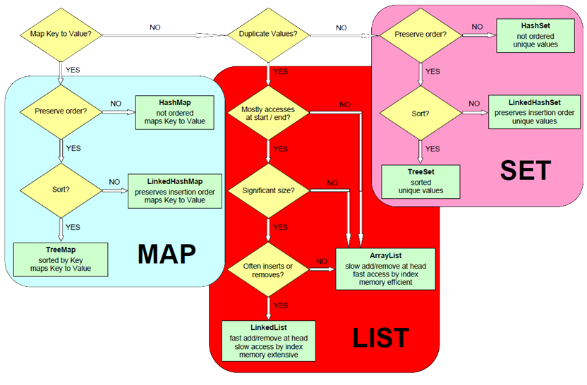
Data Structure Selection Algo

Slide 8
1Z0-809-related JCF Interfaces & Implementations
Interface | Implementation
List | ArrayList | LinkedList
Set | HashSet | TreeSet
Map | Hashtable | HashMap | TreeMap
Deque | ArrayDeque

Slide 9
List Interface
List defines generic list behavior.
Is an ordered collection of elements
List behaviors include:
Adding elements at a specific index
Getting an element based on an index
Removing an element based on an index
Overwriting an element based on an index
Getting the size of the list
List allows duplicates.

Slide 10
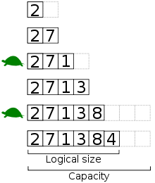
ArrayList
Is an implementation of the List interface
The list automatically grows if NOE exceeds initial capacity.
Has a numeric index
Elements are accessed by index
Elements can be inserted based on index
Elements can be overwritten
Allows duplicate elements
accessing thru index: O(1)
other operations: O(n)

Slide 11

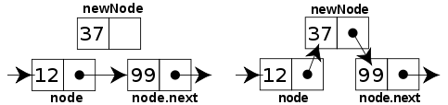
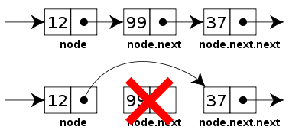
LinkedList
Supports operations similar to an ArrayList but is structured differently.
single-linked
double-linked
adding: O(1)
insertion
other: O(n)
removal

Slide 12
Traversing a List
Can be performed with an Iterator object
Possible with the enhanced-for construct
Does not allow for concurrent modification with for-each…
… but permits concurrent removal with an Iterator

Slide 13
Set Interface
A Set accepts unique elements only
Has no index
You can iterate through elements to access them
TreeSet provides sorted implementation based on a natural ordering or a specified Comparator

Slide 14

HashSet
values
“John”
null
0
A DS in which elements are placed in their respective array locations based on their hash code; features:
no duplicates
no iteration order
no maintained order
null values OK
null
1
hash: length()
"Naïve", straightforward implementation
null
2
“Sam”
4
3
“John”
4
add(), remove(), contains(): O(1)
default LF = 0.75
(16 buckets, 12 elems)
null
5
assuming sufficient distribution of data

Slide 15

TreeSet
B binary
root
20
no null values
by default
T tree
S search
8
22
5
14
21
27
2
9
16
24
30

Slide 16
TreeSet
root
20
Let's see if we've got 16
8
O(log₂n)
22
5
14
21
27
2
9
16
24
30

Slide 17
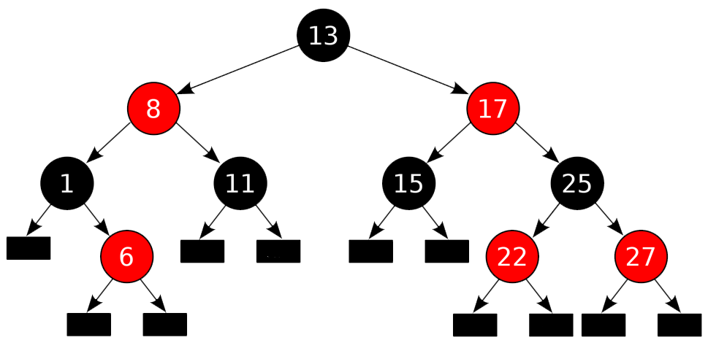
Red-Black Tree

Slide 18
Map Interface
A collection that stores multiple key-value pairs
Key: Unique identifier for each element in a collection
Value: A value stored in the element associated with the key
Called “associative arrays” or “dictionary” in other languages
Key | Value
101 | John Smith
102 | Jane Sanderson
103 | Bob Marley

Slide 19
Useful Map<K,V> Methods

Slide 20
Deque Interface
A collection that can be used as a stack or a queue
Stands for a “double-ended queue” (pronounced “deck”)
A queue provides FIFO (first in, first out) operations:
add(e) and remove() methods
A stack provides LIFO (last in, first out) operations:
push(e) and pop() methods

Slide 21
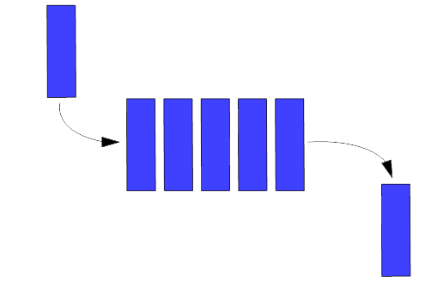
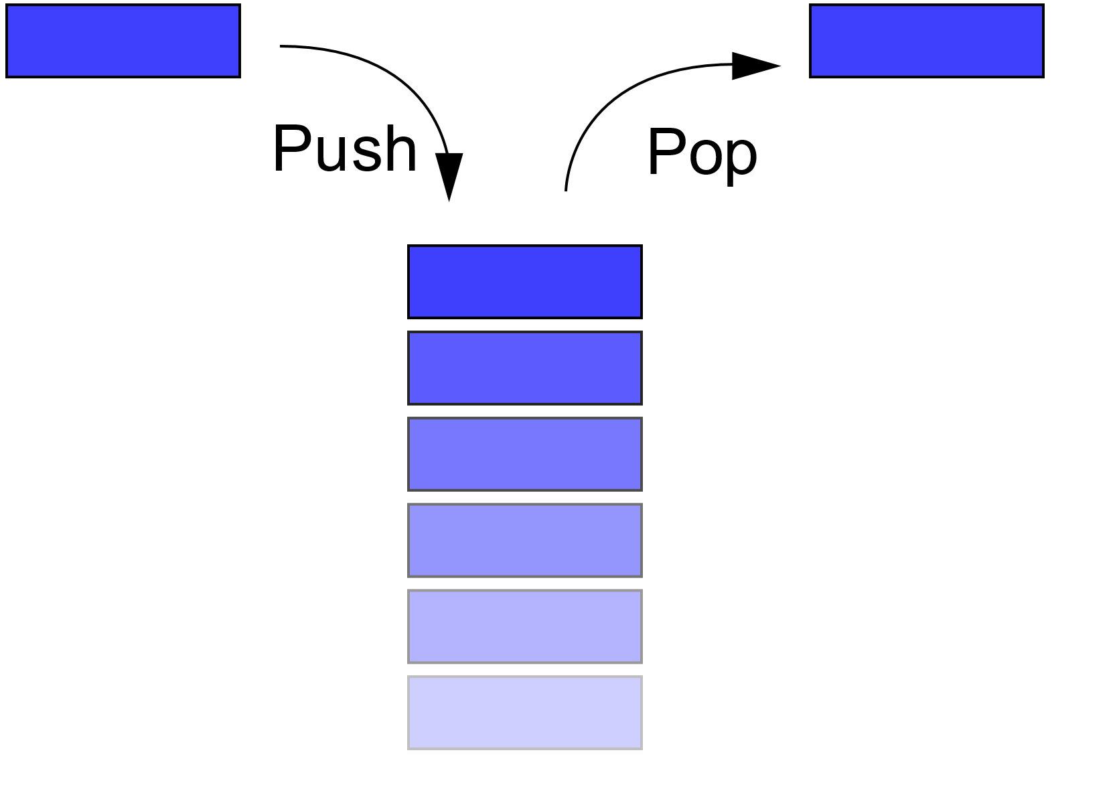
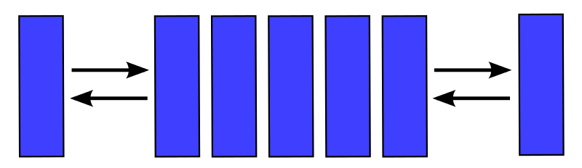
Queue vs Deque vs Stack
Tail
Head
Dequeue
Enqueue
FIFO
LIFO

Slide 22
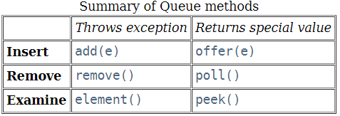
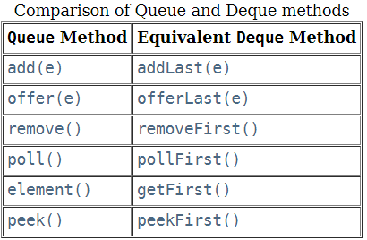
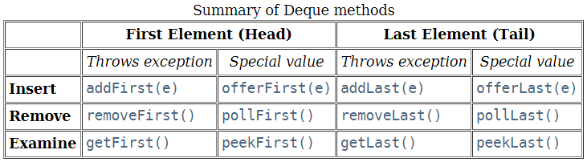
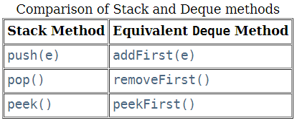
Queue vs Deque vs Stack
Queue: 1.5
Deque: 1.6
Stack: 1.0

Slide 23
Data Structure Selection Algo

Slide 24
Ordering Collections
The Comparable and Comparator interfaces are used to order collections
Both are implemented by using generics
Using the Comparable interface:
Overrides the compareTo(T other) method
This provides only one sorting option
The Comparator interface:
Is implemented by overriding the compare(T t1, T t2) method
Enables you to create multiple Comparator classes
Enables you to create and use numerous sorting options, just like in the Strategy Design Pattern

