Slide 1

DATS 6103 Group A project LinkedIn data Analysis
Group Members:
Farris, Ghadeer, Mina, Lou

Slide 2
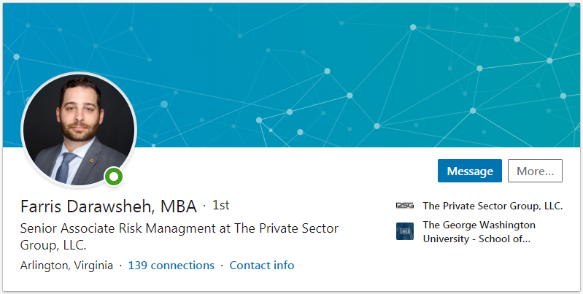
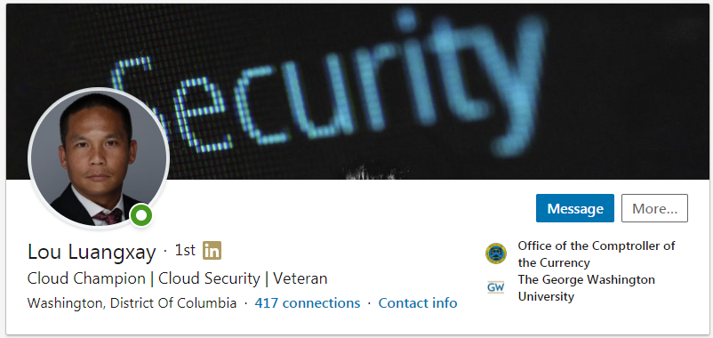
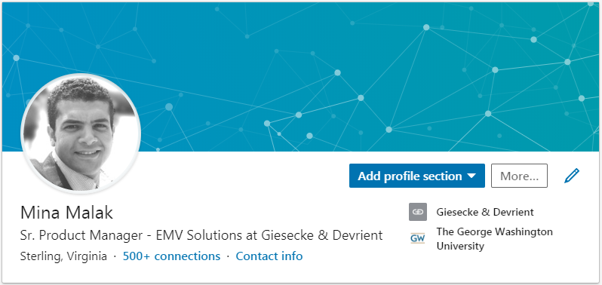
Meet the team

Slide 3
The dataset

