Slide 1
Integration of Advanced Analytics with BI Reports
Global Superstore Business Performance Review

Slide 2
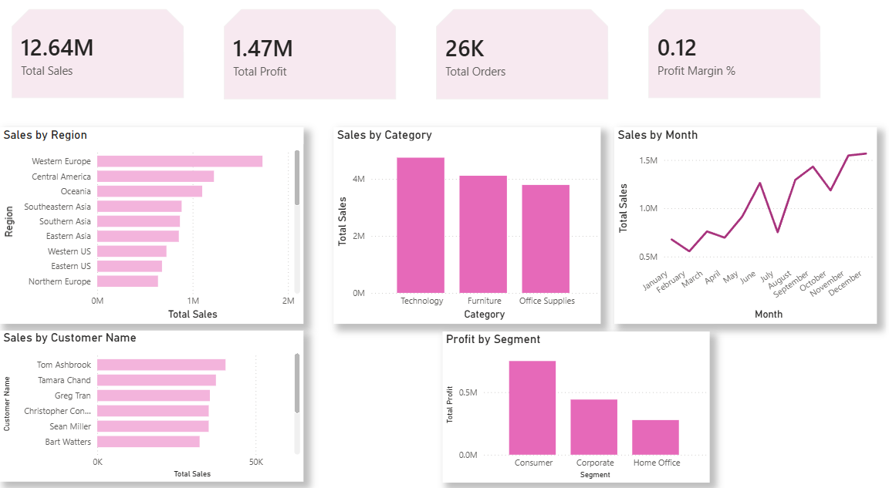
Executive Dashboard
The Dashboard brings the main KPIs and business charts together on one page.
Main Observations:
The dashboard displays sales, profit, orders and profit margin.
It compares performance by region, category and customer segment.
The selected Caribbean filter means the visible KPI values are for that filtered view.

Slide 3
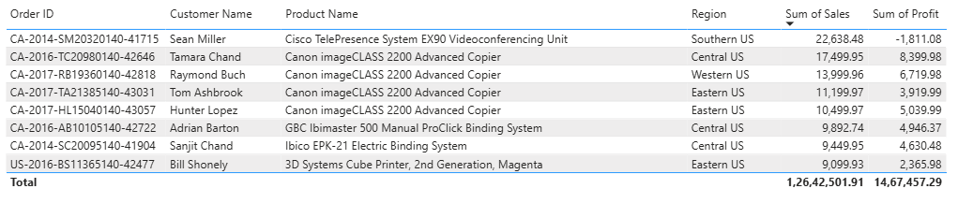
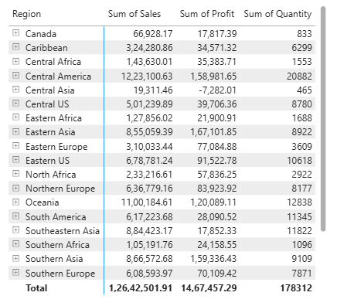
Transaction and Regional Reports
These two reports show the data at different levels of detail.
The matrix report summarizes sales, profit and quantity through the Region–State–City hierarchy.
The relational report helps inspect individual orders, customers, products, sales and profit.

Slide 4
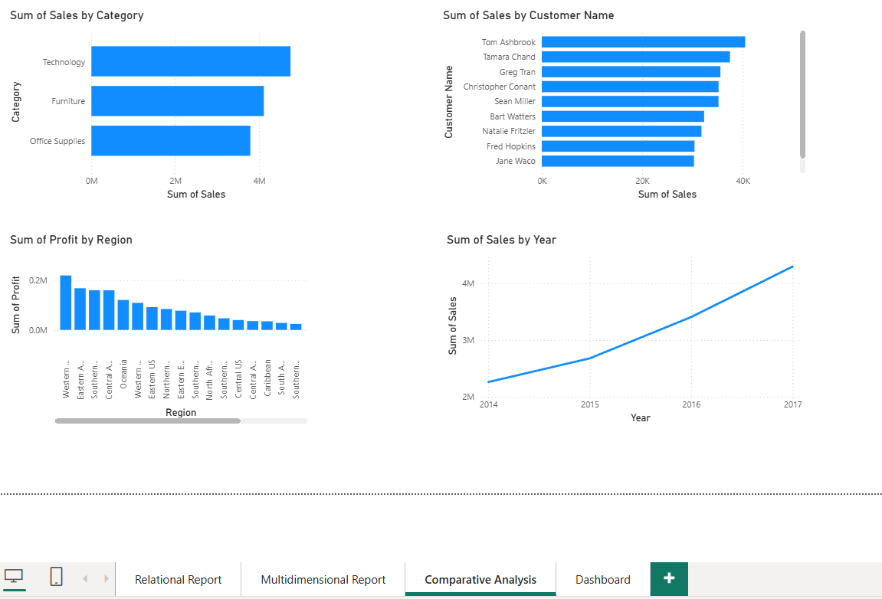
Comparative Analysis
The charts help compare categories, customers, regions and yearly sales.
What the Charts show:
Technology has the highest sales among the categories shown.
The Top 10 chart identifies customers with high sales.
The regional profit chart highlights areas that need further review.
The yearly chart shows sales movement over time.

Slide 5
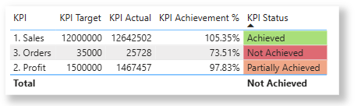
Business Scorecard
The scorecard compares actual performance with the targets entered for this practical.
Scorecard Summary:
Sales actual: 12.64M; target: 15.00M.
Profit actual: 1.47M; target: 1.50M.
Orders actual: about 26K; target: 30K.
All three indicators are marked Partially Achieved.
Targets are illustrative values used in the experiment, not verified company targets.

Slide 6
Findings and Recommendations
Summary based on the Power BI reports shared for this experiment.
Key findings:
Total sales were 12.64M and total profit 1.47M, giving an overall margin of [11.6%]. Sales rose from 2014 to 2017.
Africa was the most profitable region, and Asia was loss making.
Technology was the most profitable category and Furniture the least.
Consumer contributed the highest profit.
Recommendations:
Review discounts, prices and delivery costs in loss-making regions.
Focus on profitable products, not only high sales.
Use customer segment results to plan suitable offers.
Check sales, profit and order targets every month.
Conclusion: Sales growth alone does not guarantee profitability. Targeted action on loss-making and low-margin areas, together with growth in high-margin segments, will improve overall profit.

