Slide 1

ProjectPulse: TASK MANAGEMENT APP
Team#7 Tauha Imran 22i-1239
Minahil Ali 22i-0847
Nabeed Haider 22i-0871
Deliverable F – SE D3

Slide 2
1
Project introduction

Slide 3

Project Pulse
A MERN stack-based platform designed
to simplify task delegation, team
coordination, and project monitoring.
It features a comprehensive dashboard
for managing teams, tasks, and
Schedules and timelines.
The system focuses on usability, real-time notifications, and effective collaboration to boost productivity for small to medium teams

Slide 4
2
Functional Requirements
You can enter a subtitle here if you need it

Slide 5
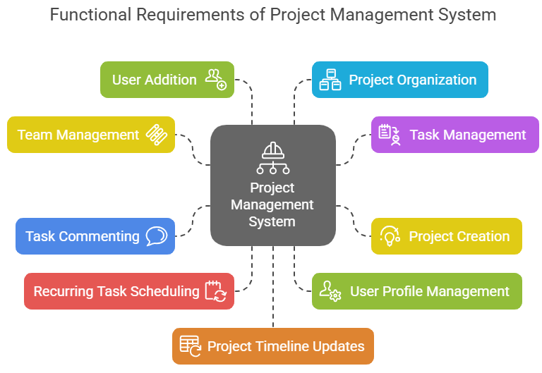

Slide 6
3
Nonfunctional Requirements

Slide 7
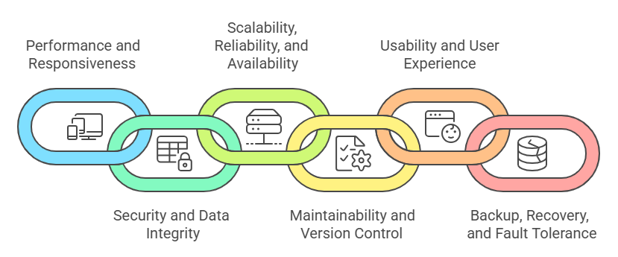
Nonfunctional Requirements

Slide 8
4
Design - Dataflow Diagram
The logical methods of the system

Slide 9
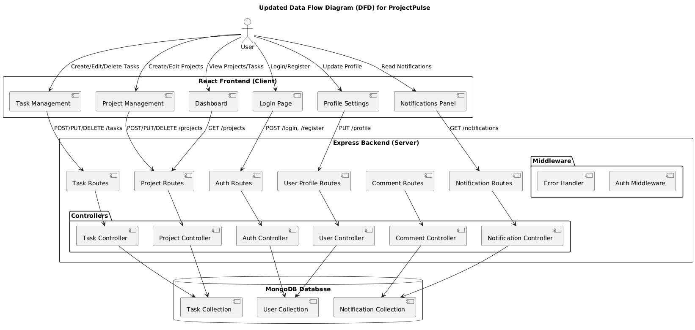
Data Flow Diagram
DD/MM/YYYY
Feature Name/Product
Your Company Name

Slide 10
5
Architecture Diagrams

Slide 11
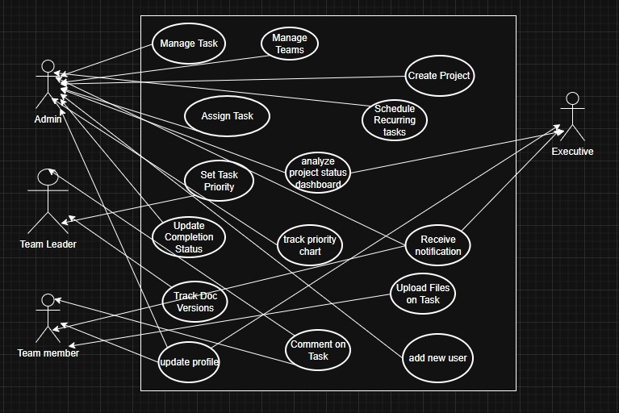
Usecase
Diagram

Slide 12
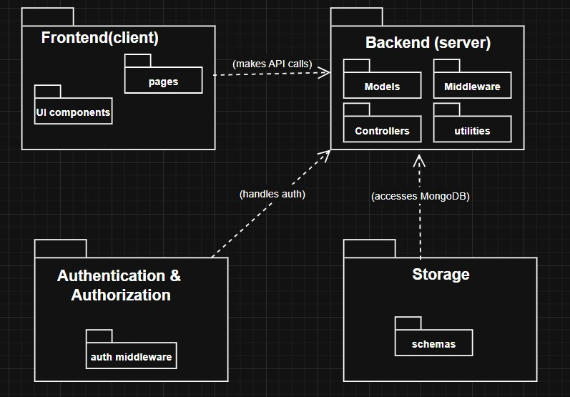
UML
Package
Diagram

Slide 13
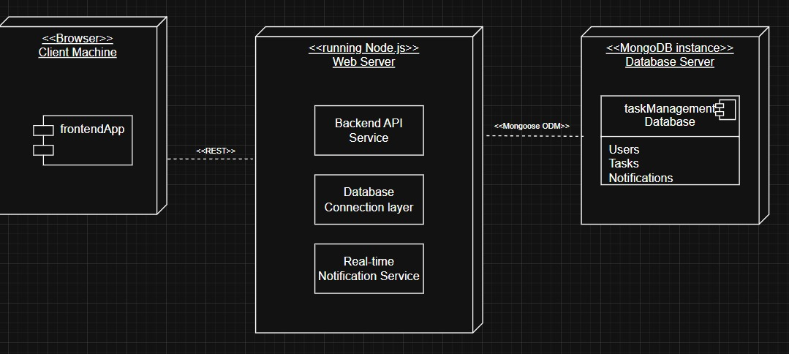
Deployment Diagram

Slide 14
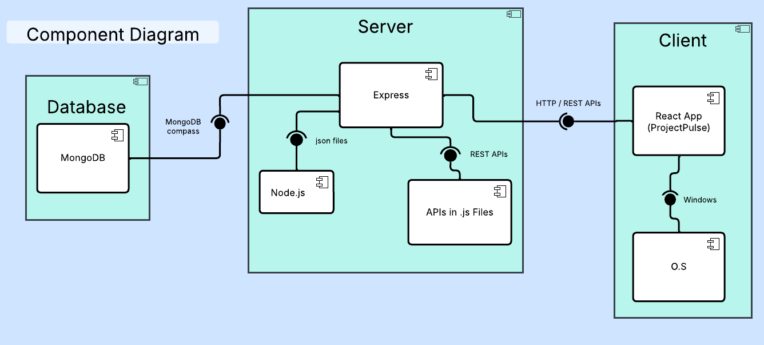

Slide 15
6
Project Implementation
Screenshots of the actual implementation.

Slide 16
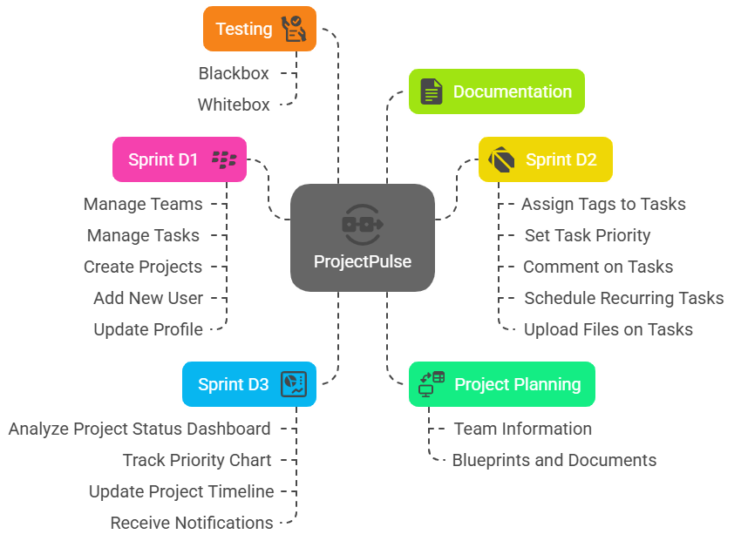
An
Overview
Of
Work
Breakdown
Structure

Slide 17
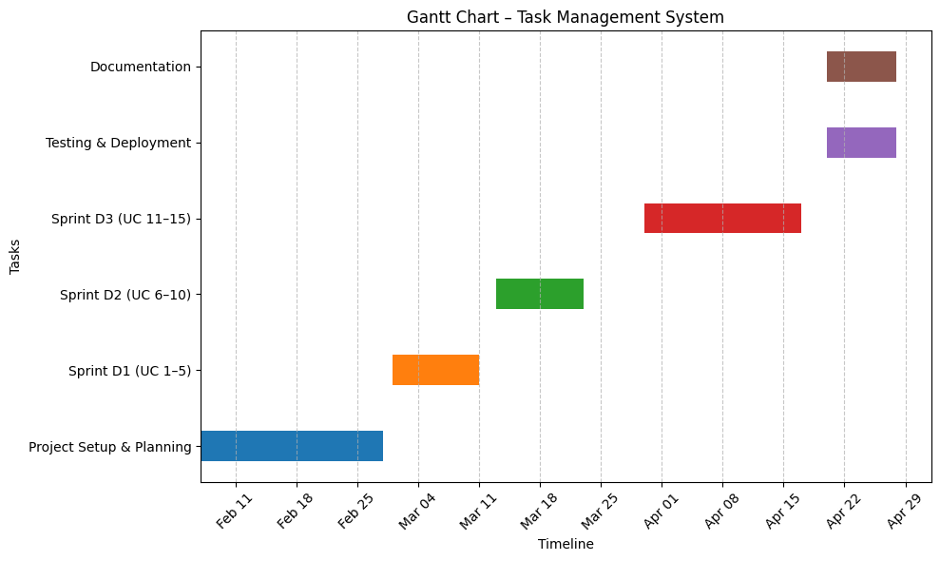
Gantt Chart

Slide 18
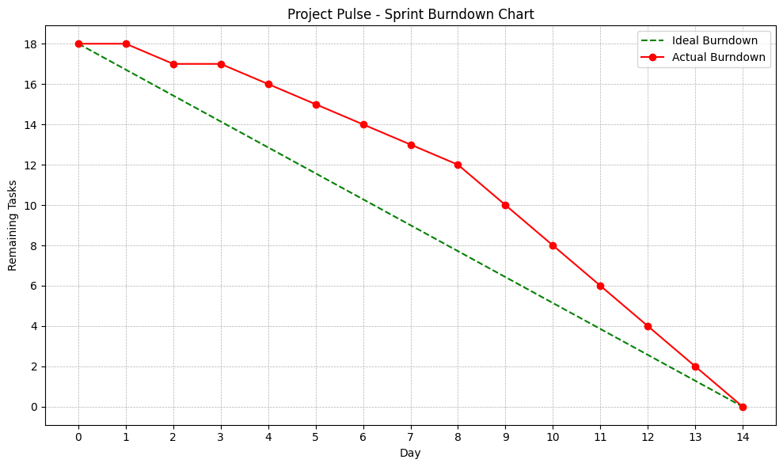
Burndown Chart

Slide 19
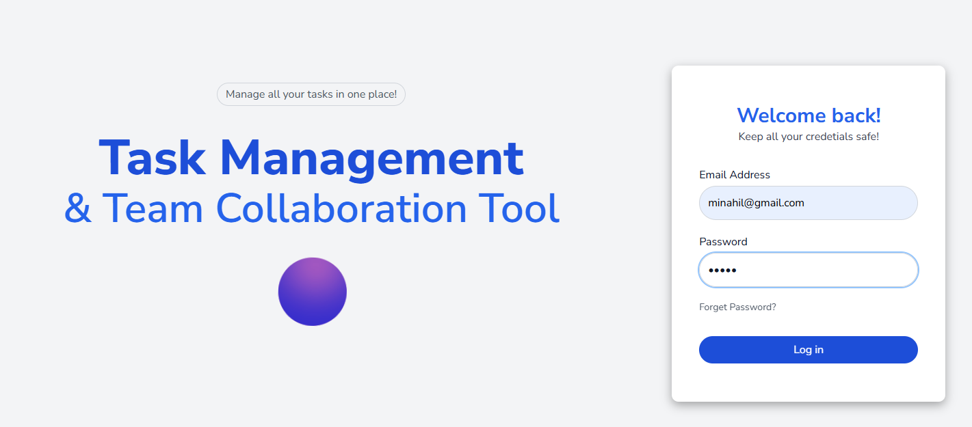
Sign in
Page

Slide 20
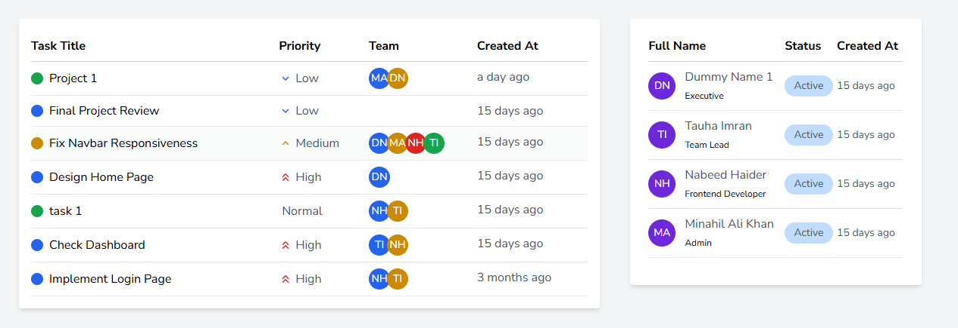
dashboard: Admin view of teams and projects

Slide 21
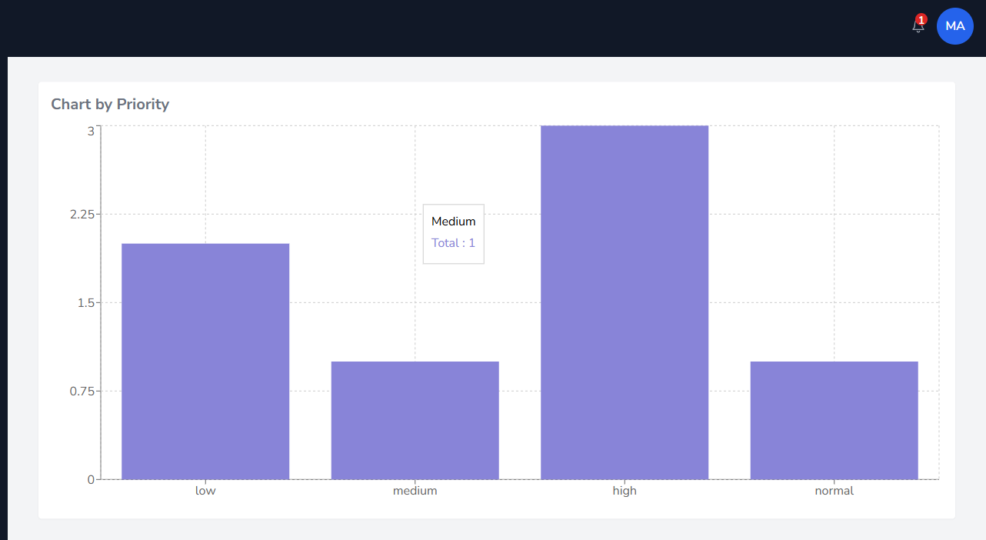
Priority
Chart

Slide 22
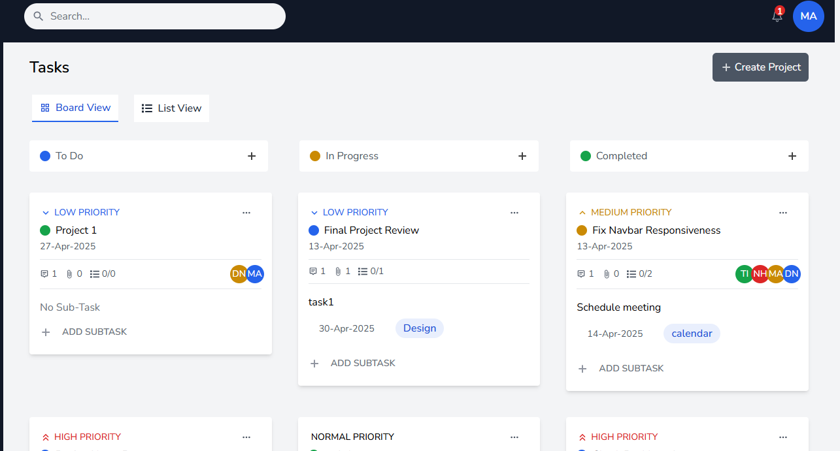
Viewing
Tasks
In Board View

Slide 23
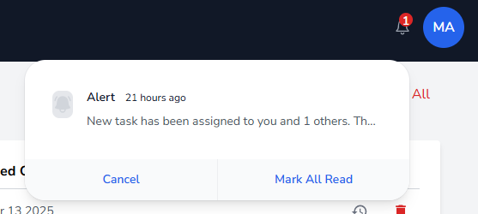
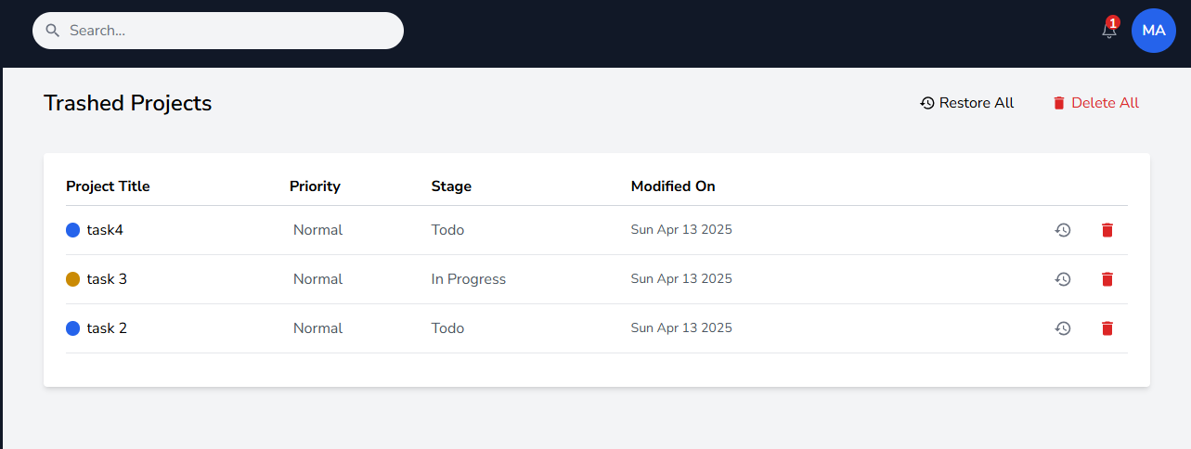
Notification Alerts (right)
Trashed Projects (left)

Slide 24
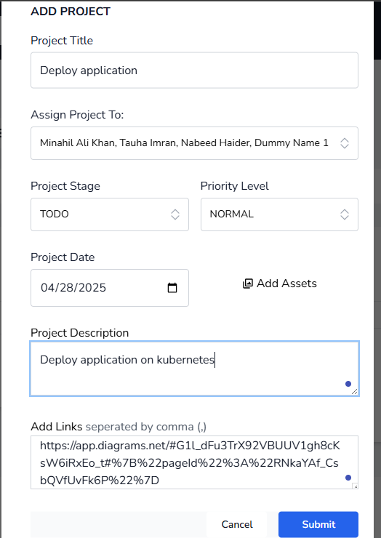
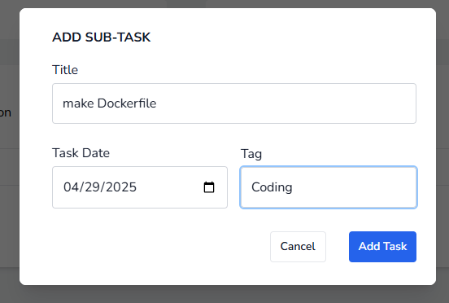
Add Project (left) & Add Task (right)

Slide 25
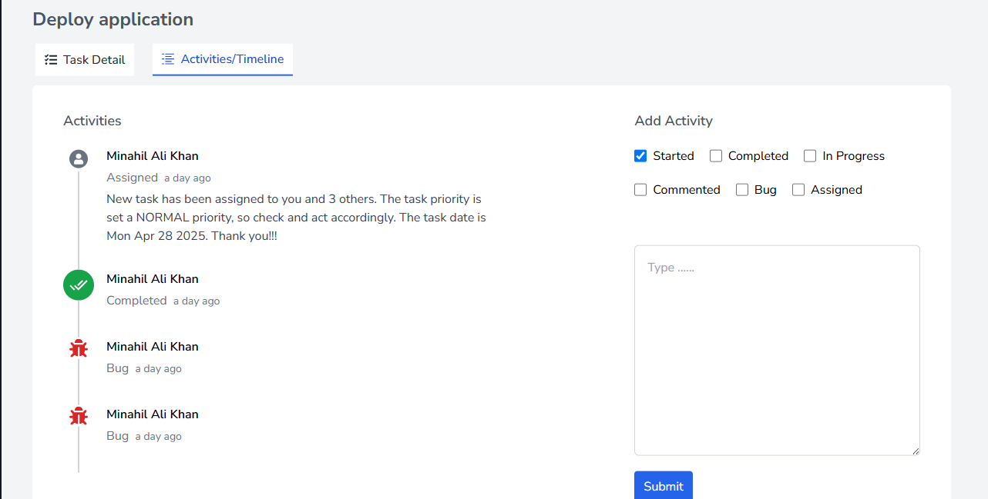
Viewing
Project
Timeline

Slide 26
6
Work Divisions

Slide 27
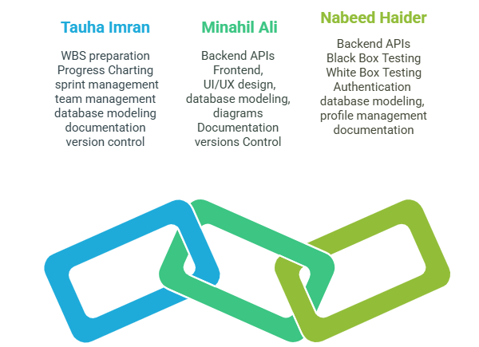
Project
Team
Contributions

Slide 28
7
Lessons Learnt

Slide 29
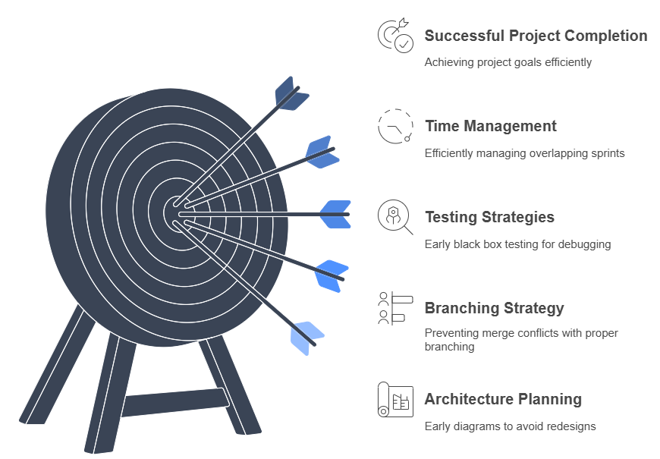
Lessons
That
We
Learnt
From
This
Project

Slide 30
Thank You.
Do you have any questions?

