Slide 1
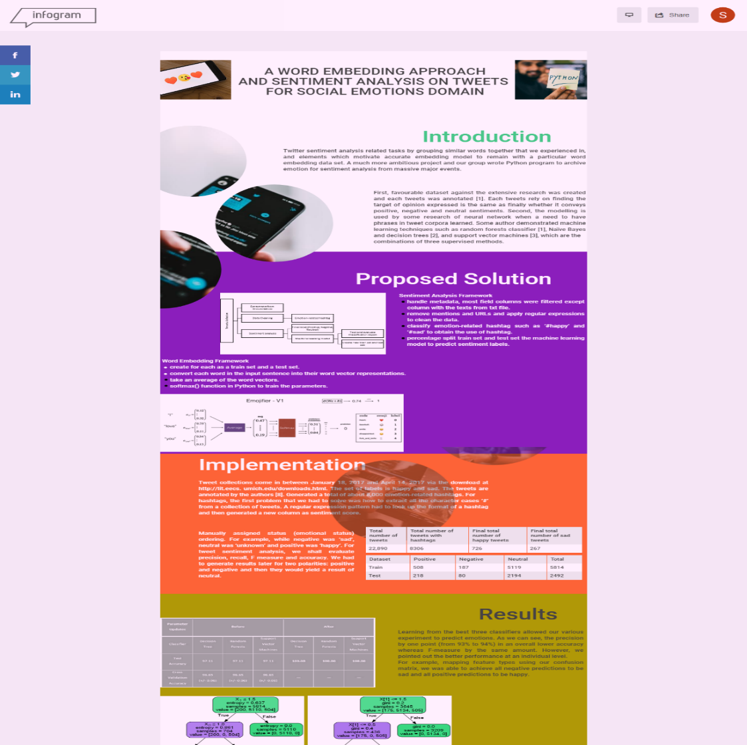
Introduction
Proposed title
-We first discussed the objective and major issues by detailing process and design specification. Further, we have discussed implementation process which covers each of the sentiment components. We then discussed how classes of sentiment score such as negative, neutral and positive which builds upon the supervised method. For the outcome that we have received from evaluation train and split sets, we accessed word embedding technique we learned in this semester.
-To tackle cleaned text, moreover, tweets often contain URLs, elongations, repeated punctuations, emoticons, abbreviations and hashtags. Thus, it points out comparison of coding expressed within regular expressions. Each program has unique challenges of its own such as R and Python.
-After handling precaution, we will find false annotation outputted by the system. Thus, it points out impact and correlation to tweets above three emoticons. For example, there are threshold between strongly positive and strongly negative instances.
❶

Slide 2
Proposed Solution
Proposed sentiment/ W.Embed framework
-This section has outlined several data preprocessing and distant supervision of both happy tweets and sad tweets such as in Python program. This section is organized as importing dataset called Grounded.csv. Then, the implementation of each use case is detailed following the components of the provided source codes.
-To do this, we need to remove mentions and URLs and apply regular expressions to clean the data. For short, regular expressions are descriptions for a pattern of text. Next, we classify emotion-related hashtag such as ‘#happy’ and ‘#sad’ to obtain the use of hashtag.
-After we loaded the EMOJISET dataset, we have to represent split as 70/30 as distribution and create for each as a train set and a test set. We will use input of the model is a string corresponding to a sentence. The output will be the probability vector of shape.
❷

Slide 3
Implementation
Summary Tweets sentiment statistics
-When working on the code with 2,557 single labelled examples, we encountered emotion tagged tweets contained within both TXT and CSV files.
-We started with a final set of about 726 happy tweets and about 267 sad tweets had mentions and URLs. After all the mentions, URLs with punctuations have been removed, we were left with about 22,000 labeled instances. Lastly, we generated a total of about 8,000 emotion-related hashtags. For hashtags, the first problem that we had to solve was how to extract all the character cases ‘#’ from a collection of tweets.
-Therefore, we manually assigned sentiment ordering. For example, while negative was ‘1’, neutral was ‘2’ and positive was ‘3’. We also manually assigned status (emotional status) ordering. For example, while negative was ‘sad’, neutral was ‘unknown’ and positive was ‘happy’. For tweet sentiment analysis, we shall evaluate precision, recall, F measure and accuracy. We had to generate results later for two polarities: positive and negative and then they would yield a result of neutral.
❸

Slide 4
Implementation
Summary one-hot/ Glove W.Embed /
backpropagation
-This one hot representation can take each row is one-hot vector. Once we have the index of the most likely emoji output, we can feed all the data into the word embedding model.
-We had to convert every sentence to lower-case, then split the sentence into a list of words. Once we have each word in the sentence, this GloVe representation can average all these values.
-we had to pass the average through forward propagation, compute the cost, and then backpropagate to update the softmax's parameters.
❸

Slide 5
Results
Proposed sentiment/ W.Embed framework
-For our testing purposes, from our 8,306 labelled sentiments, about 5,814 scores were used for training and 2,492 scores were used for testing.
-we was able to achieve all negative predictions to be sad and all positive predictions to be happy. Since neutral score in a given emotion class, we tested macro average Fmeasure of 56% and an overall accuracy of 97.0%, was among the lowest on this dataset. While the sentiment classifier was better tuned, the emotion of a tweet can be predicted with a 100.0% accuracy from overall accuracy.
-In our analysis for emoji prediction, we explored classification problem when there were total of single labelled instances with 127 examples for word vector representations. We chose the algorithm with poorly on sentences such as "This movie is not good and not feeling happy“ because it did not understand combinations of words. As such, we obtained averages all the words' embedding vectors together, without paying attention to the ordering of words.
❹

