Slide 1



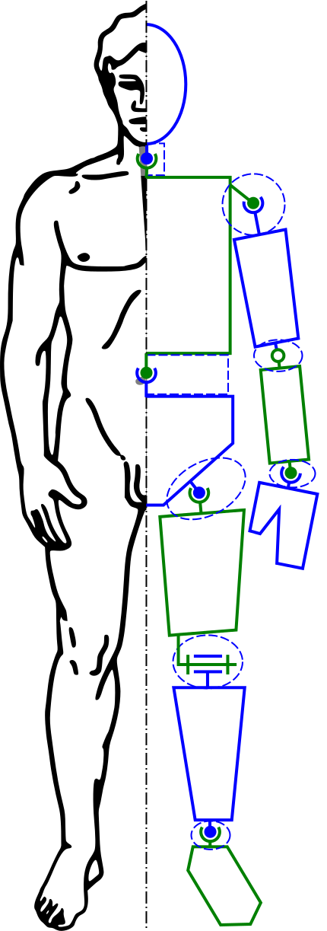
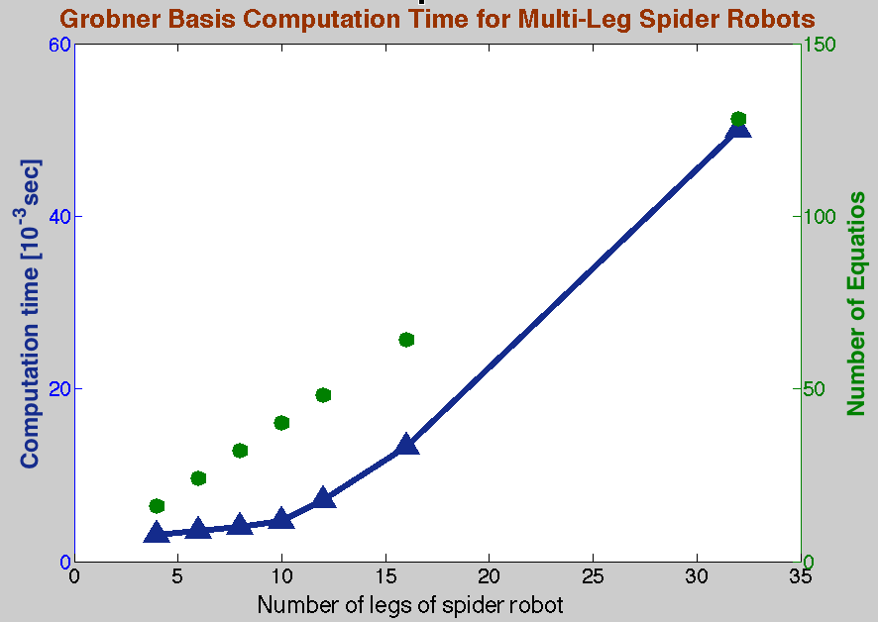
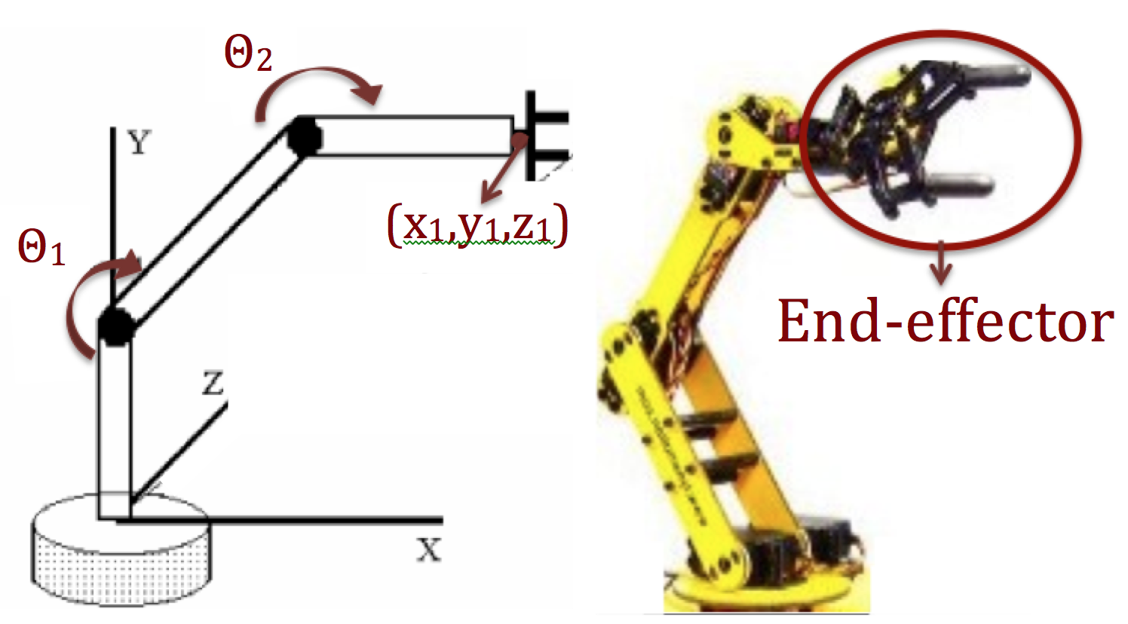
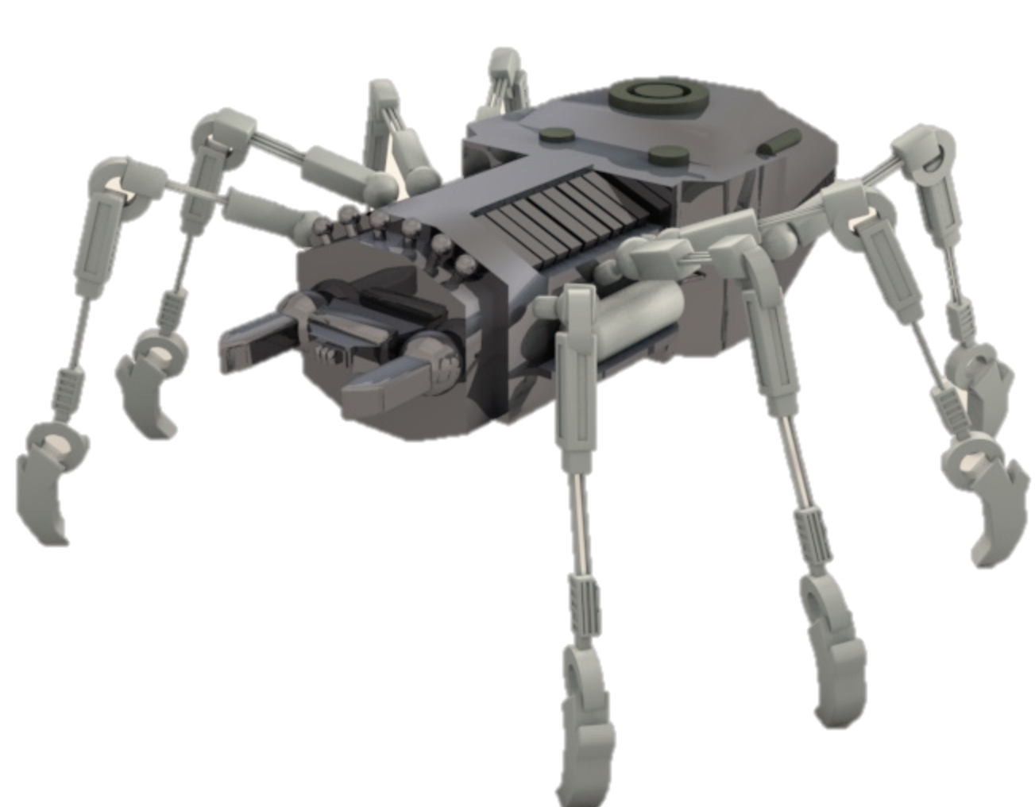
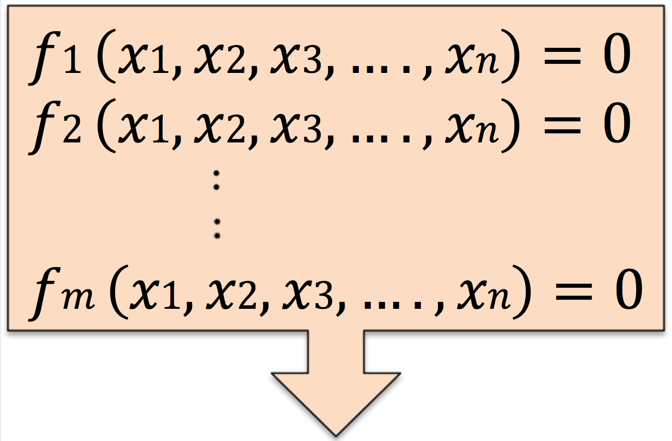
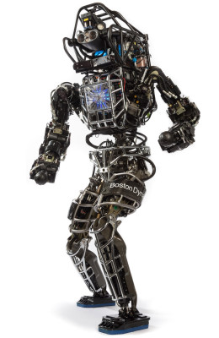



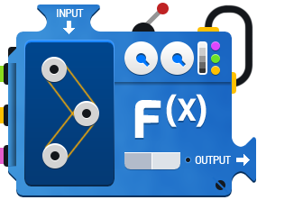




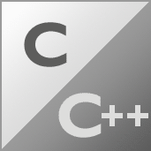

Gröbner Basis for Polynomial Systems in Robotics
Mina Khan¹, Frank Permenter² and Russ Tedrake³
¹Mount Holyoke College ^{2, 3}Electrical Engineering and Computer Science, Massachusetts Institute of Technology
Motivation: To efficiently find exact solutions to multivariate polynomial equations in robot control and motion planning.
III. ROBOT STRUCTURES
V. FAST COMPUTATIONS
Computations for sparse matrices may be simpler than computations for dense matrices.
Fig 4: We created a multi-leg spider robot (left). Each spider leg is connected to the body, but not to other legs, yielding chordal sparsity in robot graphs (right).
We achieved a 50 milliseconds computation time for Gröbner basis for a system of a spider robot with 32 legs. This system had 128 polynomials in 67 variables and we did the computations in Sage using a 1.3 GHz processor.
I. ROBOT CONTROL
Determinant of a sparse diagonal matrix
Robot control involves solving polynomial equations in inverse kinematics and dynamics problems for robots.
Kinematics ⬇ Positions
Dynamics ⬇ Forces
Fig 6: Computation time for Gröbner basis using Sage. The polynomial systems for the spider robot had 16 to 128 equations.
Body
Leg 1
Leg 2
Leg 3
Leg 4
Leg 5
Leg 6
Leg 7
Leg 8
Fig 1: The serial N-link manipulator model (left) for a robotic arm (right)
Fig 2: Bar-joint model for human
Leg 1
Body
II. Gröbner Basis
IV. ComPUTATIONAL METHODS
VI. FUTURE WORK
Gröbner basis algorithms generalize Gaussian elimination for multivariate polynomials.
Alternatives to Gröbner basis algorithms include numerical methods (such as homotopy-continuation) that do not reliably yield exact solutions.
We analyze Gröbner basis algorithms that leverage the sparsity of the polynomial matrices.
Gröbner basis algorithms include Buchberger’s algorithm, Faugère's F4, F5 and FGLM.
Apply our advances in Gröbner basis computations to improve the performance of robots, especially Boston Dynamics “Atlas” robot. We are currently integrating Sage’s algorithms in our existing MATLAB polynomial solvers.
Investigate chordal graphs to further leverage polynomial structure in Gröbner basis algorithms.
Fig 3: Gröbner basis algorithms
✔ Gröbner basis can be used to solve multivariate polynomial equations.
✖ Gröbner basis algorithms have double exponential worst-case complexity.
Software packages that have slow Gröbner basis computations
Sage is math software based on Python. Sage uses Gröbner basis algorithms in Singular and Magma, and most of these algorithms are in C/C++.
Sage allows fast Gröbner basis computations
Fig 6: Atlas humanoid robot
Gröbner basis algorithm
Solutions to Polynomial Equations
Acknowledgements
Diego Cifuentes, Robot Locomotion Group and MSRP Staff
Picture Courtesy
ROSARIO, J. M. et al. Proposal of methodology for the modeling and control of manipulators. J. Braz. Soc. Mech. Sci. 2002, vol.24, n.3 (Fig 1); http://www.societyofrobots.com/robot_arm_tutorial.shtml (Fig 1); "Modele cinematique corps humain” Wikimedia Commons (Fig 2); http://www.mathwarehouse.com/algebra/relation/evaluating-function.php (Fig 3); http://physicssum.deviantart.com/art/3D-Robot-Spider-280498884 (Fig 4); Logos: MATLAB, Maple, Macaulay2, Sage, Python, Magma, Singular, C/C++ (http://www.techhui.com/group/candcppdevelopers); http://www.fairfaxunderground.com/forum/file.php?40,file=113550,filename=Atlas-p2_nt.jpg (Fig 6)

