Slide 1



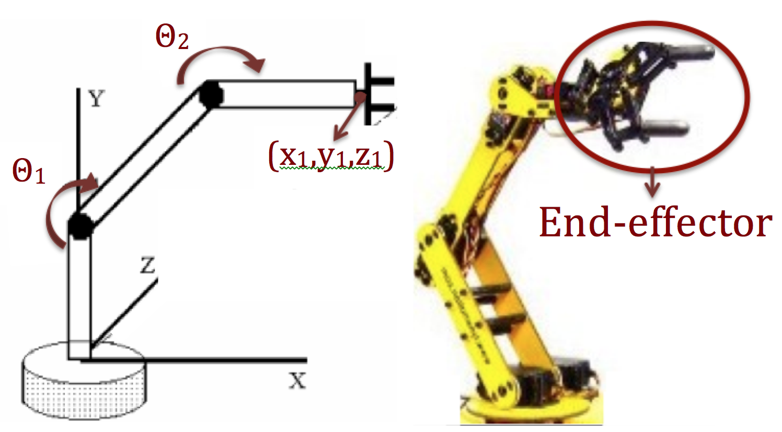
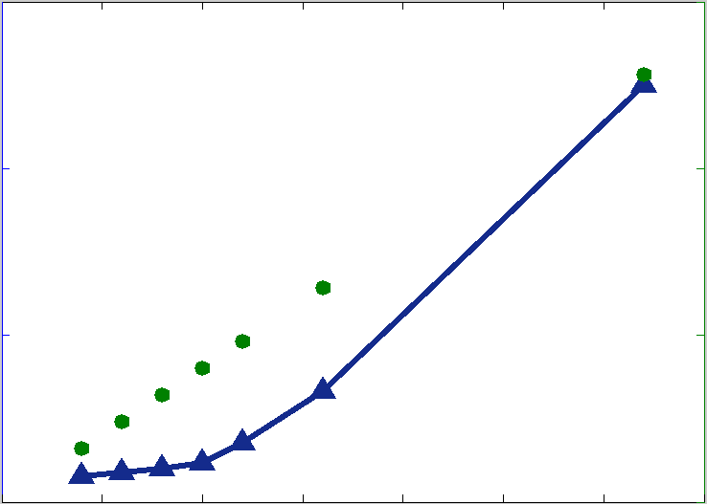
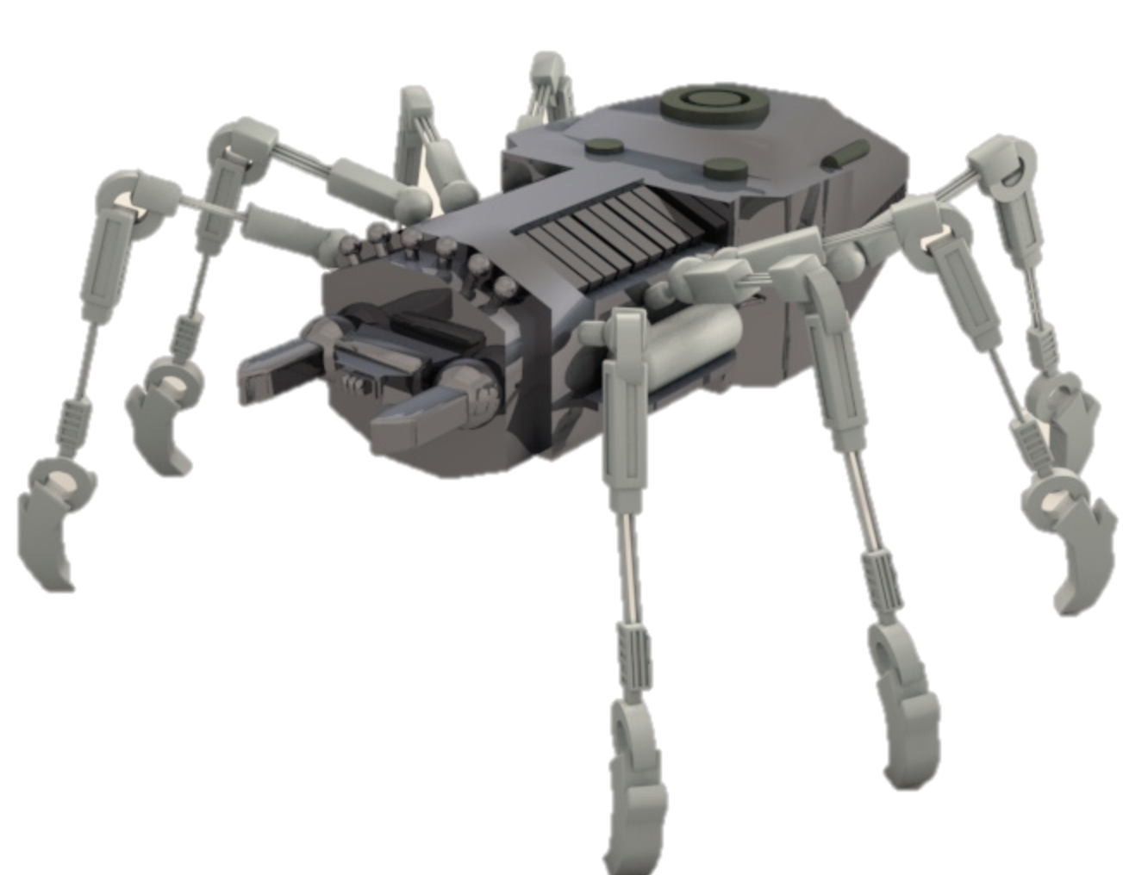
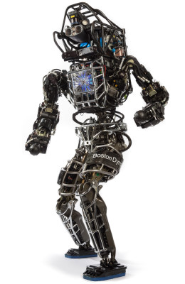



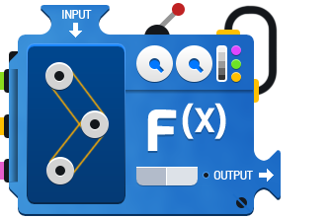



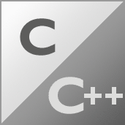


Gröbner BasEs for Polynomial Systems in Robotics
Mina Khan¹, Frank Permenter² and Russ Tedrake²
¹Mount Holyoke College, ²Electrical Engineering and Computer Science, Massachusetts Institute of Technology
Motivation: Efficiently find exact solutions to multivariate polynomial equations in robot control and motion planning.
III. ROBOT STRUCTURES
V. CONCLUSIONS
Sparse matrix computations are simpler than dense matrix computations.
Sage efficiently computes Gröbner bases using a 1.3 GHz Intel Core i5 processor. We achieved a 50 milliseconds computation time for Gröbner basis for a system of 128 polynomials in 67 variables for a 32-leg spider robot.
I. ROBOT CONTROL
Determinant of a sparse diagonal matrix
We created a spider robot (left). Each spider leg is connected to the body, but not to other legs, yielding chordal sparsity in robot graphs (right).
Gröbner basis computation time for spider robots
Computation time for Gröbner bases using Sage. Our polynomial systems for the spider robot had 16 to 128 equations.
Robot control involves solving polynomial equations in inverse kinematics (positions) and dynamics (forces) problems for robots.
60
150
Body
Leg 1
Leg 2
Leg 3
Leg 4
Leg 5
Leg 6
Leg 7
Leg 8
40
100
Computation Time (10⁻³ sec)
Number of Equations
20
50
Serial N-link manipulator model (left) for a robot arm (right)
Leg 1
Body
0
5
10
15
20
25
30
35
Number of Legs of Spider Robot
II. Gröbner BasEs
IV. Computations
VI. FUTURE WORK
✔ Gröbner bases can be used to find solutions to systems of multivariate polynomial equations.
✖ Gröbner basis algorithms have double exponential worst-case complexity, so we aim to find efficient Gröbner basis algorithms.
Gröbner basis algorithms include Buchberger’s algorithm, Faugère's F4, F5 and FGLM.
Integrate Sage’s Gröbner basis algorithms in our existing polynomial solvers to improve the performance of robots, especially Boston Dynamics “Atlas”.
Investigate chordal graphs to further leverage polynomial sparsity in Gröbner basis algorithms. Our existing algorithm using chordal graphs is slower than Sage’s algorithm.
✖ Maple, MATLAB and Macaulay2 cannot compute Gröbner basis for a polynomial system representing even one robotic spider leg.
Polynomial System
f₁(x1, x2, x3,....,xn) = 0
f₂(x1, x2, x3,....,xn) = 0
:
f_{m}(x1, x2, x3,....,xn) = 0
Gröbner basis algorithms generalize Gaussian elimination to find Gröbner bases.
Sage is Python-based math software that uses C++ libraries in Singular and Magma to compute Gröbner bases.
✔ Sage allows fast Gröbner basis computations.
Atlas robot
Gröbner basis algorithm
Acknowledgements
Robot Locomotion Group, Diego Cifuentes, and MSRP Staff
Gröbner basis
g₁(x1) = 0
g₂(x1, x2) = 0
g₃(x1, x2, x3) = 0
:
g_{m}(x1, x2, x3,....,xn) = 0
Picture Courtesy
ROSARIO, J. M. et al. Proposal of methodology for the modeling and control of manipulators. J. Braz. Soc. Mech. Sci. 2002, vol.24, n.3; http://www.societyofrobots.com/robot_arm_tutorial.shtml; http://www.mathwarehouse.com/algebra/relation/evaluating-function.php; http://physicssum.deviantart.com/art/3D-Robot-Spider-280498884; Logos: MATLAB, Maple, Macaulay2, Sage, Python, Magma, Singular, C/C++ (http://www.techhui.com/group/candcppdevelopers); http://www.fairfaxunderground.com/forum/file.php?40,file=113550,filename=Atlas-p2_nt.jpg

