Slide 1
AI vs ML vs DL
Presented By:-
Minakshi Boruah

Slide 2
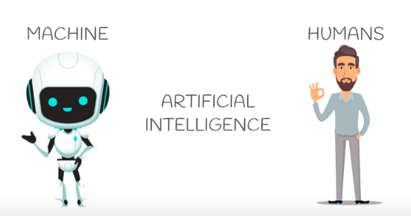
Artificial Intelligence
The capacity of a computer to perform operations analogous to learning and decision making in humans, as by an expert system, a program for CAD or CAM, or a program for the perception and recognition of shapes in computer vision systems

Slide 3



Slide 4
Traditional Artificial Intelligence…
Success
  Chess playing
  Mathematical theorem prove
  Expert systems
Failure
  Face Identification
  Natural Language processing
  Robotics

Slide 5
Symbolic Artificial Intelligence
Symbol processing
Logic programming
List processing
Top down
High level processing

Slide 6
Outline
Learning
Machine learning
Supervised learning
How brain works
Neural network and Artificial neural networks
Simple neuron - Perceptron

Slide 7
Machine Learning
Late 80s & early 90s

Slide 8
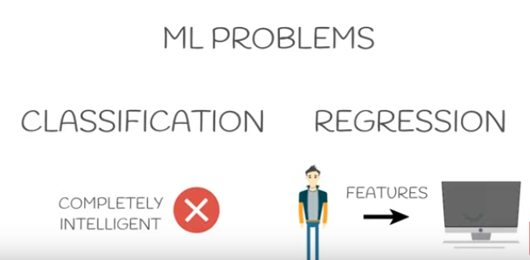

Slide 9
Distributed Artificial Intelligence
Grounded in experience
Information held in a distributed manner
Information held locally
Bottom up
No overall control
Learn from experience
Based on Biological Models
  Artificial Neural Networks

Slide 10
Artificial Neural Networks
Forecast time series
Control robots
Pattern recognition
Noise removal
Digit recognition
Personal identification
Optimise portfolios
Data mining

Slide 11
Artificial Life
Mixture of evolution and learning
Evolution of Language
Evolution of Cooperation

Slide 12
Computational Intelligence
Computational Intelligence is a subset of Artificial Intelligence. There are two types of machine intelligence: the artificial one based on hard computing techniques and the computational one based on soft computing methods, which enable adaptation to many situations.It is difficult, if not impossible, to accommodate in a formal definition disparate areas with their own established individualities such as fuzzy sets, neural networks, evolutionary computation, machine learning, Bayesian reasoning, etc.

Slide 13
Computer
Sciences
Physics
SA
Heuristics
Biology
EC
Wavelets
Computational
Intelligence
Engineering
ANN
Neural
Science
Fuzzy
Logic
Dtree
Mathematics
Machine
Learning

Slide 14
Learning
Learning is a fundamental and essential characteristic of biological neural networks.
The ease with which they can learn led to attempts to emulate a biological neural network in a computer.

Slide 15
3 main types of learning
Supervised learning
  learning with a teacher
Unsupervised learning
  Learning from pattern
Reinforcement learning
  Learning through experiences

Slide 16
Machine Learning
Machine learning involves adaptive mechanisms that enable computers to learn from experience, learn by example and learn by analogy. Learning capabilities can improve the performance of an intelligent system over time.
The most popular approaches to machine learning are artificial neural networks and genetic algorithms.

Slide 17
How the brain works
A neural network can be defined as a model of reasoning based on the human brain. The brain consists of a densely interconnected set of nerve cells, or basic information-processing units, called neurons.
The human brain incorporates nearly 10 billion neurons and 60 trillion connections, synapses, between them. By using multiple neurons simultaneously, the brain can perform its functions much faster than the fastest computers in existence today.
Each neuron has a very simple structure, but an army of such elements constitutes a tremendous processing power.
A neuron consists of a cell body, soma, a number of fibers called dendrites, and a single long fiber called the axon.

Slide 18
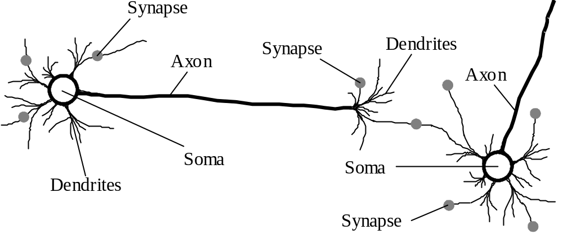
Biological neural network
Axon hillock

Slide 19
Artificial Neural Networks
An artificial neural network consists of a number of very simple processors, also called neurons, which are analogous to the biological neurons in the brain.
The neurons are connected by weighted links passing signals from one neuron to another.
The output signal is transmitted through the neuron’s outgoing connection. The outgoing connection splits into a number of branches that transmit the same signal. The outgoing branches terminate at the incoming connections of other neurons in the network.

Slide 20
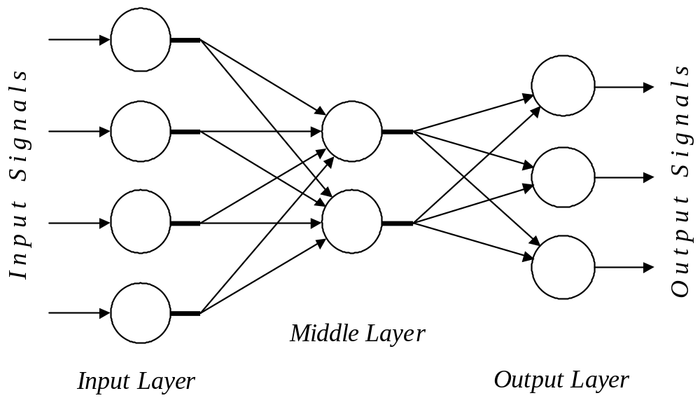
Architecture of an ANN

Slide 21
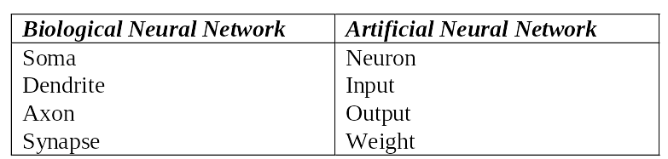
Analogy between biological and
artificial neural networks

Slide 22
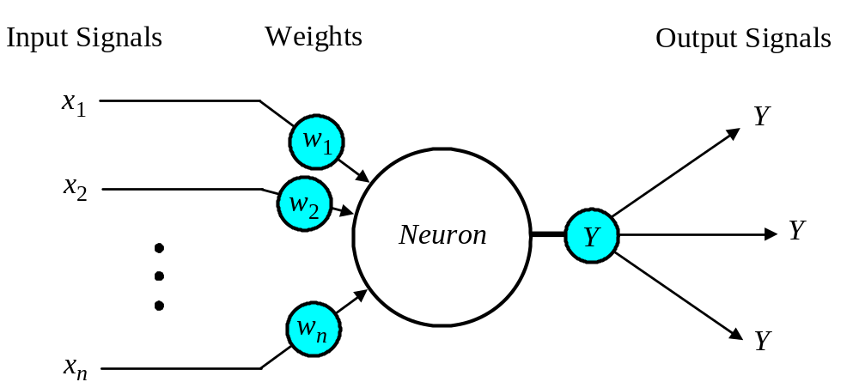
The neuron as a simple computing element
Diagram of a neuron

Slide 23
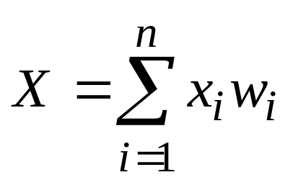
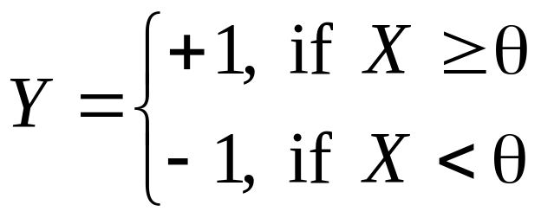
The neuron computes the weighted sum of the input signals and compares the result with a threshold value, θ. If the net input is less than the threshold, the neuron output is –1. But if the net input is greater than or equal to the threshold, the neuron becomes activated and its output attains a value +1.
The neuron uses the following transfer or activation function:
This type of activation function is called a sign function.

Slide 24
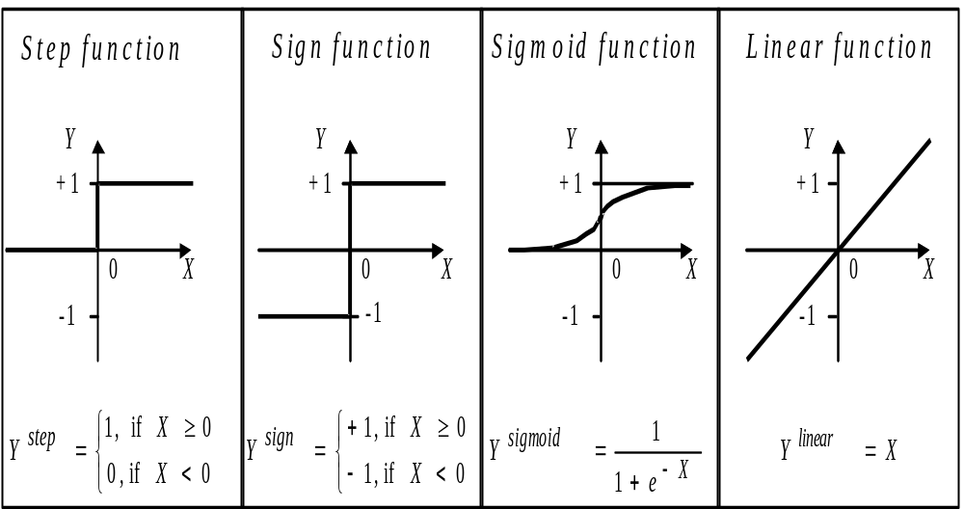
Activation functions of a neuron

Slide 25
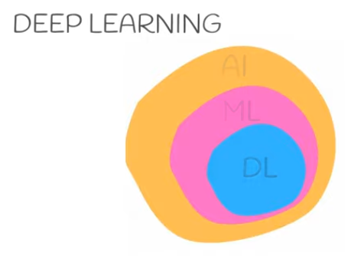

Slide 26
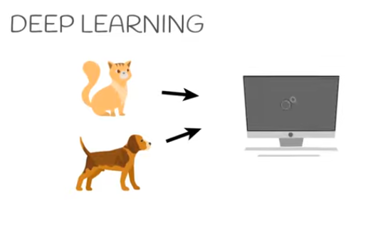
Some sources point out that Frank Rosenblatt developed and explored all of the basic ingredients of the deep learning systems of today. He described it in his book "Principles of Neurodynamics: Perceptrons and the Theory of Brain Mechanisms", published by Cornell Aeronautical Laboratory, Inc., Cornell University in 1962.

Slide 27
