Slide 1
Trash-O-Cash
Sell the Trash and earn the Cash

Slide 2
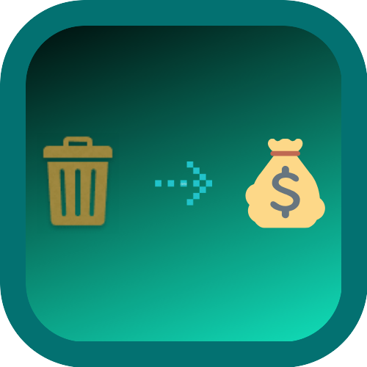
About the Idea
Trash-O-Cash acts as a mediator between user and recycling company. We here not only provide the cash (ongoing market rate) but also the credit in your app for your scrap, which you can redeem after passing threshold amount.

Slide 3


1. Introduction
‘Cleanliness is next to godliness’. We can keep our India clean only if the people of our country think like us.
The aim of our company is to make INDIA “clean and green”. By providing the online platform to the users to sell their as well as any other waste around.
For eg. If we ate kurkure, so instead of throwing it here and there, we can keep it with ourselves and when we have sufficient amount of plastic/packets then we can sell them through our app and collect the cash and credits.

Slide 4


What all you need?

Slide 5






2 Ton
75%
25%
1 ton

Slide 6

Business Model

Slide 7
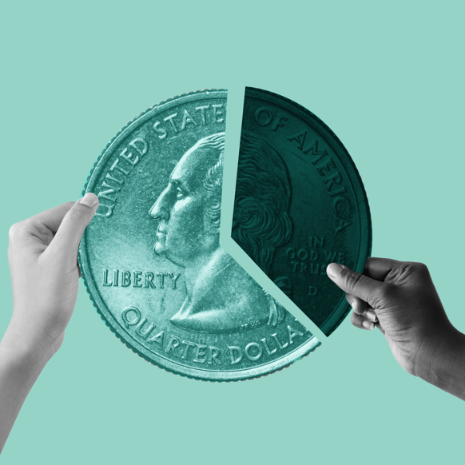
Example:
For 1 ton of plastic, Government provide on average 250$ which splits into-
Municipality community
Recycling Company

Slide 8
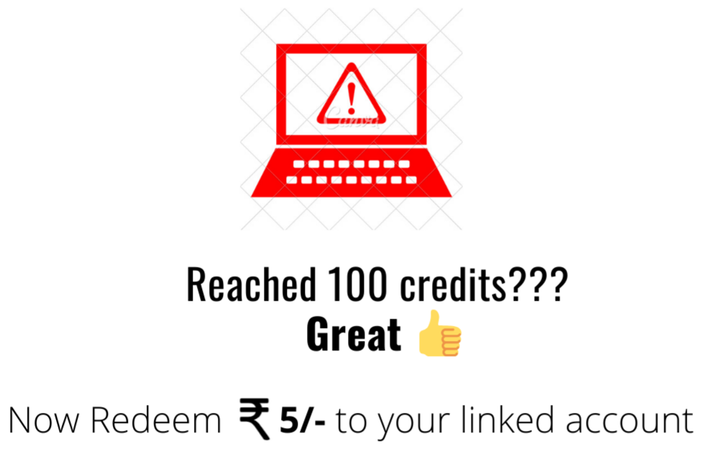
Credits??
Plastic - 10 Credits/kg
Paper - 10 Credits/kg
Soft Cardboard - 3 Credits/kg
Hard Cardboard - 10 Credits/kg
Aluminium - 40 Credits/kg
Iron - 15 Credits/kg

Slide 9
Social Impacts
More employment opportunities for junk dealers.
Profit for
Recycle Company
User
Developer
Clean India, Green India
3. Normally, junk dealers visit locality randomly.

Slide 10
How we will reach people?
Start with small (family, friends, college).
Awareness campaigns at places such as beaches (where plastic/cans are found in high quantity).
Advertisement on social platforms.

Slide 11
Additional Features
We will be provided with the location and accordingly optimized companies with the base price of the item will be mentioned on the screen.

Slide 12
Thank you
Team no. - D57
Team name -Maven

Slide 13
UDDESHYA LAL
T
E
A
M
VARUN MEHROTRA
MINAL GARG
VARTIKA VARSHNEY
SHIVANI DUBEY

