Slide 1
Citibike_analysis
File created on: 2/23/19 11:30:24 PM EST
By Minal Jajoo

Slide 2
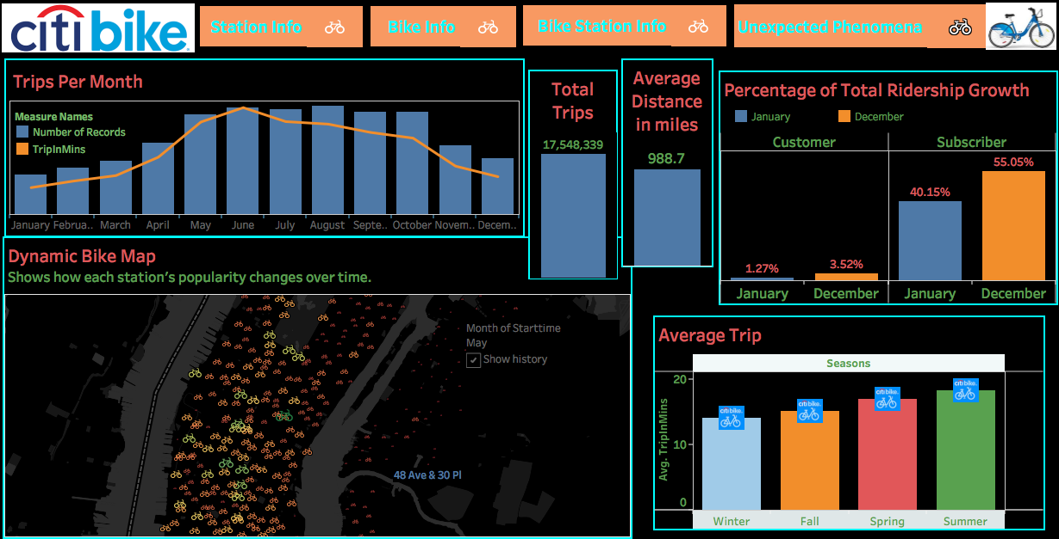

Slide 3
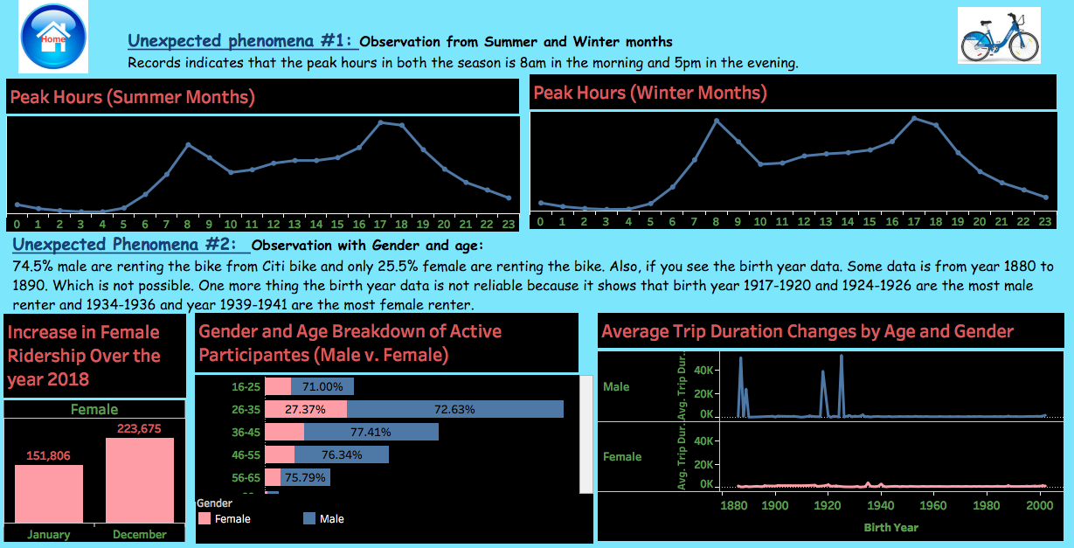

Slide 4
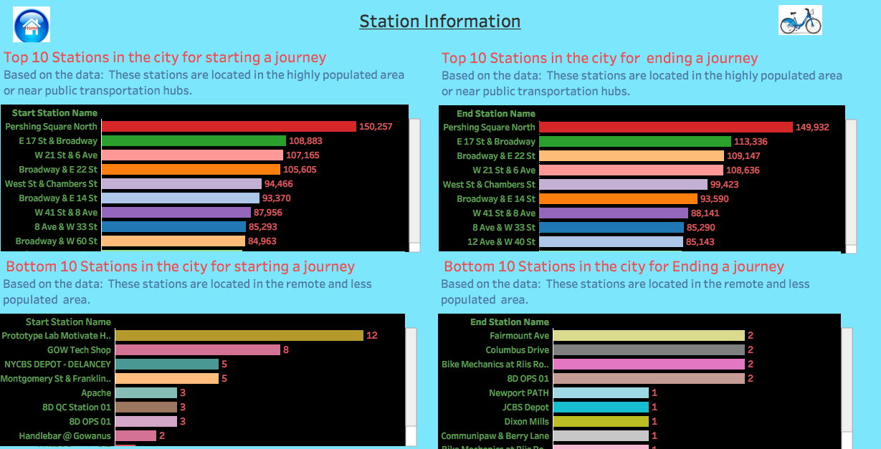

Slide 5
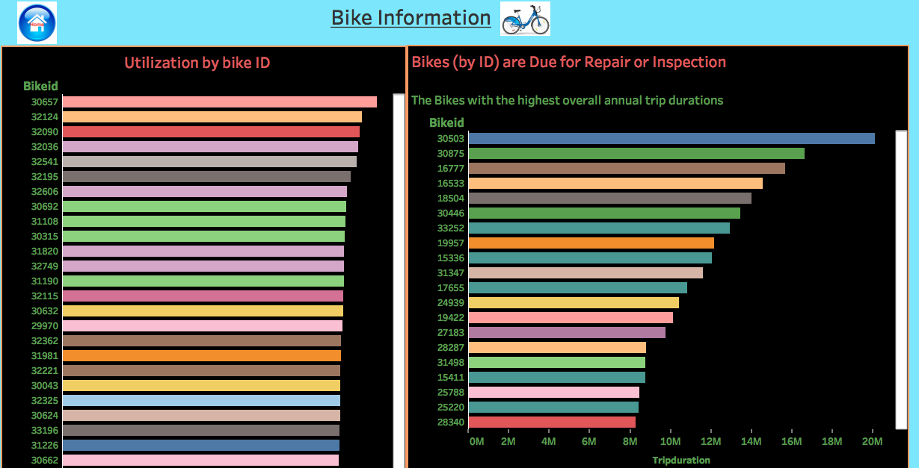

Slide 6
