Slide 1

Sentiment Analysis of Product Reviews
NAME: MINAL DEVIKAR
INSTITUTION: DIGICHROME ACADEMY

Slide 2
OVERVIEW
Introduction to the Project:
Analyzing customer sentiment from product reviews.
Using machine learning algorithms for classification.
Objective: Predict the sentiment (Positive, Neutral, Negative) from the reviews.
Tools Used: Python, Scikit-learn, TensorFlow, TextBlob, Keras

Slide 3
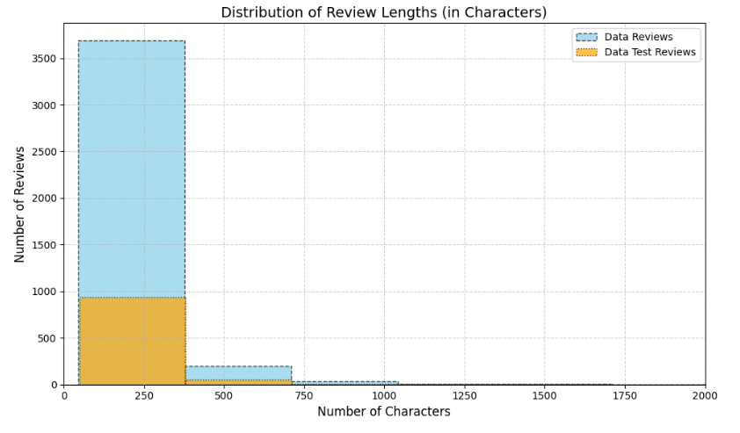
DATA VISUALISATION
The distribution of review lengths is heavily skewed towards shorter reviews, with most having fewer than 250 characters.
- The majority of the dataset consists of "Data Reviews," while "Data Test Reviews" form a smaller subset.
- Few reviews exceed 500 characters, and almost none are longer than 1000 characters.
- The plot indicates a need for handling class imbalance in review length during text preprocessing.

Slide 4

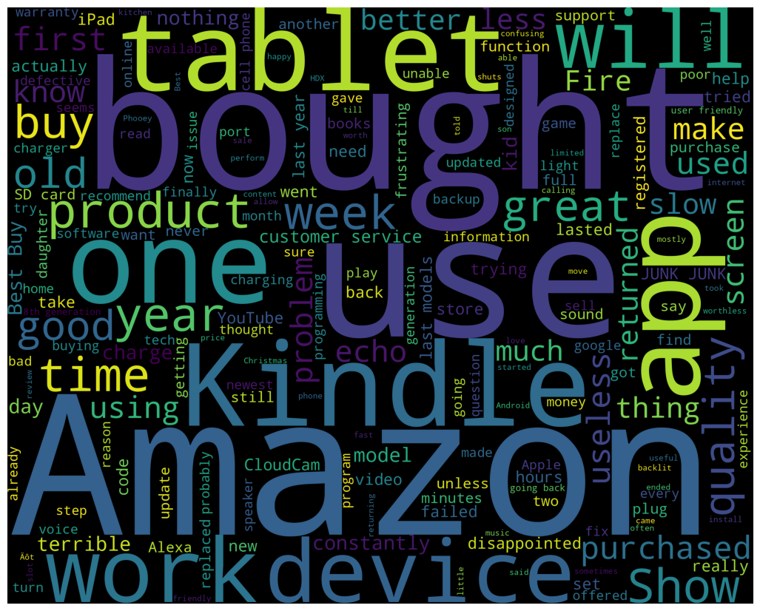
POSITIVE WORDS WORDCLOUD
NEGATIVE WORDS WORDCLOUD

Slide 5
Data Collection & Preprocessing
Data Collection:
Source: Product reviews from an online marketplace.
Columns: Review Text, Review Title, Sentiment Labels (Positive, Neutral, Negative)
Preprocessing Steps:
Text Cleaning (removal of stop words, punctuation, and unnecessary characters).
Tokenization and Lemmatization.
Sentiment label encoding and vectorization.

Slide 6
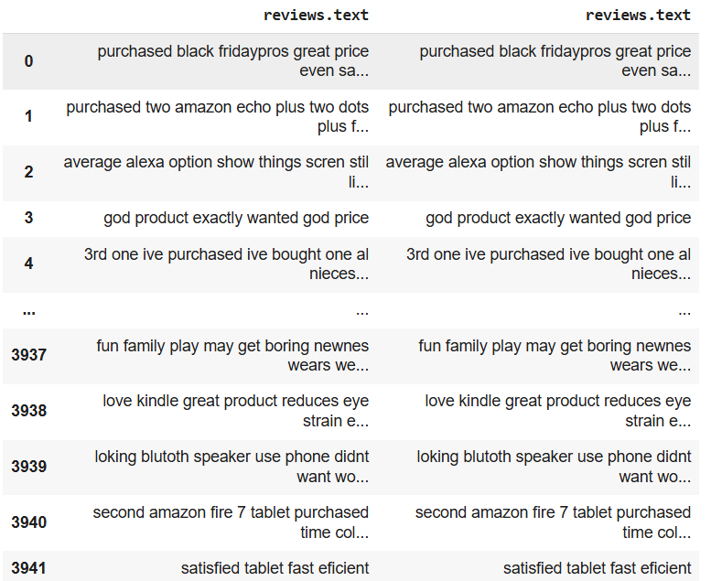
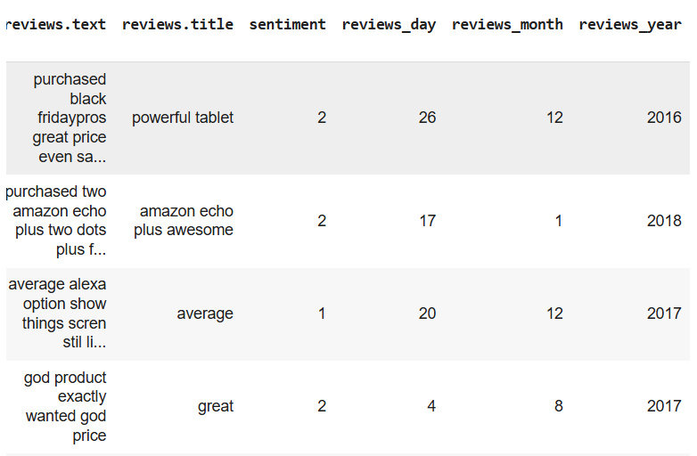
DATE TIME EXTRACTION
CLEANED DATA

Slide 7
Text Vectorization Techniques
TF-IDF VECTORIZER:
Converts text data into a matrix of TF-IDF features.
Weights words according to their frequency and relevance.
COUNT VECTORIZER:
Converts text data into a matrix of token counts.

Slide 8
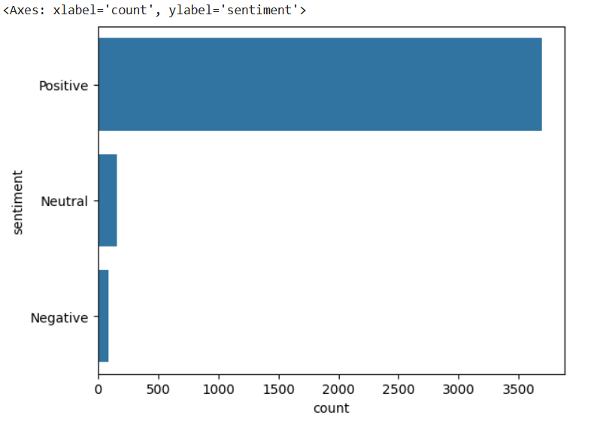
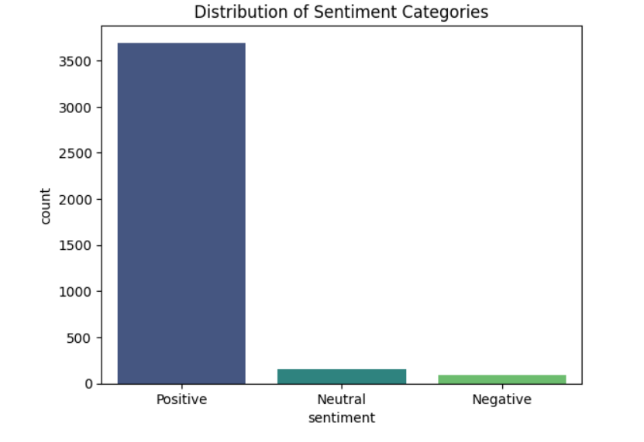
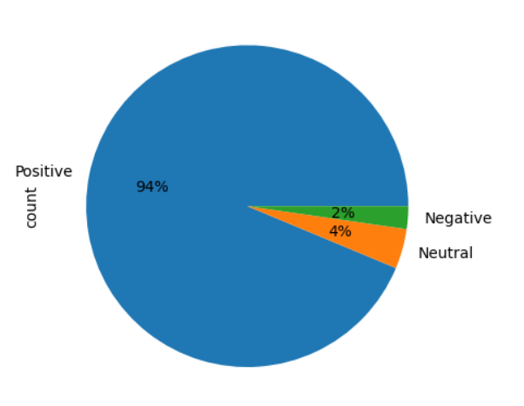
HANDLING CLASS IMBALANCE
The class distribution of the sentiment dataset is as follows:
- Positive - 3749 instances
- Neutral - 158 instances
- Negative - 93 instances
This shows a significant class imbalance, where the "Positive" sentiment dominates the dataset

Slide 9
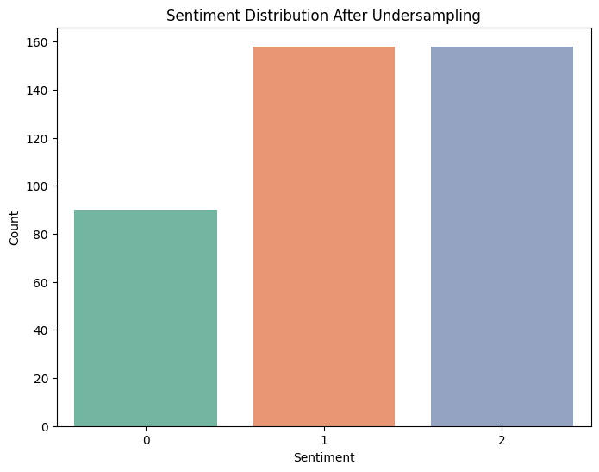
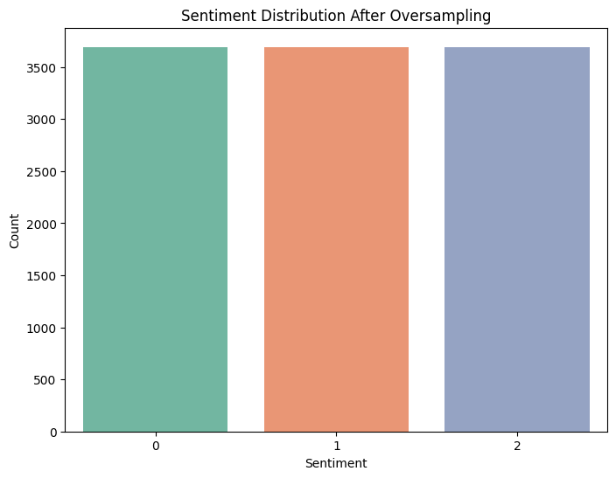
TECHNIQUES TO BALANCE DATA
1. UnderSampling
2. OverSampling

Slide 10
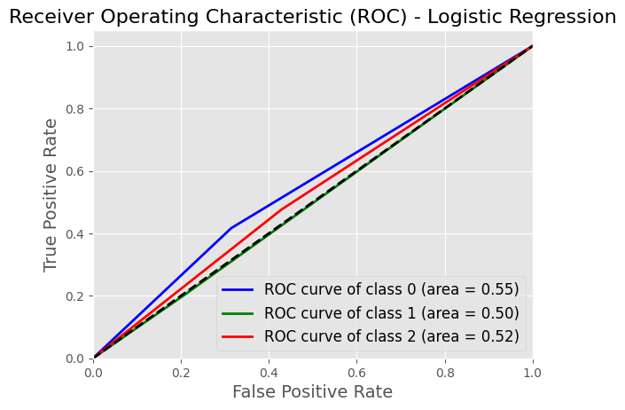
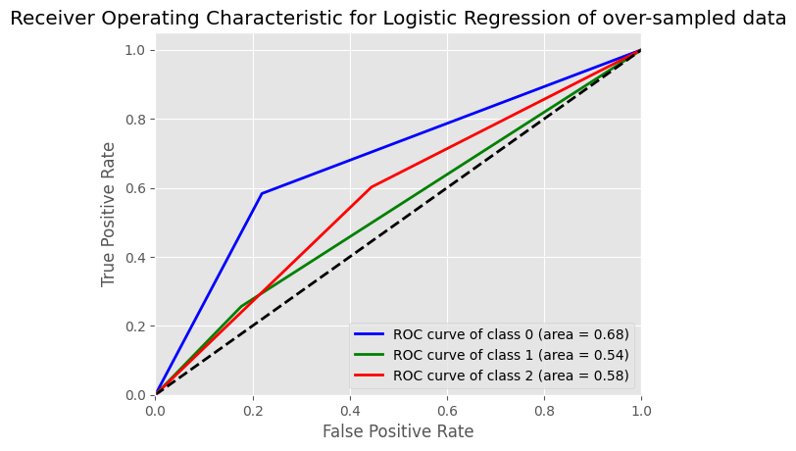
Logistic Regression for under-sampled data
Logistic Regression for over-sampled data
Logistic Regression on over-sampled data is perfrorming better than under-sampled data

Slide 11
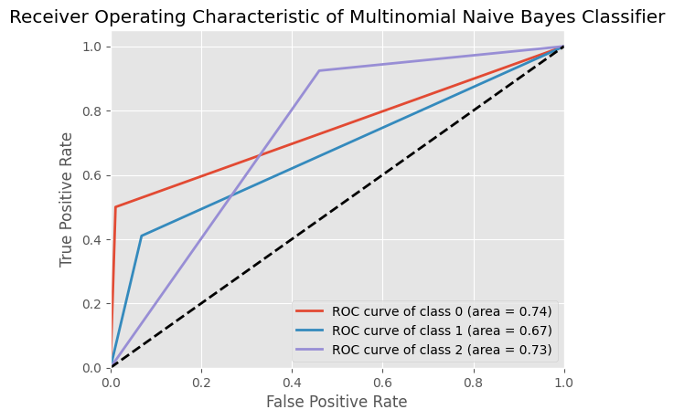
Model Training & Evaluation
Multinomial Naive Bayes model
The ROC curve illustrates the performance of the Multinomial Naive Bayes classifier across three classes.
Area Under the Curve (AUC) shows moderate performance, with Class 0 (AUC = 0.74) outperforming the others.
The classifier demonstrates limited ability to distinguish between certain classes, as seen in the lower AUC for Class 1 (AUC = 0.67).

Slide 12
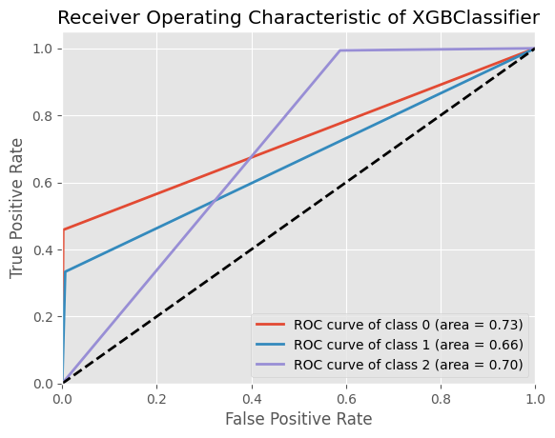
XGBClassifier
XGBoost performs better in predicting all the classes, with a more balanced performance across each class. The model demonstrates strong class separation and higher AUC, especially for underrepresented classes.

Slide 13
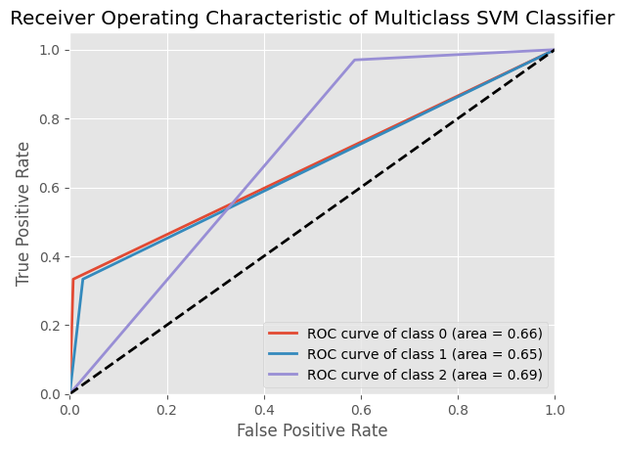
Multiclass SVM classifier
The ROC curve for the Multiclass SVM classifier indicates moderate performance, with AUC values ranging from 0.65 to 0.69 across classes.
Class 2 shows the best separability (AUC = 0.69), while Class 1 has the lowest (AUC = 0.65).
The model struggles with distinguishing certain classes, reflecting a need for better optimization or data balance.

Slide 14
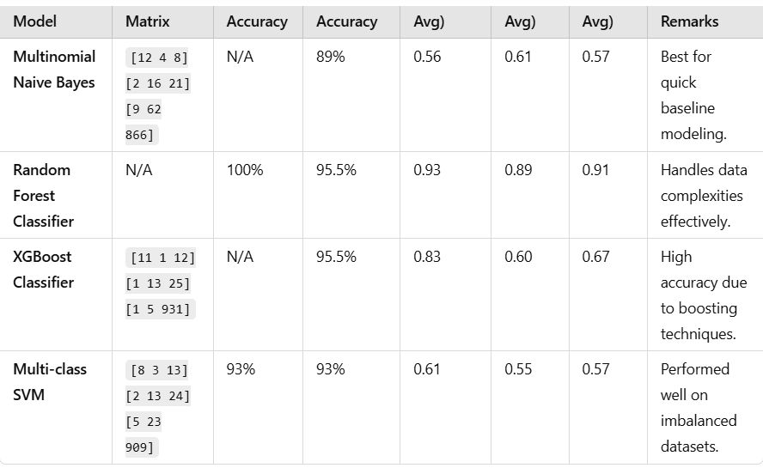
Machine Leaning Model
Confusion Matrices: SVM and XGBoost confusion matrices highlight differences in minority class performance (e.g., Class 0 and Class 1).
Accuracy Comparison: XGBoost achieved the highest validation accuracy (95.5%), while SVM also performed well at 93%.
Remarks on SVM: Effective for imbalanced datasets but lower precision for minority classes.
XGBoost: Excels in both overall accuracy and precise minority class predictions.

Slide 15
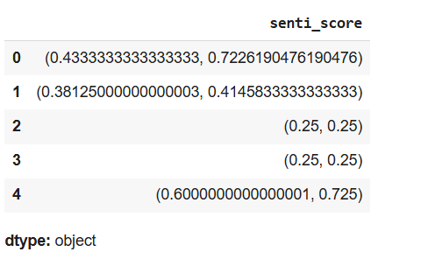
Deep Learning Models
Artificial Neural Networks (ANN):
Multi-layer perceptron for non-linear relationships.
Key Layers: Dense, Dropout.
LSTM (Long Short-Term Memory):
Sequential model for text classification.
Key Layers: LSTM, Embedding, Spatial Dropout.

Slide 16
Key Findings
XGBoost and Random Forest showed superior performance (95.5%).
SVM is a strong choice but slightly behind in accuracy (93%).
MNB struggled with imbalanced data but is computationally efficient
Conclusion & Future Work
Conclusion:
XGBoost excels in both accuracy and class balance.
Deep learning models can be further fine-tuned for complex patterns.
Future Work:
Explore Transformer models like BERT for improved text understanding.
Deploy models to production for real-world applications.

