Slide 1
W1-1: Introduction
JAPN398D: The Sounds and Dialects of Japanese
8/28/2023

Slide 2
Welcome!
Instructor: Dr. Minamida Hitomi (南田 仁美)

Slide 3
Today’s class
Self-introduction
Syllabus
What is linguistics?
Language vs. Dialect

Slide 4

Syllabus
Vance, Timothy J. 2008. The sounds of Japanese. Cambridge University Press.
This book will be reserved at the library.

Slide 5
What is linguistics?
What do you think “linguistics” is?

Slide 6
What is linguistics?
Linguistics is a scientific study of language.
Linguists are interested in “implicit knowledge” of language.
What knowledge do you have, but are not aware of having, about the language(s) you speak?

Slide 7

What is linguistics?
one wug

Slide 8

What is linguistics?
two wugs

Slide 9
What is linguistics?
This test is called the “wug test”.
Your knowledge of language includes rules.
one wug → two wugs
In English, -(e)s is attached to plural nouns.
Much of your knowledge of linguistic rules is implicit.
Native speakers of English do not have to learn how to form plural nouns.
Non-native speakers of English do have to learn how to form plurals.

Slide 10



What is linguistics?
https://www.pokemon.com/us/pokedex
How would you pronounce the plural -(e)s below?
2 Pikachu-s (ピカチュウ)
2 Psyduck-s (コダック)
2 Lapras-es (ラプラス)

Slide 11
What is linguistics?
Linguistic rules also include sound (= phonological) rules.
The plural -(e)s is pronounced in three different ways depending on the environment.
[s] after /t/, /k/, /p/, /θ/, (/f/)
[əz] after /s/, /z/, /∫/, /t∫/, /dʒ/, /ʒ/
[z] elsewhere

Slide 12
What is linguistics?
Non-native speakers of English have to learn the three phonological patterns, but native speakers of English do not.
Pikachu-s [z], Psyduck-s [s], and Lapras-es [əz] also tell us that speech is not always the same as writing.

Slide 13
What is linguistics?
What do you think about the Japanese sentences below?
私は肉が好きなので、たくさん食べれます。
ワシントンDCで、ホワイトハウスが見れます。
朝は自分で起きれます。

Slide 14
What is linguistics?
These sentences are supposed to be bad, according to the prescriptive grammar of Japanese (ら抜き言葉).
私は肉が好きなので、たくさん食べれます。
私は肉が好きなので、たくさん食べられます。
ワシントンDCで、ホワイトハウスが見れます。
ワシントンDCで、ホワイトハウスが見られます。
朝は自分で起きれます。
朝は自分で起きられます。
Notes:
る-verbs (potential)
How can you fix the sentences?

Slide 15
What is linguistics?
Prescriptive grammar
A set of rules designed to give instructions regarding the socially embedded notion of the “correct” or “proper” way or speak or write (Language Files p. 707).
= ら抜き言葉 is BAD because it is not “correct”!
Descriptive grammar
Objective description of a speaker’s or a group of speakers’ knowledge of a language based on their use of the language. (Language Files p. 695)
= ら抜き言葉 is fine because native speakers of Japanese actually use it.

Slide 16
What is linguistics?
In linguistics, descriptive grammar is more valued than prescriptive grammar.
Prescriptive vs. Descriptive
Prescriptive grammar includes explicit knowledge of language.
Descriptive grammar includes implicit knowledge of language.

Slide 17
What is linguistics?
Summary
Linguists are interested in implicit knowledge of language.
Therefore, linguists look at descriptive grammar.
In this class, we study phonetics and phonology.
Phonetics: The study of the sounds of spoken language.
Phonology: The study of the sound system of a language.

Slide 18
Language vs. Dialect
How do they differ?
Is “Standard X” a dialect of the language?

Slide 19
Language vs. Dialect
Mutual intelligibility
A and B are mutually unintelligible. → A and B are languages.
A and B are mutually intelligible. → A and B are dialects.
English and Japanese are two different languages.
American English and British English are dialects of the same language.

Slide 20
Language vs. Dialect
However, the distinction is not clear-cut!
Examples:
Mandarin vs. Cantonese → Are they dialects?
Thai vs. Lao → Are they languages?
Various dialects of English → Are they all mutually intelligible?

Slide 21

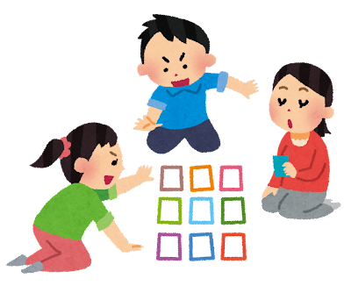
Language vs. Dialect
Maiagare! (舞いあがれ！)
NHK 朝ドラ (morning drama) broadcast in 2022-2023
The drama’s protagonist Iwakura Mai (岩倉舞) from Osaka transfers to an elementary school in the Goto Islands (五島列島), Nagasaki Prefecture, in her childhood.
In the video clip, Mai plays karuta (かるた) with her classmates in the Goto dialect.

Slide 22
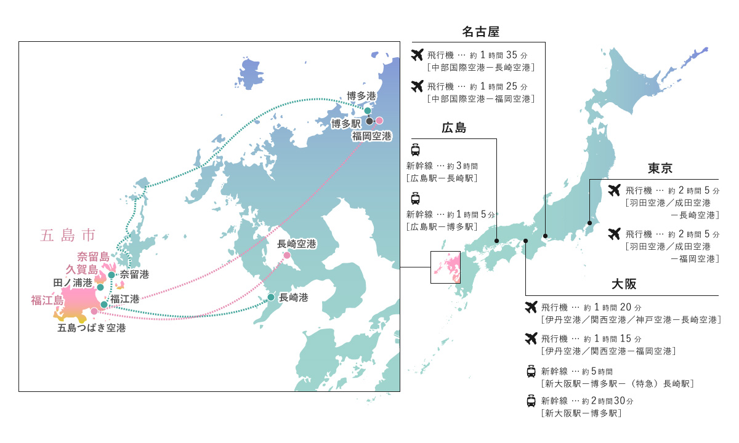
Language vs. Dialect
https://goto.nagasaki-tabinet.com/pamphlet

Slide 23
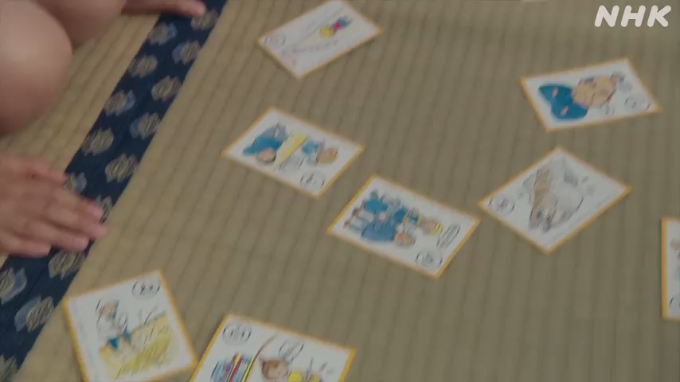
Language vs. Dialect
NHK (2022) Maiagare!

Slide 24
Language vs. Dialect
みんのみんに みんのひゃって みんのみんの いたか
右の耳に 水が入って 右の耳が 痛い
Osaka Japanese and Goto Japanese are mutually unintelligible.
One possible interpretation
Goto Japanese looks mutually unintelligible with (Osaka) Japanese just because み◯ (e.g. 右, 耳, 水) becomes みん.

Slide 25
Language vs. Dialect
Languages of Japan
Japanese
Ryukyuan (spoken in Okinawa)
Ainu (spoken in Hokkaido)
Japanese and Ryukyuan → Japonic
Ainu → Isolate
In this class, I treat the varieties spoken in mainland Japan as Japanese.

Slide 26
Language vs. Dialect
Standard X is a dialect.
The degree of prestige is different.
Some linguists avoid using the word “dialect” (方言) because it has a negative connotation.
These people instead use the word “variety” (ことば).
X Japanese (e.g. Tokyo Japanese, Osaka Japanese, etc.)
X English (e.g. Boston English, New York City English, etc.)
Notes:
Social prestige is arbitrary and political.

Slide 27
Language vs. Dialect
There is a common misunderstanding that non-standard varieties are unsystematic.
Every variety is systematic.
e.g. み◯ (e.g. 右, 耳, 水) → みん in Goto Japanese
You are encouraged to look at non-standard varieties in linguistics.
Why?

Slide 28
References
Department of Linguistics, The Ohio State University. 2016. Language Files (12th edition). Columbus, OH: The Ohio State University Press.
NHK. 2022-2023. 連続テレビ小説『舞いあがれ！』https://www.nhk.or.jp/archives/bangumi/special/asadora/drama/d_107.html
Pokédex https://www.pokemon.com/us/pokedex
五島の島たび：パンフレット https://goto.nagasaki-tabinet.com/pamphlet

