Slide 1
W1-2: English consonants
JAPN398D: The Sounds and Dialects of Japanese
8/30/2023

Slide 2
Today’s class
International Phonetic Alphabet (IPA)
Consonants vs. Vowels
Consonants in English, (Korean, and Mandarin)
3 parameters for consonants
Voicing
Place of articulation
Manner of articulation

Slide 3
International Phonetic Alphabet (IPA)
Phoneticians and phonologists use the International Phonetic Alphabet (IPA) to transcribe speech sounds.
The IPA was invented by the International Phonetic Association.
https://www.internationalphoneticassociation.org/
The IPA symbols are universally recognized.
Most symbols are from the Latin script (e.g. e) and Greek letters (e.g. ɛ).

Slide 4
International Phonetic Alphabet (IPA)
Why do we need the IPA?
There is no one-to-one mapping between writing symbols and sounds.
This is an alternate spelling of a common English word <ghoti>.
goat
gory
forty
fish
goatee

Slide 5
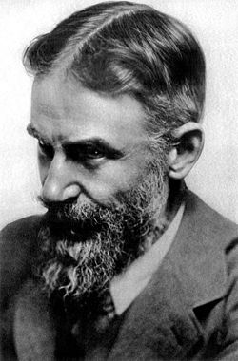
International Phonetic Alphabet (IPA)
<fish> could be spelled <ghoti>!
fish /fɪʃ/
tough /f/
women /ɪ/
nation /ʃ/
George Barnard Shaw
Public Domain

Slide 6
International Phonetic Alphabet (IPA)
Why do we need the IPA?
One word can be pronounced in different ways.
Examples
Grammatical differences: read /ɹid/ (non-past) vs. /ɹɛd/ (past)
Dialectal differences: tube /tub/ (American) vs. /tʃub/ (British)
Idiolectal differences: The language variety of an individual speaker (Language Files, p. 699).

Slide 7
International Phonetic Alphabet (IPA)
Why do we need the IPA?
The Latin alphabet letters can be pronounced in different ways in different languages.
Examples
yes /jɛs/ in English vs. ja /ja:/ in German
ラリルレロ in Japanese → ra, ri, ru, re, ro in ローマ字

Slide 8
Consonants vs. Vowels
How do they differ?

Slide 9
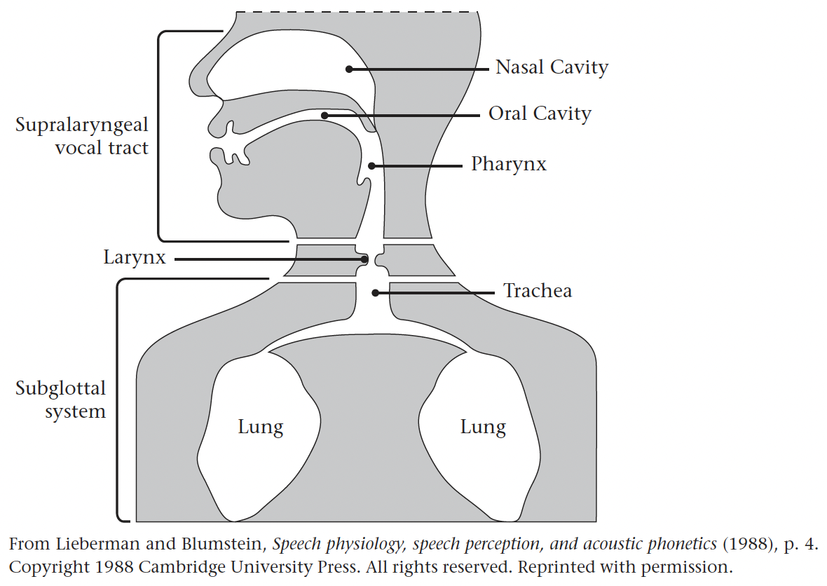
Consonants vs. Vowels
English and Japanese speakers produce sounds by manipulating exhaled air.
Consonants involve a greater or lesser degree of obstruction of the airstream.
Vowels involve no obstruction of air passage—just a change in its shape.

Slide 10
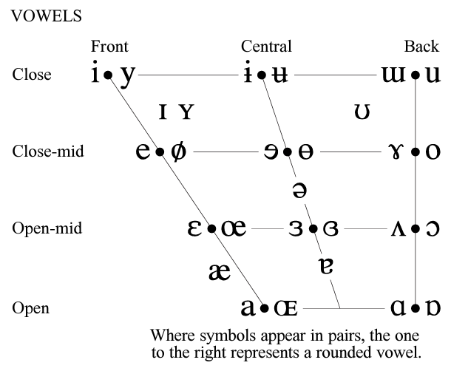
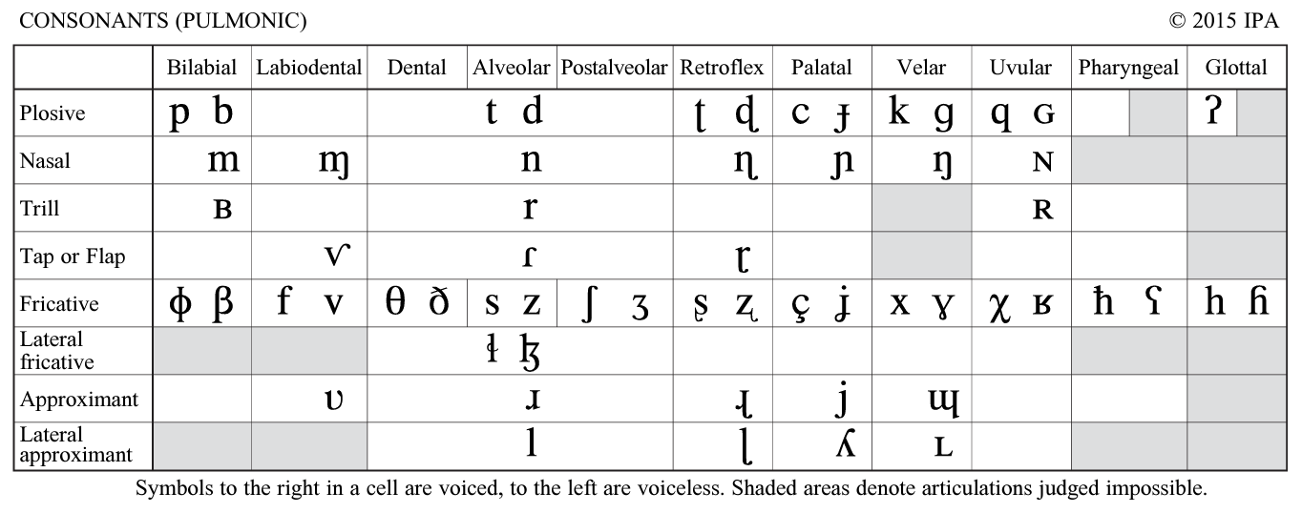
Consonants vs. Vowels
Consonants
Vowels
https://www.internationalphoneticassociation.org/content/full-ipa-chart

Slide 11
English consonants
 | Bilabial |  | Labio-dental |  | Dental |  | Alveolar |  | Post-alveolar |  | Palatal |  | Velar |  | Glottal
Stop | p | b |  |  |  |  | t | d |  |  |  |  | k | ɡ | ʔ
Fricative |  |  | f | v | θ | ð | s | z | ʃ | ʒ |  |  |  |  | h
Affricate |  |  |  |  |  |  |  |  | tʃ | dʒ
Nasal |  | m |  |  |  |  |  | n |  |  |  |  |  | ŋ
Lateral Liquid |  |  |  |  |  |  |  | l
Retroflex Liquid |  |  |  |  |  |  |  | ɹ
Glide |  | w |  |  |  |  |  |  |  |  |  | j
Notes:
25 symbols

Slide 12
English consonants
Zsiga (2013): Table 2.1
IPA | Initial | Final | Medial
p | pat | whip | upper
b | bat | bib | rubber
m | mat | whim | summer
f | fat | whiff | suffer
v | vat | wave | ever
θ (theta) | thigh | with | Ethel
ð (eth) | that | bathe | weather
t | tat | wit | retool
d | data | mid | redo
n | Nat | win | renew
s | sat | miss | presser
z | zap | wiz | buzzer
IPA | Initial | Final | Medial
l | lateral | will | filler
ɹ | rat | where | terror
ʃ (esh) | shack | wish | pressure
ʒ (ezh) |  | beige | measure
tʃ | chat | witch | etcher
dʒ | jack | wedge | edger
k | cat | wick | wrecker
ɡ | gap | wig | mugger
ŋ (engma) |  | wing | singer
h | hat |  | ahead
w | whack |  | away
j | yak

Slide 13
Korean consonants
 |  | Labial |  | Alveolar |  | Alveo-palatal |  | Palatal |  | Velar |  | Glottal
Stop, Affricate | Plain | p ㅂ |  | t ㄷ |  | ʨ ㅈ |  |  |  | k ㄱ
 | Tense | p̬ ㅃ |  | t̬ ㄸ |  | ʨ̬ ㅉ |  |  |  | k̬ ㄲ
 | Aspirated | p^{h}ㅍ |  | t^{h} ㅌ |  | ʨ^{h}ㅊ |  |  |  | k^{h} ㅋ
Fricative | Plain |  |  | s ㅅ |  |  |  |  |  |  |  | h ㅎ
 | Tense |  |  | s̬ ㅆ
Nasal |  |  | m ㅁ |  | n ㄴ |  |  |  |  |  | ŋ ㅇ
Liquid |  |  |  |  | l ㄹ
Glide |  |  | w |  |  |  |  |  | j
Based on Cho & Whitman (2020)

Slide 14
Mandarin consonants
 |  | Bilabial |  | Labio-dental |  | Alveolar |  | Retroflex |  | Alveolo-palatal |  | Velar
Stop | Unaspirated | p (b) |  |  |  | t (d) |  |  |  |  |  | k (g)
 | Aspirated | p^{h} (p) |  |  |  | t^{h} (t) |  |  |  |  |  | k^{h} (k)
Affricate | Unaspirated |  |  |  |  | ts (z) |  | tʂ (zh) |  | tɕ (j)
 | Aspirated |  |  |  |  | c (ts^{h}) |  | tʂ^{h} (ch) |  | tɕ^{h} (q)
Fricative |  |  |  | f (f) |  | s (s) |  | ʂ (sh) | ɻ (r) | ɕ (x) |  | x (h)
Nasal |  |  | m (m) |  |  |  | n (n) |  |  |  |  |  | ŋ (ng)
Lateral |  |  |  |  |  |  | l (l)
Glide |  |  | w (w) |  |  |  |  |  |  |  | j (y)
https://corpus.eduhk.hk/mandarin_pronunciation/?page_id=33
(Pinyin is in the parentheses.)

Slide 15
3 parameters for consonants
Voicing
Vocal fold vibration (voiced) or No vocal fold vibration (voiceless)
Place of articulation
The place in the vocal tract where the constriction for the production of a consonant is made (Language Files, p. 706).
Manner of articulation
How the airstream is modified by the articulators in the vocal tract to produce a consonant (Language Files, p. 702).
e.g. how narrow it is, whether the velum is open, etc.
Notes:
Consonants can be classified using three parameters.

Slide 16
3 parameters for consonants
← front PLACE of articulation → back
MANNER of articulation
Consonants are organized in two dimensions.
Voicing is a third dimension.
Notes:
Place of articulation is represented by the columns of the table.
Manner of articulation is represented by the rows of the table.

Slide 17
Voicing
Voiced sounds are produced when the vocal folds (cords) vibrate.
Voiceless sounds are produced when the vocal folds do not vibrate.
English voiced consonants
b, m, v, ð, d, n, z, l, ɹ, ʒ, dʒ, ɡ, ŋ, w, j
English voiceless consonants
p, f, θ, t, s, ʃ, tʃ, k, h, ʔ
Test for voicing: Larynx touching test

Slide 18
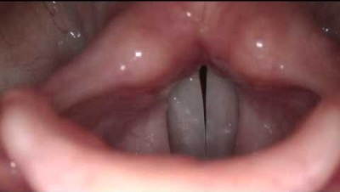
Voicing
https://www.youtube.com/watch?v=9Tlpkdq8a8c

Slide 19
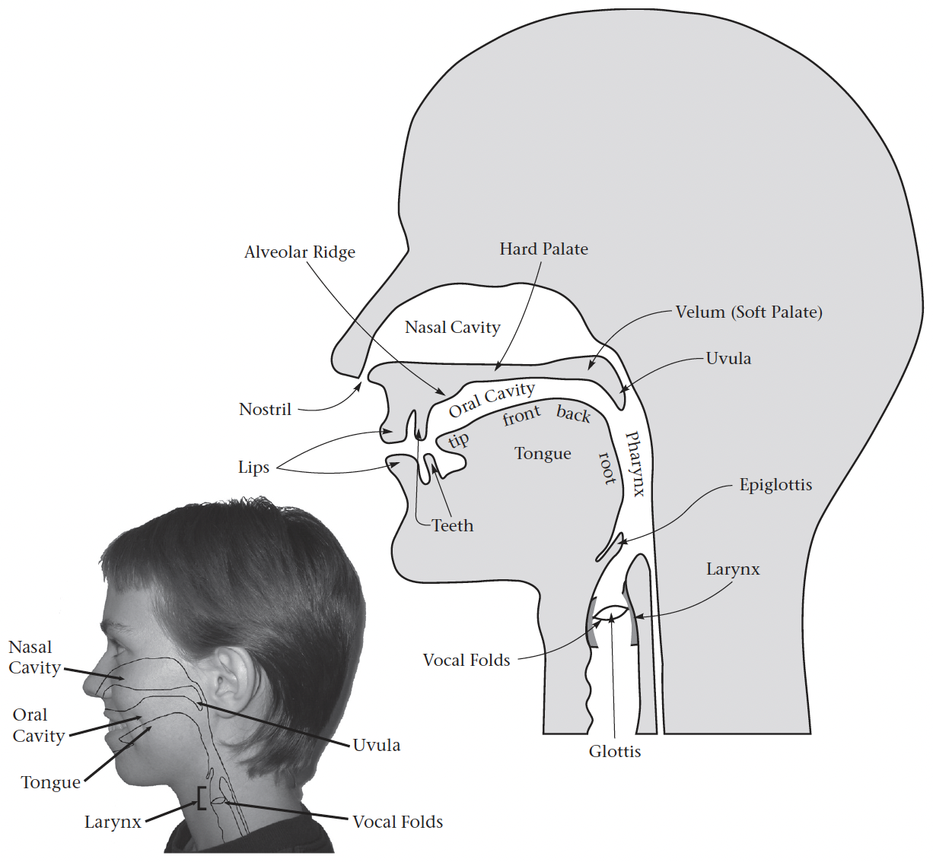
Place of articulation
Bilabial consonants are made with both lips.
p, b, m, w
Labio-dental consonants are made with the lower lip and the upper teeth.
f, v
Language Files, p. 52

Slide 20
Place of articulation
Dental consonants are made with the tongue against the upper teeth.
θ, ð
(Post-)alveolar consonants are made with the tongue against the alveolar ridge.
t, d, s, z, n, l, ɹ
ʃ, ʒ, tʃ, dʒ
Language Files, p. 52
Notes:
Post-alveolar consonants are made a bit further back (just behind the alveolar ridge).

Slide 21
Place of articulation
Palatal consonants are made with the tongue and the hard palate.
j
Velar consonants are made with the tongue and the soft palate.
k, ɡ, ŋ
Language Files, p. 52

Slide 22
Place of articulation
Glottal consonants are made with the glottis.
h, ʔ
A glottal stop ʔ appears before each vowel in uh-oh.
Language Files, p. 52

Slide 23
Manner of articulation
(Oral) stops/plosives are produced with a full closure of the oral cavity.
p, b, t, d, k, ɡ, ʔ
Nasal (stops) are also produced by the same mechanism.
m, n, ŋ

Slide 24
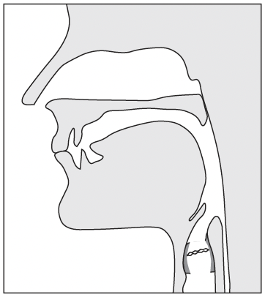
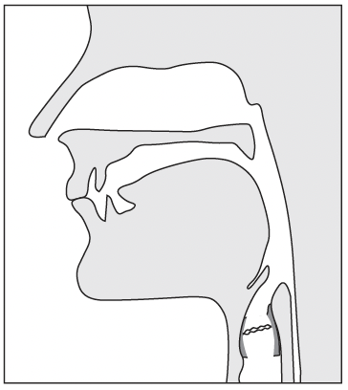
Manner of articulation
Stops and the other oral sounds
Nasals
The velum is closed (raised).
The velum is open (lowered).
Notes:
The air can(not) escape through the nasal cavity.

Slide 25
Manner of articulation
Stops and nasals are minimally different.
Denasalization (nasal → oral)
e.g. m → b, n → d

Slide 26
Manner of articulation
Go-on (呉音): on’yomi based on the Nanjing (南京) pronunciation
美 (mi): e.g. 仁美（ひとみ）
Kan-on (漢音): on’yomi based on the Chang’an (長安) pronunciation
美 (bi): e.g. 美人（びじん）
Word-initial denasalization in Modern Korean
美 (미) mi → bi
e.g. 美人 (미인) miin → biin
Notes:
呉音: names, Buddhist terms

Slide 27
Manner of articulation
Fricatives are produced with a narrow constriction in the oral cavity, generating turbulent airflow.
f, v, θ, ð, s, z, ʃ, ʒ, h
Affricates are a sequence of stop and fricative manners.
tʃ, dʒ

Slide 28
Manner of articulation
Approximants are produced with a narrow constriction, but the constriction is not narrow enough to generate turbulent airflow.
Approximants are divided into liquids and glides.
Liquids: l, ɹ
Glides: w, j

Slide 29
Manner of articulation
Liquids have a narrower constriction than glides.
/l/ in English is called lateral because air passes around both sides of the tongue. = lateral liquid
Vance describes /ɹ/ in American English as a retroflex, which is pronounced with the tongue tip curled up and back. = retroflex liquid
Glides are produced with a slight closure of the oral cavity.
Glides are sometimes called semi-vowels.
Note: I follow the descriptions of /l/ and /ɹ/ in Language Files (p. 57).

Slide 30
Manner of articulation
The conventional order of the three-part articulatory descriptions is Voicing-Place-Manner.
Examples
p: voiceless bilabial stop
ŋ: voiced velar nasal
l: voiced alveolar lateral liquid

Slide 31
Exercise 1
Provide the IPA symbol whose definition is given.
Voiced alveolar stop
Voiceless velar stop
Voiced labio-dental fricative
Voiced alveolar nasal
Voiced alveolar retroflex liquid
Notes:
1. /d/ 2. /k/ 3. /v/ 4. /n/ 5. /ɹ/

Slide 32
Exercise 1
Provide the IPA symbol whose definition is given.
Voiced alveolar stop: /d/
Voiceless velar stop: /k/
Voiced labio-dental fricative: /v/
Voiced alveolar nasal: /n/
Voiced alveolar retroflex liquid: /ɹ/

Slide 33
Exercise 2
Provide the three-part articulatory descriptions for the consonants.
/m/
/f/
/tʃ/
/ɡ/
/θ/
Notes:
1. voiced bilabial nasal 2. voiceless labio-dental fricative 3. voiceless post-alveolar affricate 4. voiced velar stop 5. voiceless dental fricative

Slide 34
Exercise 2
Provide the three-part articulatory descriptions for the consonants.
/m/: Voiced bilabial nasal
/f/: Voiceless labio-dental fricative
/tʃ/: Voiceless post-alveolar affricate
/ɡ/: Voiced velar stop
/θ/: Voiceless dental fricative

Slide 35
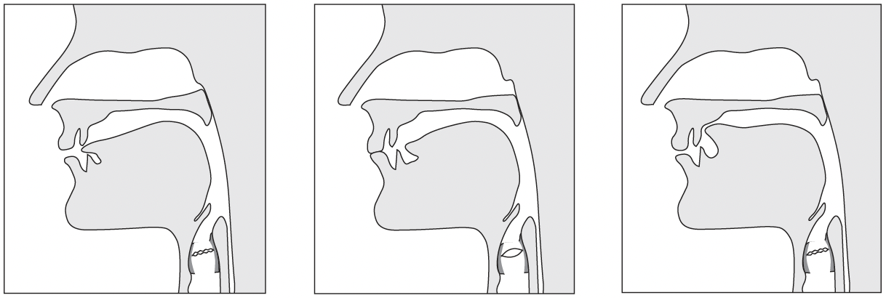
Exercise 3
Each of the diagrams illustrates the articulation of a consonant of English. Specify each of the consonants.
Voicing, Place of articulation, Manner of articulation
Notes:
1. voiced dental fricative /ð/, 2. voiceless bilabial stop /p/, 3. voiced alveolar fricative /v/

Slide 36
Hint
Voiced bilabial stop /b/
Voiced bilabial nasal /m/
The vocal folds vibrate.
The velum is closed (raised).
The vocal folds vibrate.
The velum is open (lowered).

Slide 37
Exercise 3
Each of the diagrams illustrates the articulation of a consonant of English. Specify each of the consonants.
Voicing, Place of articulation, Manner of articulation
Voiced dental fricative /ð/
Voiceless bilabial stop /p/
Voiced alveolar fricative /v/

Slide 38
References (1/2)
Cho, Sungdai, and John Whitman. 2020. Korean: A linguistic introduction. Cambridge University Press.
Corpus-based Mandarin Pronunciation learning System. 2023. Mandarin phonology. https://corpus.eduhk.hk/mandarin_pronunciation/?page_id=33
Department of Linguistics, The Ohio State University. 2016. Language Files (12th edition). Columbus, OH: The Ohio State University Press.

Slide 39
References (2/2)
IPA Chart, http://www.internationalphoneticassociation.org/content/ipa-chart, available under a Creative Commons Attribution-Sharealike 3.0 Unported License. Copyright © 2015 International Phonetic Association.
Liberman, Philip, and Sheila E. Blumstein. 1988. Speech physiology and acoustic phonetics. Cambridge University Press.
Zsiga, Elizabeth C. 2013. The sounds of language: An introduction to phonetics and phonology. Wiley-Blackwell.

Slide 40
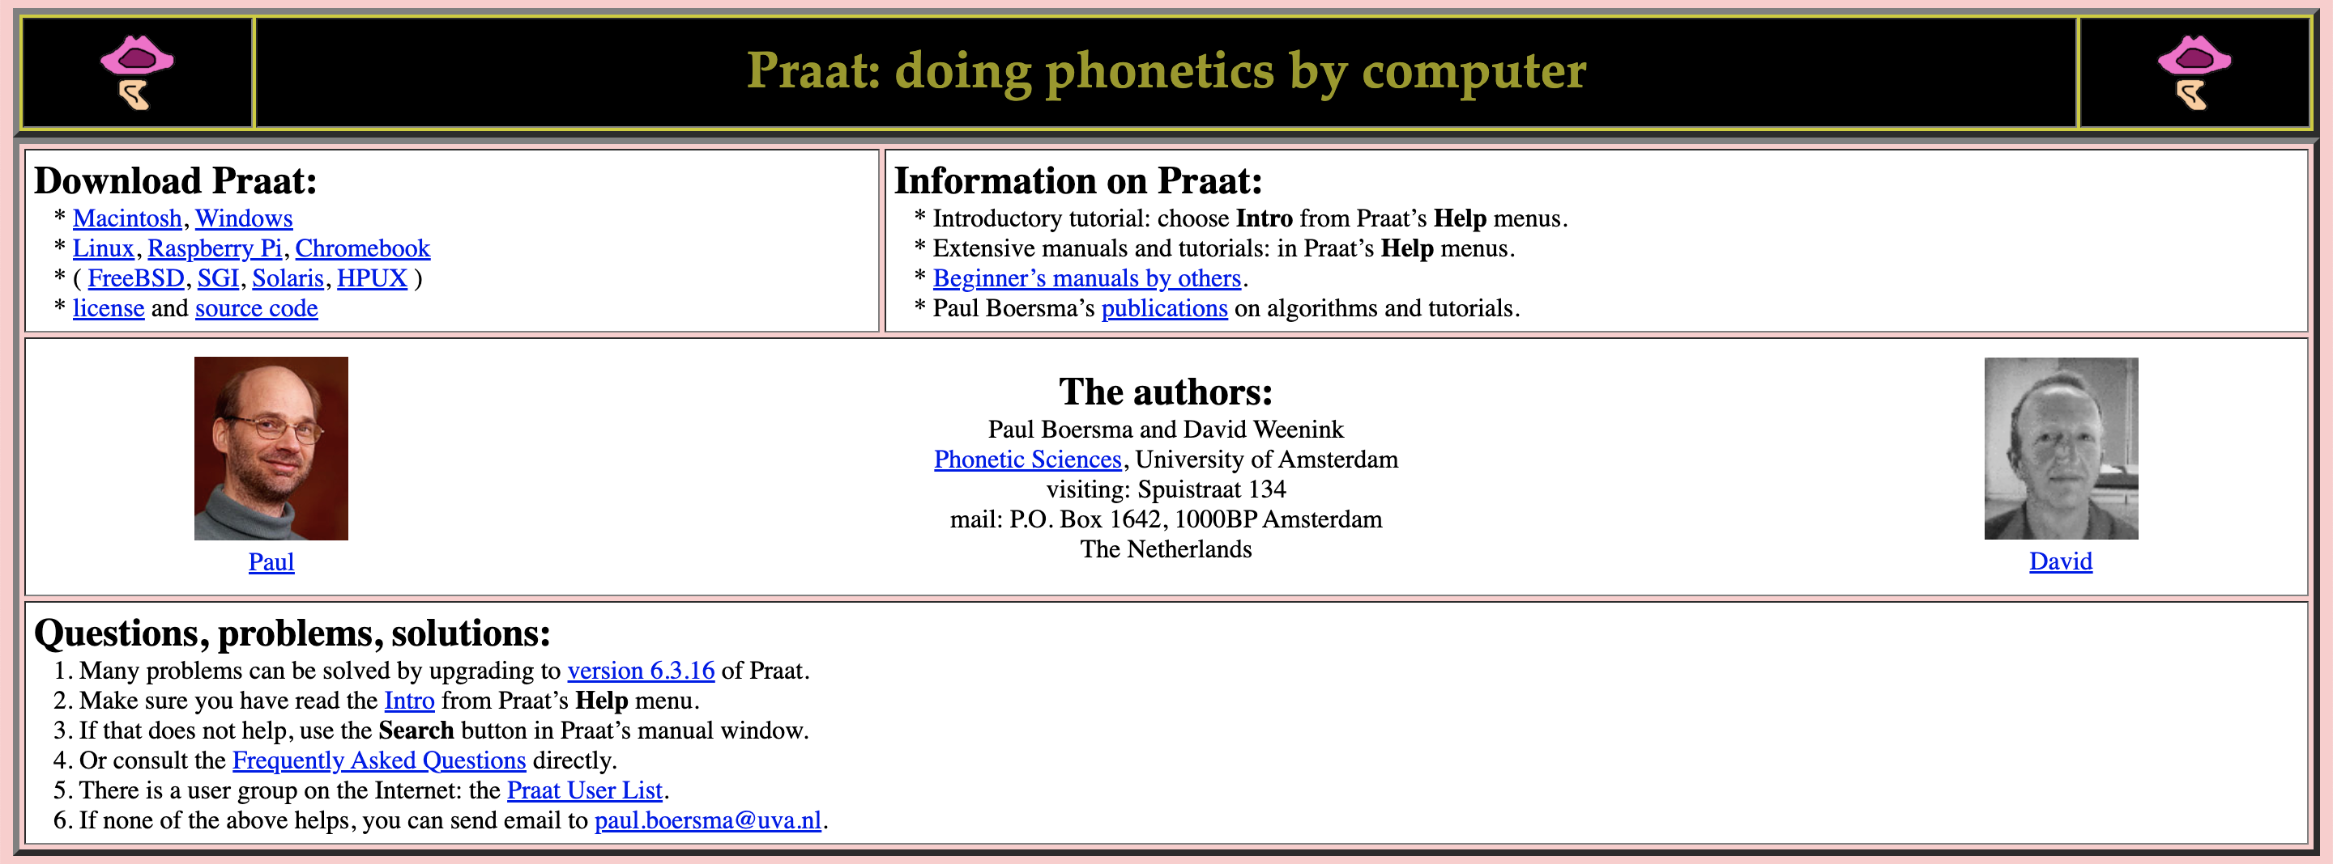
Praat
https://www.fon.hum.uva.nl/praat/
Notes:
https://www.fon.hum.uva.nl/praat/

