Slide 1
D3 – Maptime Davis
D3 is a JavaScript library which works with HTML SVG and CSS.
It uses a data driven approach to DOM manipulation

Slide 2
D3 is a language for data visualization created by Mike Bostock
D3 is a javascript library which works with HTML SVG and CSS.
It uses a data driven approach to DOM manipulation

Slide 3
DOM: Document object Model
It is an application programming language
Manipulate HTML (By document I mean a web address)

Slide 4
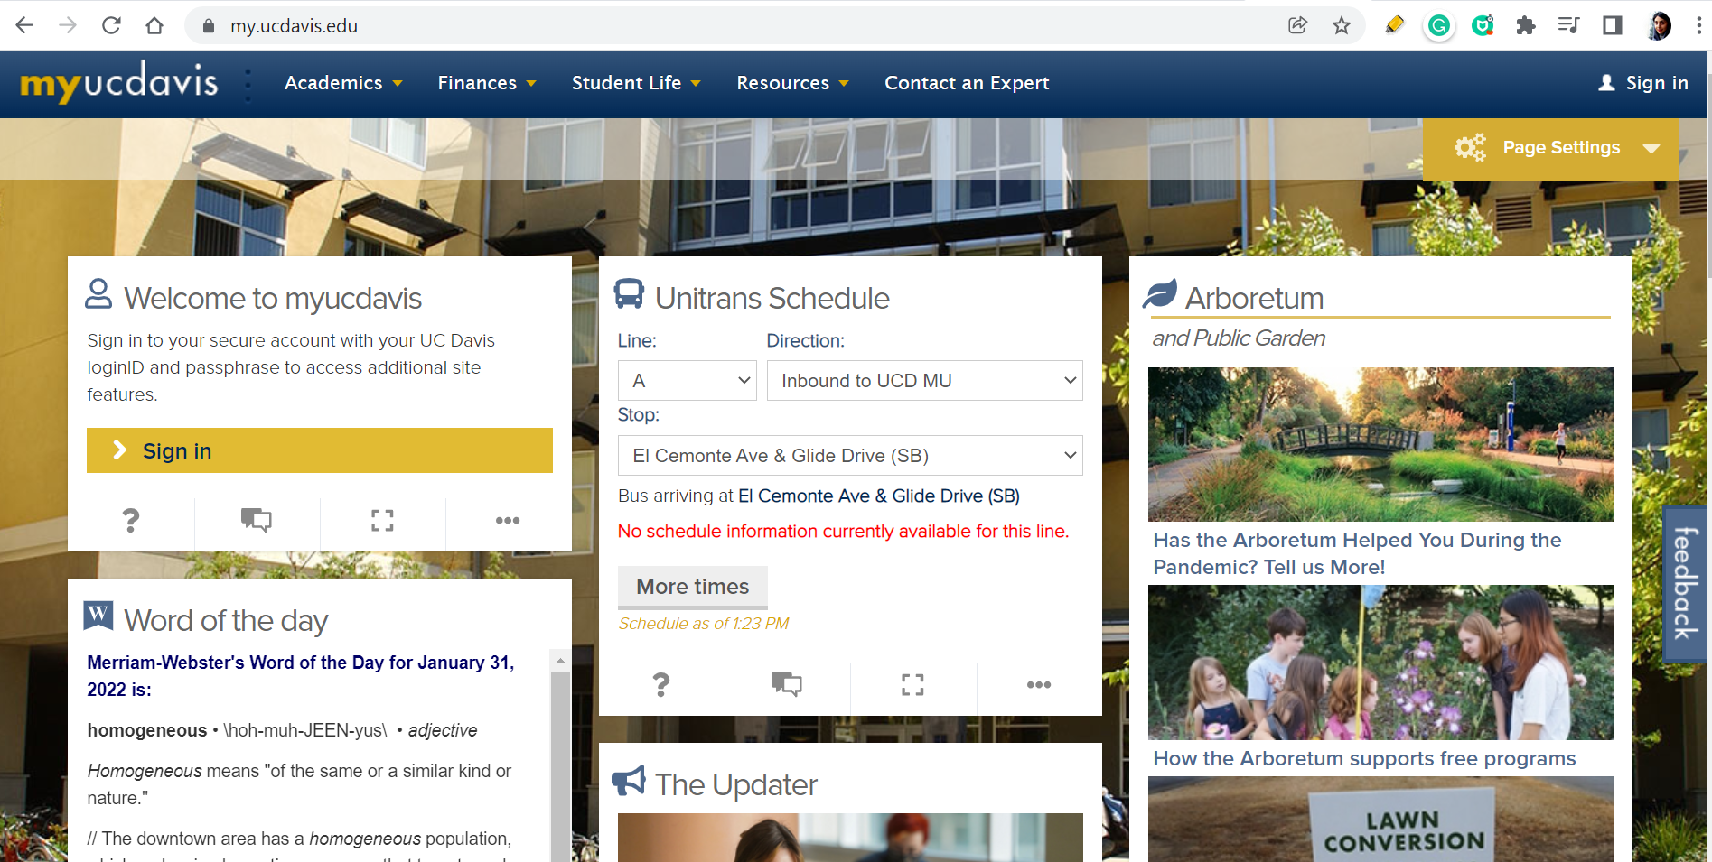
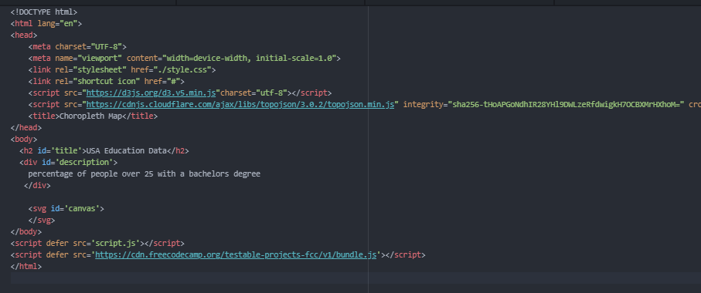
Confusing? Lets go in to more details:

Slide 5
Now- time for Java Script
JS design behavior of a webpage

Slide 6
Now- time for Java Script
const and Var, let () is used to define variables . They must be assigned to a value

Slide 7
Now- time for Java Script
const car = {type:"Fiat", model:"500", color:"white"};

Slide 8
Now- time for Java Script
Another way to define variables is using var()

Slide 9
Now- time for Java Script
Function()
is a block of code designed to perform a particular task

Slide 10
Now- time for Java Script
let x = myFunction(4, 3); // Function is called, return value will end up in x function myFunction(a, b) { return a * b; // Function returns the product of a and b } Var data [400, 300, 500]
function(d){return d/10*4;})

Slide 11
J Query
Library of javascript which simplify javascript

Slide 12
J Query
.attr function:
The attr() method sets or returns attributes and values of the selected elements.
.attr (height, 4)

Slide 13
SVG
it provides options to draw different shapes such as Lines, Rectangles, Circles, Ellipses, etc.

Slide 14
D3 what we will learn?
-data binding
-map projections
-some ways of drawing map

Slide 15
SVG and D3
Binding data to elements
d3.select ('div')
.selectAll('p')
.data([1,2,3])
.enter()
.append('p')
.text(dta=>dta)
The data() method is the very soul of D3. With it, an array of data is bound to page elements.

Slide 16
Start with small visualization
Cities | Number of people over 15 years old
Davis | 400
Sacramento | 600
Vacaville | 100

Slide 17
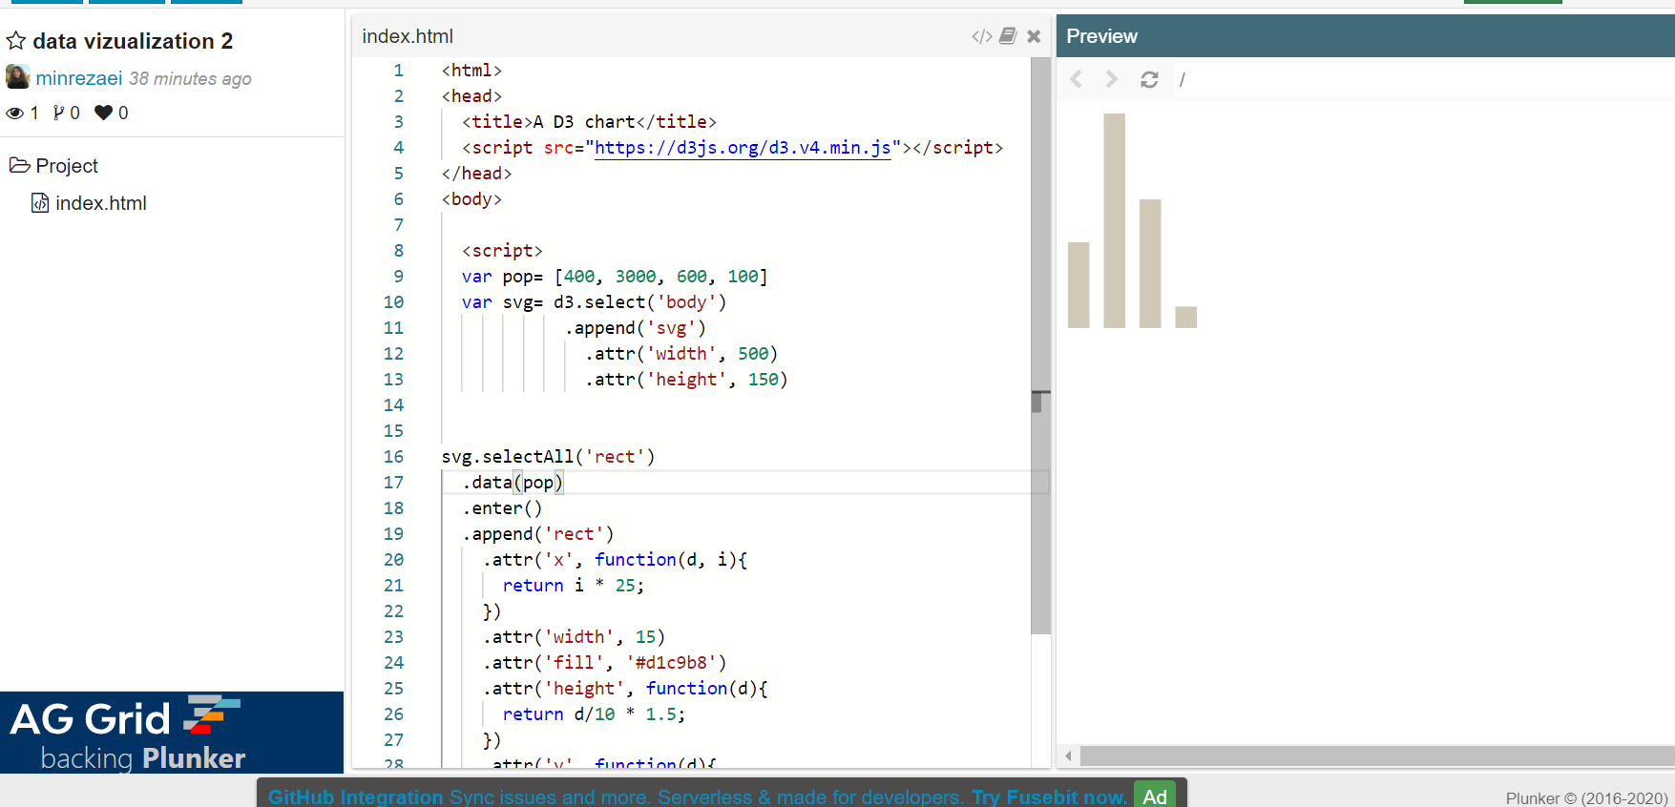
append() - Appends a new element with the specified name as the last child of each element in the current selection, returning a new selection containing the appended elements.
First : create a SVG so our bars will have a place!
2-now we select all rectangles in svg

Slide 18
Making a map
What we should do for making the map? - Loading and parsing the files -Map projections -Render geographic features

Slide 19
G is for grouping the svg elements d3.geoAlbers: for making the 2d map d3.geopath: given a GeoJSON geometry or feature object, it generates an SVG path data string or renders the path to a Canvas

Slide 20
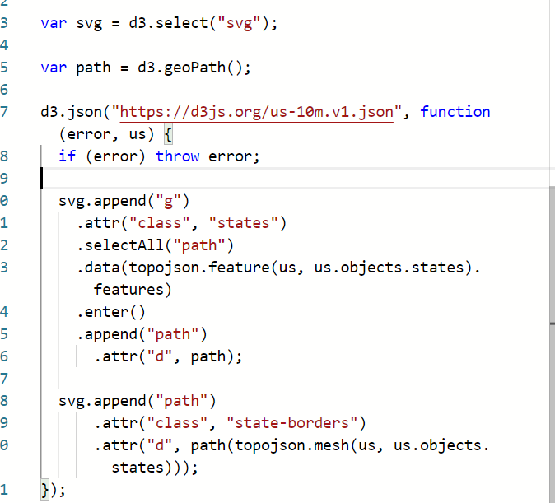
First : g groups all elements in SVG
First : topojason.feature: convert topojason to Geojason

Slide 21
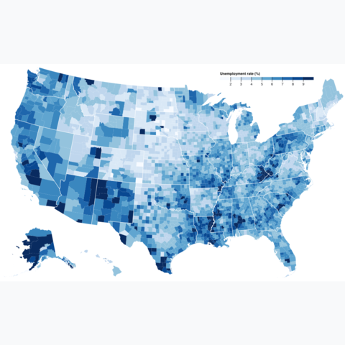
Choropleth map A choropleth map displays divided geographical areas or regions that are coloured in relation to a numeric variable. It allows to study how a variable evolutes along a territory.

Slide 22
d3.scaleThreshold
https://github.com/d3/d3-scale-chromatic
Lets explore d3 geo package too
https://github.com/d3/d3-geo

Slide 23
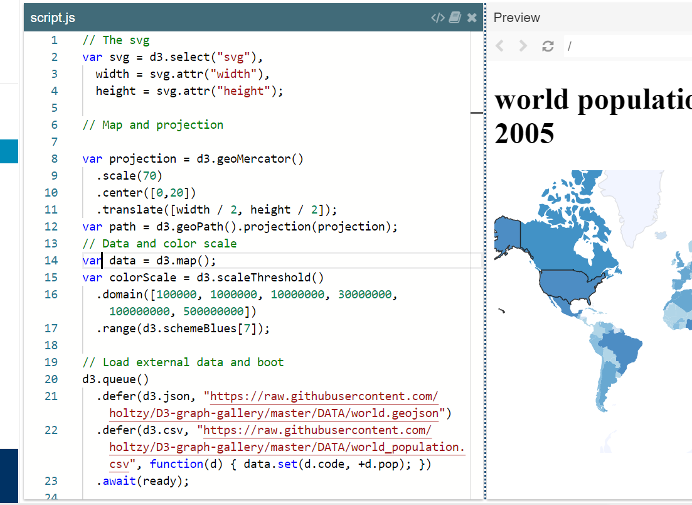
The map.values() function in D3.js used to return an array of values for every entry in the created map. The order of the returned values are arbitrary.
A queue evaluates zero or more deferred asynchronous tasks with configurable concurrency: you control how many tasks run at the same time. When all the tasks complete, or an error occurs, the queue passes the results to your await callback

Slide 24
Open the csv.file either on your browser or save it to an excel file , you will see data.code and data.pop, this function is putting those field as data to the data set

Slide 25
For your future practice check D3 gallery by Mike Bostock on observable: The Natural Earth website provides a variety of data in shape file, you can convert it to topojson and Geojson easily using mapshaper . This example is a good one for making choropleth map, the instruction is in text and also video. This example shows a choropleth map with legend ( it is as easy as it was in our practice) D3 is evolving , new functions, methods and features are being added so make sure to check out the github. Do not forget the “google” your problems, stackoverflow is also a good source to find answers to your questions. Our practice could be run on the local host, but when we have bigger data, it needs online code play grounds. I use Plunker, but Vizhub is also good.
RESOURCES

