Slide 1


Famous event in history (Title of the event)
One sentence summarizing the event, or a famous quote about the event.
BY- MINARVA,KRISHNA MOHAN,MADHUSMITA,MANAJ.

Slide 2
CONTENTS
Introduction to Data Science
Data science life cycle
Role of statistic and linear algebra in data science
Role of python in data science
Full discusion on ML,DL,AI,big data,data analysis
Data science application
Advantages n disadvantages of data science
Conclusion

Slide 3
WHAT IS DATA SCIENCE?
Data science is preparing data for analysis.
Data science is an multidisciplinary field that uses scientific methods to extract insights from structured and unstructured data, and manipulate it to solve problems in a wide range of application domains.
Data science combines multiple fields, including statistics,artificial intelligence (AI),machine learning(ML),deep learning(DL) and data analysis.

Slide 4
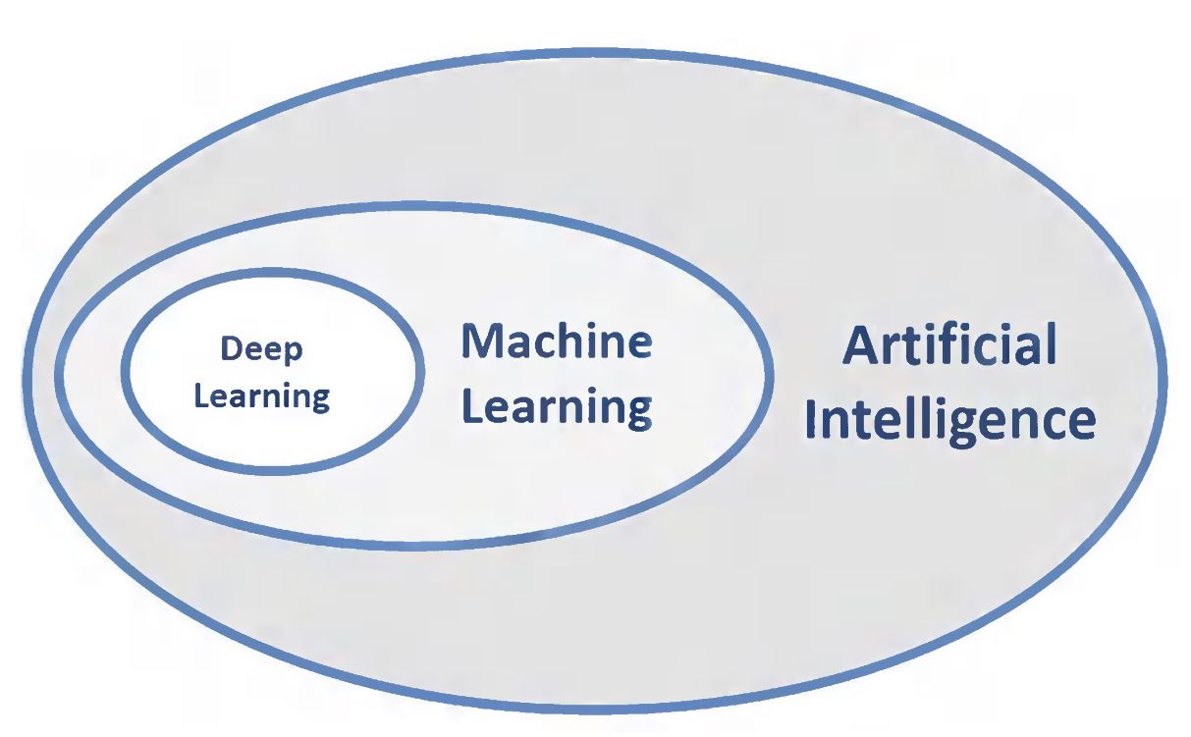
ARTIFICIAL INTELLIGENCE(AI):
The ability of a computer or a robot controlled by a computer
to do tasks that are usually done by humans.
MACHINE LEARING(ML):
It is a system of computer algorithms that have ability to
automatically learn and improve from experience without
being explicitly programmed.
DEEP LEARNING(DL):
Deep learning is a class of machine learning algorithms that
uses multiple layers to progressively extract higher-level
features from the raw input.

Slide 5
DATA SCIENCE LIFE CYCLE:
DATA SCIENCE LIFE CYCLE
Business understanding
Data mining
Data cleaning
Data exploring
Feature engineering
Predictive engineering
Data visualization

Slide 6
Business understanding:
Understand the project objectives and requirements from a business perspective.
Data mining:
process used to extract usable data from a larger set of any raw data. It implies analysing data patterns in large batches of data using one or more software.
Data cleaning:
the process of fixing or removing incorrect, corrupted, duplicate, or incomplete data within a dataset.
Data exploring:
Exploration allows for deeper understanding of a dataset, making it easier to navigate and use the data later.

Slide 7
Feature engineering:
Feature engineering is the process of using domain knowledge to extract features(characteristics, properties, attributes) from raw data.
Predictive Modeling:
Predictive modeling is a method of predicting future outcomes by using data modeling. It’s one of the premier ways a business can see its path forward and make plans accordingly.
Data visualization:
Data visualization is the graphical representation of information and data. By using visual elements like charts, graphs, and maps, data visualization tools provide an accessible way to see and understand trends, outliers, and patterns in data.

Slide 8
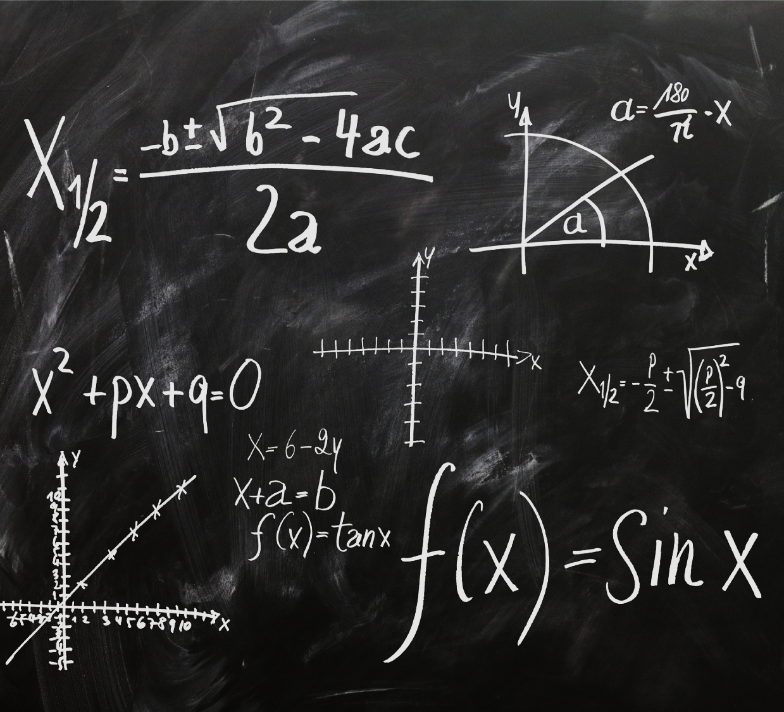

Title for the picture
Include your thesis or major claim regarding the event in history you are discussing.
Find a picture that captures the historical event you are discussing and provides a visual for your audience.

Slide 9
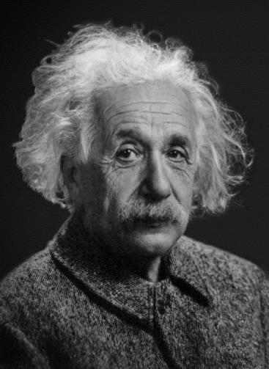
Name of important person for the historical event
Explain this person’s role or involvement in the event.

Slide 10
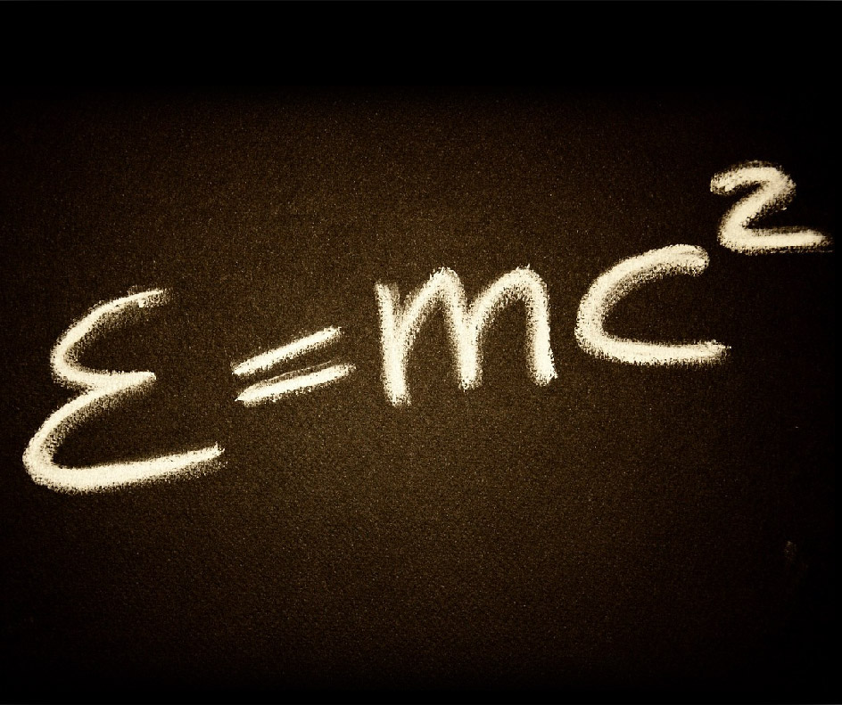
Title for the photo goes here
Insert photo (in the box to the right) supporting your thesis or claim sentence.
Explain how this photo supports your thesis or claim sentence.

Slide 11
THE GOAL IS TO TURN DATA INTO INFORMATION, AND INFORMATION INTO INSIGHTS
BY-Carly Fiorina

Slide 12
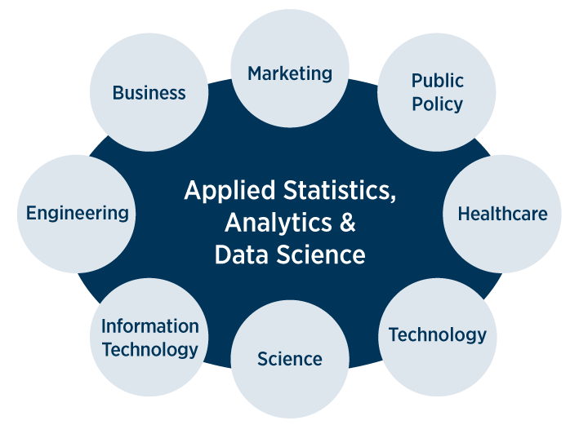
APPLICATION OF DATA SCIENCE:

Slide 13
ADVANTAGES
DISADVANTAGES
It’s on demand and Abundance in positions.
A highly paid career and job opportunities.
Data science is versatile.
Data science makes the task easier.
Customize the products..
A large number of domain knowledge is required.
Arbitrary data may yield unexpected results.
The problem of data privacy/security.
Complexity.
Not cost effective.

Slide 14
conclusion:

Slide 15

Influence & Conclusion
Explain to your audience the influence this historical event had on the world
Restate your thesis or claim sentence.

