Slide 1
Machine Learning
Yelp Review Data

Slide 2
The Question:
Given that reviews are highly subjective, and star ratings can be influenced by various aspects of business performance, can we use machine learning to standardize the interpretation of reviews?

Slide 3
The Data
Yelp Reviews (Subset)
Via Kaggle: https://www.kaggle.com/yelp-dataset/yelp-dataset
Quick Numbers:
Total Businesses | 174,567
Total Users | 1,326,101
Total Reviews | 5,261,668
Total Files | 7
Total Size | 5.53 GB

Slide 4
Constraints / Assumptions
Limit scope to Restaurants, Bars, Other Food and Drink Related Establishments
Focus only on Reviews; Text, Star Ratings
 | Entire Dataset | Restaurants Only
Businesses | 174,567 | 72,103
Users | 1,326,101 | 960,561
Reviews | 5,261,668 | 3,636,641
Files | 7 | 2
Size | 5.53 GB | 3.82 GB

Slide 5
Hypothesis: Users fall into discrete behavior groups
Can we use ML to cluster users into distinct groups based on star rating behavior?
Perhaps there are users who only rate when extremely happy or upset (rate at extremes), users who rate moderately, etc.
Approach: Use unsupervised machine learning to identify groups
K-Means Clustering
Can also be used to feed subsets of data to text-based analyses performed by team

Slide 6
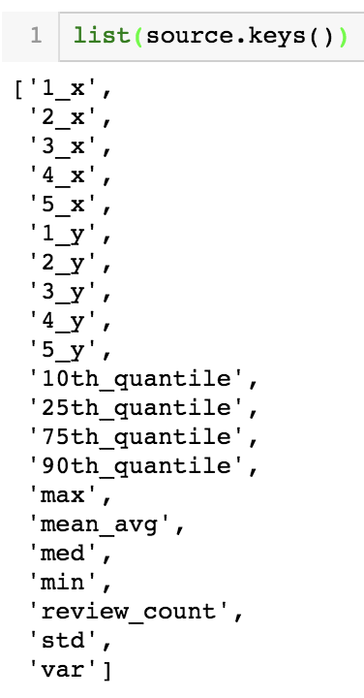
Features
Star Rating Distribution; Percentages of 1-star reviews, 2-star reviews, etc.
Review Counts
Rating Distribution Statistics per User: Mean, Median, Variance, etc.
Note: x and y correspond to the percentage of reviews with a given star rating out of all reviews written by that user and the raw count, respectively.

Slide 7
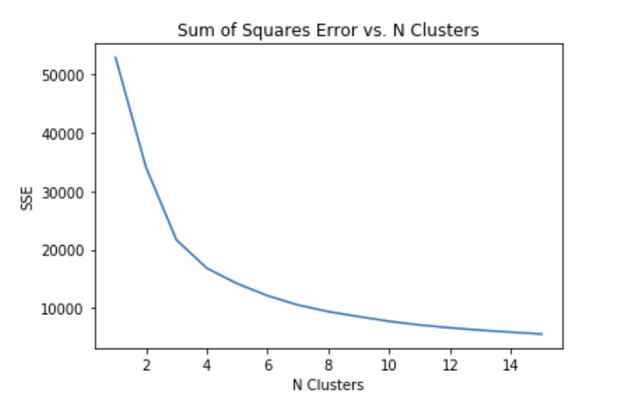
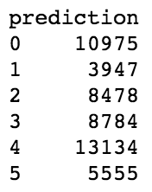
Execution
Library: sklearn
N Clusters: 6
Resulting counts of users in each cluster:
Qualitative estimate of “the knee”

Slide 8
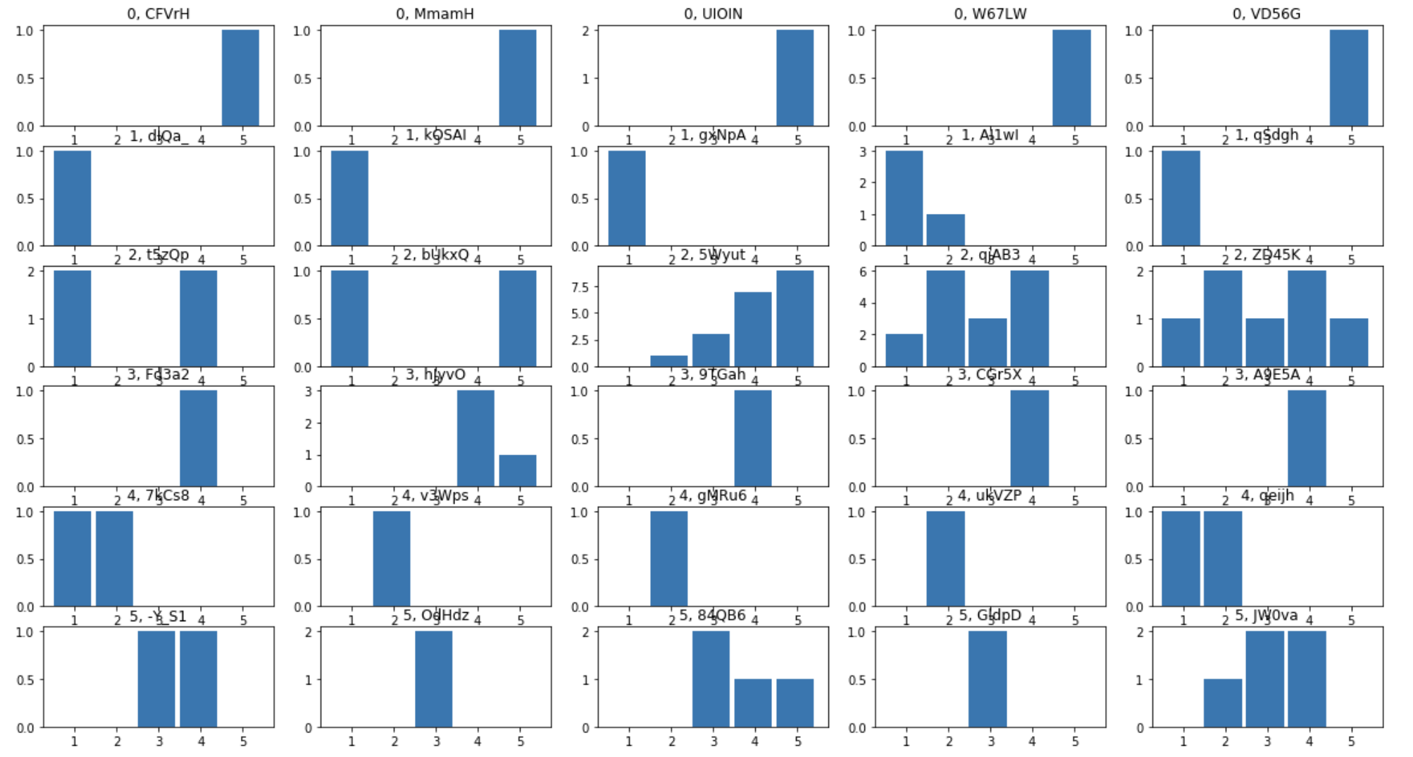
Samples per Cluster
Each Row is a random sample of user’s rating distribution from each of the clusters determined by K-Means.

Slide 9
Challenges
Since n features > 2, data cannot be well represented graphically to confirm if clusters make sense
Instead, samples plotted from each predicted cluster to qualitatively check for similarities
Difficulty determining if ML model is accurate or if hypothesis can be truly accepted or rejected

Slide 10
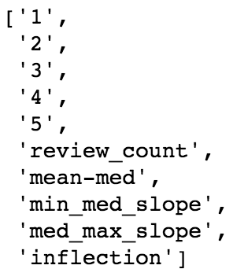
Refining Clusters
Assumption: Users with fewer than 10 ratings provided are too sparse to draw conclusions about their behavior. (10 is arbitrarily chosen)
Reduced # Users: 960,561 → 64,986
N Clusters selection: Select largest N that provides greater than 10% reduction in Sum of Squares Error
Input Features:

Slide 11
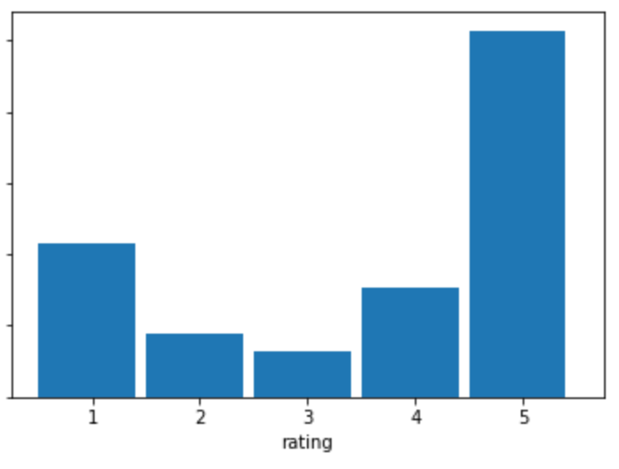
Derived Input Features
Key | Metric | Definition | Intent
1 | Mean-Med | Difference between Mean and Median Value | Rough Approx. of Skew
2 | Min-Med Slope | Slope in Percentage Points from Min to Med
3 | Med-Max Slope | Slope in Percentage Points from Med to Max
4 | Inflection | Product of <2> and <3> | Reveals if trend is constant or bell-shaped
3
2
4
= -x
Inflection is negative if the two slopes are in opposite directions.

Slide 12
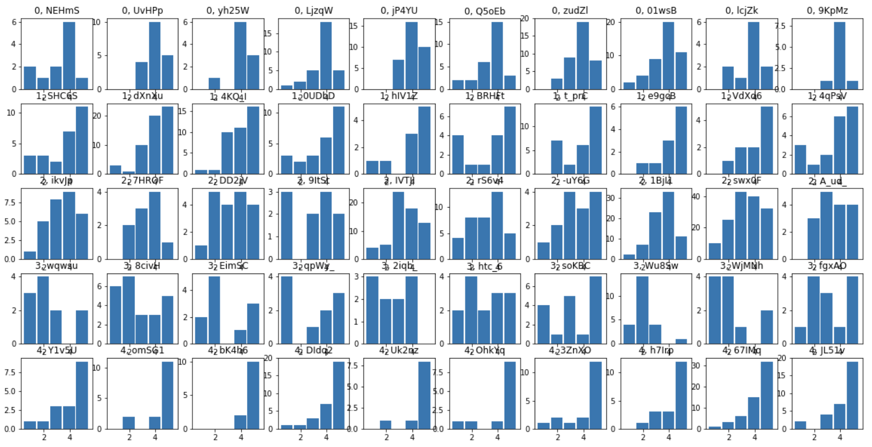
Clustering (Attempt 2)
Each Row is a random sample of user’s rating distribution from each of the clusters determined by K-Means.

Slide 13
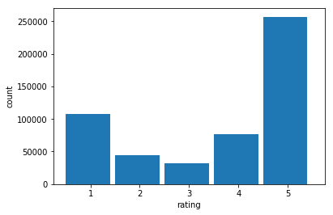
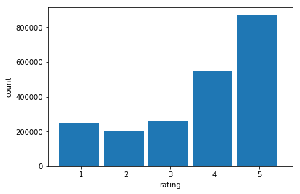
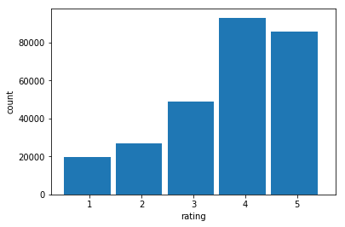
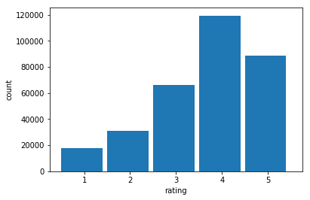
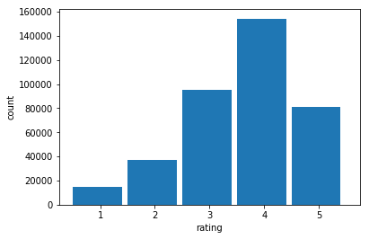
Other Findings
1 Review Only
1-30 Reviews
As Users write more reviews, the distribution of star ratings given become more and more normal. Otherwise, ratings are more commonly given on the extremes.
30-50 Reviews
50-100 Reviews
100-1000 Reviews

Slide 14
Appendix
Code

Slide 15
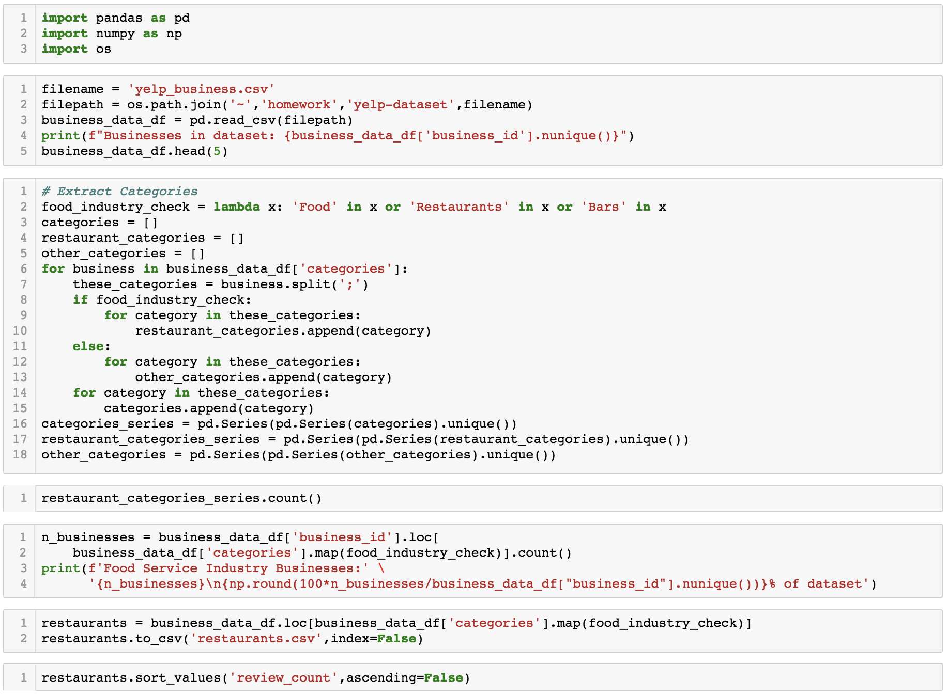
Isolating Restaurants/Food Service

Slide 16
Isolating Restaurants (continued)

Slide 17
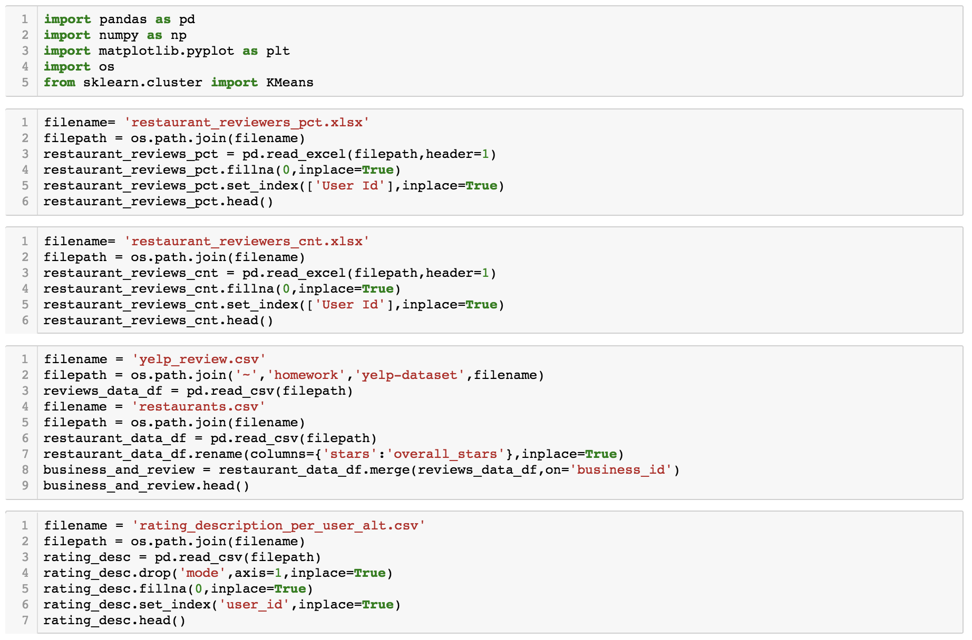
K-Means Clustering

Slide 18
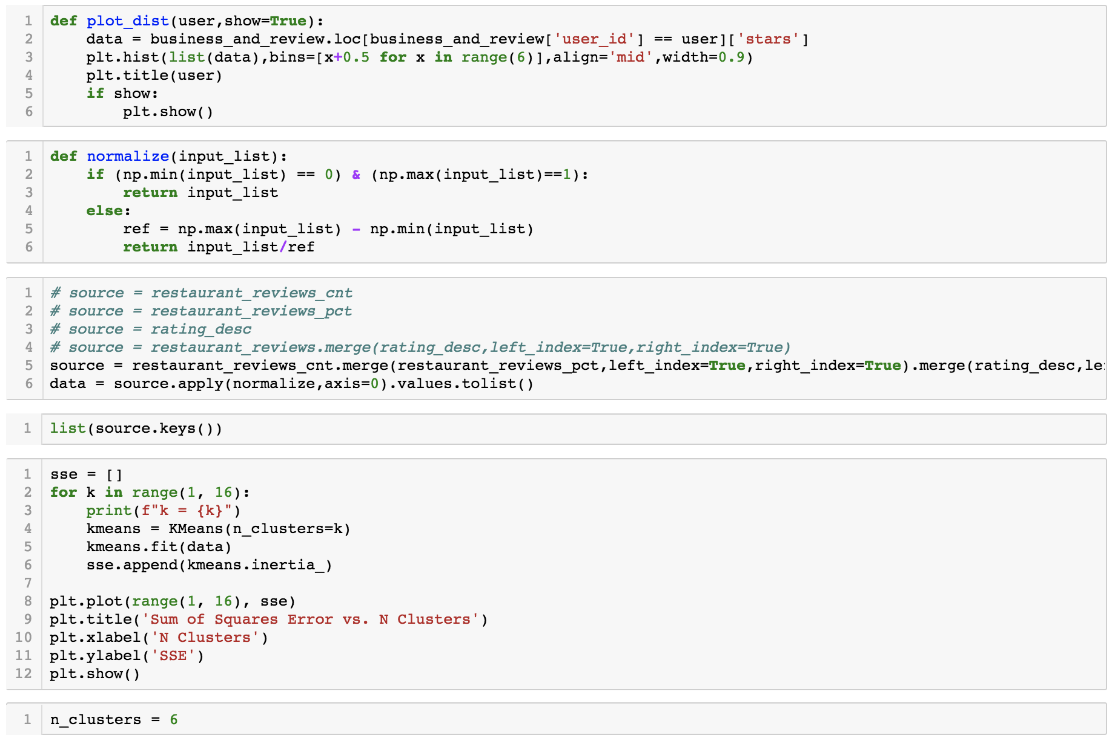
K-Means (continued)

Slide 19
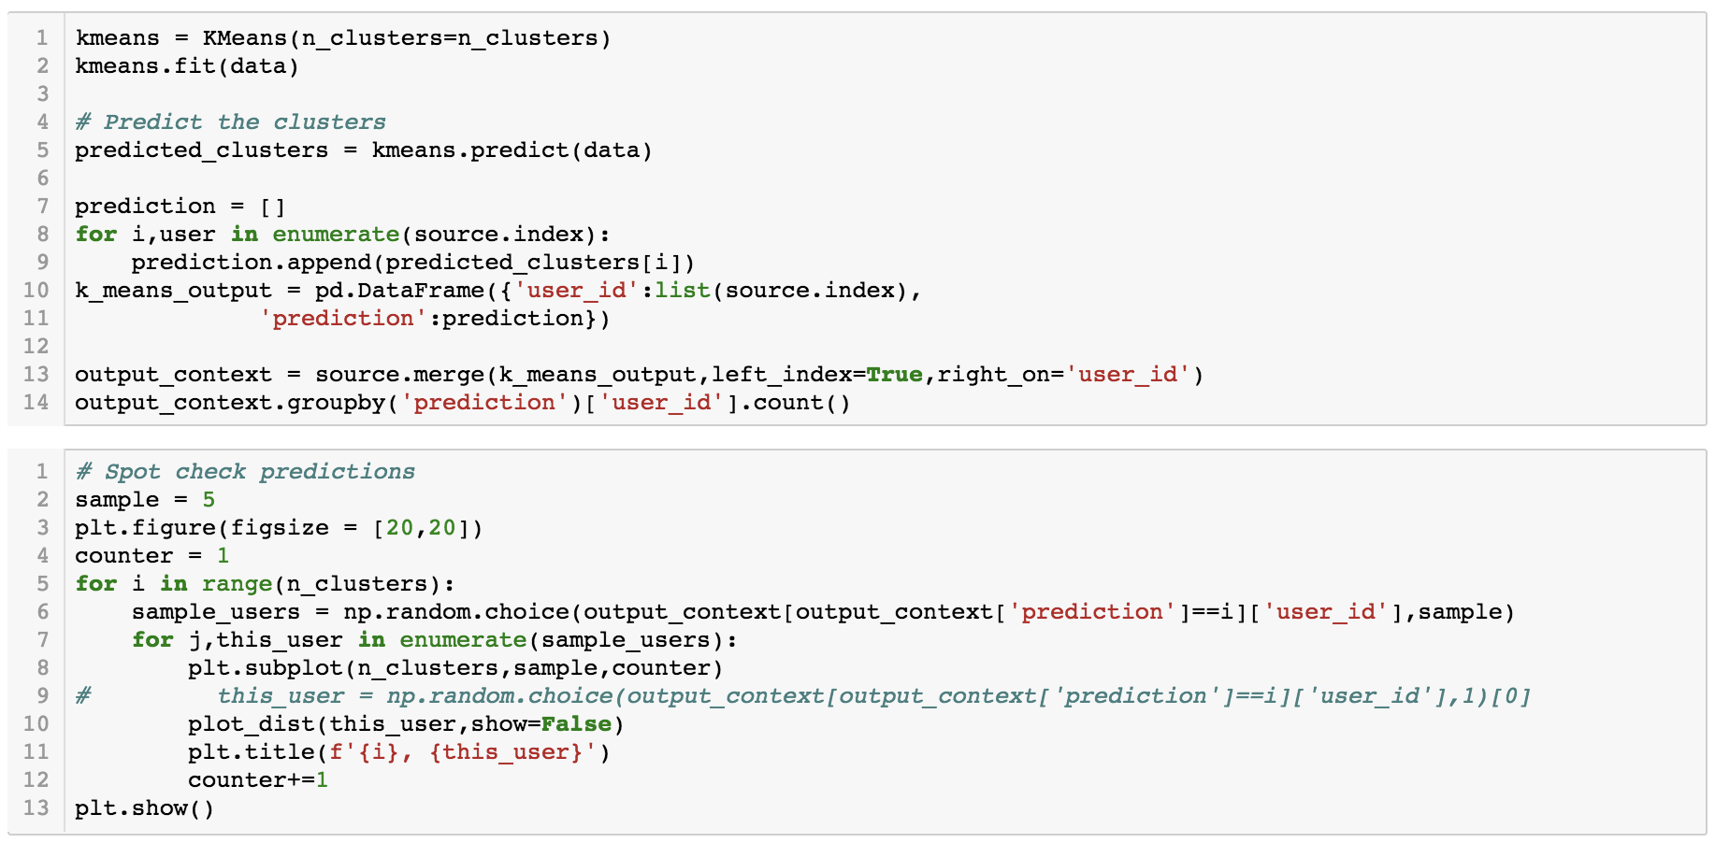
K-Means (continued)

