Slide 1
Capstone 2:
Business Analysis
with Python
Decision focus
If Maryland is the stronger benchmark, where is the clearest growth opportunity and what should marketing do next?
A Northeast Territory Comparison
This presentation highlights the two biggest signals in the notebook: revenue trend over time and the category gap driving the territory difference.
Shruti Reddy (Maryland)
Erbayne Middleton (Maine)
Mina Saeday
Region: Northeast | Data Period: 2022-2025
A short decision brief built from the capstone notebook and Python analysis.

Slide 2
Data and Approach
Five datasets were cleaned and connected in Python before the territory comparison began.
Datasets used
Python workflow
StoreSales: transaction-level sales records
1
Loaded each file with pandas and checked structure using .info().
StoreDetail: store location, region, and manager data
Corrected the customer file separator during import so rewards matching would work correctly.
2
Products: item-level product information
3
Merged sales, store, product, category, and customer data into one usable analysis flow.
ProductCategories: category and subcategory mapping
4
Filtered the final dataset to Shruti Reddy and Erbayne Middleton before answering the business questions.
customer_list: rewards customer information
Python turned separate raw files into one territory-level decision dataset.

Slide 3
Northeast Territory Snapshot
A stronger benchmark in Maryland, and a clearer growth opportunity in Maine.
Shruti Reddy
Erbayne Middleton
$11.49M
$2.14M
Maryland Territory
2022-2025 total revenue
Maine Territory
2022-2025 total revenue
9
stores
6
stores
Higher
monthly revenue benchmark
Lower
revenue, but upward growth
North Harford
major performance driver
More balanced
store performance
Top categories
Technology & Accessories, Textbooks
Top categories
Technology & Accessories, Textbooks
Maryland is the stronger benchmark, but Maine is the clearer next-quarter growth opportunity.

Slide 4
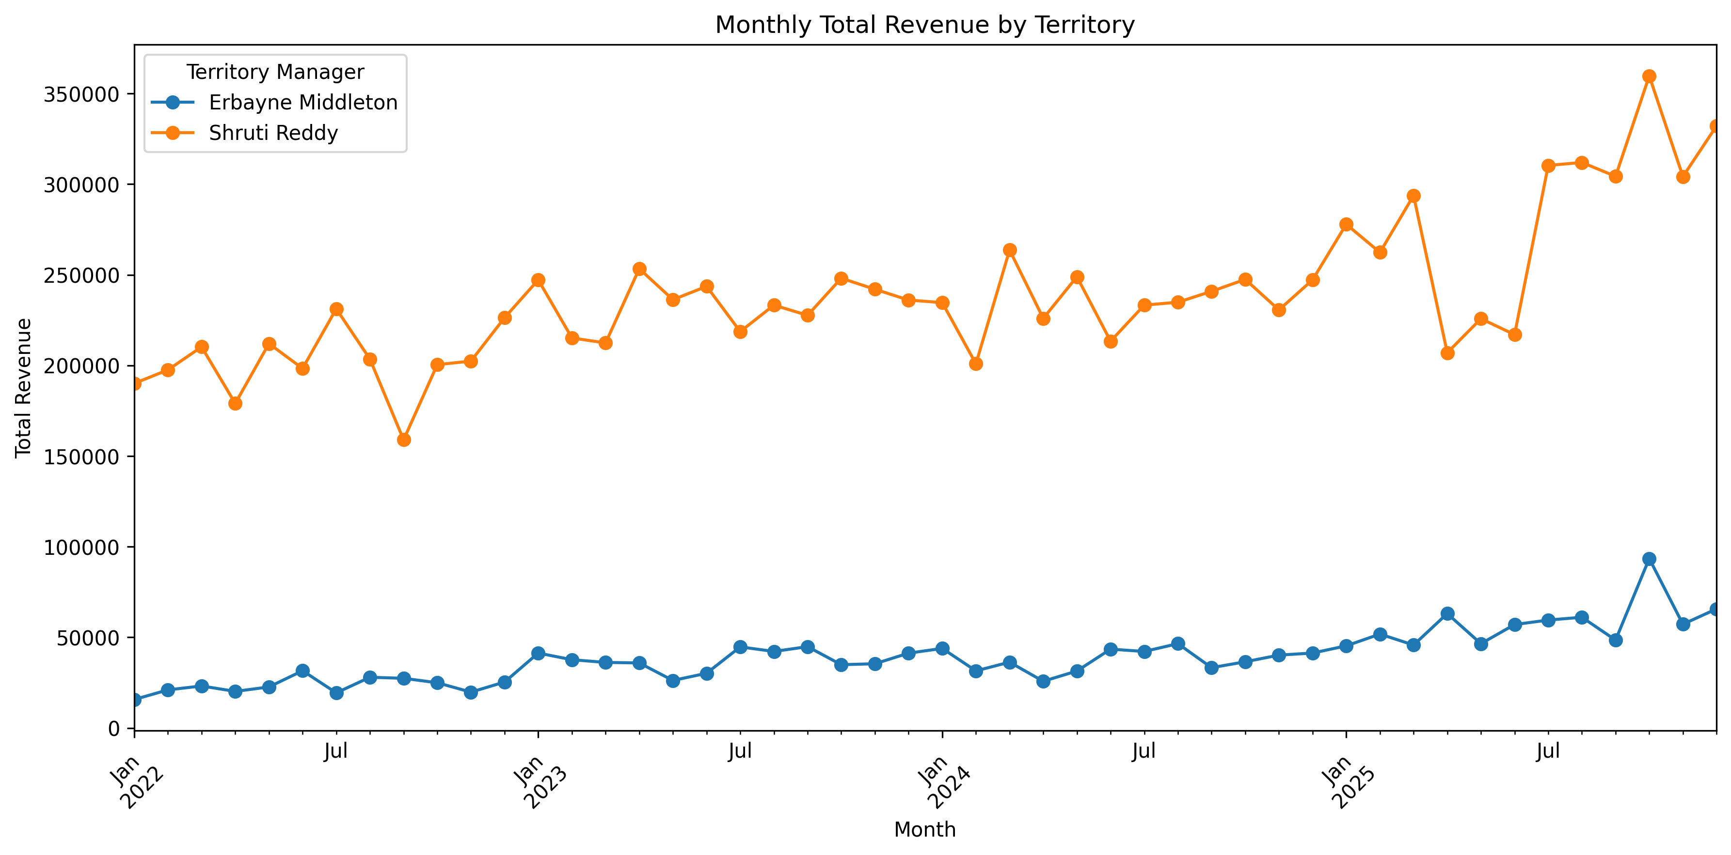
Key Finding 1: Monthly Revenue Trend
Shruti Reddy's territory stays ahead throughout the period, while Maine still shows upward momentum.
What this chart says
Shruti Reddy's territory consistently generates higher monthly revenue.
Both territories rise over time, so Maine is smaller but not stagnant.
The performance gap is persistent, which makes Maine a deliberate growth decision rather than a maintenance problem.
Line chart used because the question is about trend over time and sustained performance differences.

Slide 5
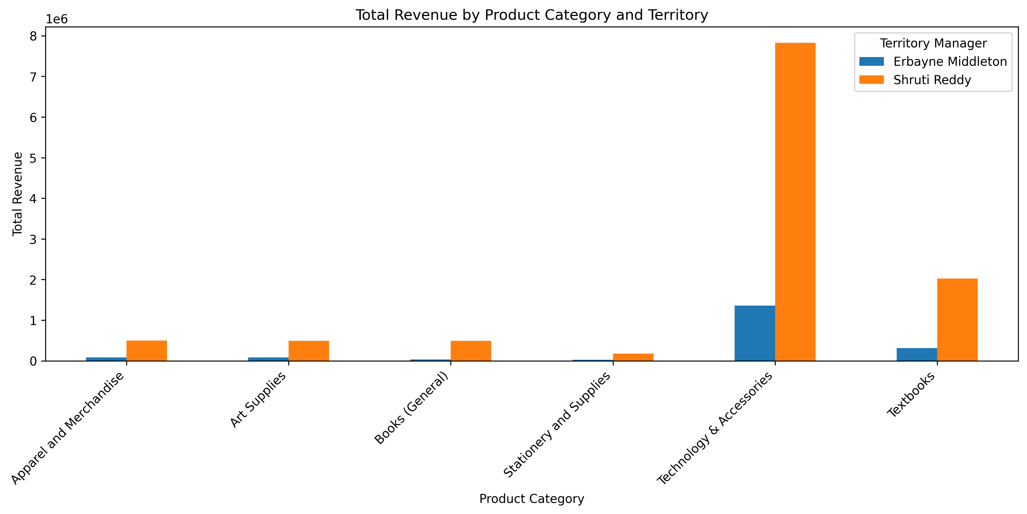
Key Finding 2: Category Performance
The largest revenue gap appears in the same high-value categories that matter most in both territories.
What this chart says
Technology & Accessories is the dominant revenue engine in both territories.
Textbooks is the second strongest category and reinforces the same pattern.
Maine trails most sharply in the highest-value categories, not in low-impact product areas.
Bar chart used because it makes category-by-category differences easy to compare at a glance.

Slide 6
Store and Customer Insight
A small number of high-impact stores and customers helps explain where performance is concentrated.
Store insight
Customer insight
$8.71M
North Harford is a major outlier and a key driver of Maryland's advantage.
$7.60K
$3.64K
North Harford total revenue
Top Maryland rewards customer
Top Maine rewards customer
Maine's stores are more balanced across locations, with less dependence on one standout site.
Maryland's top identified customer spend is much higher than Maine's, and a small group of rewards customers contributes a meaningful share of known territory revenue. That supports targeted loyalty outreach rather than broad, unfocused marketing.
This suggests Maryland's lead is strong overall, but also amplified by one especially powerful store.
Top store revenue
Top rewards customer spend
$8.71M
Cole Brown
$7.60K
North Harford
Rosita
$3.64K
South Portland
$0.33M
Top customers: Cole Brown in Maryland, Rosita in Maine
Store structure and customer concentration both support a more targeted growth strategy.

Slide 7
Recommendation for Next Quarter
Focus growth efforts where demand already exists but performance still trails the stronger benchmark.
Focus Territory
Priority Categories
Recommended Actions
Erbayne Middleton's
Technology & Accessories
Targeted promotions
Maine territory
Textbooks
Loyalty outreach
Support for high-performing stores
Maryland is the stronger benchmark, but Maine presents the better opportunity for focused revenue growth.
Recommendation is based on the combination of territory trend, category gap, store structure, and customer concentration.

