Slide 1


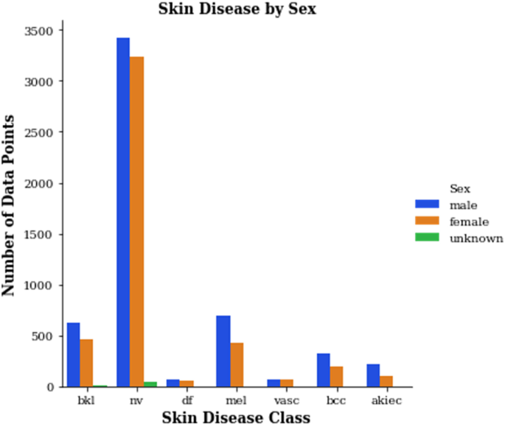
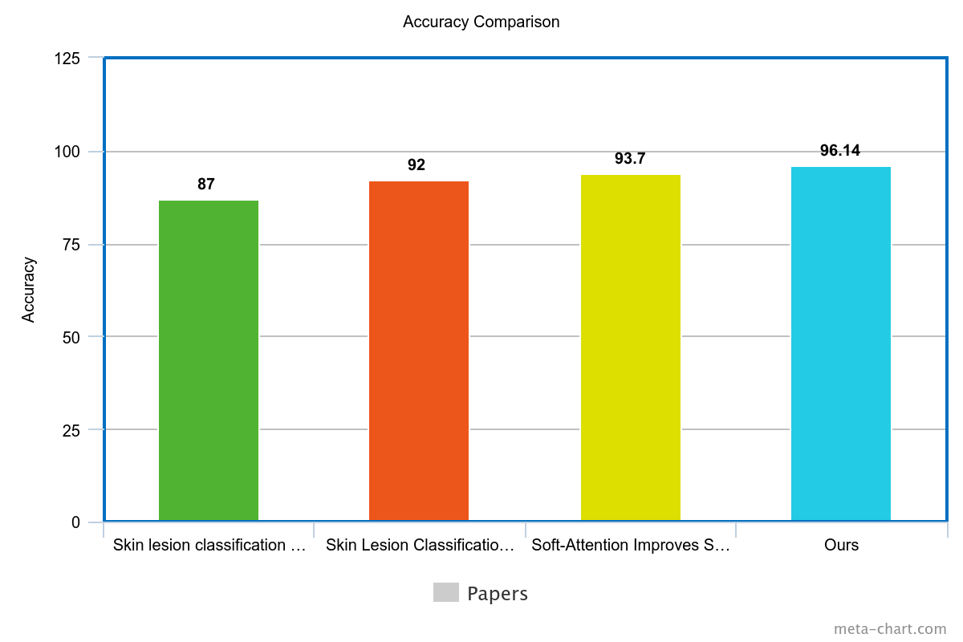


Skin Lesions Detection and Classification Using Deep Learning Algorithm
By: Marleen Tawadrous Yaacoub , Martina Sabry Mosaad,
Mohamed Tamer Mohamed, Mina Adel Louiz, Mina Nabil Asaad
Supervised by: Prof. Dr. Islam Hegazy , TA. Zeina Rayan
Faculty of Computer and Information Sciences - Ain Shams University
Introduction
Results
The skin is the broadest organ in the body which protects the body against the heat, light, and infection. It also helps to control the body temperature and to store the fat and the water[1], Skin diseases are becoming more common around the world, affecting millions of people. Many individuals, especially those in rural and underserved areas, struggle to get timely access to dermatologists. This can lead to delays in getting a diagnosis, causing stress and worsening their condition.
The accuracy of skin disease diagnoses can vary significantly, even among healthcare providers. This inconsistency highlights the need for reliable and easy-to-use tools that can aid in the identification of different types of skin lesions. Advances in deep learning and image analysis present an opportunity to address this challenge.
In our project, we aim to create a system that classifies skin images into seven specific categories using deep earning techniques. Our approach involves utilizing the HAM10000 and ISIC2018 datasets, which contain a diverse array of skin lesion images.
We explored several machine learning and deep learning models, including Support Vector Machines (SVM), Decision Trees, Random Forest, basic Convolutional Neural Networks (CNN), InceptionNet, and InceptionResNet.
Analysis of the HAM10000 and ISIC2018 datasets reveals
that 'nv' (nevus) is the most prevalent class, with a higher
count in males than females. Similarly, 'mel' (melanoma)
and 'bkl' (benign keratosis-like lesions) are more frequent
in males. Other classes, such as 'df' (dermatofibroma),
'vasc' (vascular lesions), 'bcc' (basal cell carcinoma),
and 'akiec' (actinic keratoses), show varied distributions
between sexes but generally have fewer occurrences.
Globally, skin and subcutaneous diseases account for a significant health burden. According to the Global Burden of Disease Study 2019, there were approximately 4.9 billion new cases of skin and subcutaneous diseases, with fungal and bacterial infections being the most common. These conditions led to around 98,500 deaths worldwide. The highest number of cases and deaths were reported in South Asia, with a notable incidence among young children and slightly higher rates in men than women. The burden of these diseases is particularly high in low- and middle-income countries, underscoring the need for effective management and diagnostic tools to alleviate this growing health issue​ (Frontiers)​​ (AAD Website)​.
These statistics underscore the importance of developing accessible diagnostic tools to address the varying prevalence of skin diseases across different populations. By leveraging deep learning models and mobile applications, we aim to provide timely and accurate diagnosis to those who need it most, potentially improving outcomes for millions of affected individuals.
Model | Data | Hyper parameters values | Accuracy
SVM | HAM10000 | Kernel = ’linear’, c = 1 | 42%
DT |  | Maxdepths = 100 | 44%
RF |  | n_estimators = 200 | 68%
 | HAM10000 with Data Augmentation | n_estimators = 200 | 80%
CNN | HAM10000 | Learning rate = 0.001 Epochs = 70 | 86%
Inception Net |  | Learning rate = 0.0001 Epochs = 50 Fine tuning exclude 10 layers | 85%
 |  | Learning rate = 0.001 Epochs = 50 Fine tuning exclude 5 layers | 87%
 | HAM10000 with Data Augmentation | Learning rate = 0.001 Epochs = 50 Fine tuning exclude 5 layers | 84%
Model | Data | Hyper parameters values | Accuracy
InceptionRestNet | HAM10000 | Learning rate = 0.001 Epochs = 70 | 92.3%
 | HAM10000 with Data Augmentation | Learning rate = 0.001 Epochs = 70 L2 regularization | 84%
 |  | Learning rate = 0.01 Epochs = 70 Retrain except 30 layers | 94.22%
 |  | Learning rate = 0.01 Epochs = 70 Retrain except 28 layers - Using Step Decay - Add 2 Dense layers | 96.13%
Methods
Conclusions
Support Vector Machine(SVM)
SVMs are used for their robustness in high-dimensional spaces and effectiveness in separating classes, making them suitable for distinguishing between benign and malignant skin lesions, their ability to work well with smaller datasets.
Decision Trees (DT)
Decision Trees offer interpretability and simplicity, helping in understanding the decision-making process for classifying skin lesions based on various features like color, texture, and shape.
Random Forest (RF)
Random Forests enhance the reliability and accuracy of classification by combining multiple decision trees, reducing overfitting, and handling complex, noisy datasets often encountered in medical imaging.
Convolutional Neural Network(CNN)
CNNs are essential for their ability to automatically extract and learn features from images, making them ideal for detecting and classifying skin lesions based on intricate visual patterns.
Inception Net
Inception Net's multi-scale feature extraction improves detection accuracy by capturing a wide range of lesion features, crucial for distinguishing between various types of skin lesions.
InceptionResNet
InceptionResNet combines the strengths of Inception modules and residual connections, enabling the model to learn complex features efficiently and improve classification accuracy for skin lesions.
We utilized the HAM10000 and ISIC2018 datasets, resizing images to 299x299 and applying data augmentation to improve accuracy. We tested several ML and DL models, including SVM, Decision Trees, Random Forest, basic CNN, InceptionNet, and InceptionResNet. InceptionResNet yielded the best results. We explored various hyperparameters, optimizers, batch sizes, epochs, and activation functions. Our Flutter mobile app integrates the model via Flask API for deployment on portable devices. The results were promising, with model accuracy ranging from 42% to 96.13%, demonstrating accurate identification of different skin lesions.
Bibliography
Zhang N, Cai YX, Wang YY, et al. Skin cancer diagnosis based on optimized convolutional neural network. Artif Intell Med 2020;102:101756. doi:https://doi.org/10.1016/j.artmed.2019.101756.
Dildar M, Akram S, Irfan M, et al. Skin cancer detection: a review using deep learning techniques.Int J Environ Res Public Health 2021;18(10):5479. doi:https://doi.org/10.3390/ijerph18105479.
3. Maryam Naqvi, Syed Qsim Gilani, Tehreem Syed, Oge Marques, Hee-Cheol Kim. Skin Cancer Detection Using Deep Learning-A Review; 2023. doi: https://doi.org/10.3390/diagnostics13111911
4.Marriam Nawaz, Zahid Mehmood, Tahira Nazir, Rizwan Ali Naqvi, Amjad Rehman, Munwar Iqbal, Tanzila Saba. Skin cancer detection from dermoscopic images using deep learning and fuzzy k-means clustering; 2021. doi: https://doi.org/10.1002/jemt.23908
Order online at https://www.postersession.com/order/

