Slide 1
FINAL THESIS DEFENSE
Evaluating ChatGPT for Security, Performance, and Code-Quality Improvement of a Financial Accounting REST API: A Branch-Isolated Baseline Study
Zaw Ye Htut Ko | G6519692
Master of Science in Information Technology | Assumption University
Advisor: Asst. Prof. Dr. Darun Kesrarat
One existing API · one shared baseline · three independent measurements
Notes:
TIMING: 45 seconds
KEY MESSAGE: This is an evidence-based evaluation of Codex 5.4 as an advisor.
SHOW IF ASKED: backup slide 27 (claim-to-evidence map)
APPENDIX: Appendix M
SCRIPT:
Good morning. I evaluate whether ChatGPT, used through Codex 5.4, can help improve an existing financial accounting API. The model suggests changes; I review and apply selected ones; SonarQube, OWASP ZAP, and JMeter show what the measured results support.
SOURCE: Current full report title page and Abstract.

Slide 2
OPENING
The fresh evidence is mixed
STATIC QUALITY
SECURITY
PERFORMANCE
17 to 0
Gate PASS
Target not met
Unique SonarQube issues
One raw API Medium remains
100 and 500 VU exceed limits
Defensible conclusion
ChatGPT-guided remediation closed the fresh static issues and passed the configured ZAP gate. It did not meet the predefined core performance target, despite lower soak and spike p95 values.
Current report §4.5; Table 4.5; Appendix M
2
Notes:
TIMING: 60 seconds
KEY MESSAGE: The results are mixed: code quality improved, security has one remaining alert, and core speed missed its target.
SHOW IF ASKED: backup slides 29-31 (three measured outcomes)
APPENDIX: Appendices E-G and M
SCRIPT:
Here is the result first. SonarQube issues fell from 17 to zero. ZAP's selected checks passed, but the API scan still had one Medium alert because the local site used HTTP. JMeter response times at 100 and 500 simulated users were above our study limits. Soak and spike improved, but they are separate tests.
SOURCE: Current report Table 4.5 and Appendix M.
CAUTION: Do not claim that the 50, 100, or 500 VU core p95 values improved; all three increased.

Slide 3
PROBLEM
One financial API has three different risks
Maintainability
Security
Performance
Code smells, complex controller signatures, and repeated logic
Headers, authorization boundaries, and scanner observations
Tail latency, throughput, errors, and sustained load
No one scanner can stand in for all three dimensions.
Current report §§1.1-1.4 and §3.1
3
Notes:
TIMING: 60 seconds
KEY MESSAGE: Code, security, and speed need different checks.
SHOW IF ASKED: backup slides 29-31 (the three risks)
APPENDIX: Appendices E-G
SCRIPT:
A program can have confusing code, unsafe web settings, and slow requests at the same time. One tool cannot check all three. I used SonarQube to read code, ZAP to test the running API, and JMeter to send load. I also ran tests to check that accounting behavior still worked.
SOURCE: Current report Chapter 1 and §3.1.

Slide 4
PROBLEM
Three questions, three independent answers
Can static issues be closed without material control-metric regression?
RQ1
Can configured security alerts be cleared and residual raw alerts disclosed?
RQ2
Can latency targets pass under core load as well as stress profiles?
RQ3
Current report §1.5 and Table 4.1
4
Notes:
TIMING: 65 seconds
KEY MESSAGE: I ask one measurable question for each tool.
SHOW IF ASKED: backup slides 29-31 (one answer per tool)
APPENDIX: Appendix M
SCRIPT:
First, did the code warnings decrease, and did coverage or complexity get worse? Second, did security alerts decrease, and what remained? Third, did the API stay within the response-time limits at the three user counts? I answer each question with the tool's before-and-after result, not with an AI opinion.
SOURCE: Current report §1.5 and Table 4.1.

Slide 5
METHOD
The study tested one existing accounting API
ASP.NET Core 8
Endpoint groups exercised
SQL Server financial database
JWT authentication · RBAC
Double-entry posting · audit log
Authentication and users
Accounts and periods
Journal entries and bulk posting
Financial reports
Audit logs
Four roles: Admin, FinanceManager, User, Auditor
Current report §§3.1-3.2; Table 3.3
5
Notes:
TIMING: 70 seconds
KEY MESSAGE: All comparisons use the same accounting API.
SHOW IF ASKED: backup slides 34 and 42-44 (API behavior)
APPENDIX: Appendices B-D, H, and J
SCRIPT:
This API has login, four user roles, accounts, journal entries, reports, and an audit log. It uses a local SQL Server database. I compared a baseline with changed versions of this same API. The web screenshots later show that the app can be used; those screenshots are not JMeter performance measurements.
SOURCE: Current report §§3.1-3.2, Table 3.3, Figures 4.2-4.7.

Slide 6
METHOD
Every remediation branch starts from one baseline
COMMON STARTING POINT
baseline-v0.1
Code before the changes
SonarQube
OWASP ZAP
JMeter
baseline-sonarqube-v1
baseline-zap-v1
baseline-jmeter-v1
Compared with the same baseline
Compared with the same baseline
Compared with the same baseline
Compare each changed branch with the same starting code—one tool at a time.
Current report Table 3.1 and Appendix A
6
Notes:
TIMING: 70 seconds
KEY MESSAGE: Each tool's change has its own branch.
SHOW IF ASKED: backup slide 28 (branch details)
APPENDIX: Appendix A
SCRIPT:
I used one saved baseline version as the starting point. I put the code-quality, security, and performance changes on separate branches. That lets me compare each changed version with the same starting code, one tool at a time. The exact technical references are available in Appendix A if the committee wants them.
SOURCE: Current report Appendix A and Table 3.1.

Slide 7
METHOD
Four phases turn suggestions into evidence
01
02
03
04
Capture baseline
Propose bounded fix
Review and re-test
Compare and report
Freeze code, dataset, and raw tool output
Give Codex the finding, source context, and constraints
I review, run tests, and rerun the same tool
Apply gates; disclose residuals and unmet targets
The model does not approve its own output.
Current report §3.1.1; Figures 3.1-3.4
7
Notes:
TIMING: 70 seconds
KEY MESSAGE: A suggestion must be checked before it becomes a result.
SHOW IF ASKED: backup slides 28 and 32-33 (source and tests)
APPENDIX: Appendices A, E-G, I, and K
SCRIPT:
First I saved the baseline result. Next I gave Codex a specific tool warning and the relevant code. Then I reviewed the suggested edit, ran tests, and ran the same tool again. Finally I compared the new number with the baseline and the study rule. A patch that looks good is not automatically a success.
SOURCE: Current report §3.1.1 and Figures 3.1-3.4.

Slide 8
METHOD
One local setup and a seeded dataset
ACCOUNTS
JOURNAL ENTRIES
TEST HOST
120
30,000
Windows 11
Seeded count in run record
At least 5,000 posted
.NET 8 · local SQL Server
Tool versions in the fresh reproduction
SonarQube 26.7 | OWASP ZAP 2.17 | Apache JMeter 5.5
The next slide shows the seed settings and recorded counts (Appendix H).
Current report Tables 3.2 and 3.11; Appendix H
8
Notes:
TIMING: 60 seconds
KEY MESSAGE: The 120 accounts are seeded test data, not customer records.
SHOW IF ASKED: next slide 9 (seed and run records)
APPENDIX: Appendix H; Tables 3.10-3.11
SCRIPT:
The test scripts created 120 accounts and 30,000 journal entries. At least 5,000 entries were posted, so the report endpoints had data to process. This is not a screenshot of 120 individual accounts: the count is recorded in the run record. We used one local computer and one fresh run per branch, so the result is limited to this setup.
SOURCE: Next slide 9; branch-verification.json dataset counts; current report Tables 3.10-3.11 and Appendix H.

Slide 9
EVIDENCE
Where the 120-account count comes from
Seed script settings
Recorded in the run
scripts/phase4/seed-test-data.ps1
docs/appendix/verification-runs/research/branch-verification.json
AccountCount = 120
JournalEntryCount = 30000
MinimumPostedEntries = 5000
accounts: 120
journalEntries: 30,000
postedEntries: 5,000
Appendix H; Tables 3.10-3.11; branch-verification.json
9
Notes:
TIMING: 40 seconds
KEY MESSAGE: The seed settings and the run record agree on the dataset size.
SHOW IF ASKED: backup slide 27 (evidence map)
APPENDIX: Appendix H
SCRIPT:
I used the repository seed script to request 120 accounts, 30,000 journal entries, and at least 5,000 posted entries. The run record on the right reports those same counts. I omit the local demo credential from this excerpt. Appendix H has the fuller seed explanation.
SOURCE: Appendix H; current report Tables 3.10-3.11; branch-verification.json and scripts/phase4/seed-test-data.ps1.

Slide 10
METHOD
Outcomes were judged by tool-specific measures
Area | Primary decision | Control metric
SonarQube | Compare unique issues; show gate status | Coverage and complexity disclosed
OWASP ZAP | Configured-rule gate; report raw alerts | Residual HTTP-only observation disclosed
JMeter | 50/100/500 VU core gate | 100 VU ≤500 ms; 500 VU ≤1200 ms
Regression | Focused tests and role checks | Accounting and authorization preserved
Study scenarios: 100 VU = planned peak; 500 VU = heavier load. These are not measured production traffic.
Current report Table 4.1 and §4.1
10
Notes:
TIMING: 70 seconds
KEY MESSAGE: Each tool has a rule, but the measured numbers still matter.
SHOW IF ASKED: backup slides 29-31 (results and rules)
APPENDIX: Appendices K and M
SCRIPT:
I named 100 simulated users the peak scenario and 500 the heavier-load scenario in the test plan. This was not a measured peak from real customers. The study set p95 targets of 500 milliseconds and 1,200 milliseconds respectively. Those numbers are study choices, not universal standards. I compare the after-fix result with each target and still report the actual time, so the committee can see more than a pass/fail label.
SOURCE: Current report Table 4.1 and §4.1; Document/JMETER_ZAP_TEST_PLAN.md §4.6.

Slide 11
METHOD
From a tool warning to a measured result
Tool finding
→
Relevant code
→
Suggested edit
→
I check
→
I run tests
→
Measure again
An AI suggestion is not proof: I check it, then the same tool measures the result.
Current report §§3.1.3-3.1.4; Appendices I and K
11
Notes:
TIMING: 70 seconds
KEY MESSAGE: Codex suggested changes; I checked and measured them.
SHOW IF ASKED: slide 15; backup slides 32-33 (before/after code)
APPENDIX: Appendices E-G, I, and K
SCRIPT:
Here is one example. SonarQube flagged a controller with eight query parameters. I showed Codex that warning and the relevant code. It suggested a request DTO. I reviewed the edit, ran tests, and scanned the changed branch again. SonarQube issues went from 17 to zero. I followed the same check-again process for ZAP and JMeter, including the JMeter target that was not met.
SOURCE: Current report §§3.1.3-3.1.4, Appendices I and K.

Slide 12
METHOD
The three branches changed different code
Track | Representative change | What it was meant to address
SonarQube | Eight query parameters → JournalEntryQueryDto | Controller maintainability finding S107
ZAP | SecurityHeadersMiddleware before Swagger | Browser-facing security headers
JMeter | Cache ledger data; avoid repeated report snapshot writes | Reduce repeated report and database work
Mechanism and measured outcome are shown separately on the next slides.
Current report Table 4.3; Appendices E-G
12
Notes:
TIMING: 70 seconds
KEY MESSAGE: The three branches changed different parts of the API.
SHOW IF ASKED: slide 15; backup slides 32-33 (actual changes)
APPENDIX: Appendices E-G
SCRIPT:
For code quality, I replaced eight controller parameters with one request object. For security, I put security headers before Swagger. For performance, I added ledger caching and stopped saving a new report snapshot on that read path. These are the code changes I made; the next slides show whether the measurements improved.
SOURCE: Current report Table 4.3 and Appendices E-G.

Slide 13
RESULTS
SonarQube closed all 17 fresh issues
UNIQUE ISSUES
QUALITY GATE
COVERAGE
17 → 0
OK → OK
74.4 → 74.3%
Current run
No gate conditions recorded
Down 0.1 percentage point
Do not add impact counts together
The 17 findings had overlapping impacts: Reliability 2, Security 1, Maintainability 16. Complexity rose 886 → 889; duplication stayed 0.0%.
Cyclomatic complexity counts possible decision paths through code; a higher count can need more tests.
Current report §4.2; Table 4.2; Figures L.1-L.4
13
Notes:
TIMING: 80 seconds
KEY MESSAGE: The measurable SonarQube improvement is 17 distinct issues to zero.
SHOW IF ASKED: next slides 14-15 (scan and code proof)
APPENDIX: Appendices E and L
SCRIPT:
SonarQube reported 17 distinct issues before the code change and zero after it. Cyclomatic complexity is a rough count of the different decision paths through code, such as branches. Its total rose from 886 to 889, a small increase; that is not an improvement. Coverage also fell slightly from 74.4 to 74.3 percent. Both gate statuses say OK, but the saved gate records list no conditions, so I rely mainly on the issue count. The reliability, security, and maintainability labels overlap and are not extra issues to add to 17.
SOURCE: Next slides 14-15; backup slides 29 and 35-36; SonarQube quality-gate.json and summary.json; current report Table 4.2, Appendices E and L.
CAUTION: The full report lists OK/OK; explain that the captured gate response has an empty conditions list.

Slide 14
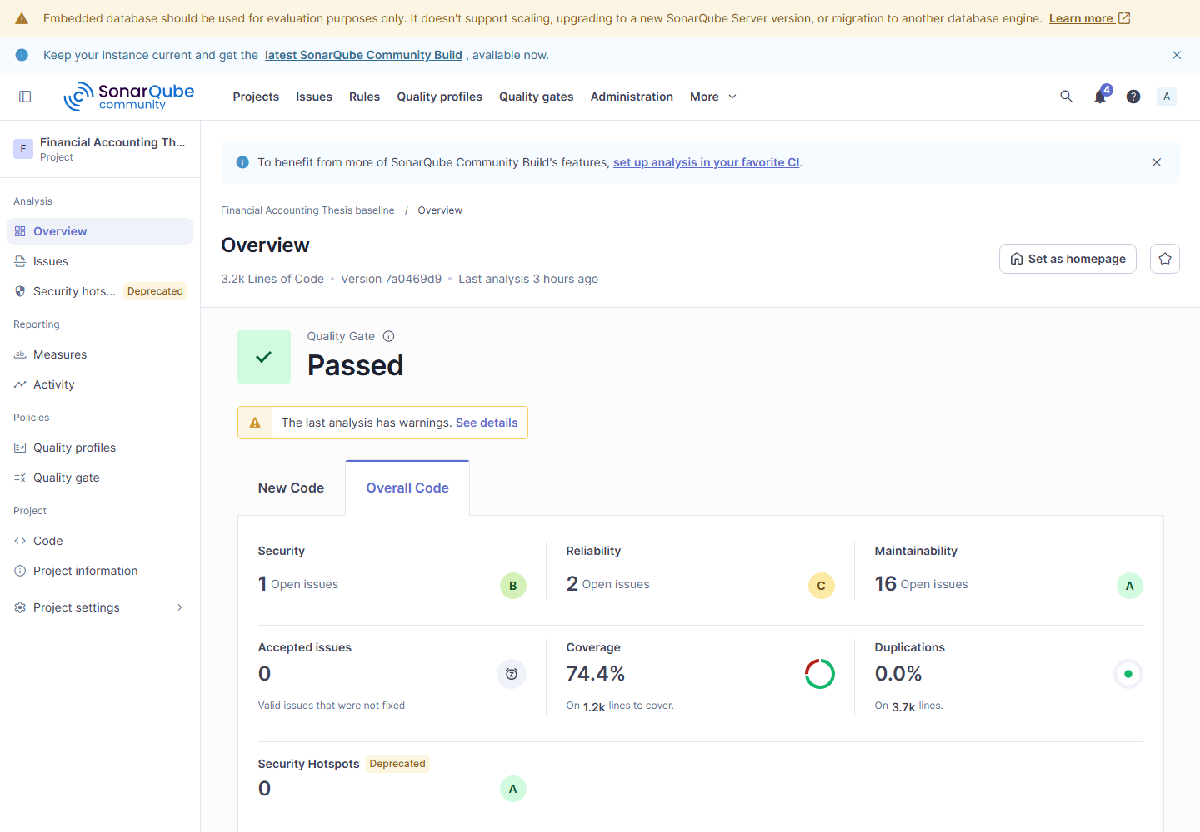
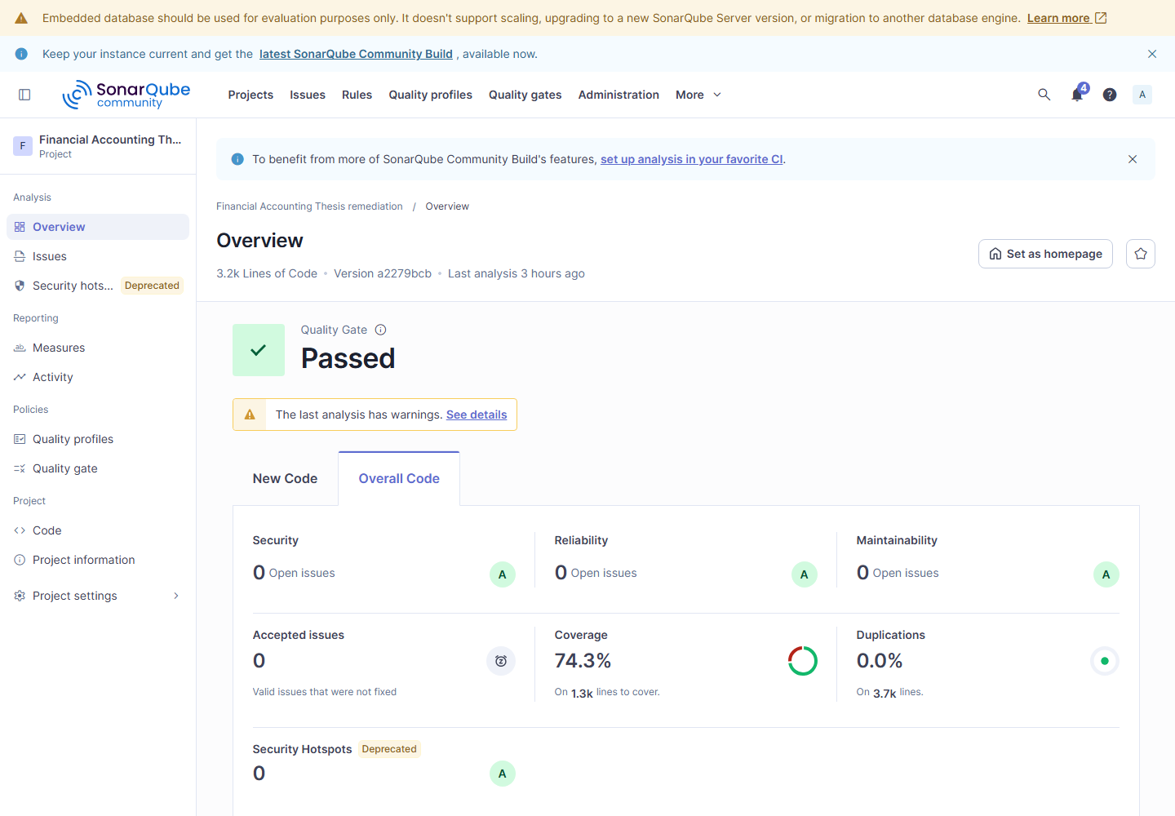
RESULTS
SonarQube issues changed; gate status did not
Baseline · commit 7a0469d9
Remediation · commit a2279bcb
Gate OK/OK has no recorded conditions; the measured improvement is 17 issues → 0.
Current capture · Appendix L, Figures L.1 and L.3
14
Notes:
TIMING: 60 seconds
KEY MESSAGE: Both dashboards say OK, but the issue count is the useful comparison.
SHOW IF ASKED: next slide 15; backup slides 29 and 35-36
APPENDIX: Appendix L, Figures L.1-L.4
SCRIPT:
If asked why both Quality Gates passed, point out that the saved gate files show OK with an empty list of conditions on each branch. That status therefore did not distinguish the scans. The baseline had 17 distinct issues; the changed branch had zero. Coverage moved from 74.4 to 74.3 percent, so I show that small decrease too. These are screenshots of the tool, not a new chart I made.
SOURCE: Next slide 15; backup slides 29 and 35-36; Appendix L Figures L.1-L.4; sonar/baseline and remediation quality-gate.json.

Slide 15
EVIDENCE
Two SonarQube fixes in source code
BEFORE · shared baseline
AFTER · SonarQube branch
S107: eight query inputs
S107: one query DTO
GetPaged(
from, to, status, accountId,
search, page, pageSize, sort
)
GetPaged(
JournalEntryQueryDto query
)
S6966: host startup
S6966: async host startup
app.Run();
await app.RunAsync();
These are representative changes, not all 17 issue fixes; the full excerpts are in Appendix E.
Appendix E, Listings E.1-E.2
15
Notes:
TIMING: 45 seconds
KEY MESSAGE: These two code excerpts show what changed, but they do not stand for all 17 issues.
SHOW IF ASKED: backup slide 32 (larger S107 example)
APPENDIX: Appendix E, Listings E.1-E.2
SCRIPT:
Here are two representative before-and-after changes I reviewed. The S107 controller action passed eight query values separately; after the change it accepts one query object. The S6966 startup call changed from app.Run to await app.RunAsync. Appendix E shows fuller excerpts. The SonarQube issue lists on the preceding slide and in backup show the measured 17-to-zero result.
SOURCE: Appendix E Listings E.1-E.2; backup slide 32 for the larger S107 example; Appendix L Figures L.2 and L.4 for the issue lists.

Slide 16
RESULTS
ZAP passive alerts cleared; raw API Medium remains
PASSIVE SCAN · BASELINE
PASSIVE SCAN · AFTER FIXES
Severity-card screenshots rendered from the current ZAP scan JSON.
Medium 3 → 0 | Low 6 → 0
This scan observes ordinary responses and headers. The signed-in API scan follows on slide 17.
Current report §4.3; ZAP raw scan JSON; Appendix F
16
Notes:
TIMING: 55 seconds
KEY MESSAGE: The passive scan improved, but it is only one view of security.
SHOW IF ASKED: next slide 17 (fresh ZAP proof)
APPENDIX: Appendices F and M
SCRIPT:
I am showing the passive scan before and after the changes. This scan observes normal responses and their headers; it does not sign in. In the upper screenshot, ZAP reports three Medium and six Low alert types. In the lower screenshot, both counts are zero. These are screenshots of report cards rendered from my current raw ZAP scan data. They are not a claim that the protected API is free of alerts. I will show that separate scan on the next slide.
SOURCE: Next slide 17; backup slide 30; current report §4.3; Appendix F; fresh passive raw ZAP JSON and summaries.

Slide 17
EVIDENCE
Signed-in API scan: Low cleared; one Medium remains
AUTHENTICATED API SCAN · BASELINE
AUTHENTICATED API SCAN · AFTER FIXES
Severity-card screenshots rendered from the current ZAP scan JSON.
Medium 1 → 1 | Low 3 → 0
Remaining Medium: HTTP Only Site. Configured rules passed; HTTPS needs a separate retest.
Current report §4.3; ZAP raw scan JSON and alert 10106; Appendix F
17
Notes:
TIMING: 65 seconds
KEY MESSAGE: The signed-in scan improved, but it did not clear every raw alert.
SHOW IF ASKED: backup slide 30 (raw ZAP counts)
APPENDIX: Appendix F
SCRIPT:
I am showing the signed-in API scan before and after the changes. Unlike the passive scan, this test signs in and exercises protected routes. Low alert types fell from three to zero, while Medium stayed at one. The remaining alert is called HTTP Only Site: my local scan target was served over HTTP. The selected security rules passed, but that pass result is different from saying every raw alert disappeared. I would need a working HTTPS endpoint and another scan before calling this Medium alert cleared. These screenshots were rendered from the current raw ZAP scan data; the raw counts and the alert are in Appendix F.
SOURCE: Backup slide 30; current report §4.3; Appendix F and Appendix M; fresh API raw ZAP JSON, summaries, alert 10106.

Slide 18
RESULTS
JMeter tested three user counts, plus soak and spike
50 VU
100 VU
500 VU
SOAK
SPIKE
50 users
100 users
500 users
steady
burst
Normal scenario
Planned peak scenario
Heavier-load scenario
Long-running test
Sudden-load test
VU means simulated users; p95 is the time within which 95% of requests finish.
Current report §§3.8 and 4.4; Appendix K
18
Notes:
TIMING: 60 seconds
KEY MESSAGE: User count and response-time percentile are different things.
SHOW IF ASKED: backup slides 31 and 37-41 (JMeter profiles)
APPENDIX: Appendices K and L
SCRIPT:
VU means simulated users. The 50, 100, and 500 VU tests use different user counts; 100 VU is only the planned peak scenario, not a measured customer peak. Soak keeps traffic going for a long time. Spike sends a sudden burst. p95 is a time in milliseconds: 95 percent of requests finish at or below it. Soak and spike are extra tests; they do not replace the three core user-count checks.
SOURCE: Current report §§3.8 and 4.4, Appendix K.

Slide 19
RESULTS
Core performance target was not met
Profile | Baseline p95 | After p95 | Fresh judgment
50 VU | 33 ms | 199.9 ms | Slower after fixes
100 VU | 255.9 ms | 1146.9 ms | Slower after fixes
500 VU | 106 ms | 1547.95 ms | Slower after fixes
NOT MET: 100 VU 1,146.9 > 500 ms; 500 VU 1,547.95 > 1,200 ms
Fixes: cache ledger data; avoid report snapshot writes. Exact cause of slowdown not isolated.
Current report §4.4; Table 4.5; fresh JMeter summary.json
19
Notes:
TIMING: 90 seconds
KEY MESSAGE: The code changes did not meet the core speed target; the precise cause is unknown.
SHOW IF ASKED: next slides 20-21 (native 100/500 VU dashboards)
APPENDIX: Appendices G, K, L, and N
SCRIPT:
The performance branch cached account-ledger data and stopped saving a new report snapshot on that read path. These changes were intended to reduce repeated work. JMeter measured response times, throughput, and errors. At 100 and 500 simulated users, the p95 response times were higher after the change and exceeded our study limits. CPU, memory, database-query, and cache-hit measurements were outside this study's measured scope, so I can report the slowdown but cannot identify one cause for it.
SOURCE: Next slides 20-21 for native JMeter proof; backup slide 33 and Appendix G for the code; Appendix N for the measurement limits.
CAUTION: Do not say caching or the host caused the slowdown; the evidence does not isolate either cause.

Slide 20
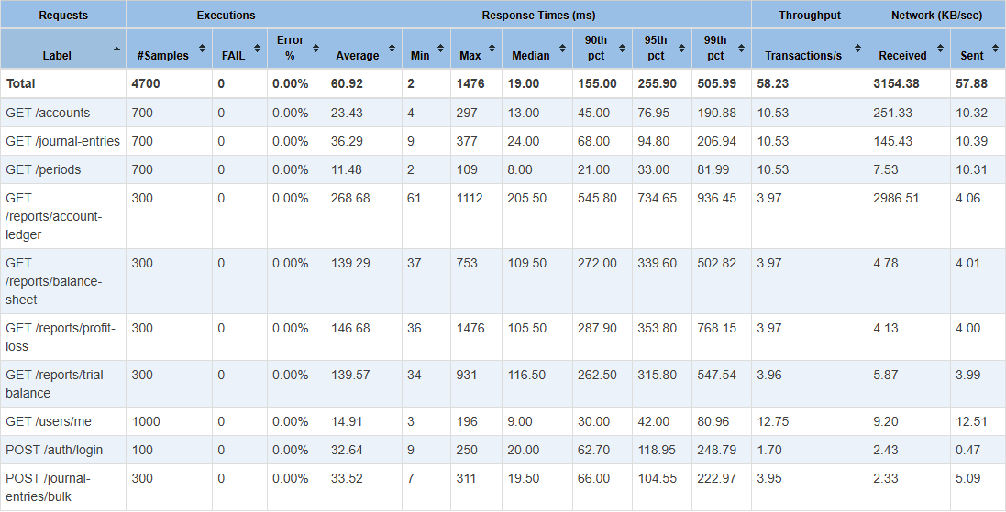
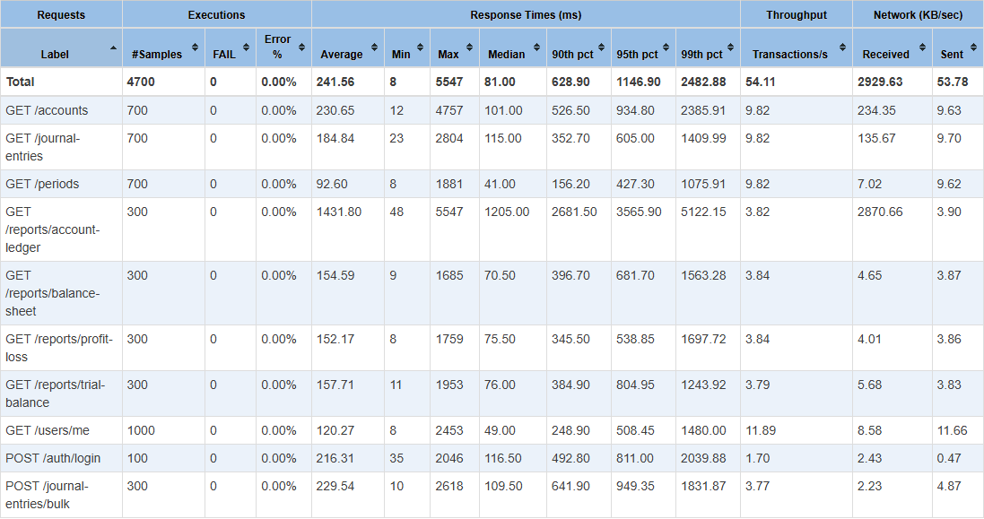
EVIDENCE
JMeter 100 VU: native dashboard proof
BASELINE
AFTER FIXES
TOTAL row, 95th pct: 255.9 → 1146.9 ms; study limit 500 ms — target not met.
Appendix L Figures L.10 and L.15; fresh JMeter summary.json
20
Notes:
TIMING: 40 seconds
KEY MESSAGE: At 100 VU, the after-fix p95 exceeded the study limit.
SHOW IF ASKED: backup slide 38 (larger 100 VU dashboard)
APPENDIX: Appendix L, Figures L.10 and L.15
SCRIPT:
These are the native JMeter statistics views for 100 VU. Point to the Total row and the 95th-percentile column. It changed from 255.9 to 1146.9 milliseconds; the study limit was 500 milliseconds. The screenshots show the measured time, while the test rule supplies the not-met judgment. They do not establish why the code ran slower.
SOURCE: Appendix L Figures L.10 and L.15; fresh JMeter summary.json; Document/JMETER_ZAP_TEST_PLAN.md §4.6.

Slide 21
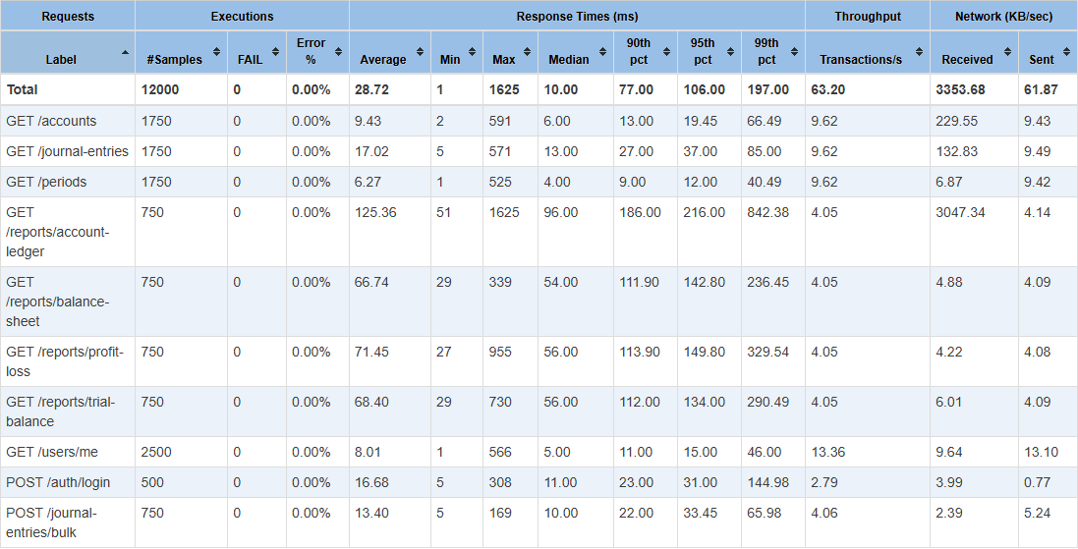
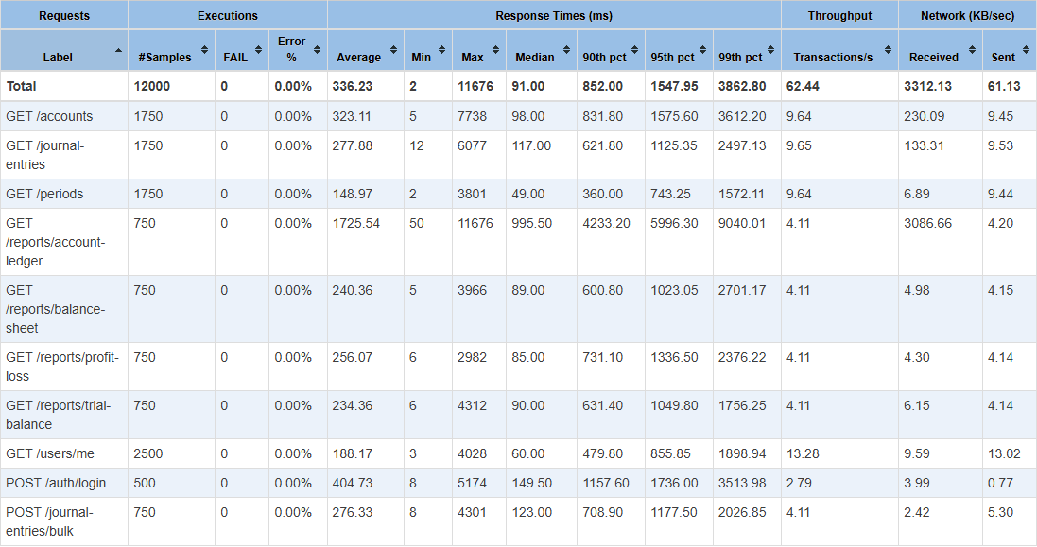
EVIDENCE
JMeter 500 VU: native dashboard proof
BASELINE
AFTER FIXES
TOTAL row, 95th pct: 106 → 1547.95 ms; study limit 1,200 ms — target not met.
Appendix L Figures L.11 and L.16; fresh JMeter summary.json
21
Notes:
TIMING: 40 seconds
KEY MESSAGE: At 500 VU, the after-fix p95 exceeded the study limit.
SHOW IF ASKED: backup slide 39 (larger 500 VU dashboard)
APPENDIX: Appendix L, Figures L.11 and L.16
SCRIPT:
These are the native JMeter statistics views for 500 VU. Point to the Total row and the 95th-percentile column. It changed from 106 to 1547.95 milliseconds; the study limit was 1,200 milliseconds. The screenshots show the measured time, while the test rule supplies the not-met judgment. They do not establish why the code ran slower.
SOURCE: Appendix L Figures L.11 and L.16; fresh JMeter summary.json; Document/JMETER_ZAP_TEST_PLAN.md §4.6.

Slide 22
RESULTS
Soak/spike p95 fell; core p95 rose
SOAK TOTAL p95
SPIKE TOTAL p95
443.95 → 171 ms
33,402 → 4,731 ms
61% lower on the fresh run
86% lower; errors 0.4688% → 0.0%
p99 lower; average time and throughput worse
p99 and average time lower; throughput higher
Core 50, 100, and 500 VU p95 all worsened; these separate gains do not reverse that result.
Current report §4.4; fresh JMeter summary.json
22
Notes:
TIMING: 75 seconds
KEY MESSAGE: Exactly which measurements improved differs by test shape.
SHOW IF ASKED: backup slides 31 and 40-41 (soak and spike)
APPENDIX: Appendix L, Figures L.12-L.13 and L.17-L.18
SCRIPT:
At 50, 100, and 500 simulated users, the total p95 response time got worse after the change; none of those core p95 results improved. In the long soak test, total p95 and p99 were lower, but average response time rose and throughput fell. In the sudden spike test, p95, p99, and average response time were lower, throughput increased, and the error rate fell to zero. I call the evidence mixed because these gains are specific to soak and spike, while the primary user-count speed targets were not met.
SOURCE: Fresh JMeter baseline/remediation summary.json; current report §4.4.

Slide 23
RESULTS
GET /reports/account-ledger behaved differently
Account-ledger profile | Baseline p95 | After p95 | Interpretation
Soak | 741.95 ms | 3,825.70 ms | Regression
Spike | 50,288.30 ms | 12,910.20 ms | Improvement
Why this matters
The same endpoint behaved differently under two workloads. These results do not identify one cause.
Current report Table 4.4; Appendix G
23
Notes:
TIMING: 70 seconds
KEY MESSAGE: One report endpoint improved in one test and slowed in another.
SHOW IF ASKED: backup slides 33 and 40-41 (mixed endpoint behavior)
APPENDIX: Appendix G; Table 4.4
SCRIPT:
The GET /reports/account-ledger endpoint got slower during the long soak test: p95 rose from about 742 to 3,826 milliseconds. During the sudden spike test it improved, from about 50.3 seconds to 12.9 seconds. This does not tell us why. It shows that I cannot claim every report request became faster under every workload.
SOURCE: Current report Table 4.4 and Appendix G.

Slide 24
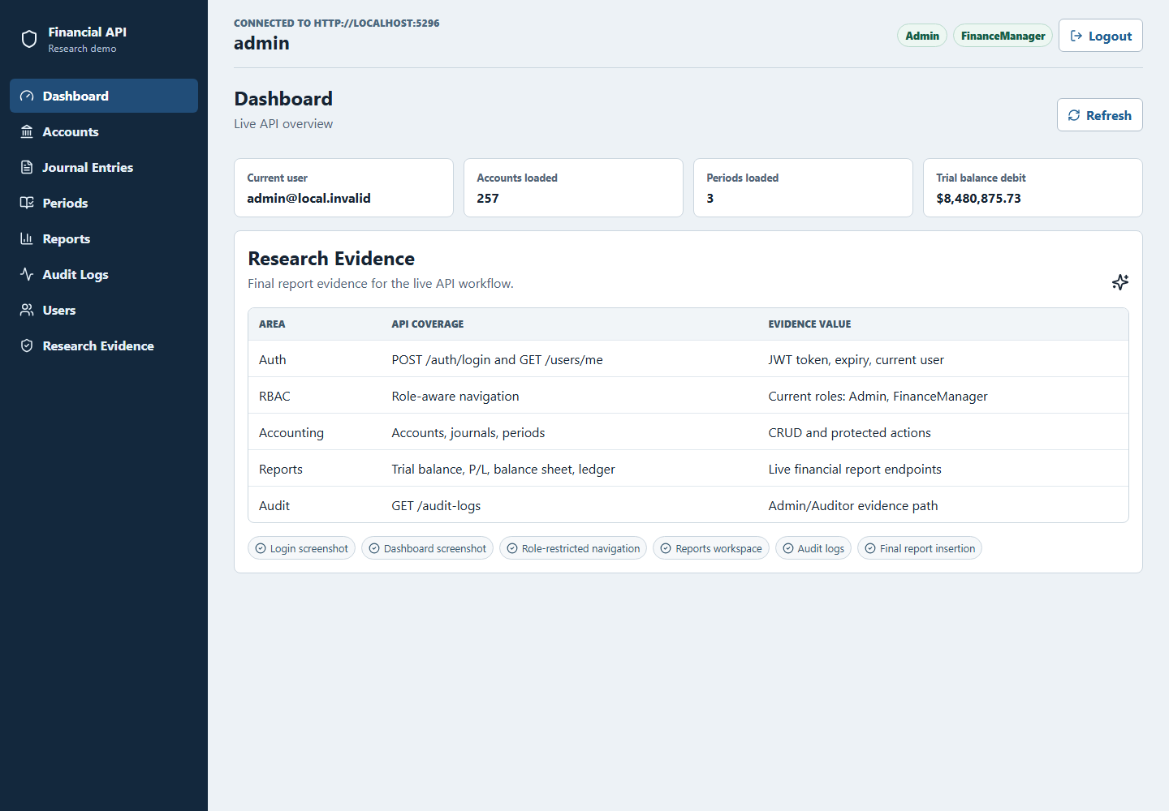
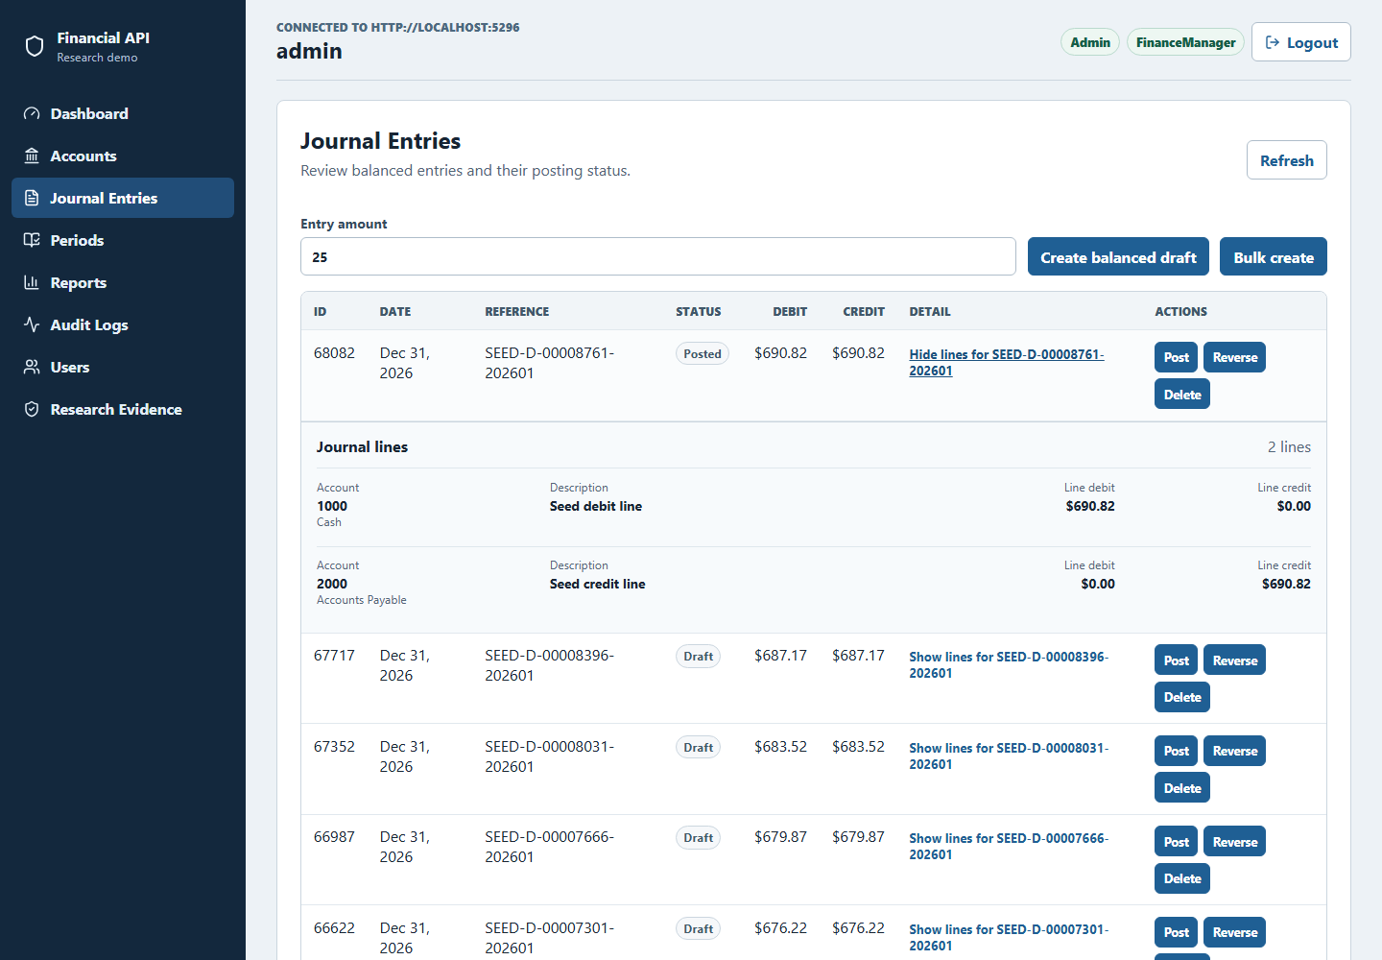
RESULTS
The API was exercised through a role-aware client
Admin dashboard
Balanced journal-entry lines
These are browser workflow screenshots; their displayed counts are not benchmark metrics.
Current report §4.6, Figures 4.2 and 4.7
24
Notes:
TIMING: 70 seconds
KEY MESSAGE: These are app screens, not speed-test results.
SHOW IF ASKED: backup slides 42-44 (browser views)
APPENDIX: Appendix J; Figures 4.2-4.7
SCRIPT:
The pictures show the admin dashboard and a journal entry whose debit and credit lines balance. They help demonstrate that I can use the API through the web app. They do not show how fast the API is. For performance evidence, use backup slide 31 or the JMeter dashboards on slides 37-41.
SOURCE: Current report §4.6 and Figures 4.2-4.7.

Slide 25
SYNTHESIS
The three results are different
Area | Decision | Why
Code quality | Achieved | 17 issues → 0; gate OK; small coverage/complexity regressions
Security | Configured gate passed | Passive cleared; raw API Medium transport alert remains
Core performance | Not achieved | 100 VU and 500 VU p95 exceeded thresholds
Soak/spike p95 | Improved separately | Tail p95 fell; other measures were mixed
Limits: one API · one host · one run per branch · CPU/RAM and service tiers not controlled
Current report Table 4.5; Appendix N
25
Notes:
TIMING: 80 seconds
KEY MESSAGE: The study does not support a blanket claim that everything improved.
SHOW IF ASKED: backup slides 29-31 (outcome details)
APPENDIX: Appendices M and N
SCRIPT:
Code warnings fell from 17 to zero, although coverage fell a little and complexity rose. ZAP's selected checks passed, but the local HTTP alert stayed. JMeter missed the main 100- and 500-user speed targets even though soak and spike improved. This is one API on one computer with one fresh run per branch. We did not save CPU and memory readings for those runs, so I would repeat the tests before claiming the result applies elsewhere.
SOURCE: Current report Table 4.5 and Appendix N.

Slide 26
CLOSING
The strongest contribution is the traceable check-and-fix method
The model can help
01
Seventeen fresh static issues closed; security rule gate passed.
Measurement can reject it
02
The primary JMeter target was not met despite lower soak and spike p95.
Provenance makes it auditable
03
Pinned branches, tests, dashboard captures, and raw records remain available.
Thank you. Questions?
Current report Chapter 5; Appendices A-N
26
Notes:
TIMING: 80 seconds
KEY MESSAGE: The contribution is a way to check AI suggestions, including when they do not work.
SHOW IF ASKED: backup slide 27 (where every claim is checked)
APPENDIX: Appendices A, M, and N
SCRIPT:
Codex helped me propose code changes. I reviewed them, and the original tools measured the results. Code warnings reached zero and selected security checks passed, but the main performance target was not met. My contribution is the traceable process and this honest mixed result, not a claim that ChatGPT always improves an API. Thank you; I welcome questions.
SOURCE: Current report Chapter 5 and Appendices A-N.

Slide 27
BACKUP EVIDENCE
Where each defense claim can be checked
Claim | Machine-readable record | Report evidence
Dataset: 120 accounts | branch-verification.json | Tables 3.10-3.11 · Appendix H
Static issues | sonar/*/summary.json | Table 4.2 · Appendix E · Figures L.1-L.4
ZAP raw/gate | zap/*/summary.json | §4.3 · Appendices F and M
JMeter p95/gate | jmeter/*/summary.json | §4.4 · Appendix G · Figures L.9-L.18
Working API | role/browser run records | §4.6 · Figures 4.2-4.7
Current report Appendices A-N and fresh run summaries
27
Notes:
TIMING: 0 seconds
KEY MESSAGE: Backup evidence: evidence map.
SCRIPT:
Start with the claim in the left column. The middle column names the raw result file; the right column names the report section. The first row confirms the 120 seeded accounts used by the tests.
SOURCE: branch-verification.json dataset counts; current report Appendices A-N.

Slide 28
BACKUP EVIDENCE
Exact baseline and remediation commits
Role | Branch | Tested commit
Shared baseline | baseline-v0.1 | 7a0469d9
Static quality | baseline-sonarqube-v1 | a2279bcb
Security | baseline-zap-v1 | 5f3bd3cc
Performance | baseline-jmeter-v1 | 78b08b62
Reproduction | codex/thesis-reproducibility-v1 | efa19cea
Current report Appendix A; Table 3.1
28
Notes:
TIMING: 0 seconds
KEY MESSAGE: Backup evidence: branch provenance.
SCRIPT:
Open this slide if asked for proof. Point to the relevant number or code change, then name the source shown on the slide.
SOURCE: Current report Appendix A and Table 3.1.

Slide 29
BACKUP EVIDENCE
Fresh SonarQube metric detail
Metric | Baseline | After | Meaning
Total unique issues | 17 | 0 | Distinct issue count
Code smells | 17 | 0 | Legacy type
Bugs | 0 | 0 | Legacy type
Vulnerabilities | 0 | 0 | Legacy type
Reliability impact* | 2 | 0 | Overlapping impact
Security impact* | 1 | 0 | Overlapping impact
Maintainability impact* | 16 | 0 | Overlapping impact
Security hotspots | 0 | 0 | Scanner finding
Coverage | 74.4% | 74.3% | Down 0.1 point
Duplicated lines | 0.0% | 0.0% | Unchanged
Cyclomatic complexity | 886 | 889 | Up 3
Cognitive complexity | 165 | 165 | Unchanged
Quality Gate | OK | OK | OK/OK; no conditions saved
Current report Table 4.2; fresh SonarQube summaries
29
Notes:
TIMING: 0 seconds
KEY MESSAGE: Backup evidence: full fresh SonarQube metrics.
SCRIPT:
Point to Total unique issues: 17 before, zero after. The gate status is OK on both, but no gate conditions were saved, so do not use that status alone to claim improvement. Coverage slipped by 0.1 percentage point.
SOURCE: Current report Table 4.2; fresh SonarQube summary.json and quality-gate.json.
CAUTION: * MQR impacts overlap; do not sum them as unique issues. Both saved gate files have an empty conditions list.

Slide 30
BACKUP EVIDENCE
Fresh ZAP raw alert counts and gate
Scan | Role | High | Medium | Low | Info | Gate
Passive | baseline | 0 | 3 | 6 | 3 | PASS
Auth API | baseline | 0 | 1 | 3 | 5 | PASS
Passive | remediation | 0 | 0 | 0 | 4 | PASS
Auth API | remediation | 0 | 1 | 0 | 5 | PASS
Raw API Medium after remediation = 1 (HTTP Only Site); configured rule gate = PASS.
Current report §4.3; fresh ZAP summaries; Appendix F
30
Notes:
TIMING: 0 seconds
KEY MESSAGE: Backup evidence: full fresh ZAP outcomes.
SCRIPT:
Point to the Auth API after-fix row: Medium is still one, while Low is zero. The Medium is HTTP Only Site because the local scan used HTTP. The configured rule gate passed, but this raw alert was not cleared; an HTTPS retest is needed.
SOURCE: Current report §4.3 and fresh ZAP summary.json.
CAUTION: Configured gate PASS does not mean every raw API Medium alert cleared.

Slide 31
BACKUP EVIDENCE
Fresh JMeter profile matrix
Profile | Baseline p95 | After p95 | Before err | After err | After tx/s
50 VU | 33.00 | 199.90 | 0.0000% | 0.0000% | 52.64
100 VU | 255.90 | 1,146.90 | 0.0000% | 0.0000% | 54.11
500 VU | 106.00 | 1,547.95 | 0.0000% | 0.0000% | 62.44
soak | 443.95 | 171.00 | 0.0000% | 0.0000% | 170.98
spike | 33,401.75 | 4,730.85 | 0.4688% | 0.0000% | 149.90
Baseline core gate PASS; remediation core gate FAIL (100 VU and 500 VU thresholds).
Current report §4.4; fresh JMeter summaries
31
Notes:
TIMING: 0 seconds
KEY MESSAGE: Backup evidence: full fresh JMeter matrix.
SCRIPT:
Point to the 100- and 500-VU rows. Their after-fix p95 values are higher than before and exceed the study limits, so the core target was not met. Soak and spike have lower p95 after the fix, but those are separate tests.
SOURCE: Fresh JMeter baseline/remediation summary.json and current report §4.4.

Slide 32
BACKUP EVIDENCE
S107 source: eight parameters to one DTO
BEFORE · baseline-v0.1
AFTER · baseline-sonarqube-v1
GetPaged(
from, to, status, accountId,
search, page, pageSize, sort
)
// 8 query parameters
GetPaged(
JournalEntryQueryDto query
)
// DTO carries the query inputs
Measured result: fresh SonarQube issues 17 → 0; the route remains GET /journal-entries.
Current report Listing E.1; Tables 3.4 and 4.3
32
Notes:
TIMING: 0 seconds
KEY MESSAGE: Backup evidence: S107 controller DTO change.
SCRIPT:
Open this slide if asked for proof. Point to the relevant number or code change, then name the source shown on the slide.
SOURCE: Current report Listing E.1, Table 4.3, Appendix E.

Slide 33
BACKUP EVIDENCE
Source examples: security order and report persistence
SECURITY · API/Program.cs
PERFORMANCE · FinancialReportService.cs
SecurityHeadersMiddleware
→ before Swagger/OpenAPI
Swagger UI exposed only when the separate UI flag allows it.
Cache account-ledger data
+ stop report snapshot writes on this read path
The core speed target was not met.
This shows what changed in code; slide 31 shows the measured performance result.
Current report Listings F.1-F.2 and G.1-G.3
33
Notes:
TIMING: 0 seconds
KEY MESSAGE: Backup evidence: security and performance source paths.
SCRIPT:
The left side shows the security-header change. The right side shows my performance attempt: cache ledger data and avoid a report snapshot write on this read path. This proves the change was made, not that it made the API faster. For speed numbers, open backup slide 31 and dashboards 38-39.
SOURCE: Current report Appendices F and G.

Slide 34
BACKUP EVIDENCE
Authorization and accounting controls remained testable
Control | Evidence path | Expected boundary
JWT / roles | Controller attributes + RBAC matrix | Protected routes reject unauthorized roles
Journal posting | Balanced debit-credit source | Closed periods and unequal totals rejected
Audit trail | Service + browser log view | Actor and sensitive action recorded
Browser roles | Admin / Auditor screenshots | Navigation and read-only behavior visible
Current report Appendices C, D, I and §4.6
34
Notes:
TIMING: 0 seconds
KEY MESSAGE: Backup evidence: authorization and accounting evidence.
SCRIPT:
Open this slide if asked for proof. Point to the relevant number or code change, then name the source shown on the slide.
SOURCE: Current report Appendices C, D, I and Figures 4.2-4.7.

Slide 35
BACKUP · NATIVE DASHBOARDS
SonarQube overview · baseline vs remediation
BASELINE
REMEDIATION
17 issues → 0; gate OK/OK (no conditions recorded); coverage 74.4% → 74.3%.
Appendix L Figures L.1 and L.3
35
Notes:
TIMING: 0 seconds
KEY MESSAGE: Backup evidence: SonarQube overview · baseline vs remediation.
SCRIPT:
The two current screenshots show different issue counts: 17 before and zero after. Both show Quality Gate OK, but the saved gate files contain no conditions. Do not present OK/OK as the evidence of improvement; use the issue counts and disclose that coverage fell slightly.
SOURCE: Appendix L Figures L.1 and L.3
CAUTION: Capture classification: fresh-reproduction. Baseline origin/baseline-v0.1 @ 7a0469d9, run 20260922-183352; remediation origin/baseline-sonarqube-v1 @ a2279bcb, run 20260922-183352.

Slide 36
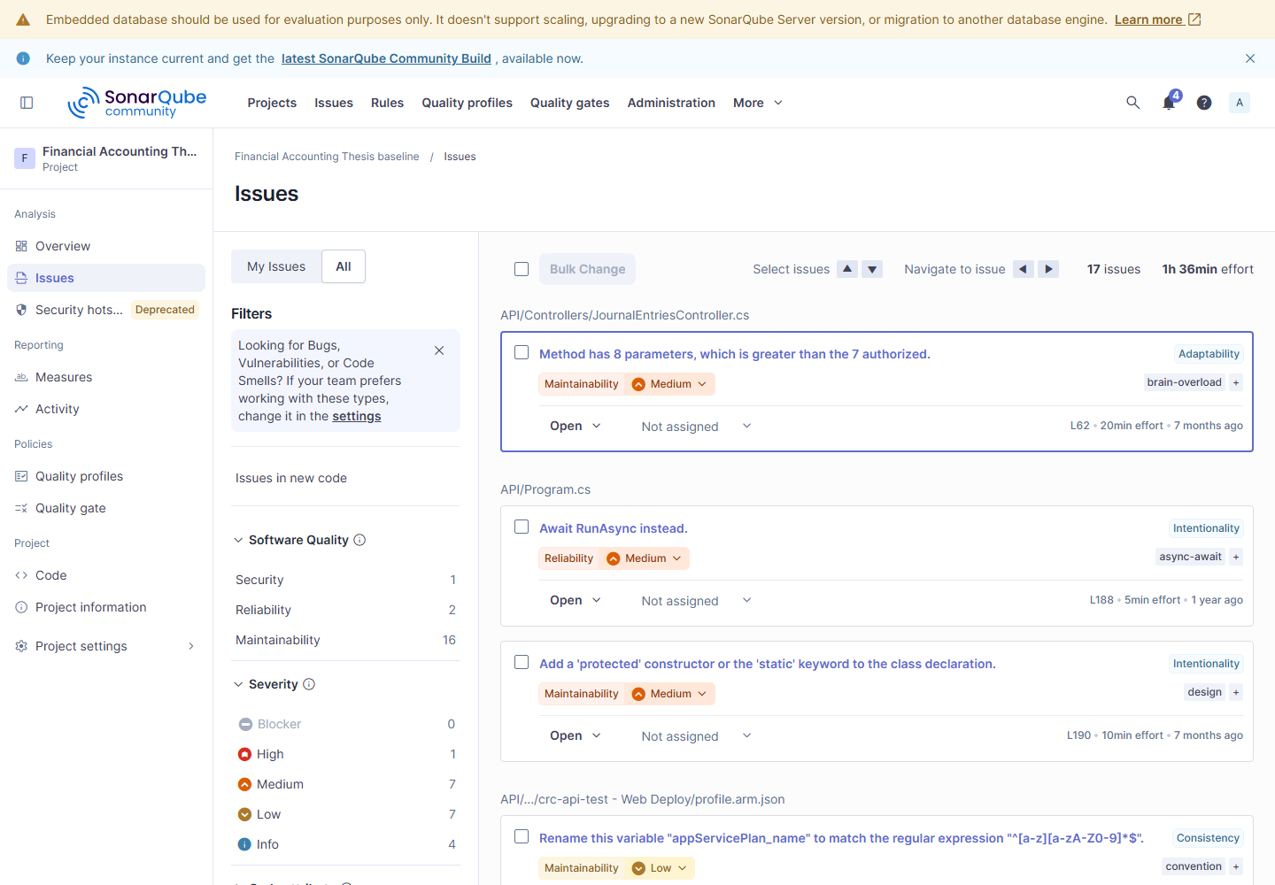
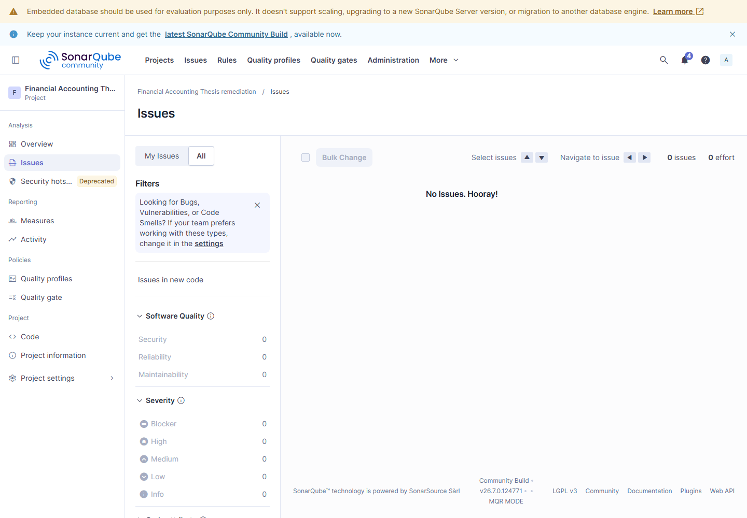
BACKUP · NATIVE DASHBOARDS
SonarQube issues · baseline vs remediation
BASELINE
REMEDIATION
Fresh issue-list views: 17 baseline findings and 0 after remediation.
Appendix L Figures L.2 and L.4
36
Notes:
TIMING: 0 seconds
KEY MESSAGE: Backup evidence: SonarQube issues · baseline vs remediation.
SCRIPT:
Point to the issue list: the baseline has 17 distinct findings and the changed branch has zero. These are the direct issue-count views; the gate status is separate.
SOURCE: Appendix L Figures L.2 and L.4
CAUTION: Capture classification: fresh-reproduction. Baseline origin/baseline-v0.1 @ 7a0469d9, run 20260922-183352; remediation origin/baseline-sonarqube-v1 @ a2279bcb, run 20260922-183352.

Slide 37
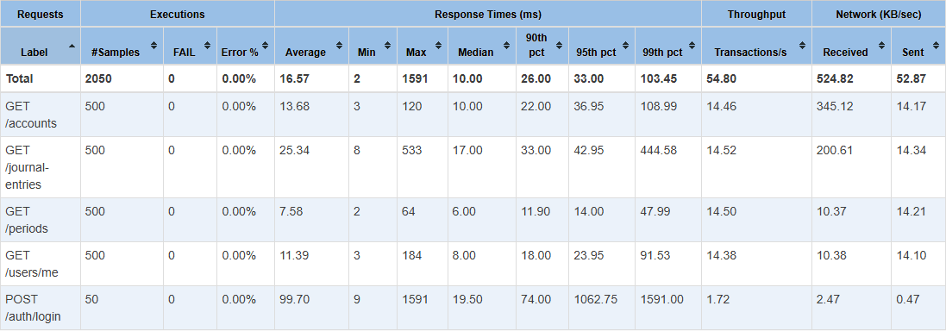
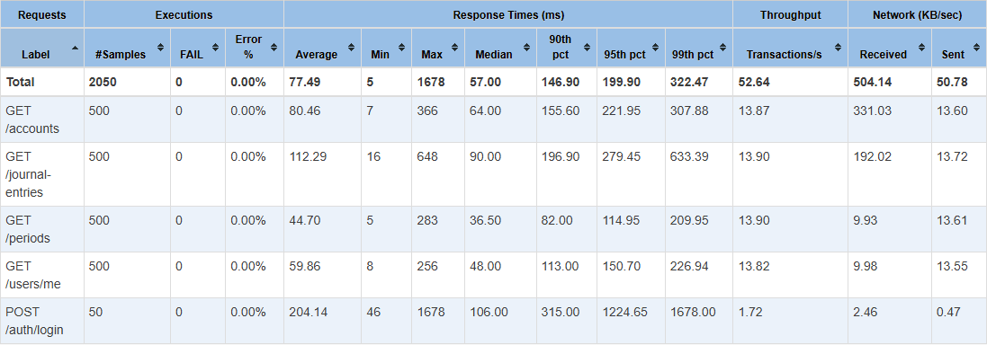
BACKUP · NATIVE DASHBOARDS
JMeter 50 VU · baseline vs remediation
BASELINE
REMEDIATION
Fresh total p95 33 → 199.9 ms · CORE SLOWER.
Appendix L Figures L.9 and L.14; fresh JMeter summary.json
37
Notes:
TIMING: 0 seconds
KEY MESSAGE: Backup evidence: JMeter 50 VU · baseline vs remediation.
SCRIPT:
At 50 simulated users, total p95 rose from 33 to 199.9 milliseconds. It is slower after the code change, even though it stayed below this study's 300-millisecond limit.
SOURCE: Appendix L Figures L.9 and L.14; fresh JMeter summary.json
CAUTION: Capture classification: fresh-reproduction. Baseline origin/baseline-v0.1 @ 7a0469d9, run baseline-20260922-192730; remediation origin/baseline-jmeter-v1 @ 78b08b62, run remediation-20260922-200712.

Slide 38
BACKUP · NATIVE DASHBOARDS
JMeter 100 VU · baseline vs remediation
BASELINE
REMEDIATION
Fresh total p95 255.9 → 1146.9 ms · CORE TARGET NOT MET.
Appendix L Figures L.10 and L.15; fresh JMeter summary.json
38
Notes:
TIMING: 0 seconds
KEY MESSAGE: Backup evidence: JMeter 100 VU · baseline vs remediation.
SCRIPT:
In the Total row, find the 95th-percentile response time. At 100 VU, it rose from 255.9 to 1146.9 milliseconds. The after-fix value is above this study's 500-millisecond limit, so the core target was not met. This is a measurement, not proof of what caused the slowdown.
SOURCE: Appendix L Figures L.10 and L.15; fresh JMeter summary.json
CAUTION: Capture classification: fresh-reproduction. Baseline origin/baseline-v0.1 @ 7a0469d9, run baseline-20260922-192730; remediation origin/baseline-jmeter-v1 @ 78b08b62, run remediation-20260922-200712.

Slide 39
BACKUP · NATIVE DASHBOARDS
JMeter 500 VU · baseline vs remediation
BASELINE
REMEDIATION
Fresh total p95 106 → 1547.95 ms · CORE TARGET NOT MET.
Appendix L Figures L.11 and L.16; fresh JMeter summary.json
39
Notes:
TIMING: 0 seconds
KEY MESSAGE: Backup evidence: JMeter 500 VU · baseline vs remediation.
SCRIPT:
In the Total row, find the 95th-percentile response time. At 500 VU, it rose from 106 to 1547.95 milliseconds. The after-fix value is above this study's 1200-millisecond limit, so the core target was not met. This is a measurement, not proof of what caused the slowdown.
SOURCE: Appendix L Figures L.11 and L.16; fresh JMeter summary.json
CAUTION: Capture classification: fresh-reproduction. Baseline origin/baseline-v0.1 @ 7a0469d9, run baseline-20260922-192730; remediation origin/baseline-jmeter-v1 @ 78b08b62, run remediation-20260922-200712.

Slide 40
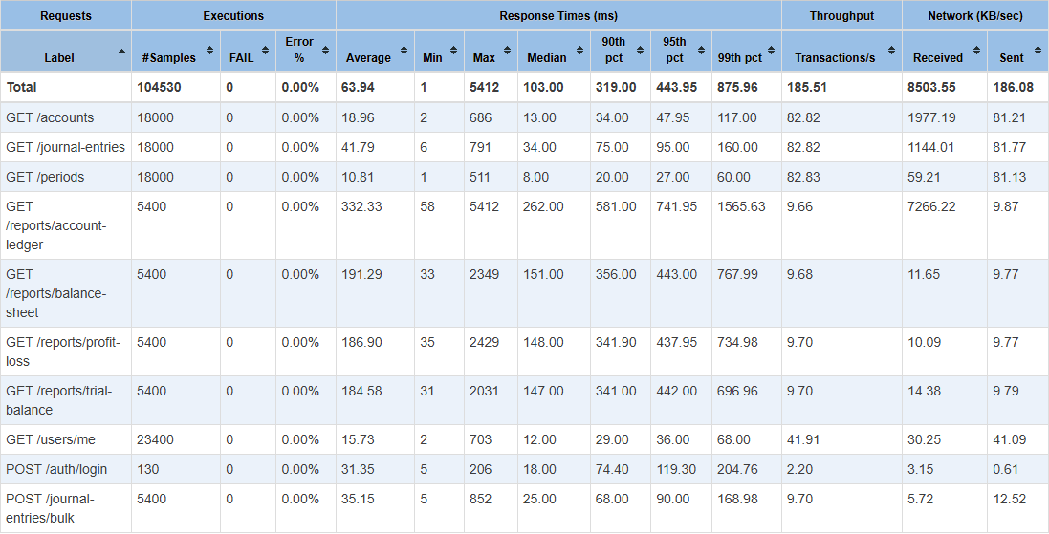
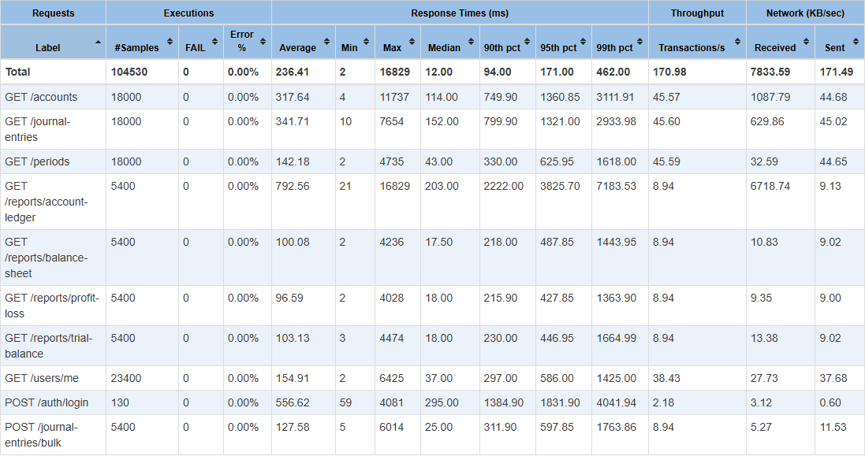
BACKUP · NATIVE DASHBOARDS
JMeter soak · baseline vs remediation
BASELINE
REMEDIATION
Fresh total p95 443.95 → 171 ms · SOAK p95 LOWER.
Appendix L Figures L.12 and L.17; fresh JMeter summary.json
40
Notes:
TIMING: 0 seconds
KEY MESSAGE: Backup evidence: JMeter soak · baseline vs remediation.
SCRIPT:
This long steady soak test had a lower total p95 after the change: 443.95 to 171 milliseconds. That is an improvement for this test only. It does not change the unmet 100- and 500-user core targets on slide 31.
SOURCE: Appendix L Figures L.12 and L.17; fresh JMeter summary.json
CAUTION: Capture classification: fresh-reproduction. Baseline origin/baseline-v0.1 @ 7a0469d9, run baseline-20260922-192730; remediation origin/baseline-jmeter-v1 @ 78b08b62, run remediation-20260922-200712.

Slide 41
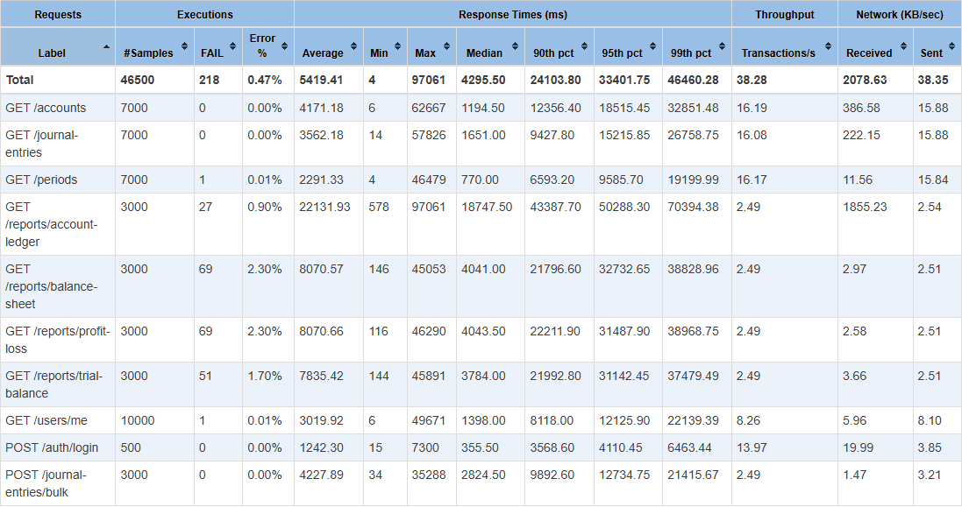
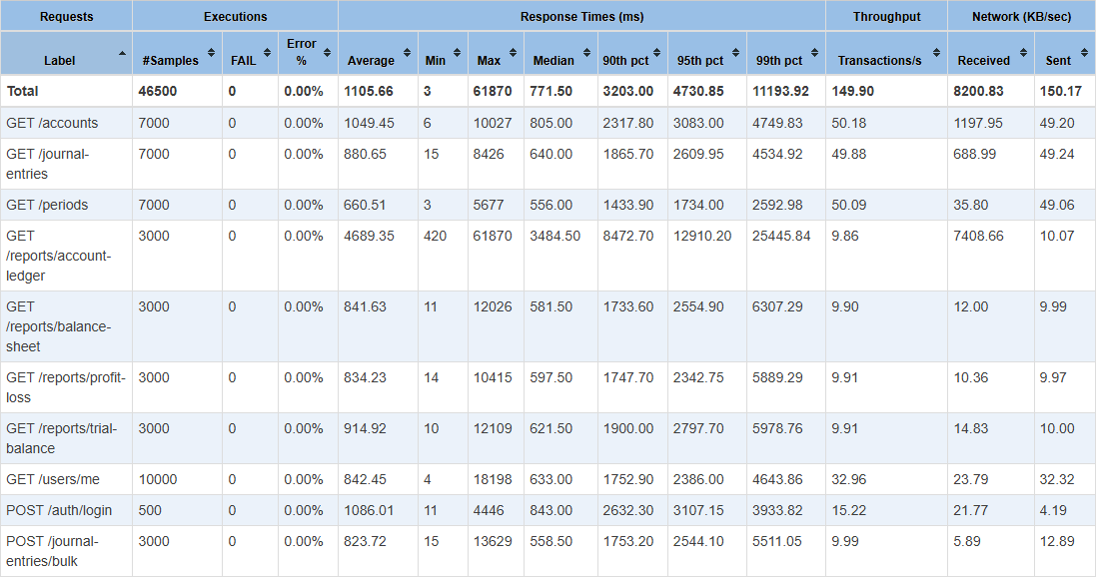
BACKUP · NATIVE DASHBOARDS
JMeter spike · baseline vs remediation
BASELINE
REMEDIATION
Fresh total p95 33401.8 → 4730.85 ms · SPIKE p95 LOWER.
Appendix L Figures L.13 and L.18; fresh JMeter summary.json
41
Notes:
TIMING: 0 seconds
KEY MESSAGE: Backup evidence: JMeter spike · baseline vs remediation.
SCRIPT:
This sudden spike test had a lower total p95 after the change: 33401.8 to 4730.85 milliseconds. That is an improvement for this test only. It does not change the unmet 100- and 500-user core targets on slide 31.
SOURCE: Appendix L Figures L.13 and L.18; fresh JMeter summary.json
CAUTION: Capture classification: fresh-reproduction. Baseline origin/baseline-v0.1 @ 7a0469d9, run baseline-20260922-192730; remediation origin/baseline-jmeter-v1 @ 78b08b62, run remediation-20260922-200712.

Slide 42
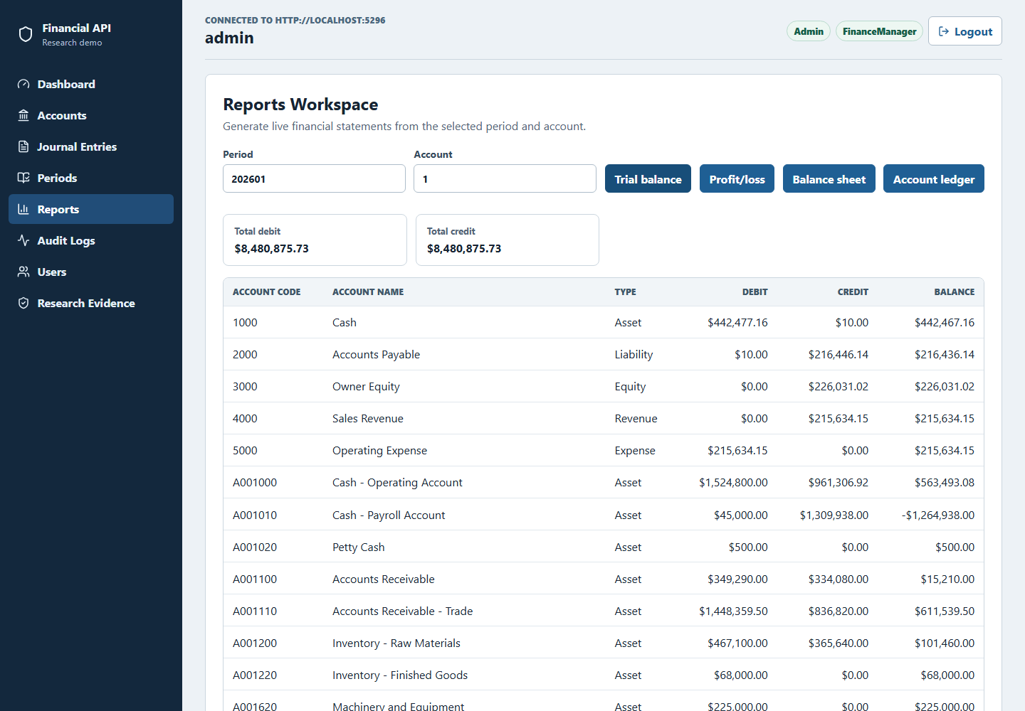
BACKUP · APPLICATION EVIDENCE
App screens—not load-test data
Admin dashboard
Trial-balance report
Current report Figures 4.2 and 4.3
42
Notes:
TIMING: 0 seconds
KEY MESSAGE: Backup evidence: App screens—not load-test data.
SCRIPT:
These pictures show that I can use the application and see its accounting screens. They do not measure speed. For JMeter response times, open backup slide 31 or dashboards 37-41.
SOURCE: Current report Figures 4.2 and 4.3
CAUTION: These are browser workflow captures; visible live application counts are not JMeter benchmark metrics.

Slide 43
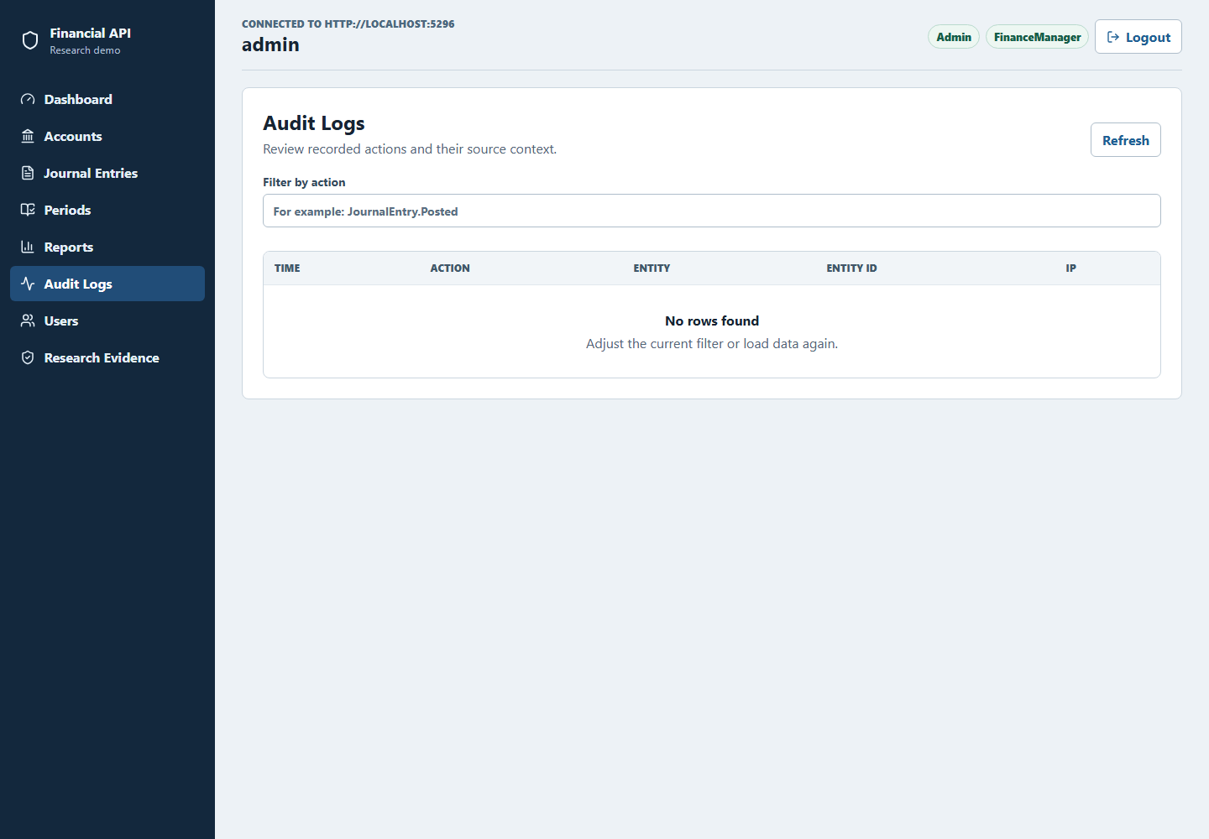
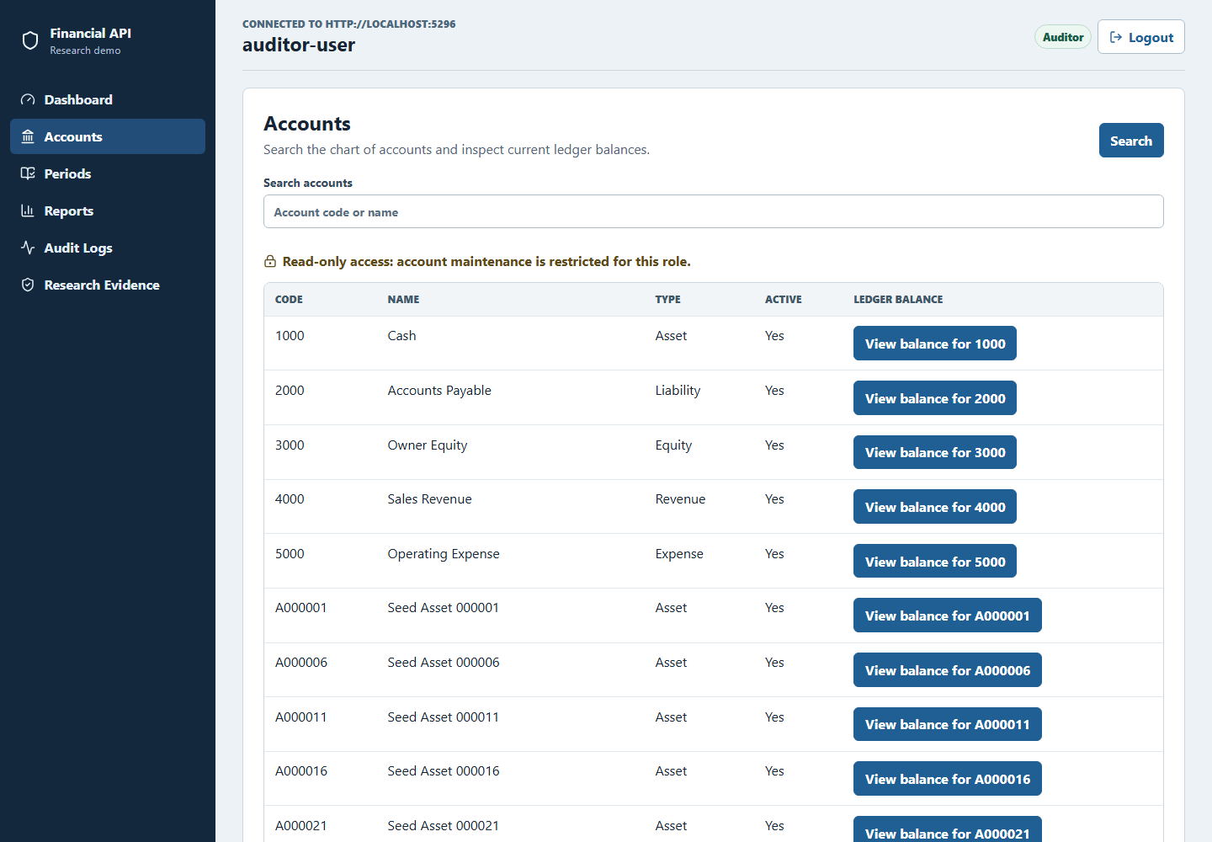
BACKUP · APPLICATION EVIDENCE
Application: audit and role restrictions
Audit-log view
Auditor navigation
Current report Figures 4.4 and 4.5
43
Notes:
TIMING: 0 seconds
KEY MESSAGE: Backup evidence: Application: audit and role restrictions.
SCRIPT:
These pictures show that I can use the application and see its accounting screens. They do not measure speed. For JMeter response times, open backup slide 31 or dashboards 37-41.
SOURCE: Current report Figures 4.4 and 4.5
CAUTION: These are browser workflow captures; visible live application counts are not JMeter benchmark metrics.

Slide 44
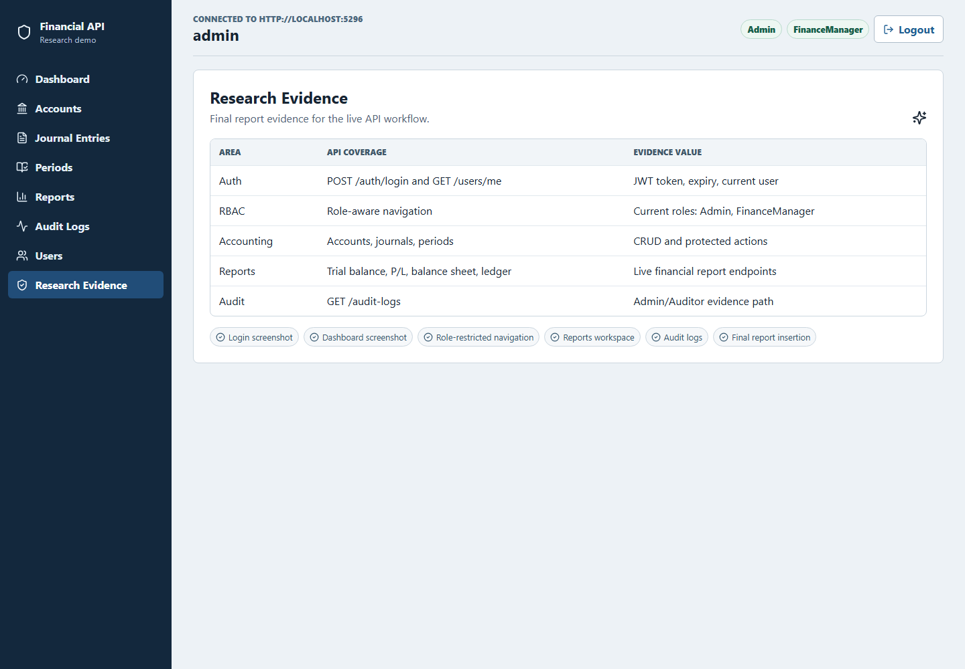
BACKUP · APPLICATION EVIDENCE
Application: evidence and balanced journal lines
Research-evidence map
Expanded debit and credit lines
Current report Figures 4.6 and 4.7
44
Notes:
TIMING: 0 seconds
KEY MESSAGE: Backup evidence: Application: evidence and balanced journal lines.
SCRIPT:
These pictures show that I can use the application and see its accounting screens. They do not measure speed. For JMeter response times, open backup slide 31 or dashboards 37-41.
SOURCE: Current report Figures 4.6 and 4.7
CAUTION: These are browser workflow captures; visible live application counts are not JMeter benchmark metrics.

