Slide 1

CSCE 606 Software Engineering
Hank Walker
Based on materials from Armando Fox and David Patterson
© 2013 Armando Fox & David Patterson, all rights reserved

Slide 2
Outline
Class Organization
§1.1 Introduction to Software Engineering
§1.5 Software as a Service
§1.4 Service Oriented Architecture
§1.6 Cloud Computing
§1.7 Beautiful vs. Legacy Code
§1.8 Software Quality Assurance: Testing
§1.9 Productivity: Clarity via Conciseness, Synthesis, Reuse, & Tools

Slide 3
Course Goals
Learn Software Engineering Principles by understanding new challenges, opportunities, and open problems of SaaS
Take a SaaS project from conception to public deployment
Solve Non-Technical Customer problem
Server side: Ruby on Rails
Client side: HTML, CSS, AJAX, JavaScript
Deploy using cloud computing

Slide 4
Projects for Non-Profits
Teams of ~6 students build projects for non-technical customers from nearby nonprofit organizations, e.g.,
Humane Society Pet Matchmaker
Student Dormitory Package Notifier
Minority VC firm Customer Relationship Manager (tracks startup proposals)
Children’s Hospital Nurse Vacation Scheduler
Teams meet weekly with TA; start forming this week!

Slide 5
Children’s Hospital
Screencast of Spring 2012 UCB CS169 project Nurse Scheduler https://vimeo.com/44837891
Interview with Nurse Managers https://vimeo.com/46770083
Your team will record a video interview and screencast for your project

Slide 6
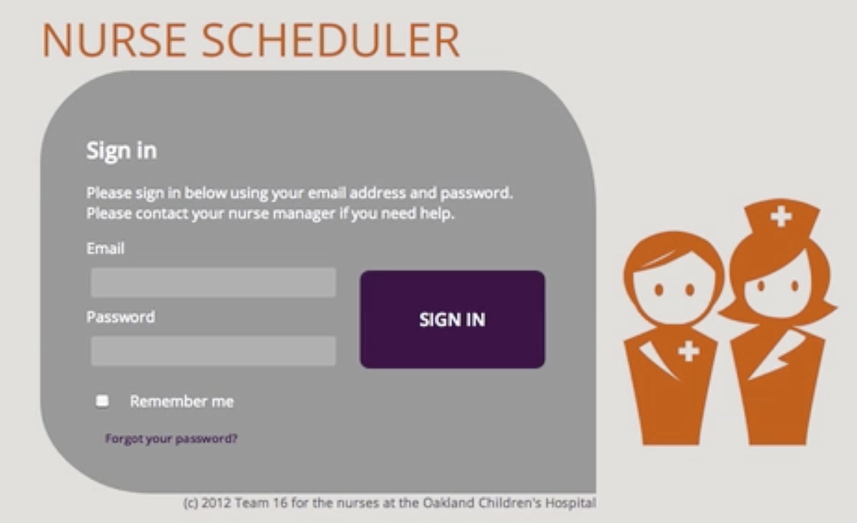
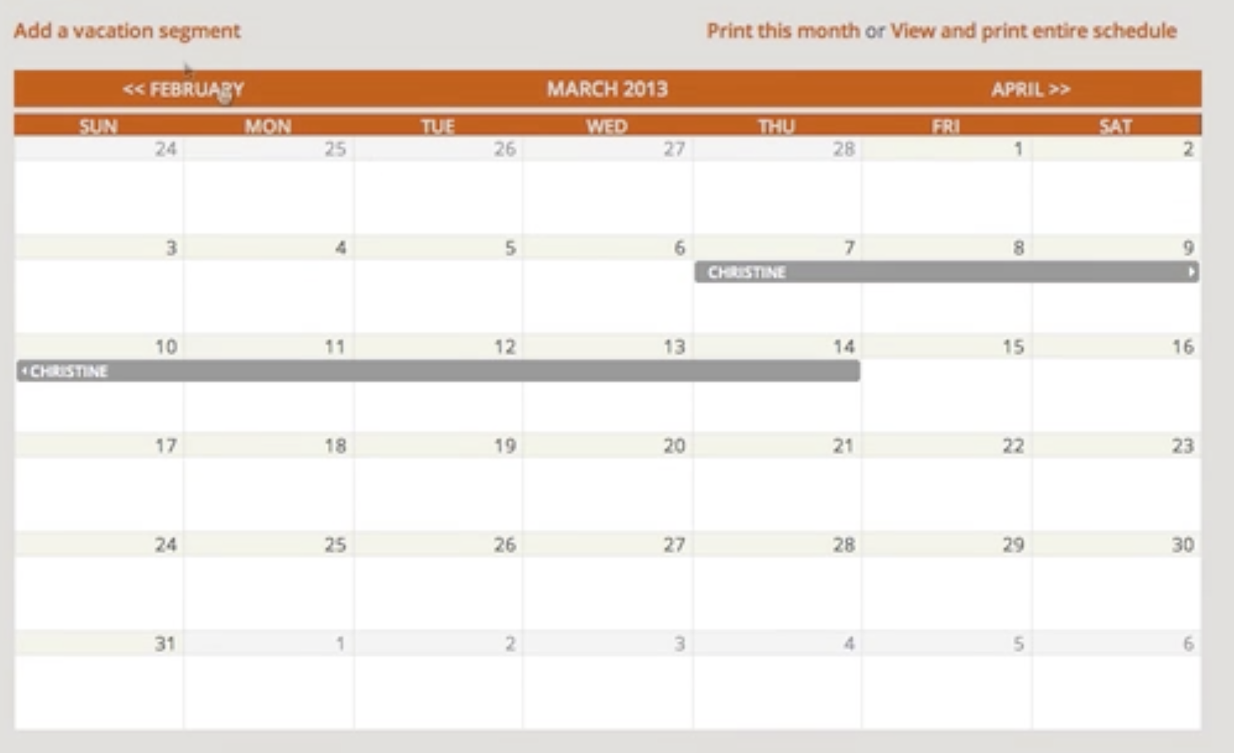
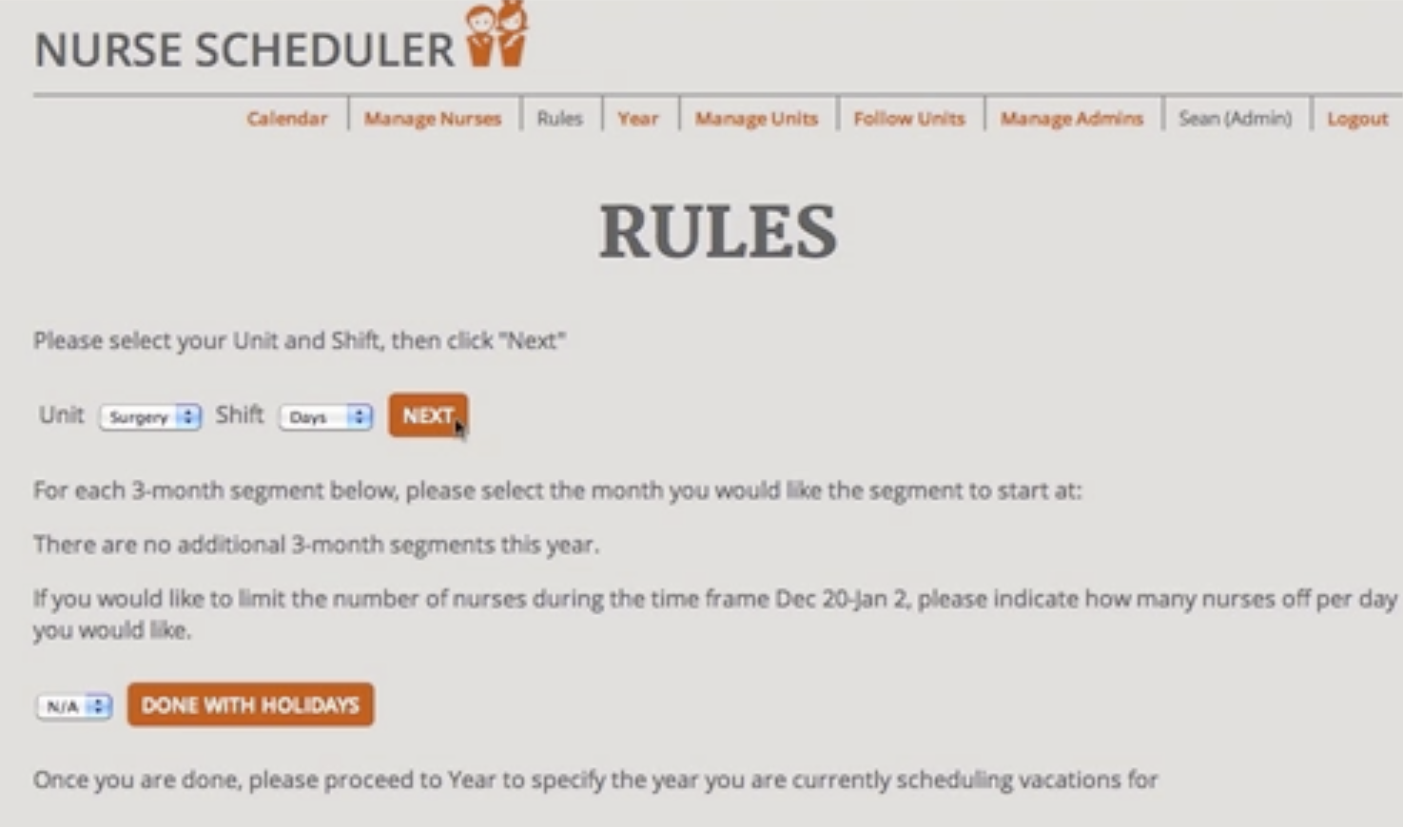
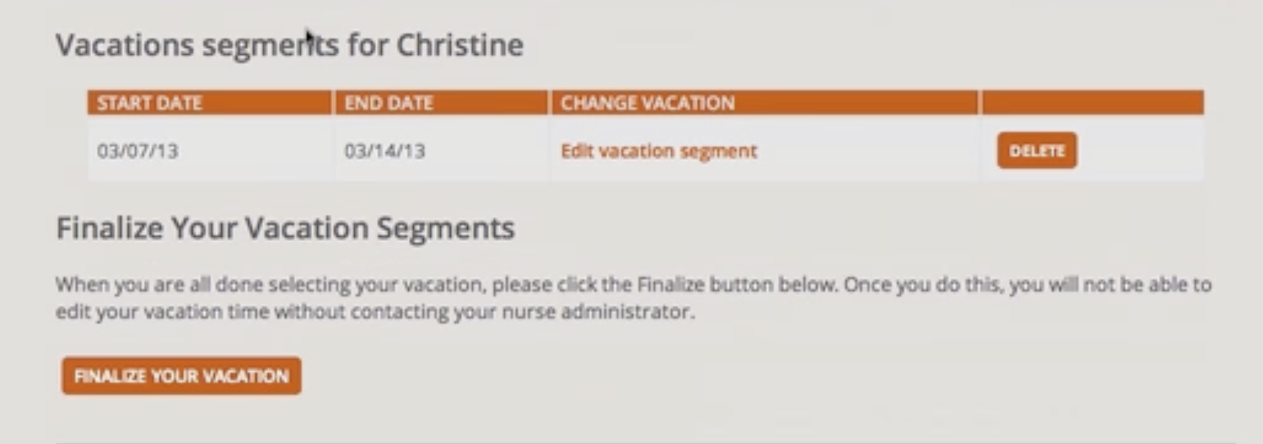
Nurse Scheduler Deployed at Oakland Children’s Hospital

Slide 7
Results/Observations
Non-technical customer feedback
90% of teams reported customers “happy” or “thrilled”
50% of customers tried to hire students to continue work
67% of students intend to maintain app after semester
Students engaged in process
Later iteration stories more uniform in complexity & size
Projects varied in code quantity but rarely quality

Slide 8
Course Organization
Grading
20% assignments
15% quizzes
15% midterm
50% project
Bonus points based on Participation and Altruism (e.g., answering Piazza questions)
Schedule
Tue/Thu: lecture 11:10am-12:25pm, ARCC 207
Teams meet TA in office hours
Use Piazza
Notes:
Proactive helping with correct and helpful answers in Piazza to help class

Slide 9
Prereqs & Course Format
Prereqs
Official: CSCE 431 or approval of instructor
Practical: Know object-oriented programming language
Format
Before lecture: do reading
In lecture: put reading in context
After lecture: assignments, for hands-on practice
Required “2-pizza team” (~6 students) project
Design, develop, deploy to “production ISP” (Heroku)
Outsiders invited to final project poster session
Wed, May 6, 2015, Time/Location TBD

Slide 10
Programming Assignments
Some done on your own, others in pairs
Due Sunday night
Late policy: ¾ credit if 1 day late, ½ credit if 2 days late, 0 if later
Almost all assignments and project will be deployed using cloud computing and evaluated there
GitHub: Get a Free Micro Account for Students for use in this class
Notes:
Virtualbox on your own computer, or use AWS
Good luck if want to install everything on your own, including the bugs – we can’t help

Slide 11
Honor Code
The Aggie Honor Code:
“An Aggie does not lie, cheat, or steal or tolerate those who do.”
If you wouldn’t want fellow students, parents, or professors to know about it, then stop it!
Your instructors join you in pledging to adhere to this code
It is easy to lose your reputation and very hard to regain it!

Slide 12
Virtual Machine (VM)
http://www.saasbook.info/bookware-vm-instructions
Option 1:
Obtain Amazon Web Services (AWS) account
You must give them a credit card number
$10 coupon with Kindle version of book
Set up VM
Option 2:
Download Course Virtual Machine “VirtualBox” (for Mac, Win, Linux) and get it running on your computer

Slide 13
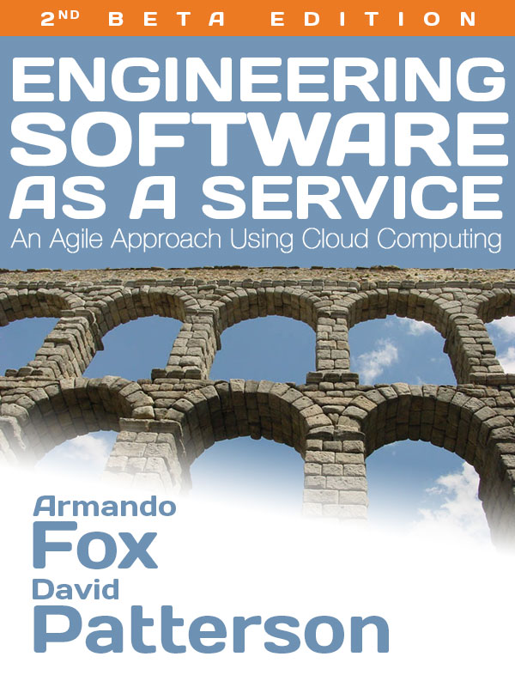
Textbook
http://saasbook.info
1st edition (1.1.1 as of 9/2014)
Ebook ($10)
Kindle format
Print book ($30)
Print + Ebook bundle ($33)
Notes:
New this year is a textbook – now
Guarantees
Cheapest new textbook you’ve purchased
Best textbook you’ll ever read by a wrestler and a musical director
Will be updated as ebook if find bugs
Hoping trouble shoot beta edition

Slide 14
Teaching Assistant
Meghanath Reddy
Office: RDMC 021B
Email: meghz17@tamu.edu
Office Hours: Mon 10am-1pm

Slide 15
Online Resources
http://www.saasbook.info/students
Online “get started” tutorials on Ruby in case you want to start on Ruby now
Pointers to online HTML/CSS tutorials in case you want start on Rails now
Tutorials on other tools (GitHub, etc.)
Feel free to suggest more on Piazza

Slide 16
YOUR BRAIN ON COMPUTERS; Hooked on Gadgets, and Paying a Mental Price
NY Times, June 7, 2010, by Matt Richtel
SAN FRANCISCO -- When one of the most important e-mail messages of his life landed in his in-box a few years ago, Kord Campbell overlooked it.
Not just for a day or two, but 12 days. He finally saw it while sifting through old messages: a big company wanted to buy his Internet start-up.
''I stood up from my desk and said, 'Oh my God, oh my God, oh my God,' '' Mr. Campbell said. ''It's kind of hard to miss an e-mail like that, but I did.''
The message had slipped by him amid an electronic flood: two computer screens alive with e-mail, instant messages, online chats, a Web browser and the computer code he was writing.
While he managed to salvage the $1.3 million deal after apologizing to his suitor, Mr. Campbell continues to struggle with the effects of the deluge of data. Even after he unplugs, he craves the stimulation he gets from his electronic gadgets. He forgets things like dinner plans, and he has trouble focusing on his family. His wife, Brenda, complains, ''It seems like he can no longer be fully in the moment.''
This is your brain on computers.
Scientists say juggling e-mail, phone calls and other incoming information can change how people think and behave. They say our ability to focus is being undermined by bursts of information.
These play to a primitive impulse to respond to immediate opportunities and threats. The stimulation provokes excitement -- a dopamine squirt -- that researchers say can be addictive. In its absence, people feel bored.
The resulting distractions can have deadly consequences, as when cellphone-wielding drivers and train engineers cause wrecks. And for millions of people like Mr. Campbell, these urges can inflict nicks and cuts on creativity and deep thought, interrupting work and family life.
While many people say multitasking makes them more productive, research shows otherwise. Heavy multitaskers actually have more trouble focusing and shutting out irrelevant information, scientists say, and they experience more stress.
And scientists are discovering that even after the multitasking ends, fractured thinking and lack of focus persist. In other words, this is also your brain off computers.
Notes:
Glad to see not lots of computers and phones – Research on productivity when multitasking, don’t understand anything you do.
Harder to concentrate
As we will see this week ; real companies like Pivotal Labs with Pair Programming – work 9 to 5, but concentrate during day, catch up with email at tables without chairs

Slide 17
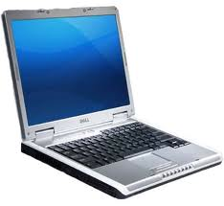
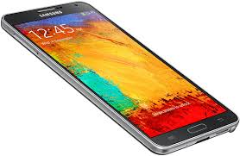
The Rules (and we really mean it!)

Slide 18
Architecture of a Lecture
Full
Administrivia
“And in conclusion…”
Attention
0
20
25
73
75
Time (minutes)
Notes:
Temptation after 20 minutes, starting on time
Open to Facebook, tweet
Be quiet, during last minute

Slide 19


Peer Instruction Questions
Increase real-time learning in lecture, test understanding of concepts vs. details
As complete a “segment” ask multiple choice question
<1 minute: decide yourself, vote
<2 minutes: discuss in pairs, then team vote; flash card to pick answer
Try to convince partner; learn by teaching
Mark and save flash cards
1
2
3
4
Notes:
Number the cards now –
Test colors now: Orange, Olive Green. Red, Blue
Have questions
Explain model – individual vote, discuss, pair vote

Slide 20
Have You Used GitHub?
☐
Yes, I have used GitHub
☐
No, I have not used GitHub
☐
What is GitHub?
☐
I’ve already lost my yellow 3x5 card
Notes:
VertLeftWhiteCheck1
No field upgrade when improve – really it’s the data
Almost one Exabyte for YouTube; 1M TB
Search needs Petabytes of data

Slide 21
Which is True About CSCE 606 Schedule?
☐
I can leave for Spring Break early since we won’t have a lecture the week before
☐
I can leave for summer early since the project poster/demo session is optional
☐
Faculty don’t mind if I text or do Facebook during lecture on my cell/laptop
☐
You project team needs to hold weekly meetings with the TA
Notes:
VertLeftWhiteCheck1
No field upgrade when improve – really it’s the data
Almost one Exabyte for YouTube; 1M TB
Search needs Petabytes of data

Slide 22
END

Slide 23
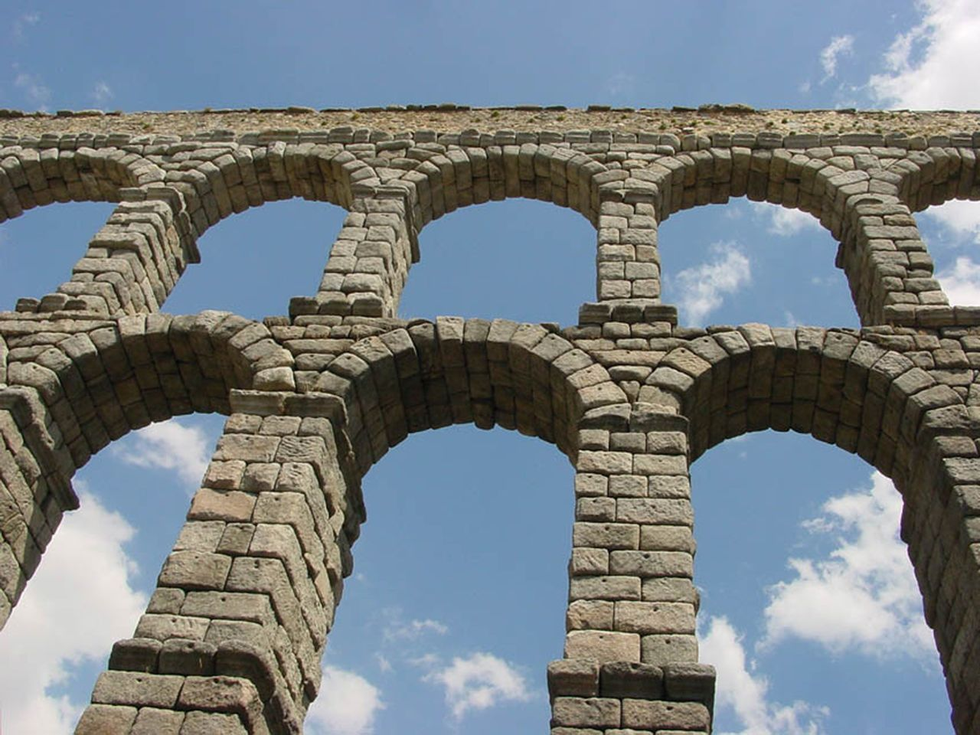
Introduction to Software Engineering
(Engineering Software as a Service §1.1, 1.5)
Notes:
Very popular topics

Slide 24
Ranking Top 200 Jobs (2012)
28. Civil Engineer
38. Nurse
40. Physician
47. Accountant
60. Mechanical Engineer
73. Electrical Engineer
87. Attorney
1. Software Engineer
104. Airline Pilot
133. Fashion Designer
137. High School Teacher
163. Police Officer
173. Flight Attendant
185. Firefighter
196. Newspaper Reporter
200. Lumberjack
InformationWeek 5/15/12. Based on salary, stress levels, hiring outlook, physical demands, and work environment (www.careercast.com)
Notes:
Software Engineer ranks No. 1, followed by Actuary, Human Resources Manager, Dental Hygienist and Financial Planner.

Slide 25
If SW Engineering So Popular, Why So Many SWE Disasters?
Therac-25 lethal radiation overdose
1985: Reused SW from machine with HW interlock on machine without it: SW bug => 3 died
Mars Climate Orbiter disintegration
1999: SW used wrong units (pound-seconds vs. newton-seconds) => wasted $325M
FBI Virtual Case File project abandonment
2005: give up after 5 years of work => wasted $170M
Ariane 5 rocket explosion
1996 => wasted $370M
Notes:
Decollage = takeoff; 350M of satellites; save memory 16 bit
June 4, 1996 -- Ariane 5 Flight 501. Working code for the Ariane 4 rocket is reused in the Ariane 5, but the Ariane 5's faster engines trigger a bug in an arithmetic routine inside the rocket's flight computer. The error is in the code that converts a 64-bit floating-point number to a 16-bit signed integer. The faster engines cause the 64-bit numbers to be larger in the Ariane 5 than in the Ariane 4, triggering an overflow condition that results in the flight computer crashing.
First Flight 501's backup computer crashes, followed 0.05 seconds later by a crash of the primary computer. As a result of these crashed computers, the rocket's primary processor overpowers the rocket's engines and causes the rocket to disintegrate 40 seconds after launch.
From wired Magazine, History's Worst Software Bugs, 2005, http://www.wired.com/software/coolapps/news/2005/11/69355?currentPage=2
French for “take off” decollage, applause
That is what a SW bug looks like
Worked in Ariane 4. Went faster, higher speed, arithmetic overflow: 64bit FP to 16bit integer

Slide 26
How Can You Avoid Infamy?
Lessons from 60 years of SW development
This class will review many approaches in lecture, listing pros and cons
Will get hands on experience with one approach good for Software as a Service

Slide 27
END

Slide 28
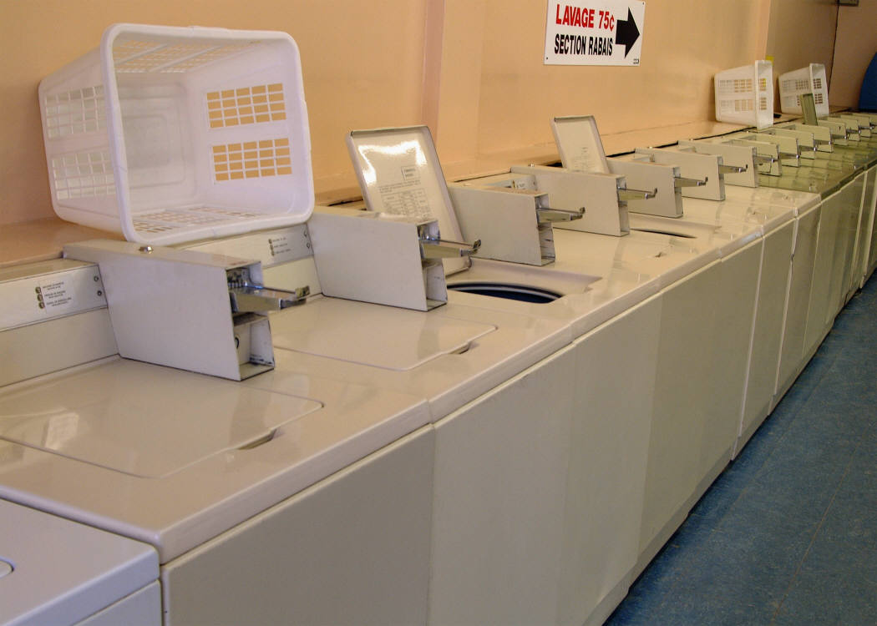
Software as a Service
(Engineering Software as a Service §1.2)
Notes:
Very popular topics
Rent like using doing your laundry in a service

Slide 29
Software Targets
Traditional SW: binary code installed and runs wholly on client device, which users must upgrade repeatedly
Must work with many versions of hardware, OS
New versions must go through extensive release cycle to ensure compatibility
Alternative: develop SW that only needs to work on one HW & OS platform?
➔ Quicker release cycle, no user upgrades?

Slide 30
Software as a Service: SaaS
SaaS delivers SW & data as service over Internet via thin program (e.g., browser) running on client device
Search, social networking, video
Now also SaaS version of traditional SW
E.g., Microsoft Office 365, TurboTax Online
Instructors think SaaS is revolutionary, the future of virtually all software
Notes:
May change SW industry by end of decade, switch of leaders and followers

Slide 31
6 Reasons for SaaS
No install worries about HW, OS
No worries about data loss (data is remote)
Easy for groups to interact with same data
If data is large or changes frequently, simpler to keep 1 copy at central site
1 copy of SW, single HW/OS environment => no compatibility hassles for developers => beta test new features on 1% of users
1 copy => simplifies upgrades for developers and no user upgrade requests
Notes:
Is laptop backed up? Lose my cellphone?
6 means SW changes all the time with more features
Continuosly being asked to upgrade my software on my laptop

Slide 32
SaaS Loves Rails
Many frameworks/languages for SaaS
Django/Python, Zend/PHP, Spring/Java
We use Ruby on Rails (“Rails”)
Rails popular programming framework that uses Ruby – e.g., Twitter
Ruby, a modern scripting language: object oriented, functional, automatic memory management, dynamic types, reuse via mix-ins & closures, synthesis via metaprogramming
Notes:
Dozens of options,
Why Rails designer picked Ruby

Slide 33
Why Take Time for Ruby/Rails?
14 weeks to learn:
SaaS, Agile, Pair Programming, Behavior Driven Design, LoFi UI, Storyboards, User Stories, Test Driven Development, Enhance Legacy Code, Scrum, Velocity, JavaScript, Design Patterns, UML, Deployment, Security
You only work part-time on this class
Only hope is highly productive language, tools, framework: Rails currently the best
See “Crossing the Software Education Chasm,” A. Fox, D. Patterson, Comm. ACM, May 2012
Notes:
3 weeks full time
SW Engineer – lifelong learning

Slide 34
END

Slide 35
Which is WEAKEST Argument for a Google App’s Popularity as SaaS?
☐
Don’t lose data: Gmail
☐
Cooperating group: Drive
☐
Large/Changing Dataset: YouTube
☐
No field upgrade to get improved app: Search
Notes:
No field upgrade when improve – really it’s the data
Almost one Exabyte for YouTube; 1M TB
Search needs Petabytes of data

Slide 36
END

Slide 37
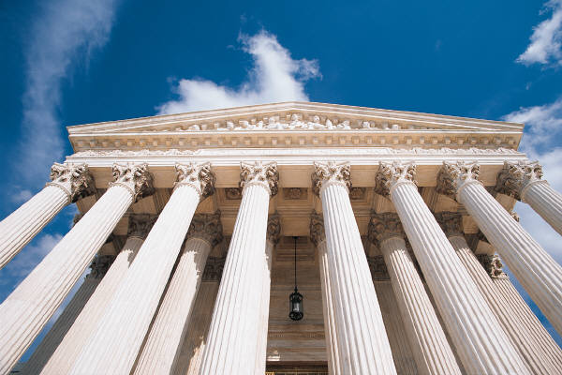
Service Oriented Architecture (SOA)
(Engineering Software as a Service §1.4)
Notes:
Technical idea that almost died because people couldn’t agree on what SOA means (too inclusive

Slide 38
Software Architecture
Can you design software so that you can recombine independent modules to offer many different apps without a lot of programming?

Slide 39
Service Oriented Architecture
SOA: SW architecture where all components are designed to be services
Apps composed of interoperable services
Easy to tailor new version for subset of users
Also easier to recover from mistake in design
Contrast to “SW silo” without internal APIs
Notes:
Simply, every component can be a service. We’ll do examples of what is and what isn’t.
Combine services into new apps – tailored service is easy
Easier to repair, so easy to replace components
In contrast monolithic behind a firewall

Slide 40
CEO: Amazon shall use SOA!
“All teams will henceforth expose their data and functionality through service interfaces.”
“Teams must communicate with each other through these interfaces.”
“There will be no other form of interprocess communication allowed: no direct linking, no direct reads of another team's data store, no shared-memory model, no back-doors whatsoever. The only communication allowed is via service interface calls over the network.”
Notes:
Blogger at Google used to be at Amazon
Internal blog, for Google rant how screwed up company was
External blog for public
Mixed them up, and we put it into the book before he deleted entry
Amazon for all its weaknesses, does SOA
Google, for all its strengths, doesn’t get SOA
Started as silo’d sw in 1995, then 7 years later switched to SOA via directive from Bezos, CEO and founder of Amazon
BS in CS Princeton
Blogger claims one of 7 points is false; we’ll figure out which at end
Email from CEO

Slide 41
CEO: Amazon shall use SOA!
“It doesn't matter what [API protocol] technology you use.”
“Service interfaces, without exception, must be designed from the ground up to be externalizable. That is to say, the team must plan and design to be able to expose the interface to developers in the outside world. No exceptions.”
“Anyone who doesn't do this will be fired.”
“Thank you; have a nice day!”
Notes:
Why should listen to CEO? What does he know? Don’t you read Dilbert? I’m smarter than the CEO. Why should I follow this email? Bezos has EECS degree from Princeton.
False was 7. Bezos doesn’t care about your day. He got them with “fired”
5 points is one of best descriptions of SOA; everything must use API
Facebook too; Facebook platform 3 years later, switched from monolithic silo’d to facebook (Facebook Platform)
(Google doesn’t get it – Google Groups could only watch what others could do)

Slide 42
Bookstore: Silo
Internal subsystems can share data directly
Review access user profile
All subsystems inside single API (“Bookstore”)
(Figure 1.7, Engineering Software as a Service by Armando Fox and David Patterson, 1st edition, 2014.)
Notes:
Start with Silo’d version – natural to do
Shared memory, no extra overhead
the reviews subsystem can get user profile info out of the users subsystem
3 independent services inside the silo

Slide 43
Bookstore: SOA
Subsystems independent, as if in separate data centers
Review Service accesses User Profile API
Can recombine to make new service (“Favorite Books”)
(Figure 1.7, Engineering Software as a Service by Armando Fox and David Patterson, 1st edition, 2014.)
Notes:
Creates another app – group’s favorite books app from standard bookstore just another combination
Even though all inside same datacenter, SW written as if in different ones
No service can access another services data – must go through API of service
Note not a layered model of software, but a network connection

Slide 44
END

Slide 45
Which is NOT True About SOA?
☐
SOA does not affect performance
☐
Silo’d systems are likely completely down on a failure, SOA must handle partial failures
☐
SOA improves developer productivity primarily through reuse
☐
No SOA service can name or access another service's data; it can only make requests for data thru an external API
Notes:
each invocation of a service involves the higher cost of wading through the deeper software stack of a network interface, so there is a performance hit to SOA.
Not: SOA does not affect performance
(it does)
Partial failure is a lot harder to figure out what to do, how to fix

Slide 46
END

Slide 47

Cloud Computing
(Engineering Software as a Service §1.6)

Slide 48
What is Ideal HW for SaaS?
Amazon, Google, Microsoft … developed hardware systems to run SaaS
What did they use: Mainframes? Supercomputers?
How can independent SW developers build SaaS apps and compete without similar HW investments to Amazon, Google, Microsoft?

Slide 49
SaaS Infrastructure?
SaaS’s 3 demands on infrastructure:
Communication
Allow customers to interact with service
Scalability
Fluctuations in demand during day + new services to add users rapidly
Dependability
Service & communication available 24x7
Notes:
Scalability for holidays
Has to work all the time – since only in one place

Slide 50
Services on Clusters
Clusters: Commodity computers connected by commodity Ethernet switches
More scalable than conventional servers
Much cheaper than conventional servers
20X for equivalent vs. largest servers
Dependability via extensive redundancy
Few operators for 1000s servers
Careful selection of identical HW/SW
Virtual Machine Monitors simplify operation
Notes:
VM help with kill program
20x cheaper so 2 or 3 times as many copies, SW handles failure

Slide 51
Warehouse Scale Computers
Clusters grew from 1000 servers to 100k based on customer demand for SaaS apps
Economies of scale pushed down cost of largest data center by factors 3X to 8X
Purchase, house, operate 100K v. 1K computers
Traditional data centers utilized 10% - 20%
Earn $ offering pay-as-you-go use at less than customer’s costs for as many computers as customer needs
Notes:
Services got popular, so had to keep scaling (100X)
House – build own customer warehouse, so cheaper
Network Bandwidth
Consolidate 100 companies into one datacenter,
2006 Bezos said should be able to sell – AWS Elastic Computing Cloud (EC2)
Original argument was underutilized 11 months of the year – spare cycles, became so popular
Today its reversed – Amazon now runs on Amazon Web Services

Slide 52
Utility Computing / Public Cloud Computing
Offers computing, storage, communication at pennies/hour
No premium to scale:
1000 computers @ 1 hour = 1 computer @ 1000 hours
Illusion of infinite scalability to cloud user
As many computers as you can afford
Leading examples: Amazon Web Services, Google App Engine, Microsoft Azure
Notes:
No premium for scale is striking – usually much more expensive to scale

Slide 53
2013 AWS Instances & Prices
Instance Type | $ Per Hour | $ Ratio to small | Virtual Cores | Compute Units | Memory (GB) | Storage (GB)
m1.small | 0.06 | 1.0 | 1 | 1.0 | 1.7 | 1 x 160
m1.medium | 0.12 | 2.0 | 1 | 2.0 | 3.8 | 1 x 410
m1.large | 0.24 | 4.0 | 2 | 4.0 | 7.5 | 2 x 420
m1.xlarge | 0.48 | 8.0 | 4 | 8.0 | 15.0 | 4 x 420
m3.xlarge | 0.50 | 8.3 | 4 | 13.0 | 15.0 | EBS
m3.2xlarge | 1.00 | 16.7 | 8 | 26.0 | 30.0 | EBS
c1.medium | 0.15 | 2.5 | 2 | 5.0 | 1.7 | 1 x 350
c1.xlarge | 0.58 | 9.7 | 8 | 20.0 | 7.0 | 4 x 420
cc2.8xlarge | 2.40 | 40.0 | 32 | 88.0 | 60.5 | 4 x 840
m2.xlarge | 0.41 | 6.8 | 2 | 6.5 | 17.1 | 1 x 420
m2.2xlarge | 0.82 | 13.7 | 4 | 13.0 | 34.2 | 1 x 850
m2.4xlarge | 1.64 | 27.3 | 8 | 26.0 | 68.4 | 2 x 840
cr1.8xlarge | 3.50 | 58.3 | 32 | 88.0 | 244.0 | 2 x 120 SSD
hi1.4xlarge | 3.10 | 51.7 | 16 | 35.0 | 60.5 | 2 x 1024 SSD
hs1.8xlarge | 4.60 | 76.7 | 16 | 35.0 | 117.0 | 24 x 2048
t1.micro | 0.02 | 0.3 | 1 | varies | 0.6 | EBS
cg1.4xlarge | 2.10 | 35.0 | 16 | 33.5 | 22.5 | 2 x 840
Notes:
17 options – vary in cost 75:1, vary in performance 90:1, vary in memory size 150:1, vary in storage 300:1 (EBS = Elastic Block Store)
Pay per hour
2006 for $0.10, now just $0.06

Slide 54
Supercomputer for Hire
Top 500 supercomputer competition in 2012
532 8xlarge (@ $2.40/hour), 17000 cores = 240 TeraFLOPS
72nd/500 supercomputer @ ~$1300 per hour
Credit card => can use 1000s computers
FarmVille on AWS
Prior biggest online game 5M users
What if startup had to build data center?
4 days =1M; 2 months = 10M; 9 months = 75M
Notes:
CC2 = Cluster Compute Eight Extra Large
Zygna make Farmville using AWS
Biggest in world; too big, too much $
Calling dell, take 6 months,
AWS scale with demand

Slide 55
IBM Watson for Hire?
Jeopardy Champion IBM Watson
Hardware: 90 IBM Power 750 servers
3.5 GHz 8 cores/server
90 @~$2.40/hour = ~$200/hour
Cost of human attorney or accountant
For what tasks could AI be as good as highly trained person @ $200/hour?
What would this mean for society?
Notes:
Same rate as lawyers and accountants. Really 32 cores/IBM server (2880 cores total), so cost $800/hour.
$200 as much as IBM payed for Jeopardy champion
What is this going to mean down the road?
Might want to talk this over wine with your friends majoring in law or accounting
Great jobs for us; what about future of rest of society; ML is delivering

Slide 56
END

Slide 57
Which is NOT True About SaaS, SOA, and Cloud Computing?
☐
Clusters are collections of commodity servers connected by LAN switches
☐
The Internet supplies the communication for SaaS apps
☐
Cloud computing uses HW clusters + SW layer using redundancy for dependability
☐
Private data centers could match cost of Warehouse Scale Computers if they just used same type of HW and SW
Notes:
VertLeftWhiteCheck1
Private datacenters cannot match cost of Warehouse Scale Computers even if they just purchased the same type of hardware, since they don’t get the economies of scale at 1000 vs. 100,000 in purchasing, housing, operators

Slide 58
END

Slide 59
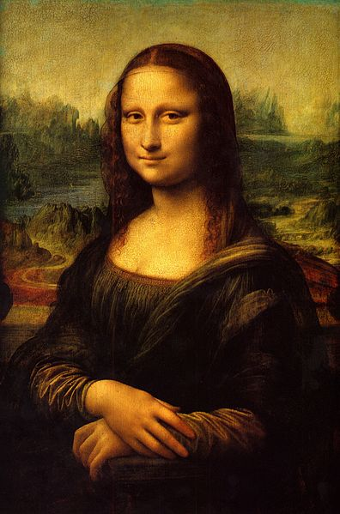
Legacy SW vs. Beautiful SW
(Engineering Software as a Service §1.7)

Slide 60
Programming Aesthetics
Do I care what others think of my code?
If it works, does it matter what code looks like?
Notes:
Will anyone else ever look at your code?

Slide 61
Legacy SW vs. Beautiful SW
Legacy code: old SW that continues to meet customers' needs, but difficult to evolve due to design inelegance or antiquated technology
___% SW maintenance costs adding new functionality to legacy SW
___% for fixing bugs
Contrasts with beautiful code: meets customers' needs and easy to evolve
Notes:
60% SW maintenance
17% fixing bugs
Failure: Unexpectedly short-lived code
Example in book of program used for 50 years
Yet Legacy SW is successful SW
If connotation of antiquaited, old-fashioned
What is contrast to legacy code
Easy to evolve; evolution to

Slide 62
Legacy SW vs. Beautiful SW
Legacy code: old SW that continues to meet customers' needs, but difficult to evolve due to design inelegance or antiquated technology
60% SW maintenance costs adding new functionality to legacy SW
17% for fixing bugs
Contrasts with beautiful code: meets customers' needs and easy to evolve
Notes:
60% SW maintenance
17% fixing bugs
Failure: Unexpectedly short-lived code
Yet Legacy SW is successful SW

Slide 63
Legacy Code: Vital but Ignored
Missing from traditional SWE courses and textbooks
#1 request from industry experts we asked: What should be in new SWE course?
Save work by reusing existing code (e.g., open source)
Will have legacy lectures and programming assignments later in course
Helps you learn how to make beautiful code
Notes:
Our paychecks delivered with Cobol
Amazon, Google, Microsoft, all companies – chapter and programming code

Slide 64
END

Slide 65
Which Type of SW is Considered an Epic Failure?
☐
Beautiful code
☐
Legacy code
☐
Unexpectedly short-lived code
☐
Both legacy code and unexpectedly short lived code
Notes:
Failure: Unexpectedly short-lived code
Legacy SW is successful SW
People make a lot of money
Long lasting but beautiful

Slide 66
END

Slide 67

Quality Assurance &Testing (Engineering Software as a Service §1.8)

Slide 68
Software Quality
What is software quality, and how to we assure it? (QA)
V&V: What is the difference (if any) between Verification and Validation?

Slide 69
Software Quality
Product quality (in general): “fitness for use”
Business value for customer and manufacturer
Quality Assurance : processes/standards => high quality products & to improve quality
Software quality:
Satisfies customers’ needs - easy to use, gets correct answers, does not crash, …
Be easy for developer to debug and enhance
Software QA: ensure quality and improve processes in SW organization

Slide 70
Assurance
Verification: Did you build the thing right?
Did you meet the specification?
Validation: Did you build the right thing?
Is this what the customer wants?
Is the specification correct?
Hardware focus generally____________
Software focus generally___________
2 options: Testing and Formal Methods
Notes:
HW on verification
SW on validation

Slide 71
Assurance
Verification: Did you build the thing right?
Did you meet the specification?
Validation: Did you build the right thing?
Is this what the customer wants?
Is the specification correct?
Hardware focus generally Verification
Software focus generally Validation
Testing to Assure Software Quality
Notes:
HW on verification
SW on validation

Slide 72
Testing
Exhaustive testing infeasible
Divide and conquer: perform different tests at different phases of SW development
Upper level doesn’t redo tests of lower level
System or acceptance test: integrated program meets its specifications
Integration test: interfaces between units have consistent assumptions, communicate correctly
Module or functional test: across individual units
Unit test: single method does what was expected
Notes:
1 ns test, 64-bit variable, 2^64 ns = 500 years!
e.g., unit testing works within a single class and functional testing works across classes
Unit test: single method does what was expected
Module or functional test: across individual units (within a class)
Integration test: interfaces between units have consistent assumptions, communicate correctly
System or acceptance test: integrated program meets its specifications

Slide 73
More Testing
Black box vs. White Box testing
Testing based on specs vs. on implementation
Test Coverage: % of code paths tested
Regression testing: automatically rerun old tests to check that changes don’t break what used to work
Continuous Integration (CI) testing: continuous regression testing on each code check-in vs. later testing phase
Notes:
Conditional variables
Evolve over time; run every night
Modern service continuous tests as evolve it
TDD (test-driven development) seems unnatural

Slide 74
END

Slide 75
Which is NOT True About Testing?
☐
With better test coverage, you are more likely to catch faults
☐
While difficult to achieve, 100% test coverage insures design reliability
☐
Each higher level test delegates more detailed testing to lower levels
☐
Unit testing works within a single class and module testing works across classes
Notes:
Answer of what is wrong: While difficult to achieve, 100% test coverage insures design reliability

Slide 76
END

Slide 77

Productivity: Conciseness, Synthesis, Reuse, and Tools (Engineering Software as a Service §1.9)

Slide 78
Productivity
50 years of Moore’s Law => 2X /1.5 years
HW designs get bigger
Faster processors and bigger memories
SW designs get bigger
Had to improve SW productivity
4 techniques
Clarity via conciseness
Synthesis
Reuse
Automation and Tools

Slide 79
Clarity via conciseness
Syntax: shorter and easier to read assert_greater_than_or_equal_to(a,7) vs. ________________
Notes:
a.should be ≥ 7
Bad syntax is hard to read!
Legal Ruby code!

Slide 80
Clarity via conciseness
Syntax: shorter and easier to read assert_greater_than_or_equal_to(a,7) vs. a.should be ≥ 7
Raise the level of abstraction:
HLL programming languages vs. assembler
Automatic memory management (Java vs. C)
Scripting languages: reflection, metaprogramming
Notes:
a.should be ≥ 7

Slide 81
Synthesis
Software synthesis
BitBlt: generate code to fit situation & remove conditional test
Research Stage: Programming by example

Slide 82
Reuse
Reuse old code vs. write new code
Techniques in historical order:
Procedures and functions
Standardized libraries (reuse single task)
Object oriented programming: reuse and manage collections of tasks
Design patterns: reuse a general strategy even if implementation varies
Notes:
Big productivity gain
To reuse

Slide 83
Automation and Tools
Replace tedious manual tasks with automation to save time, improve accuracy
New tool can make lives better (e.g., make)
Concerns with new tools: Dependability, UI quality, picking which one from several
Good software developer must repeatedly learn how to use new tools: lifetime learning
Lots of chances in this course: Cucumber, RSpec, Pivotal Tracker, …

Slide 84
END

Slide 85
Which is TRUE About Productivity?
☐
Copy and pasting code is another good way to get reuse
☐
Metaprogramming helps productivity via program synthesis
☐
Of the 4 productivity reasons, the primary one for HLL is reuse
☐
A concise syntax is more likely to have fewer bugs and be easier to maintain
Notes:
HLL – raise the level abstraction, it does synthesis
TRUE: Metaprogramming helps productivity via program synthesis
Χονχισε – 50 λινεσ οφ ϑαϖα; ηοω μανψ δοινγ σομετηινγ, ϖσ. γιϖινγ ιντεντ οφ ωηατ γοινγ το δο
(νοτ Περλ – τοο χονχισε το βε υνδερστανδαβλε)

Slide 86
END

Slide 87
DRY
“Every piece of knowledge must have a single, unambiguous, authoritative representation within a system.”
Andy Hunt and Dave Thomas, 1999
Don't Repeat Yourself (DRY)
Don’t want to find many places have to apply same repair
Refactor code so that it has a single place to do things

Slide 88
END

Slide 89
And in Conclusion: §§1.1, 1-4-1.9
Class: SW eng. Principles via Cloud app by team for customer + enhancing legacy app
SaaS less hassle for developers and users
Service Oriented Architecture makes it easy to reuse current code to create new apps
Scale led to savings/CPU => reduced cost of Cloud Computing => Utility Computing
Testing to assure software quality, which means good for customer and developer
Developer Productivity: Conciseness, Synthesis, Reuse, and Tools

