Slide 1
Hybrid K-means with OpenMP and MPI
Asimina Vouronikoy

Slide 2
The algorithm(1/2)
The algorithm consists of three basic steps:
Place K points in the n – dimensional space where are gathered the data objects for clustering. These points are the initial centroids of the clusters
Assign each data object to the cluster that has the closest centroid. When all objects has been assigned recalculate the positions of k – centroids
Repeat steps 2 and 3 until the centroids no longer move. This produces a separation of the objects in clusters.

Slide 3
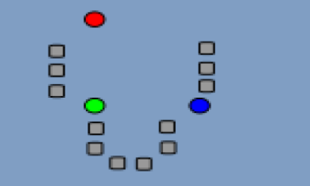
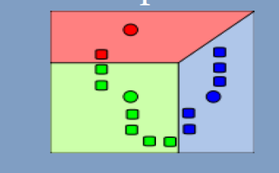
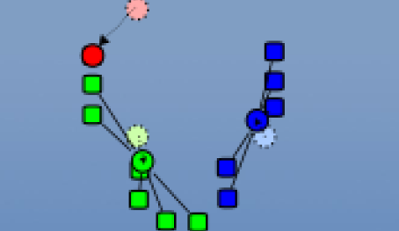
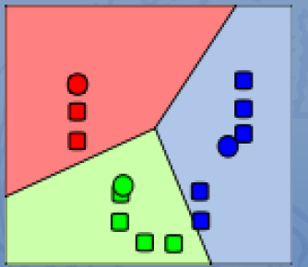
The algorithm(2/2)
Κ -points are randomly chosen as centroids Κ-clusters are created, connecting every object with the closer
centroid
Recalculation of the centroids
Repeat the process until there is no movement

Slide 4
Complexity of the algorithm
The complexity is O(n*k*I*d)
n = number of objects
k = number of clusters
I = number of iterations
d = dimension
For constant k,d the algorithm is observed to complete the clustering in exactly O(n^{dk+1} log n) time

Slide 5
Need for parallelism
Objects are independent inherit parallelism
The algorithm is significantly sensitive in the initial placement
Need a “smart” placement
As the dataset scales becomes more difficult to use the k-means for such a large amount of data
A hybrid solution developed in OpenMP and MPI.
MPI communication between the clusters
OpenMP parallelism of the work inside the node

Slide 6
Sequential code Optimizations
Centroid initialization
The KKZ algorithm initialization :
Compute the norms of all vectors in the dataset. Choose the vector with the largest norm as the first centroid
Compute the distances of all vectors in the dataset from the first centroid. Choose the vector with the largest distance as the second centroid
For a set of centroids of size I with i = 2,3 ... calculate the distance of each vector from each centroid and keep the smaller. From all distances the greater is the (i +1) centroid. Continue until K-centroids are calculated
Termination condition of the algorithm
Generally iterations stop based on a tolerance In our implementation, the iterations stop if there was no movement
more efficient
optimal placement of objects into clusters

Slide 7
Parallelization with OpenMP
Parallelization Strategy
The calculation of the nearest cluster for each object is performed in parallel with OpenMP parallel for
Measurement of changes in clusters is made individually with omp atomic.
The aggregation of the objects of each cluster and the measurement of their appearances is made individually with omp atomic.
The calculation of the new centroids is done in parallel with OpenMP parallel for.

Slide 8
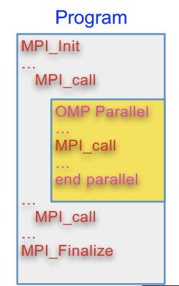
Hybrid Implementation with OpenMP-MPI
Parallelization Strategy
Initialization of MPI model
Share objects into clusters
At each iteration within each node:
The calculation of the nearest cluster for each object is performed in parallel with OpenMP parallel for
Measurement of changes in clusters is made individually with omp atomic.
The aggregation of the objects of each cluster and the measurement of their appearances is made individually with omp atomic.
The calculation of the new centroids is done in parallel with OpenMP parallel for.
At the end of every iteration we have reduction of the results
Node 0: calculation of new centroids, broadcast to everybody else
Iterations continue until no movement in clusters

Slide 9
Experiments
Cluster of 4 multicore systems
Every machine has 4 cores, 8 GB RAM ,Intel Xeon W3550 @3.07GHz processor
Measurements were performed for 4 data sets in clusters of 1,2 and 4 machines and for 1,2 and 4 threads per machine
Comparisons:
KKZ Initialization vs. Random Initialization
Hybrid vs. OpenMP
Hybrid vs. MPI
Hybrid vs. Serial
MPI vs. OpenMP

Slide 10
Pure MPI - Speedup

Slide 11
Pure OpenMP - Speedup

Slide 12
Objects: 1.200.000, dim: 16, centroids: 10.000
Random Initialization

Slide 13
Execution Time - Hybrid vs. OpenMP vs. MPI vs. Serial
Random Initialization

Slide 14
Pure MPI - Speedup

Slide 15
Pure OpenMP - Speedup

Slide 16

Objects: 1.200.000, dim: 16, centroids: 10.000

Slide 17
Execution Time - Hybrid vs. OpenMP vs. MPI vs. Serial

Slide 18
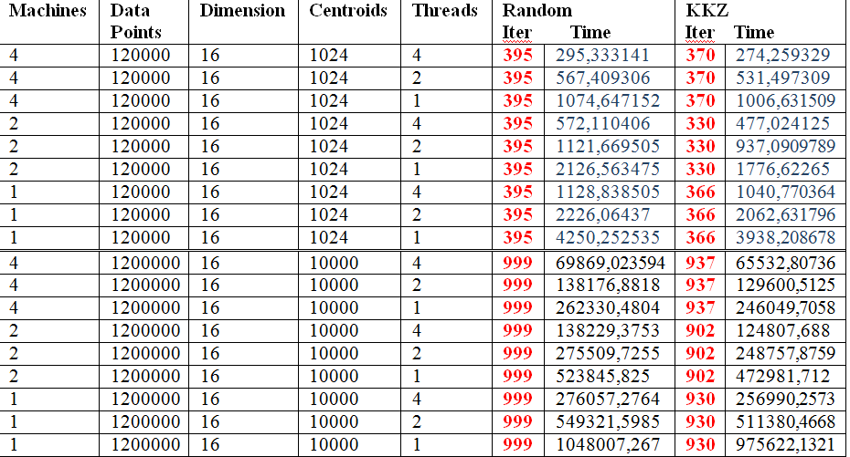
ΚΚZ vs. Random Initialization

Slide 19
Conclusions
ΚΚΖ algorithm leads to:
Less iterations therefore smaller execution time than random initialization
Better placement of the objects than random initialization
Pure MPI linear speedup
Pure OpenMP linear speedup
MPI slight superiority over the OpenMP
Hybrid implementation:
clear dominance
Performance scaling between the datasets in both parallel and sequential implementations

Slide 20
Thank you!

