Slide 1
Advanced Database
IS411

Slide 2
Querying for Data
Using SELECT to Retrieve Data
The SELECT statement retrieves information from one or more tables. Retrievals tend to be the most common database operation, so it's important to understand how SELECT works and what you can do with it.
SELECT values_to_display
FROM table_name
WHERE expression
GROUP BY how_to_group
HAVING expression
ORDER BY how_to_sort
LIMIT row_count;
The syntax shown here is simplified from the full SELECT syntax, which includes additional clauses
MySQL 5 Certification Study Guide <number>

Slide 3
Querying for Data
To indicate what values to retrieve, name them following the SELECT keyword.
mysql> SELECT 2+2, REPEAT('x',5), DATE_ADD('2001-01-01',INTERVAL 7 DAY), 1/0;
+-----+--------------------+----------------------------------------------------------+------+
| 2+2 | REPEAT('x',5) | DATE_ADD('2001-01-01',INTERVAL 7 DAY) | 1/0 |
+-----+--------------------+----------------------------------------------------------+------+
| 4 | xxxxx | 2001-01-08 | NULL |
+-----+--------------------+----------------------------------------------------------+------+
mysql> DESCRIBE City;
+-------------+----------+------+-----+---------+----------------+
| Field | Type | Null | Key | Default | Extra |
| ID | int(11) | NO | PRI | NULL | auto_increment |
| Name | char(35) | NO | | | |
| CountryCode | char(3) | NO | | | |
| District | char(20) | NO | | | |
| Population | int(11) | NO | | 0 | |
+-------------+----------+------+-----+---------+----------------+
MySQL 5 Certification Study Guide <number>

Slide 4
Querying for Data
To retrieve the contents of these columns, write the SELECT statement as follows:
SELECT ID, Name, CountryCode, District, Population FROM City;
SELECT * FROM City;
Output column names, by default, are the same as the column or expression selected. To rename a column, provide an alias following the column in the output list:
mysql> SELECT 1 AS One, 4*3 'Four Times Three';
+------+------------------------+
| One | Four Times Three |
+------+------------------------+
| 1 | 12 |
+------+------------------------+
Columns aliases are used as follows:
  The keyword AS is optional.
  An alias may be quoted. If it consists of multiple words, it must be quoted.
To specify a database explicitly in the SELECT statement itself, qualify the table name. That is, precede the table name with the database name and a period:
SELECT * FROM world.Country;
MySQL 5 Certification Study Guide <number>

Slide 5
Querying for Data
Specifying Which Rows to Retrieve
A WHERE clause can be as simple or complex as necessary to identify the rows that are relevant for your purposes.
  SELECT * FROM Country WHERE IndepYear > 1990;
  SELECT * FROM Country
  WHERE Population >= 1000000 AND Population <= 2000000;
  SELECT * FROM Country
WHERE Population BETWEEN 1000000 AND 2000000;
Some operators have higher precedence than others. For example, AND has a higher precedence than OR.
WHERE GNP < 1000 AND Continent = 'Africa' OR Continent = 'Asia‘
Using ORDER BY to Sort Query Results
By default, the rows in the result set produced by a SELECT statement are returned by the server to the client in no particular order. When you issue a query, the server is free to return the rows in any convenient order. This order can be affected by factors such as the order in which rows are actually stored in the table or which indexes are used to process the query. If you require output rows to be returned in a specific order, include an ORDER BY clause that indicates how to sort the results.
MySQL 5 Certification Study Guide <number>

Slide 6
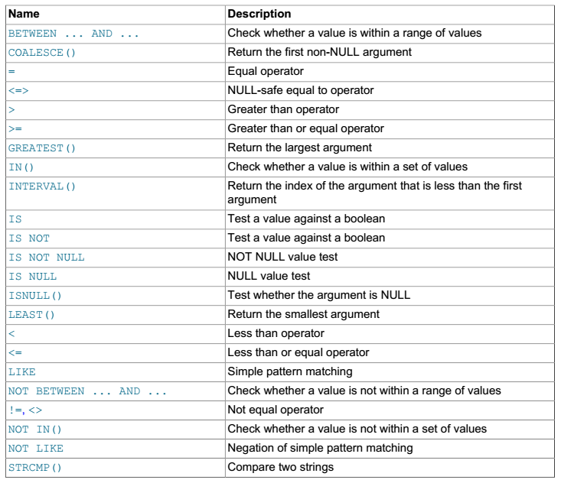
Comparison Functions and Operators
MySQL 5 Certification Study Guide <number>

Slide 7
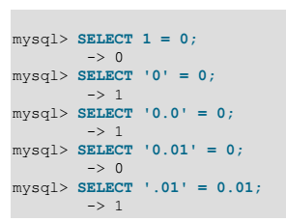
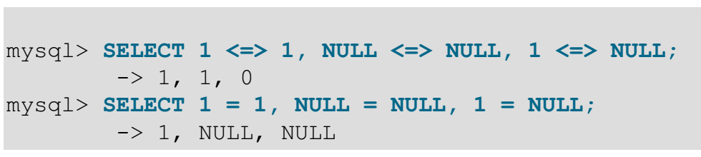
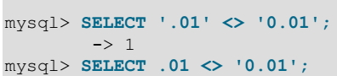

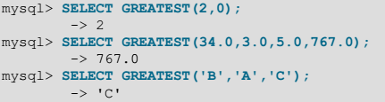


See chapter 13

Slide 8
Querying for Data
mysql> SELECT id, last_name, first_name, birth FROM t ORDER BY birth;
+------+-----------+------------+-----------------+
| id | last_name | first_name | birth |
+------+-----------+-------------+----------------+
| 2 | Larsson | Sven | 1965-01-03 |
| 4 | Larsson | Selma | 1968-05-29 |
| 3 | Brown | Betty | 1971-07-12 |
| 1 | Brown | Bill | 1972-10-14 |
+------+-----------+-------------+----------------+
mysql> SELECT id, last_name, first_name, birth FROM t ORDER BY last_name, first_name;
+------+-----------+------------+------------+
| id | last_name | first_name | birth |
+------+-----------+------------+------------+
| 3 | Brown | Betty | 1971-07-12 |
| 1 | Brown | Bill | 1972-10-14 |
| 4 | Larsson | Selma | 1968-05-29 |
| 2 | Larsson | Sven | 1965-01-03 |
+------+-----------+------------+------------+
MySQL 5 Certification Study Guide <number>

Slide 9
Querying for Data
By default, ORDER BY sorts values in ascending order (smallest to largest).
ORDER BY last_name, first_name
ORDER BY last_name ASC, first_name ASC
To sort values in descending order (largest to smallest), follow the sort column name with DESC:
mysql> SELECT id, last_name, first_name, birth FROM t ORDER BY id DESC;
+------+-----------+------------+------------+
| id | last_name | first_name | birth |
+------+-----------+------------+------------+
| 4 | Larsson | Selma | 1968-05-29 |
| 3 | Brown | Betty | 1971-07-12 |
| 2 | Larsson | Sven | 1965-01-03 |
| 1 | Brown | Bill | 1972-10-14 |
+------+-----------+------------+------------+
MySQL 5 Certification Study Guide <number>

Slide 10
Querying for Data
ORDER BY typically refers to table columns by name:
SELECT last_name, first_name FROM t ORDER BY last_name, first_name;
However, it's possible to refer to columns in other ways. If a column is given an alias in the output column list, you should refer to that column in the ORDER BY column by its alias:
SELECT last_name AS last, first_name AS first FROM t ORDER BY last, first;
Or you can specify a number corresponding to the column's position in the column output list (1 for the first output column, 2 for the second, and so forth) :
SELECT last_name, first_name FROM t ORDER BY 1, 2;
It's possible to perform a sort using an expression result.
SELECT id, last_name, first_name, MONTH(birth)
FROM t ORDER BY MONTH(birth);
Output sorting can be based on values that don't appear in the output at all.
mysql> SELECT id, last_name, first_name, MONTHNAME(birth) FROM t ORDER BY MONTH(birth);
MySQL 5 Certification Study Guide <number>

Slide 11

Querying for Data
Character Sets and Collations in General
A character set is a set of symbols and encodings. A collation is a set of rules for comparing characters in a character set. Let's make the distinction clear with an example of an imaginary character set.
Suppose that we have an alphabet with four letters: “A”, “B”, “a”, “b”. We give each letter a number: “A” = 0, “B” = 1, “a” = 2, “b” = 3. The letter “A” is a symbol, the number 0 is the encoding for “A”, and the combination of all four letters and their encodings is a character set.
mysql> SHOW CHARACTER SET;
mysql> SHOW COLLATION;
The Natural Sort Order of String
The sort order for a string column that has a data type other than ENUM or SET depends on whether the column contains non-binary or binary values. Non-binary strings sort in the order defined by their collation. This order can be case sensitive or not, depending on the collation. Binary strings sort based on the numeric values of the bytes contained in the strings. For example, assume that a table t has a CHAR column c that has the latin1 character set and that contains the following values:
mysql> SELECT c FROM t;
MySQL 5 Certification Study Guide <number>

Slide 12


Querying for Data
A CHAR column is non-binary, so its contents sort according to the column's collation. If the collation is not case sensitive, values sort lexically without regard to lettercase:
mysql> SELECT c FROM t ORDER BY c;
Notice that the results come out in letter order, but the rows for a given letter are not further sorted by lettercase.
If the collation is case sensitive, lettercase becomes significant. You can force a string column sort to be case sensitive by using the COLLATE operator with a case-sensitive collation:
mysql> SELECT c FROM t ORDER BY c COLLATE latin1_general_cs;
MySQL 5 Certification Study Guide <number>

Slide 13

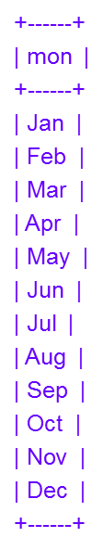
Querying for Data
If the collation is binary, numeric character values are the determining factor:
mysql> SELECT c FROM t ORDER BY c COLLATE latin1_bin;
The sort order for members of an ENUM or SET column is based on their internal numeric values. These values correspond to the order in which the enumeration or set members are listed in the column definition. Suppose that a table t contains a column mon that is an ENUM listing abbreviations for months of the year:
CREATE TABLE t
( mon ENUM('Jan','Feb','Mar','Apr','May','Jun','Jul','Aug','Sep','Oct','Nov','Dec'));
Assume that table t has 12 rows, one for each of the possible enumeration values. When you sort this column, the values come out in month-of-year order:
mysql> SELECT mon FROM t ORDER BY mon;
MySQL 5 Certification Study Guide <number>

Slide 14
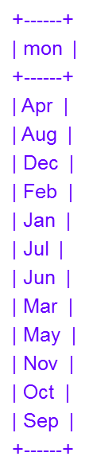
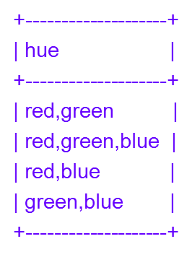
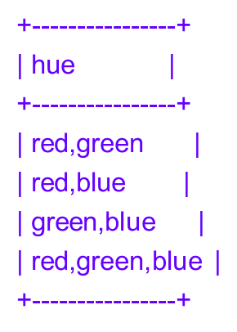
Querying for Data
This occurs because 'Jan' through 'Dec' are assigned internal values 1 through 12 based on their order in the column definition, and those values determine the sort order. To produce a lexical string sort instead, use CAST() to convert the enumeration values to CHAR values:
mysql> SELECT mon FROM t ORDER BY CAST(mon AS CHAR);
SET columns also sort using the internal values of the set's legal members. The ordering is more complex than with ENUM because values may consist of multiple SET members. For example, the following SET column contains three members:
CREATE TABLE t (hue SET('red','green','blue'));
Assume that t contains the following rows:
mysql> SELECT hue FROM t;
The SET members 'red', 'green', and 'blue' have internal values of 1, 2,
and 4, respectively. Thus, the rows of the table have internal numeric
values of 1+2 = 3, 1+2+4 = 7, 1+4 = 5, and 2+4 = 6. An ORDER BY
on the column sorts using those numeric values:
mysql> SELECT hue FROM t ORDER BY hue;
MySQL 5 Certification Study Guide <number>

Slide 15
Querying for Data
As with ENUM, SET values can be sorted lexically by using CAST() to convert them to strings:
mysql> SELECT hue FROM t ORDER BY CAST(hue AS CHAR);
+----------------+
| hue |
+----------------+
| green,blue |
| red,blue |
| red,green |
| red,green,blue |
+----------------+
NULL values in a column sort together at the beginning for ascending sorts and at the end for descending sorts.
MySQL 5 Certification Study Guide <number>

Slide 16
Querying for Data
Limiting a Selection Using LIMIT
MySQL supports a LIMIT clause in SELECT statements, which tells the server to return only some of the rows selected by the statement.
SELECT * FROM Country LIMIT 10;
SELECT * FROM Country LIMIT 20,10;
SELECT * FROM t ORDER BY id LIMIT 1;
SELECT * FROM t ORDER BY id DESC LIMIT 1;
The two-argument form of LIMIT is useful in conjunction with ORDER BY for situations in which you want to process successive sections of a result set. For example, in Web applications, it's common to display the result of a large search across a series of pages that each present one section of the result. To retrieve sections of the search result this way, issue a series of statements that all specify the same number of rows to return in the LIMIT clause, but vary the number of initial rows to skip:
SELECT * FROM t ORDER BY id LIMIT 0, 20;
SELECT * FROM t ORDER BY id LIMIT 20, 20;
SELECT * FROM t ORDER BY id LIMIT 40, 20;
SELECT * FROM t ORDER BY id LIMIT 60, 20;
...
MySQL 5 Certification Study Guide <number>

Slide 17
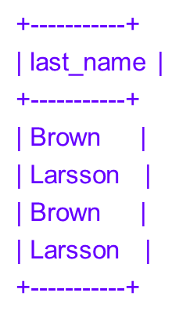
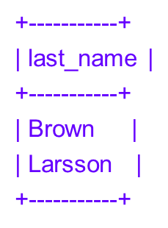

Querying for Data
Using DISTINCT to Eliminate Duplicates
Suppose that a query returns a result set that contains duplicated rows:
mysql> SELECT last_name FROM t;
Adding DISTINCT removes the duplicates and returns only unique rows:
mysql> SELECT DISTINCT last_name FROM t;
DISTINCT treats all NULL values within a given column as having
the same value. Suppose that a table t contains the following rows:
mysql> SELECT i, j FROM t;
Adding DISTINCT to the query eliminates one of them
as a duplicate:
mysql> SELECT DISTINCT i, j FROM t;
+------+------+
| i | j |
+------+------+
| 1 | 2 |
| 1 | NULL |
+------+------+
MySQL 5 Certification Study Guide <number>

Slide 18
Querying for Data
Aggregating Results
Functions such as AVG() that calculate summary values for groups are known as "aggregate" functions because they're based on aggregates or groups of values. There are several types of aggregate functions. Those discussed here are as follows:
  MIN() and MAX() find smallest and largest values.
  SUM() and AVG() summarize numeric values to produce sums (totals) and averages.
  COUNT() counts rows, values, or the number of distinct values.
  GROUP_CONCAT() concatenates a set of strings to produce a single string value.
The MIN() and MAX() Aggregate Functions
mysql> SELECT MIN(Population), MAX(Population) FROM Country;
+-----------------+-----------------+
| MIN(Population) | MAX(Population) |
+-----------------+-----------------+
| 0 | 1277558000 |
+-----------------+-----------------+
mysql> SELECT MIN(Name), MAX(Name) FROM Country;
+-------------+-----------+
| MIN(Name) | MAX(Name) |
+-------------+-----------+
| Afghanistan | Zimbabwe |
+-------------+-----------+
MySQL 5 Certification Study Guide <number>

Slide 19
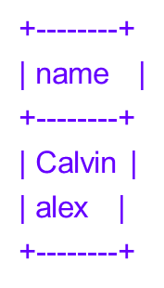
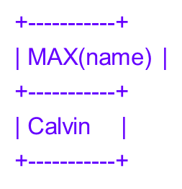
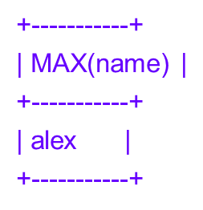
Querying for Data
For string values, the behavior of MIN() and MAX() depends on whether the strings are non-binary or binary. Consider a table t that contains the following string values:
mysql> SELECT name FROM t;
mysql> SELECT MAX(name) FROM t;
mysql> ALTER TABLE t MODIFY name BINARY(20);
mysql> SELECT MAX(name) FROM t;
MIN() and MAX() ignore NULL values.
MySQL 5 Certification Study Guide <number>

Slide 20
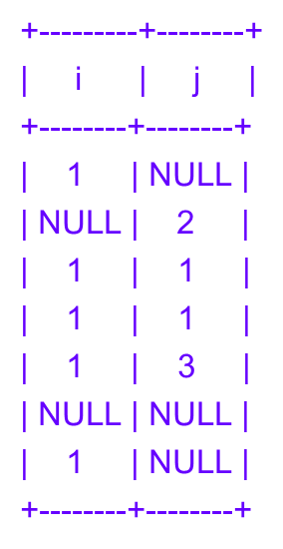
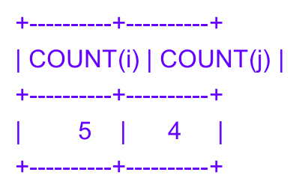
Querying for Data
The COUNT() Aggregate Function
The COUNT() function can be used in several ways to count either rows or values.
mysql> SELECT i, j FROM t;
COUNT(expression) counts the number of non-NULL values of the given expression. It's common for expression to be a column name, in which case COUNT() counts the number of non-NULL values in the column:
mysql> SELECT COUNT(i), COUNT(j) FROM t;
mysql> SELECT COUNT(DISTINCT i), COUNT(DISTINCT j) FROM t;
+-------------------+-------------------+
| COUNT(DISTINCT i) | COUNT(DISTINCT j) |
+-------------------+-------------------+
| 1 | 3 |
+-------------------+-------------------+
MySQL 5 Certification Study Guide <number>

Slide 21
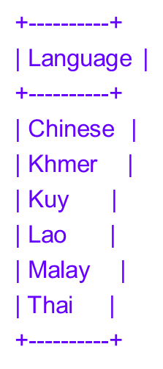
Querying for Data
It's also possible to give a list of expressions separated by commas. In this case, COUNT() returns the number of distinct combinations of values that contain no NULL values. The following query counts the number of distinct rows for which neither i nor j is NULL:
mysql> SELECT COUNT(DISTINCT i, j) FROM t;
+----------------------+
| COUNT(DISTINCT i, j) |
+----------------------+
| 2 |
+----------------------+
The GROUP_CONCAT() Function
The purpose of the GROUP_CONCAT() function is to concatenate column values into a single string.
mysql> SELECT Language FROM CountryLanguage WHERE CountryCode = 'THA';
MySQL 5 Certification Study Guide <number>

Slide 22
Querying for Data
To concatenate the values into a single string, use GROUP_CONCAT():
mysql> SELECT GROUP_CONCAT(Language) AS Languages
-> FROM CountryLanguage WHERE CountryCode = 'THA';
+-----------------------------------------------+
| Languages |
+-----------------------------------------------+
| Chinese,Khmer,Kuy,Lao,Malay,Thai |
+-----------------------------------------------+
The default string separator used by GROUP_CONCAT() is ',' (comma). To change the separator, use a SEPARATOR clause:
mysql> SELECT GROUP_CONCAT(Language SEPARATOR ' - ') AS Languages
-> FROM CountryLanguage WHERE CountryCode = 'THA';
+--------------------------------------------+
| Languages |
+--------------------------------------------+
| Chinese - Khmer - Kuy - Lao - Malay - Thai |
+--------------------------------------------+
MySQL 5 Certification Study Guide <number>

Slide 23
Querying for Data
GROUP_CONCAT() adds strings to the result in the order in which the database server reads them. To change the concatenation order, add an ORDER BY clause.
mysql> SELECT GROUP_CONCAT(Language ORDER BY Language DESC)
-> AS Languages FROM CountryLanguage WHERE CountryCode = 'THA';
+----------------------------------+
| Languages |
+----------------------------------+
| Thai,Malay,Lao,Kuy,Khmer,Chinese |
+----------------------------------+
Grouping Results
If a query does not contain a GROUP BY clause to place rows of the result set into groups, an aggregate function produces a result that is based on all the selected rows. A GROUP BY clause may be added to generate a more fine-grained summary that produces values for subgroups within a set of selected rows.
MySQL 5 Certification Study Guide <number>

Slide 24
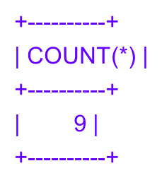
Querying for Data
mysql> SELECT * FROM personnel;
+---------+--------+---------+-------------+----------+
| pers_id | name | dept_id | title | salary |
+---------+--------+---------+-------------+----------+
| 1 | Wendy | 14 | Supervisor | 38000.00 |
| 2 | Wally | 7 | Stock clerk | 28000.00 |
| 3 | Ray | 7 | Programmer | 41000.00 |
| 4 | Burton | 14 | Secretary | 32000.00 |
| 5 | Gordon | 14 | President | 78000.00 |
| 6 | Jeff | 7 | Stock clerk | 29000.00 |
| 7 | Doris | 7 | Programmer | 48000.00 |
| 8 | Daisy | 7 | Secretary | 33000.00 |
| 9 | Bea | 7 | Accountant | 40000.00 |
+---------+--------+---------+-------------+----------+
mysql> SELECT COUNT(*) FROM personnel;
MySQL 5 Certification Study Guide <number>

Slide 25
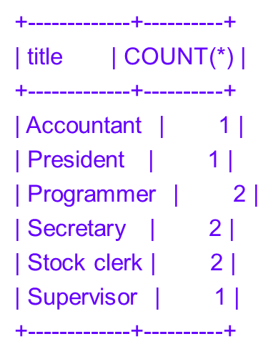
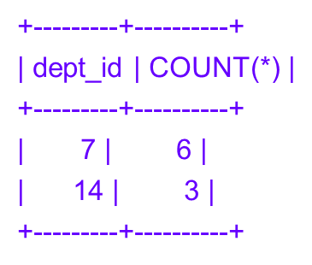
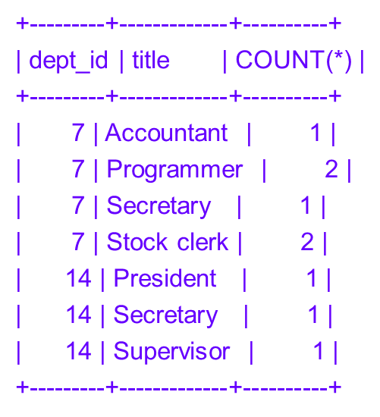
Querying for Data
mysql> SELECT title, COUNT(*) FROM personnel GROUP BY title;
mysql> SELECT dept_id, COUNT(*) FROM personnel
-> GROUP BY dept_id;
mysql> SELECT dept_id, title, COUNT(*) FROM personnel
-> GROUP BY dept_id, title;
MySQL 5 Certification Study Guide <number>

Slide 26
Querying for Data
Selecting Groups with HAVING
1. WHERE, if present, identifies the initial set of records to select from a table.
2. GROUP BY arranges the selected records into groups.
3. Aggregate functions compute summary values for each group.
4. HAVING identifies which groups to retrieve for the final result set.
mysql> SELECT title, salary FROM personnel WHERE dept_id = 7;
+-------------+----------+
| title | salary |
+-------------+----------+
| Stock clerk | 28000.00 |
| Programmer | 41000.00 |
| Stock clerk | 29000.00 |
| Programmer | 48000.00 |
| Secretary | 33000.00 |
| Accountant | 40000.00 |
+-------------+----------+
MySQL 5 Certification Study Guide <number>

Slide 27
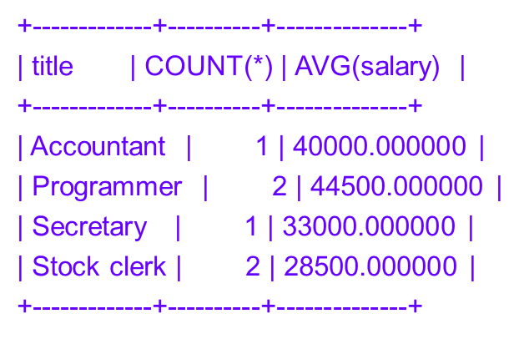
Querying for Data
mysql> SELECT title, COUNT(*), AVG(salary) FROM personnel WHERE dept_id = 7
-> GROUP BY title;
mysql> SELECT title, salary, COUNT(*), AVG(salary)
-> FROM personnel WHERE dept_id = 7
-> GROUP BY title
-> HAVING COUNT(*) > 1;
+-------------+----------+----------+--------------+
| title | salary | COUNT(*) | AVG(salary) |
+-------------+----------+----------+--------------+
| Programmer | 41000.00 | 2 | 44500.000000 |
| Stock clerk | 28000.00 | 2 | 28500.000000 |
+-------------+----------+----------+--------------+
MySQL 5 Certification Study Guide <number>

Slide 28

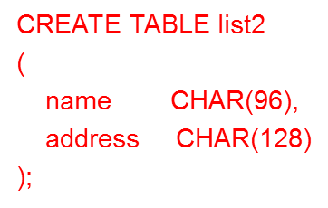



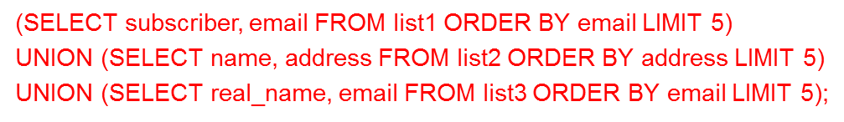
Querying for Data
Using UNION
The UNION keyword enables you to concatenate the results from two or more SELECT statements.
MySQL 5 Certification Study Guide <number>

Slide 29
Querying for Data
String Expressions
mysql> SELECT CONCAT('abc','def',REPEAT('X',3));
+-----------------------------------+
| CONCAT('abc','def',REPEAT('X',3)) |
+-----------------------------------+
| abcdefXXX |
+-----------------------------------+
The || operator is treated as the logical OR operator by default, but can be used for string concatenation if you enable the PIPES_AS_CONCAT SQL mode:
mysql> SELECT ‘1' || ‘0';
+----------------+
| ‘1‘ || ‘0' |
+----------------+
| 1 |
+----------------+
mysql> SET sql_mode = 'PIPES_AS_CONCAT';
mysql> SELECT 'abc' || 'def';
+----------------+
| 'abc' || 'def' |
+----------------+
| abcdef |
+----------------+
MySQL 5 Certification Study Guide <number>

Slide 30

Querying for Data
Case Sensitivity in String Comparisons
mysql> SELECT 'Hello' = 'hello';
+-------------------+
| 'Hello' = 'hello' |
+-------------------+
| 1 |
+-------------------+
mysql> SELECT BINARY 'Hello' = 'hello';
+--------------------------+
| BINARY 'Hello' = 'hello' |
+--------------------------+
| 0 |
+--------------------------+
String comparison rules also apply to GROUP BY and DISTINCT operations. Suppose that t has a column c with the following contents:
mysql> SELECT c FROM t;
MySQL 5 Certification Study Guide <number>

Slide 31
Querying for Data
If c is a non-binary, case-insensitive column, GROUP BY and DISTINCT do not make lettercase distinctions:
mysql> SELECT c, COUNT(*) FROM t GROUP BY c;
+---------+----------+
| c | COUNT(*) |
+---------+----------+
| Goodbye | 2 |
| Hello | 2 |
+---------+----------+
mysql> SELECT DISTINCT c FROM t;
+---------+
| c |
+---------+
| Hello |
| Goodbye |
+---------+
MySQL 5 Certification Study Guide <number>

Slide 32
Querying for Data
On the other hand, if c is a BINARY column, those operations use byte values for sorting:
mysql> SELECT c, COUNT(*) FROM t GROUP BY c;
+---------+----------+
| c | COUNT(*) |
+---------+----------+
| Goodbye | 1 |
| Hello | 1 |
| goodbye | 1 |
| hello | 1 |
+---------+----------+
mysql> SELECT DISTINCT c FROM t;
+---------+
| c |
+---------+
| Hello |
| hello |
| Goodbye |
| goodbye |
+---------+
MySQL 5 Certification Study Guide <number>

Slide 33
Querying for Data
The UPPER() and LOWER() functions perform case conversion only if the argument is a non-binary string.
mysql> SELECT UPPER('AbCd'), LOWER('AbCd');
+---------------+---------------+
| UPPER('AbCd') | LOWER('AbCd') |
+---------------+---------------+
| ABCD | abcd |
+---------------+---------------+
mysql> SELECT UPPER(BINARY 'AbCd'), LOWER(BINARY 'AbCd');
+----------------------+----------------------+
| UPPER(BINARY 'AbCd') | LOWER(BINARY 'AbCd') |
+----------------------+----------------------+
| AbCd | AbCd |
+----------------------+----------------------+
MySQL 5 Certification Study Guide <number>

Slide 34
Querying for Data
Using LIKE for Pattern Matching
Patterns used with the LIKE pattern-matching operator can contain two special characters (called "metacharacters" or "wildcards") that stand for something other than themselves:
  The '%' character matches any sequence of zero or more characters. For example, the pattern 'a%' matches any string that begins with 'a', '%b' matches any string that ends with 'b', and '%c%' matches any string that contains a 'c'. The pattern '%' matches any string, including empty strings.
  The '_' (underscore) character matches any single character. 'd_g' matches strings such as 'dig', 'dog', and 'd@g'. Because '_' matches any single character, it matches itself and the pattern 'd_g' also matches the string 'd_g'.
LIKE evaluates to NULL if either operand is NULL, but any non-NULL literal value matches itself. Likewise, a function call that produces a non-NULL value matches itself (with one exception). Thus, the following expressions evaluate as true:
mysql> SELECT 'ABC' LIKE 'abc', 'ABC' LIKE BINARY 'abc';
+------------------+-------------------------+
| 'ABC' LIKE 'abc' | 'ABC' LIKE BINARY 'abc' |
+-----------------+-------------------------+
| 1 | 0 |
+------------------+-------------------------+
MySQL 5 Certification Study Guide <number>

Slide 35
Querying for Data
The exception is that different invocations of the RAND() random-number function might return different values, even within the same query:
mysql> SELECT RAND(), RAND();
+------------------+------------------+
| RAND() | RAND() |
+------------------+------------------+
| 0.15430032289987 | 0.30666533979277 |
+------------------+------------------+
As a result, the expression RAND() LIKE RAND() normally will be false.
To invert a pattern match, use NOT LIKE rather than LIKE:
mysql> SELECT 'ABC' LIKE 'A%', 'ABC' NOT LIKE 'A%';
+-----------------+---------------------+
| 'ABC' LIKE 'A%' | 'ABC' NOT LIKE 'A%' |
+-----------------+---------------------+
| 1 | 0 |
+-----------------+---------------------+
MySQL 5 Certification Study Guide <number>

Slide 36
Querying for Data
Functions in SQL Expressions
mysql> SELECT PI ();
+----------+
| PI () |
+----------+
| 3.141593 |
+----------+
LEAST() and GREATEST() take a set of values as arguments and return the one that is smallest or largest, respectively:
mysql> SELECT LEAST(4,3,8,-1,5), LEAST('cdef','ab','ghi');
+-------------------+--------------------------+
| LEAST(4,3,8,-1,5) | LEAST('cdef','ab','ghi') |
+-------------------+--------------------------+
| -1 | ab |
+-------------------+--------------------------+
mysql> SELECT GREATEST(4,3,8,-1,5), GREATEST('cdef','ab','ghi');
+----------------------+-----------------------------+
| GREATEST(4,3,8,-1,5) | GREATEST('cdef','ab','ghi') |
+----------------------+-----------------------------+
| 8 | ghi |
+----------------------+-----------------------------+
MySQL 5 Certification Study Guide <number>

Slide 37
Querying for Data
Control Flow Functions
mysql> SELECT IF(1 > 0, 'yes','no');
+-----------------------+
| IF(1 > 0, 'yes','no') |
+-----------------------+
| yes |
+-----------------------+
The CASE construct is not a function, but it too provides flow control. It has two forms of syntax. The first looks like this:
mysql> SET @val = 1;
mysql> SELECT CASE @val
-> WHEN 0 THEN '@val is 0'
-> WHEN 1 THEN '@val is 1'
-> ELSE '@val is not 0 or 1'
-> END AS result;
+-----------+
| result |
+-----------+
| @val is 1 |
+----------+
MySQL 5 Certification Study Guide <number>

Slide 38
Querying for Data
The following CASE expression tests whether the value of the @val user variable is NULL or less than, greater than, or equal to 0:
mysql> SET @val = NULL;
mysql> SELECT CASE
-> WHEN @val IS NULL THEN '@val is NULL'
-> WHEN @val < 0 THEN '@val is less than 0'
-> WHEN @val > 0 THEN '@val is greater than 0'
-> ELSE '@val is 0'
-> END AS result;
+--------------+
| result |
+--------------+
| @val is NULL |
+-------------+
MySQL 5 Certification Study Guide <number>

Slide 39
Querying for Data
Temporal Functions
Temporal functions perform operations such as extracting parts of dates and times, reformatting values, or converting values to seconds or days.
mysql> SET @d = '2010-04-15', @t = '09:23:57';
mysql> SELECT YEAR(@d), MONTH(@d), DAYOFMONTH(@d);
+----------+-----------+----------------+
| YEAR(@d) | MONTH(@d) | DAYOFMONTH(@d) |
+----------+-----------+----------------+
| 2010 | 4 | 15 |
+---------+-----------+----------------+
mysql> SELECT DAYOFYEAR(@d);
+---------------+
| DAYOFYEAR(@d) |
+---------------+
| 105 |
+---------------+
mysql> SELECT HOUR(@t), MINUTE(@t), SECOND(@t);
+----------+------------+------------+
| HOUR(@t) | MINUTE(@t) | SECOND(@t) |
+----------+------------+------------+
| 9 | 23 | 57 |
+----------+------------+------------+
MySQL 5 Certification Study Guide <number>

Slide 40
Querying for Data
MAKEDATE() and MAKETIME() compose dates and times from component values. MAKEDATE() produces a date from year and day of year arguments:
mysql> SELECT MAKEDATE(2010,105);
+--------------------+
| MAKEDATE(2010,105) |
+--------------------+
| 2010-04-15 |
+--------------------+
mysql> SELECT MAKETIME(9,23,57);
+-------------------+
| MAKETIME(9,23,57) |
+-------------------+
| 09:23:57 |
+-------------------+
If you need to determine the current date or time, use CURRENT_DATE or CURRENT_TIME. To get the current date and time as a single value, use CURRENT_TIMESTAMP or NOW():
mysql> SELECT CURRENT_DATE, CURRENT_TIME, CURRENT_TIMESTAMP;
+--------------+--------------+---------------------+
| CURRENT_DATE | CURRENT_TIME | CURRENT_TIMESTAMP |
+--------------+--------------+---------------------+
| 2005-05-31 | 21:40:18 | 2005-05-31 21:40:18 |
+--------------+--------------+---------------------+
MySQL 5 Certification Study Guide <number>

Slide 41
Querying for Data
1- https://www.w3resource.com/mysql-exercises/
2-https://www.ntu.edu.sg/home/ehchua/programming/sql/MySQL_Beginner.html
https://www.ntu.edu.sg/home/ehchua/programming/sql/SampleDatabases.html
MySQL 5 Certification Study Guide <number>

