Slide 1
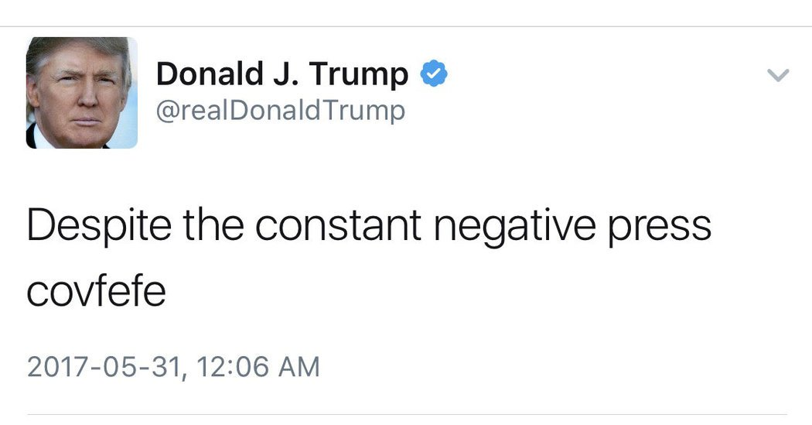
ENSE 470, Milestone 3
Team Covfefe
Taylen, Scott and Jinpeng
February.1st, 2018

Slide 2
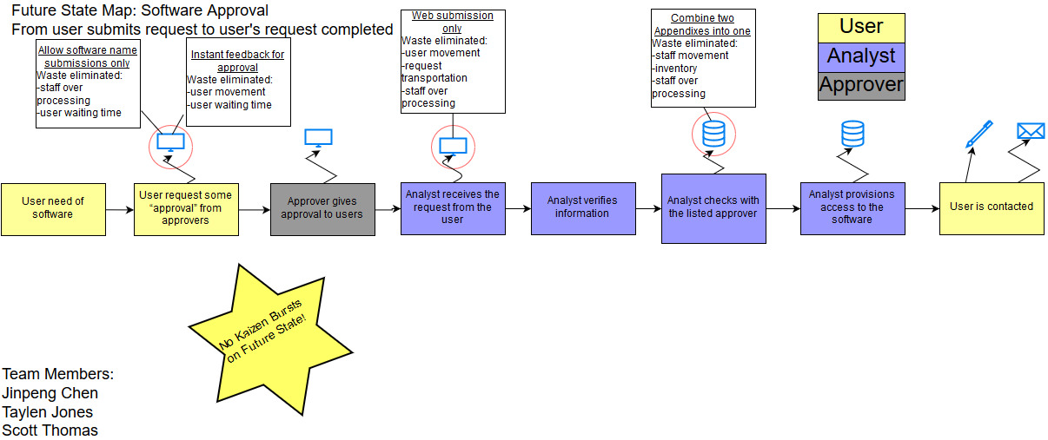
Recall, Future state VSM
Kaizen bursts from current state map resolved

Slide 3
User Stories
As a user i want to request access to the software so I can use it in my job
As an approver I want to approve user requests for the valid users so they can use the software
As an analyst I want to receive user requests in one medium so I can work through them easily
As an analyst I want to access the database easily to add users to the software, and check approver list

Slide 4
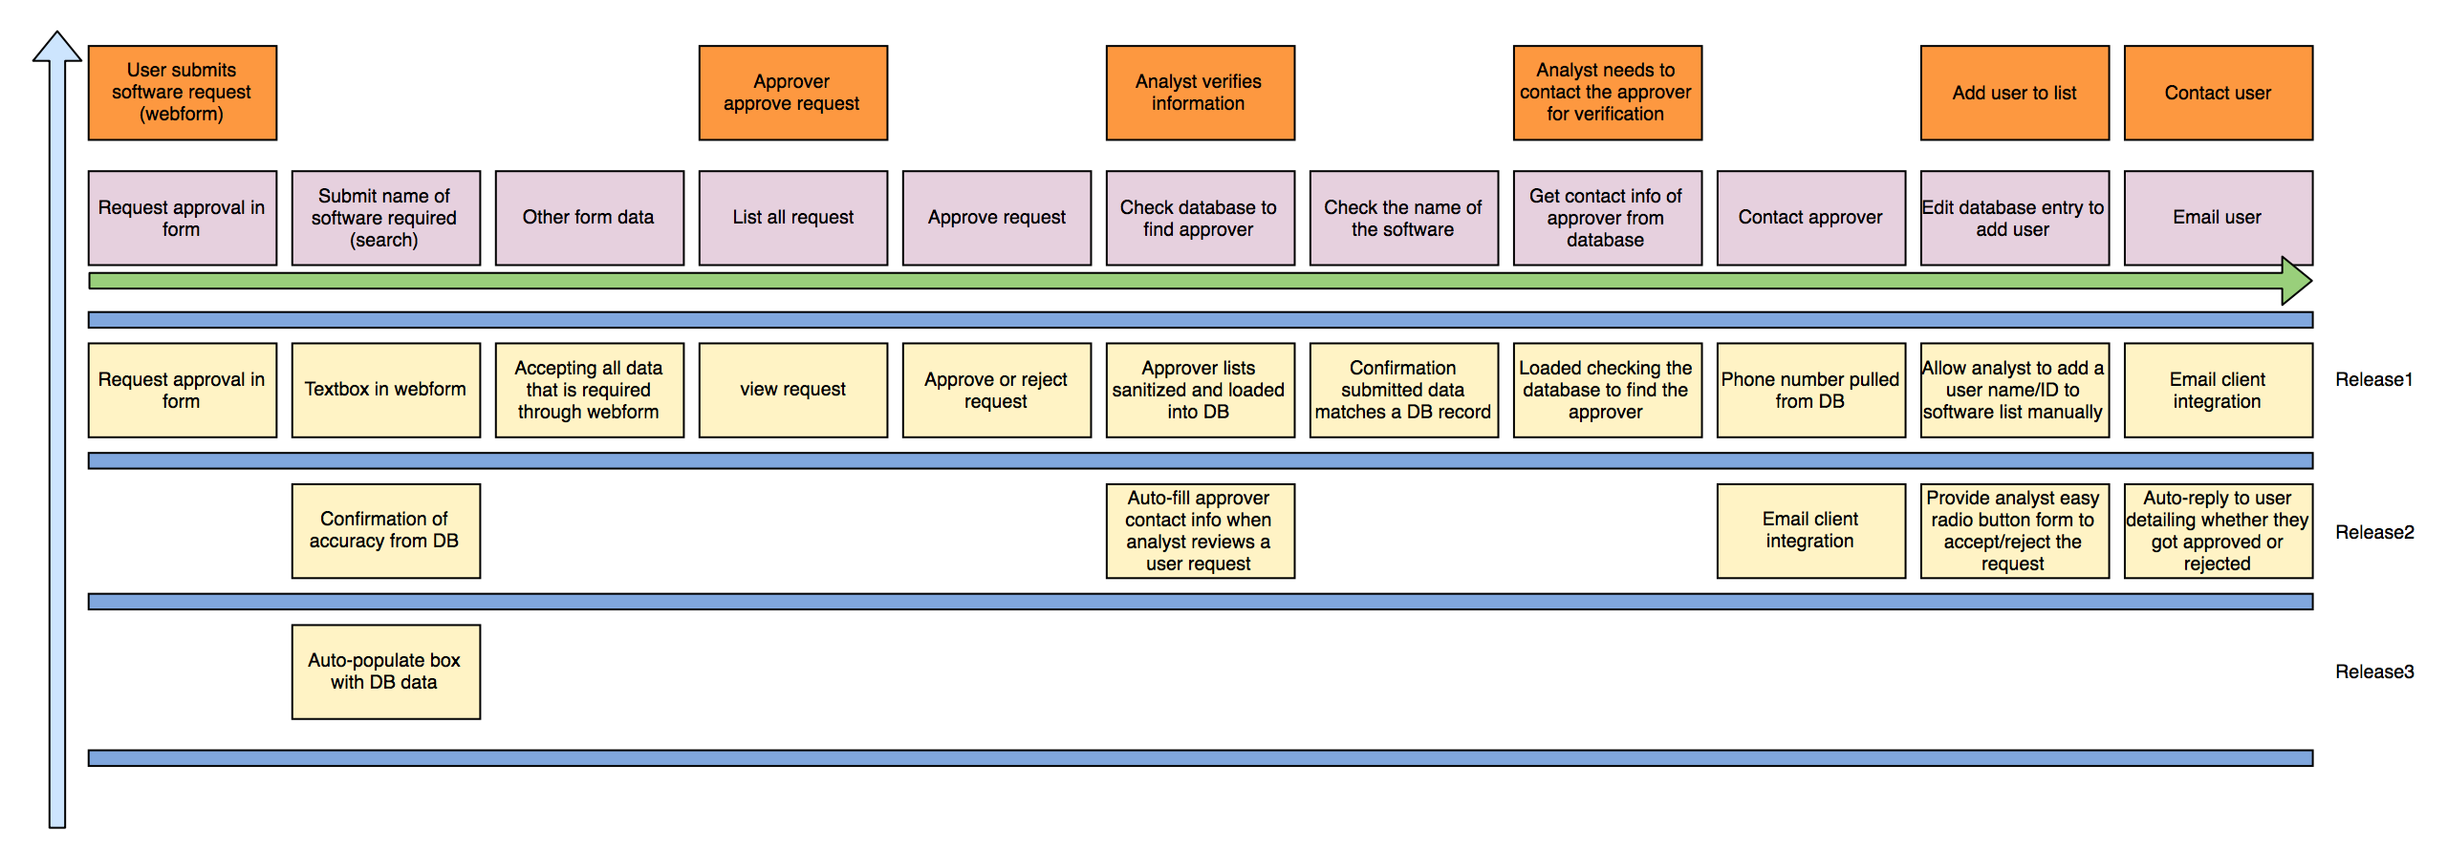
User Story Map

Slide 5
Group reflection
How did you feel about this milestone? What did you like about it? What did you dislike?
  This milestone gave us a clear picture of the steps and processes that we want our software to go through when it is finished
  Easier to plan releases
What did you learn about yourself as you collaborated and worked through this milestone?
  No self discovery this time
How will you use what you have learned going forward?
  Visualizing and mapping out each step can help to solve any of life's problems
What “stuff & things” related to this milestone would you want help with?
  Nothing this time, it was pretty straightforward

