Slide 1
ENSE 470, Milestone 5
Team Covfefe
Jinpeng,Scott and Taylen
March.15th, 2018

Slide 2
Acceptance Test-Driven Development (ATDD)
Our experience
  This activity opened us up a bit more to how much we have to do in the amount of time given
  Allowed us to explore different scenarios that our users might experience
  A lot of testing that needs to go in so that we can confirm the existence of all the functionalities

Slide 3
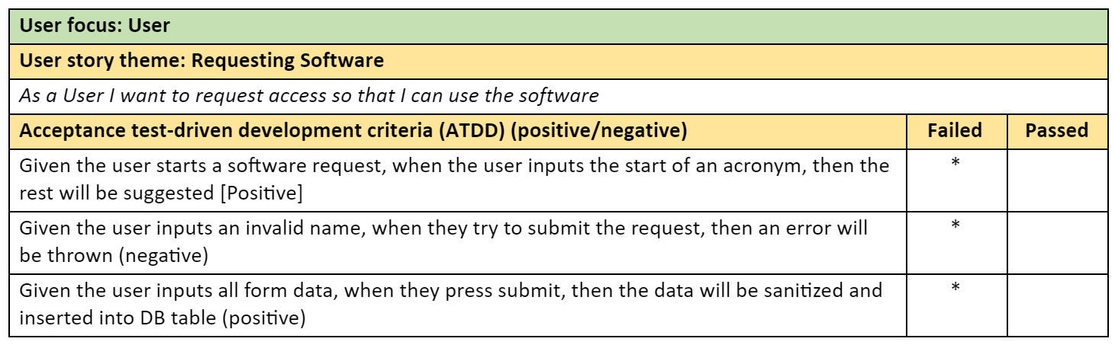
ATDDs – User View

Slide 4
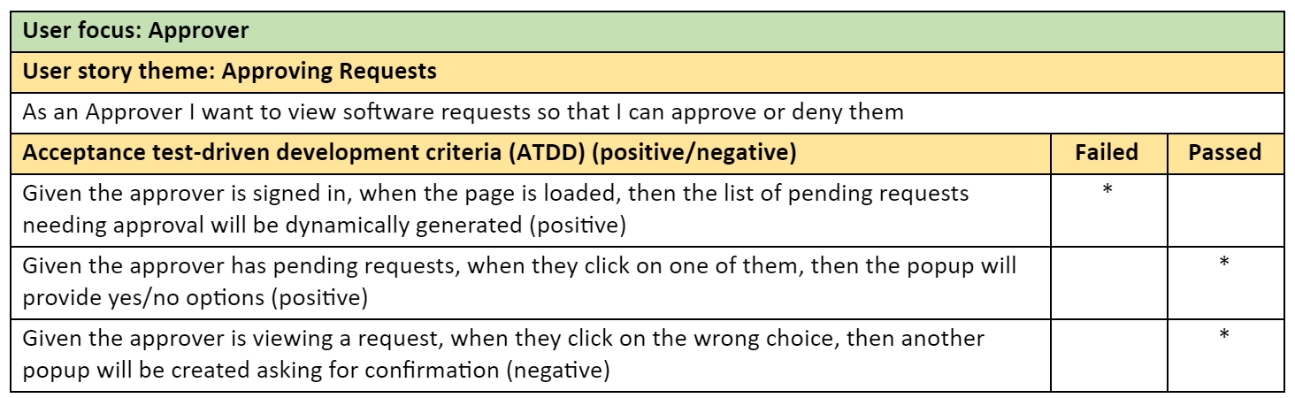
ATDDs – Approver View

Slide 5
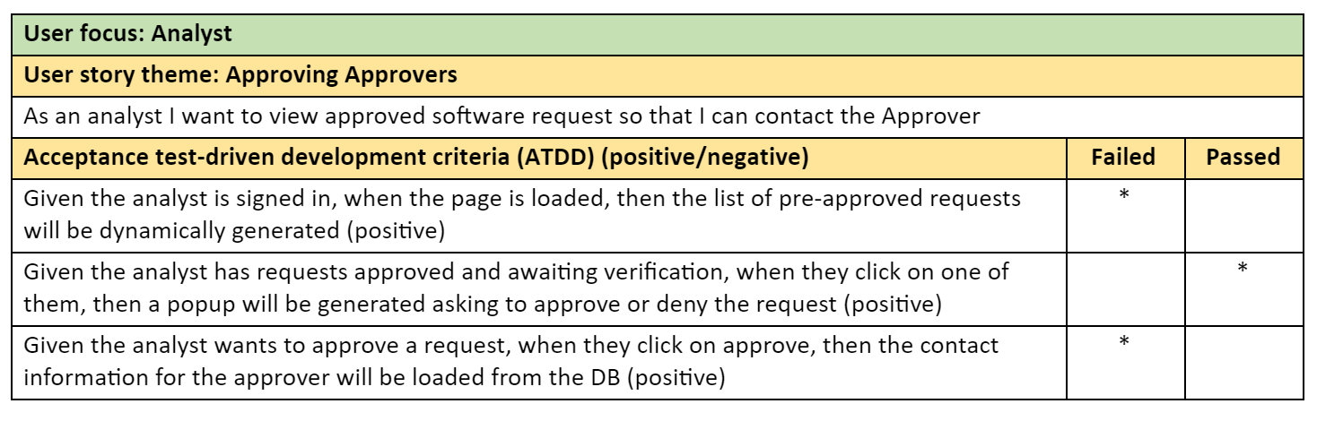
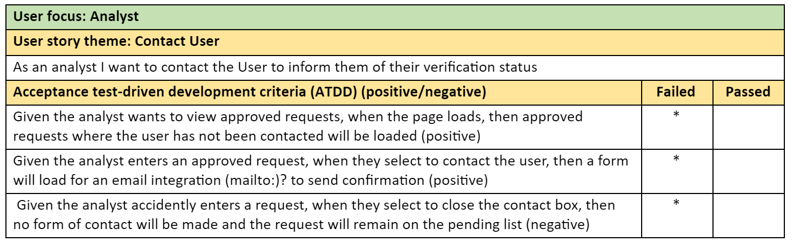
ATDDs – Analyst View

Slide 6
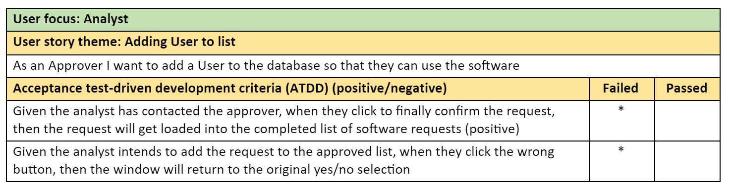
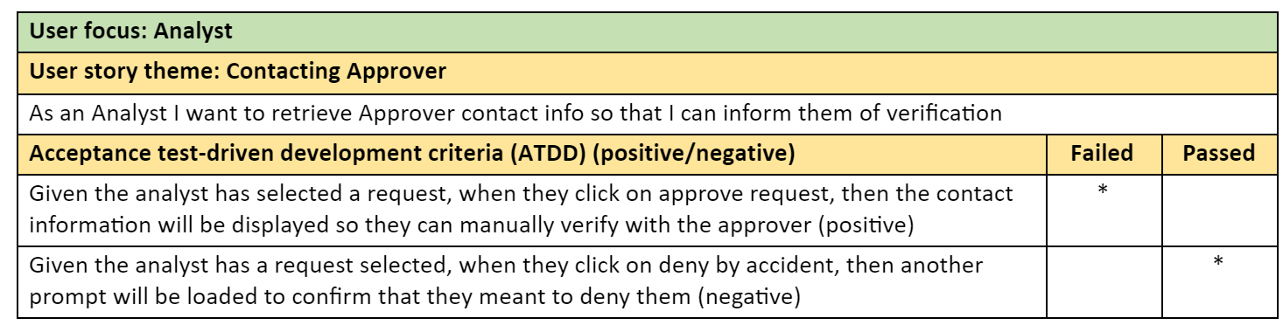
ATDDs – Analyst View

Slide 7
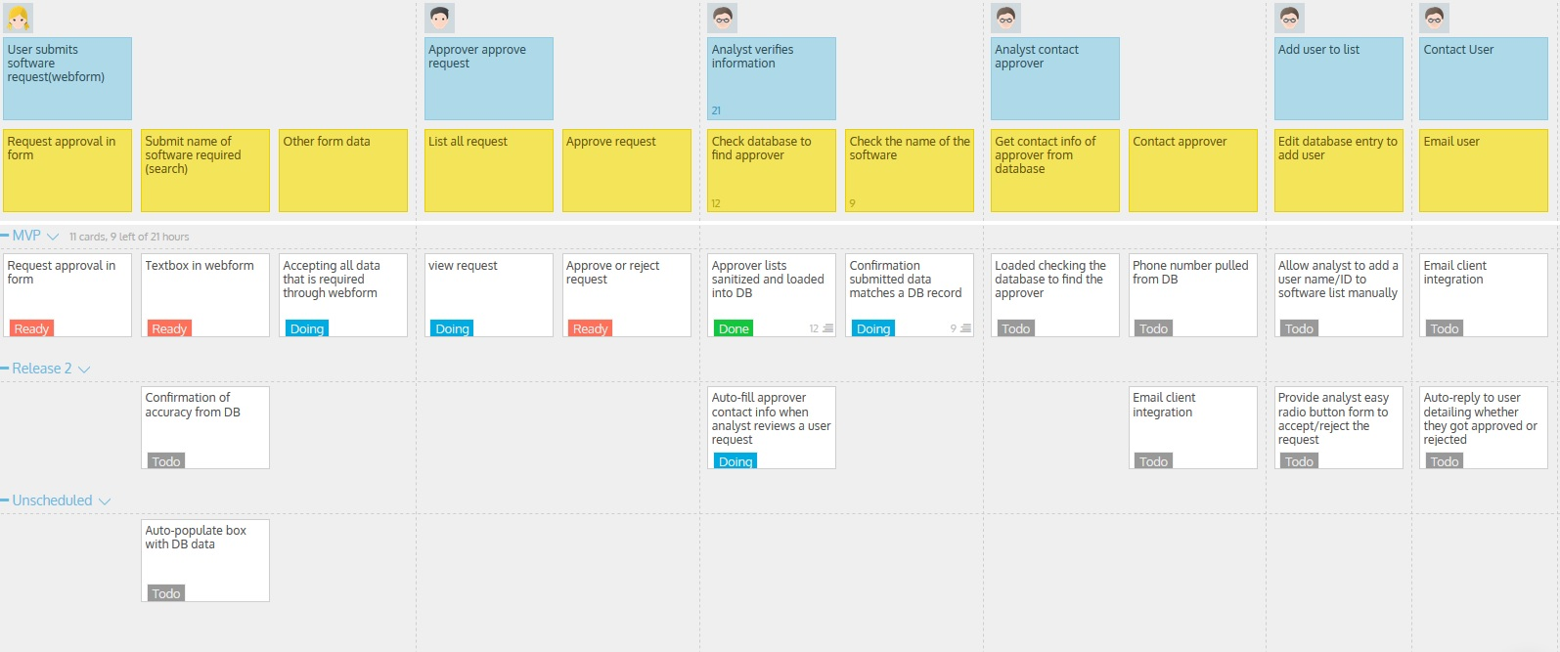
“Daily” Scrum
We are currently on track to deliver a “working” product for MVP release 1. 3 ready to testing, 1 done, and 4 in progress
Any barriers to your group’s success? Other classes, life, not enough time in a day put together the “perfect” release 1
Do you envision being able to achieve more (or less) for your release 1/MVP? Both, there are some things that we might be able to fit in to release 1 but we might not have the time to get to others

Slide 8
Group reflection
How did you feel about this milestone? What did you like about it? What did you dislike?
  ATDD is going help “push” our development efforts
What did you learn about yourself as you collaborated and worked through this milestone?
  We’re still dear friends
How will you use what you have learned going forward?
  Coding to meet these test cases is a good practice to help development
What “stuff & things” related to this milestone would you want help with?
  Nothing for this milestone

