Slide 1
ENSE 470, Milestone 7
Team Covfefe
Taylen, Scott, and Jinpeng
April 12, 2018

Slide 2
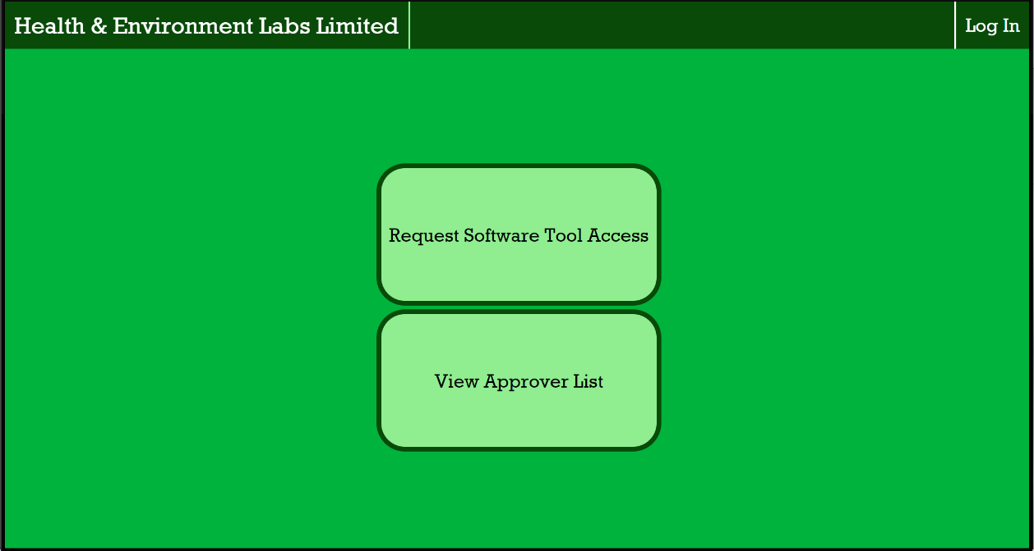
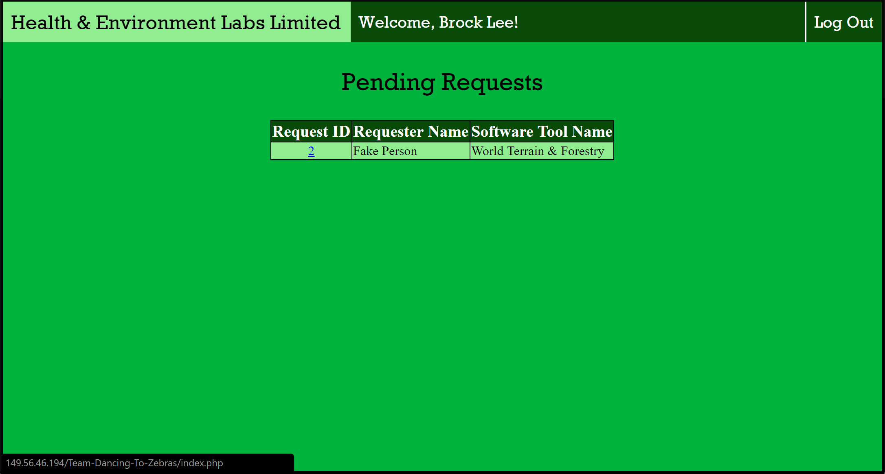
Introduction
Review of team Dancing to Zebras

Slide 3
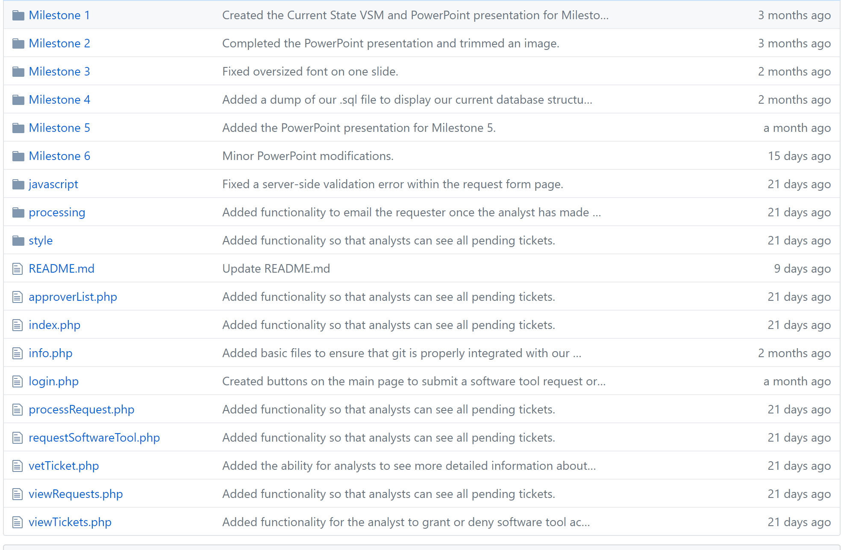
Team GitHub

Slide 4
Team GitHub review
The repository is mostly readable, but making a dedicated folder for software that contains all the files and directories would clean it up
The naming structure was good, folders for all the milestones helped
Picking up where they left off would not be too difficult

Slide 5
Refactor Review
For the most part the code is readable
All ATDD’s pass
User Story Map release 1 objectives complete
Overall high quality code, but some code reuse/redundancy exists (in greater depth in final report out)
Positives include the design pattern usage, and guiding documentation throughout the code

Slide 6
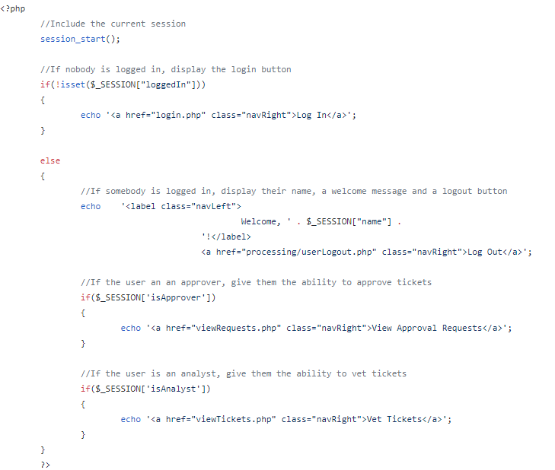
Refactor review
This code could be placed into a header.php file and in each individual document include <?php require “header.php”; ?>

Slide 7
Design pattern discussion (High-level focus)
The patterns used were composite, state, decorator, observer, and façade
Overall the implementation was mostly surface level because the program was not coded in java or similar.
The rough concept of each of the design patterns exists as one step in the overall picture of the final result
Decorator and State were both implemented very effectively in the basic implementation of the program

Slide 8
Reviewed team’s response

Slide 9
Group reflection
How did you feel about this milestone? What did you like about it? What did you dislike?
  Difficult to sort through another project and specifically look for code smells before having an understanding of how everything works first. Overall it went pretty well.
What did you learn about yourself as you collaborated and worked through this milestone?
  Didn’t learn anything new this time
How will you use what you have learned going forward?
  Refactoring and code smells are fairly universal and will be applied in our careers in the workforce in the coming years
What “stuff & things” related to this milestone would you want help with?
  Better defined requirements for the report would be nice

