Slide 1
The Data Science Process
& Problem Definition
This document is for the exclusive use of Deep Dive bootcamp participants during the bootcamp. This document may not be shared or duplicated

Slide 2
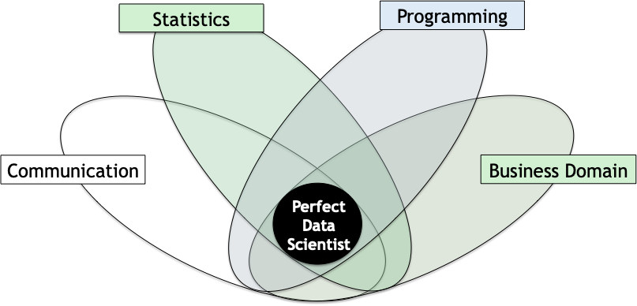
Data Science: a Multidisciplinary Blend of Skills
This document is for the exclusive use of Deep Dive bootcamp participants during the bootcamp. This document may not be shared or duplicated

Slide 3
Data Science Process
Problem Definition
Understand the project's objectives from a business viewpoint.
Data Collection
Gather relevant data. If data are already available, understand how data were collected.
Data Cleaning & Exploratory Data Analysis
Understand, clean and explore data.
Processing
Use modeling techniques to gain useful insights into data and meet objectives of the project.
Communication of Results
Communicate results of analysis. Draw meaningful conclusions.

Slide 4

Don’t do Data Science … Solve Business Problems
“A good data science problem should be relevant, specific and unambiguous. It should align with the business strategy.”
Business
Problem
Data Science
Problem
Business leaders and subject matter experts need to work alongside data scientists to formulate a business problem and translate it to a data science problem.
This document is for the exclusive use of Deep Dive bootcamp participants during the bootcamp. This document may not be shared or duplicated

Slide 5
Defining the Business Problem
Below are some things to consider when defining a business problem.
What problem does the business have?
What data do we need to solve this?
What will success look like? How will we measure performance?
How will the results be used?
What constraints do we have?

Slide 6

Fraud Detection - Example
We are a credit card processing company and have had issues with fraudulent charges.
We want to be able to predict when a pending transaction is fraudulent.

Slide 7
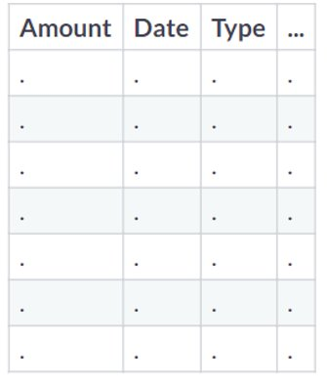
Fraud Detection – Example
Question | Answer
What is the business problem?
What data do we need to solve this?
What will success look like?
How will the results be used?
What constraints do we have?

Slide 8
Data Science Problems
Once the business problem has been defined, we can work on translating the business problem to a data science problem.
Data science problems typically
Categorize or group data
Detect patterns (or anomalies)
Show relationships between variables
Predict outcomes
This document is for the exclusive use of Deep Dive bootcamp participants during the bootcamp. This document may not be shared or duplicated

Slide 9
Types of Data
Data
Categorical - Data that fall into distinct categories
Numerical – Quantitative data
Ordinal – Natural Ordering. Ex. Small, Medium, Large
Nominal – Unordered. Ex. Dog, Cat, Mouse
Discrete – Countable # of values. Ex. Customer Complaints
Continuous – Infinite # of values. Ex. Time, Temperature
You need to know the type(s) of data you are dealing with before you can define your data science problem.

Slide 10
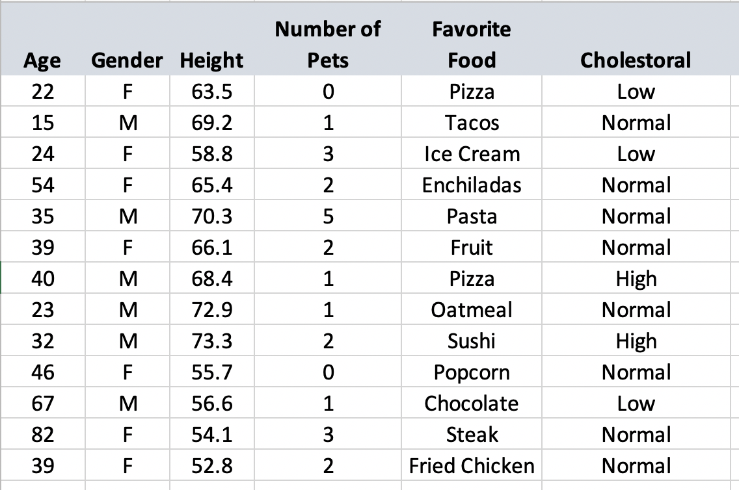
Types of Data Quiz

Slide 11
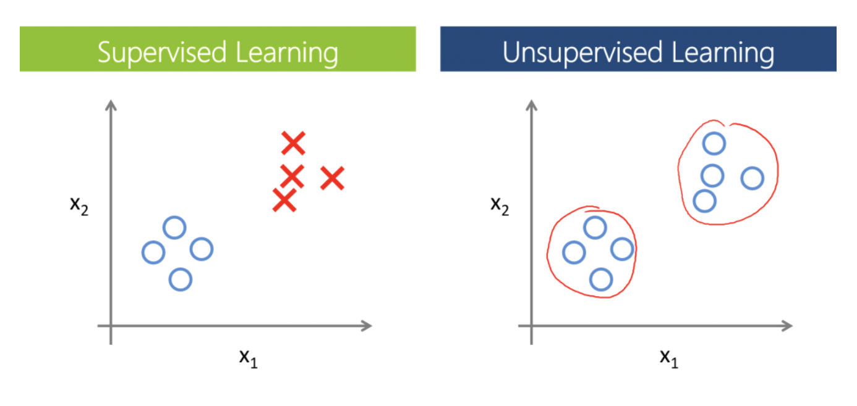
What Type of Data Science Problem is it?
Supervised vs. Unsupervised Learning
Supervised learning involves building a model for predicting an output based one or more inputs. ​
Unsupervised learning involves learning relationships of inputs without a labeled output.

Slide 12
What Type of Data Science Problem is it?
X1 age | X2 income | Response Purchase?
18 | 5,000 | No
20 | 20,000 | No
22 | 19,000 | No
24 | 32,000 | No
28 | 40,000 | Yes
32 | 35,000 | Yes
35 | 50,000 | Yes
42 | 55,000 | Yes
X1 age | X2 income
18 | 5,000
20 | 20,000
22 | 19,000
24 | 32,000
28 | 40,000
32 | 35,000
35 | 50,000
42 | 55,000
Supervised learning involves building a model for predicting an output based one or more inputs. ​
Unsupervised learning involves learning relationships of inputs without a labeled output.

Slide 13
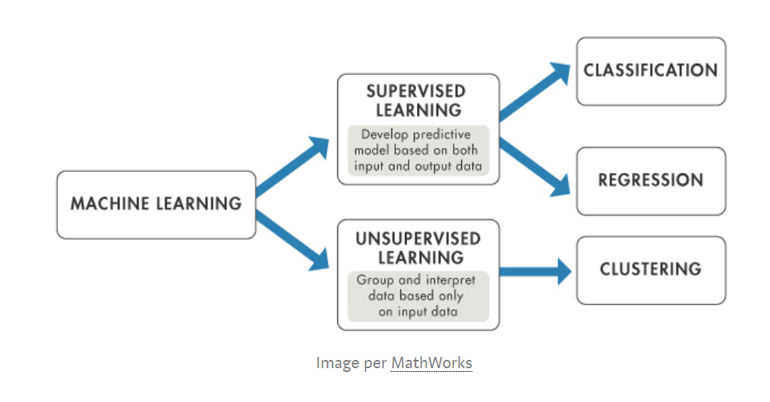
What Type of Data Science Problem is it?
Supervised learning can be broken up into classification and regression problems. ​
Unsupervised learning is generally a clustering problem.
This document is for the exclusive use of Deep Dive bootcamp participants during the bootcamp. This document may not be shared or duplicated

Slide 14


Regression vs. Classification
Regression
Let's build a model to predict what the temperature will be tomorrow.
Classification
Let's build a model to predict whether or not it will rain tomorrow.
70° F
Yes
Regression involves making a prediction of a continuous output.
Classification involves making a prediction of a categorical or binary output.

Slide 15
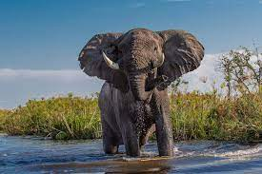
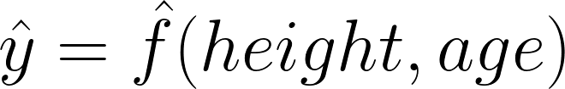
What is a Predictive Model?
Real Life Observation
Our Model Approximating Real Life
Response
Prediction
Dependent Variable
Output
Model
Features
Predictors
Independent Variables
Inputs

Slide 16


What Are the Use Cases?
Supervised: Classification
Predicts a discrete category
Medical imaging, Natural Language Processing, image recognition
Supervised: Regression
Predicts a numerical response
Home sale price, weather forecasting, blood sugar levels
Unsupervised: Clustering
Groups together data based on similar characteristics
Political polling, retail recommendation system
This document is for the exclusive use of Deep Dive bootcamp participants during the bootcamp. This document may not be shared or duplicated

Slide 17
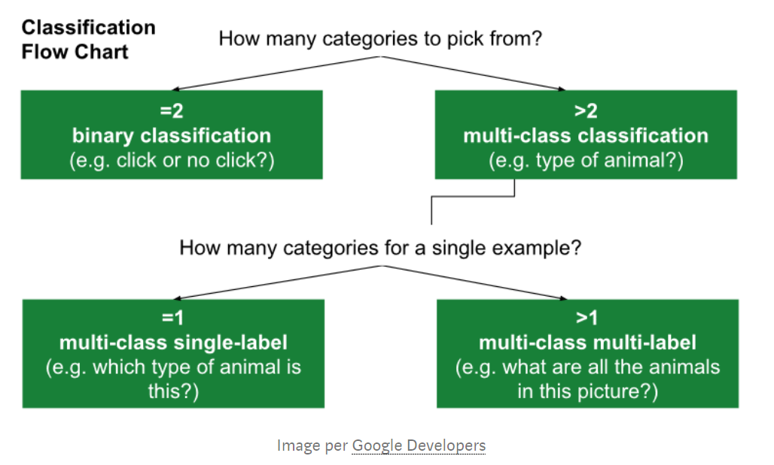
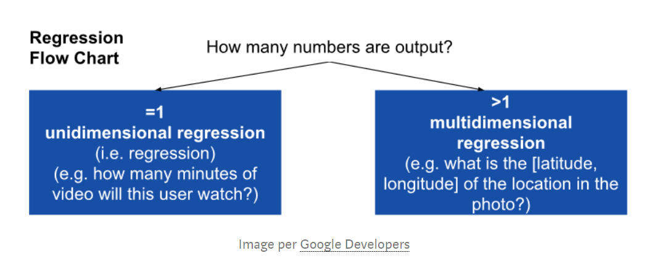
Get Specific on Problem Type

Slide 18
Fraud Detection - Example
We are a credit card processing company and have had issues with fraudulent charges.
We want to be able to predict when a pending transaction is fraudulent.
What type of data science problem is this?

Slide 19
Data Science Problem Activity

Slide 20
Recap
Data science is the process of using data analytics, statistics, and programming to solve business problems.
Don't do data science; instead, solve business problems.
When scoping your problem, think about the following:
The data needed to solve the problem
The desired outcome or intended usage
How success will be measured
Any constraints
The data science problem
This document is for the exclusive use of Deep Dive bootcamp participants during the bootcamp. This document may not be shared or duplicated

