Slide 1
Intro to Stats
This document is for the exclusive use of Deep Dive bootcamp participants during the bootcamp. This document may not be shared or duplicated

Slide 2


Population, Sample & Observation
The units on which we measure data—such as people, cities, animals — are called observations.
The collection of all observations that we are interested in is called a population.
If we consider a selection of observations, then these observations are called a sample.
Population
All students at
a college
Sample
A few selected students from the college

Slide 3
Summary Statistics
A statistic is a measure of some attribute of sampled data. They can be used to concisely describe features of a dataset.
The choice of summary statistic depends on whether we are looking at numerical or categorical data.

Slide 4
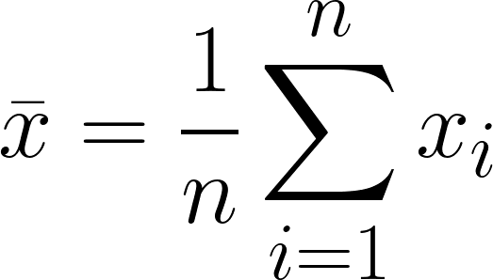
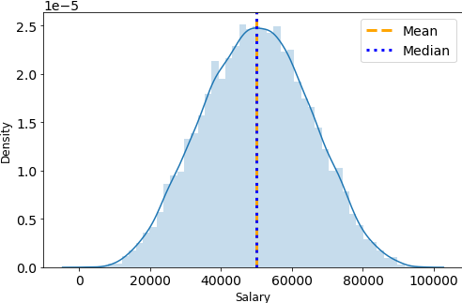
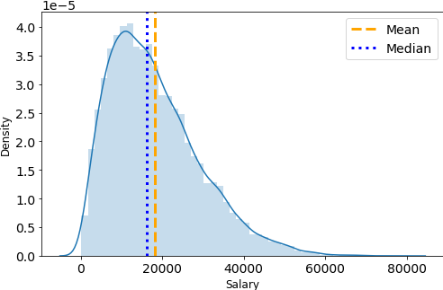
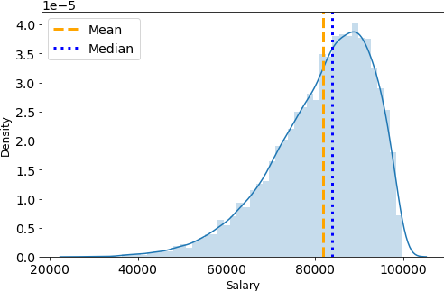
Summary Statistics - Measures of Central Tendency Numerical Data (Univariate)
Mean - The sum of the data values divided by the number of observations
Median - The 50th percentile of the data (the point below which 50% of the observations fall)
Positive Skew
Negative Skew

Slide 5
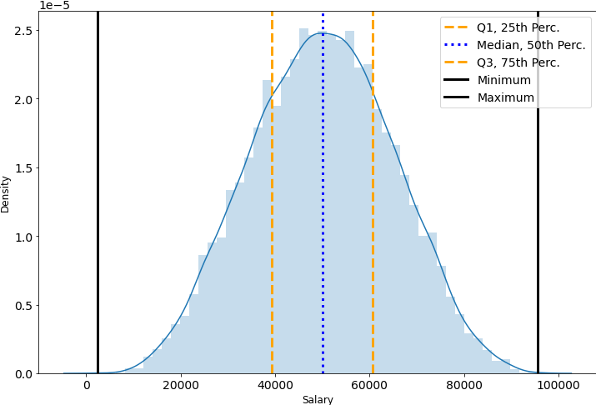
Summary Statistics - Percentiles
A percentile is a value at which a certain percentage of the data fall below. For example, the 75th percentile is the value at which 75% of the data fall below.
Certain percentiles have special names:
The 25th percentile is also called the 1st quartile.
The 50th percentile is also called the 2nd quartile or the median.
The 75th percentile is also called the 3rd quartile.

Slide 6
Summary Statistics - Measures of Spread (1/2) Numerical Data (Univariate)
Range - the difference between the minimum and maximum of the data
Interquartile Range - the difference between the 1st and 3rd quartiles of the data.
IQR
Range

Slide 7
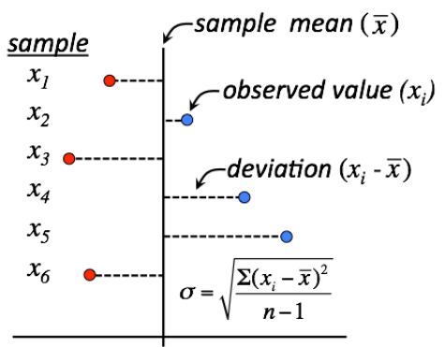
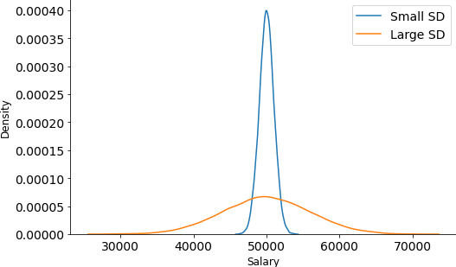
Summary Statistics - Measures of Spread (2/2) Numerical Data (Univariate)
Standard Deviation - The sum of the data values divided by the number of observations

Slide 8
Example
Say we collected the following test scores from 10 students:
85, 90, 92, 73, 95, 60, 89, 78, 99, 90
Calculate the following:
Mean
Median
Range

Slide 9
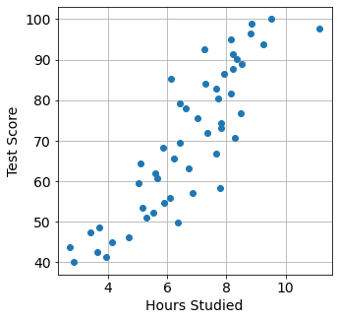
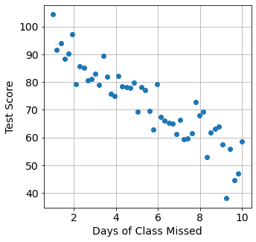
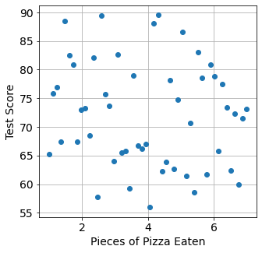
Summary Statistics – Correlation Numerical Data (Bivariate)
Correlation between two continuous variables can be thought of as the strength of the linear relationship between the variables. The correlation coefficient is a number between -1 and +1 that quantifies the strength and direction of the relationship.
r = 0.87
r = -0.90
r = -0.10

Slide 10
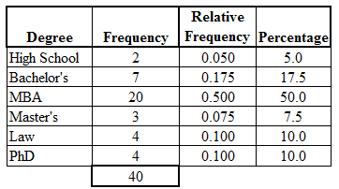
Summary Statistics – Categorical Data
Frequency
Relative Frequency
Percentage

Slide 11
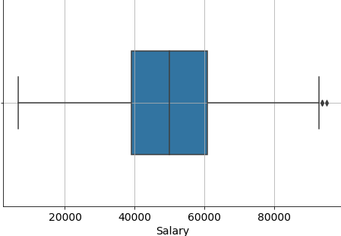
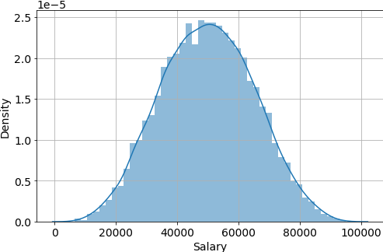
Visualizations – Numerical Data (Univariate)
Boxplot
Histogram
Effective Min
Median
Outliers
Effective Max
IQR

Slide 12
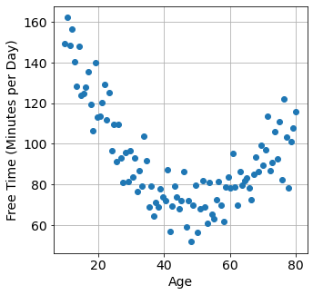
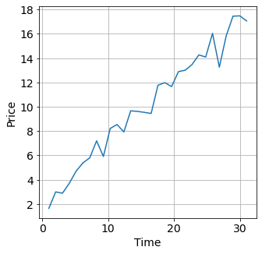
Visualizations – Numerical (Bivariate)
Scatter Plot
Line Plot

Slide 13
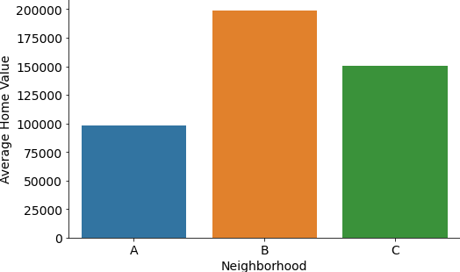
Visualizations – Categorical Data (Univariate)
Bar Plot

Slide 14
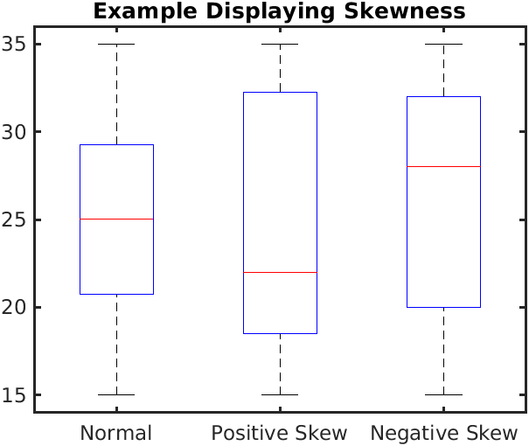
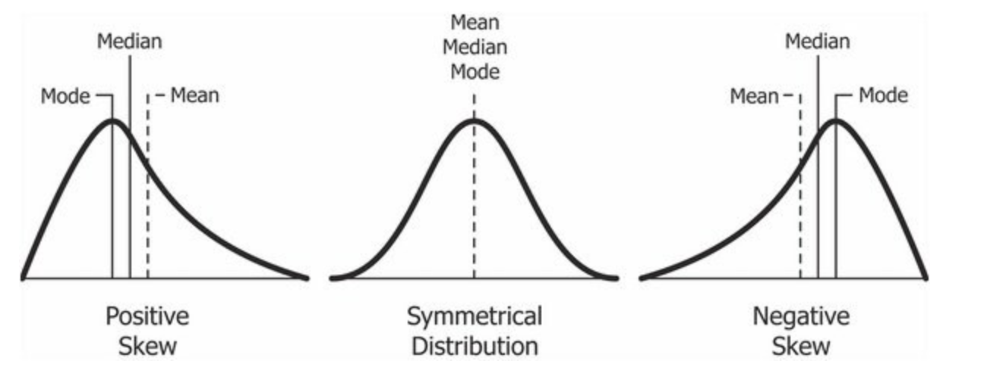
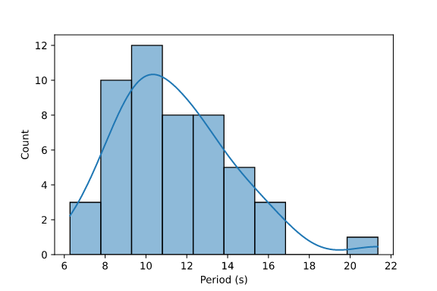
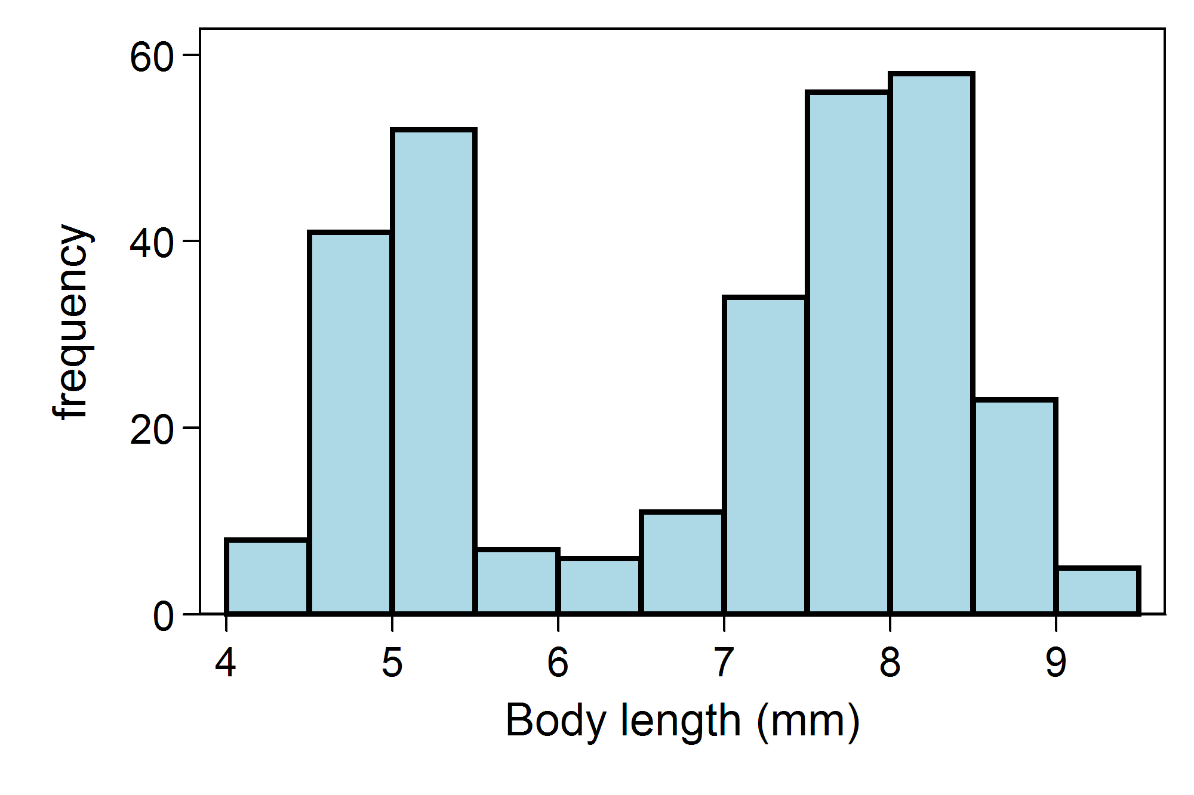
Things to Look Out for In Visualizations

