Slide 1
Data Cleaning & Exploratory Data Analysis
This document is for the exclusive use of Deep Dive bootcamp participants during the bootcamp. This document may not be shared or duplicated

Slide 2
Data Science Process
Problem Definition
Understand the project's objectives from a business viewpoint.
Data Collection
Gather relevant data. If data are already available, understand how data were collected.
Data Cleaning & Exploratory Data Analysis
Understand, clean and explore data.
Processing
Use modeling techniques to gain useful insights into data and meet objectives of the project.
Communication of Results
Communicate results of analysis. Draw meaningful conclusions.

Slide 3
Data Science Process
Problem Definition
Understand the project's objectives from a business viewpoint.
Data Collection
Gather relevant data. If data are already available, understand how data were collected.
Data Cleaning & Exploratory Data Analysis
Understand, clean and explore data.
Processing
Use modeling techniques to gain useful insights into data and meet objectives of the project.
Communication of Results
Communicate results of analysis. Draw meaningful conclusions.

Slide 4
Tidy Data
It is often said that 80% of data analysis is spent on data cleaning.
There is a concept called tidy data that has set a standard for structuring datasets to more easily facilitate analysis.
What's a relatively easy way to save time and resources? Make sure your team collects data in a tidy format!
"Tidy datasets are all alike, but every messy dataset is messy in its own way".
Source: https://www.jstatsoft.org/article/view/v059i10

Slide 5
Tidy Data Organization
p variables
Three characteristics of tidy data:
Every column is a variable.
Every row is an observation.
Every cell is a single value.
Patient | Weight | Height | BP | Age | Diabetes
A | 150 | 65 | 120 | 35 | Yes
B | 132 | 63 | 140 | 44 | No
C | 190 | 69 | 130 | 56 | Yes
D | 178 | 70 | 135 | 52 | No
n observations

Slide 6
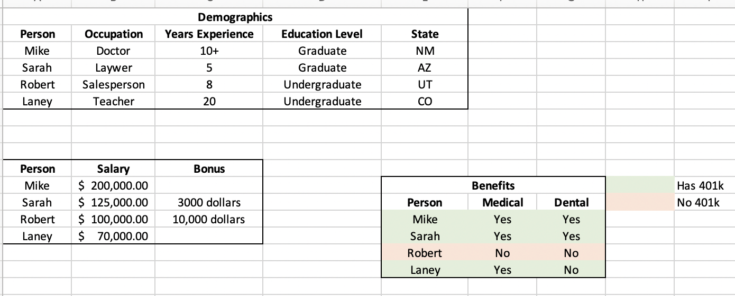
Not So Good Data Structure

Slide 7
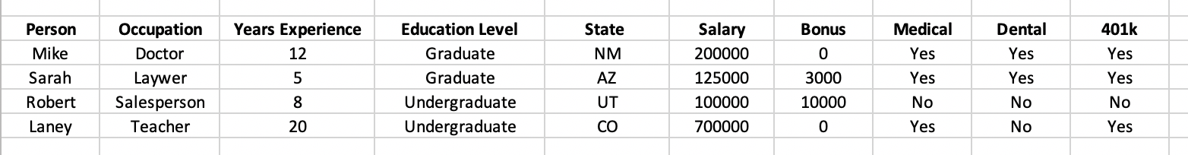
Good Data Structure

Slide 8
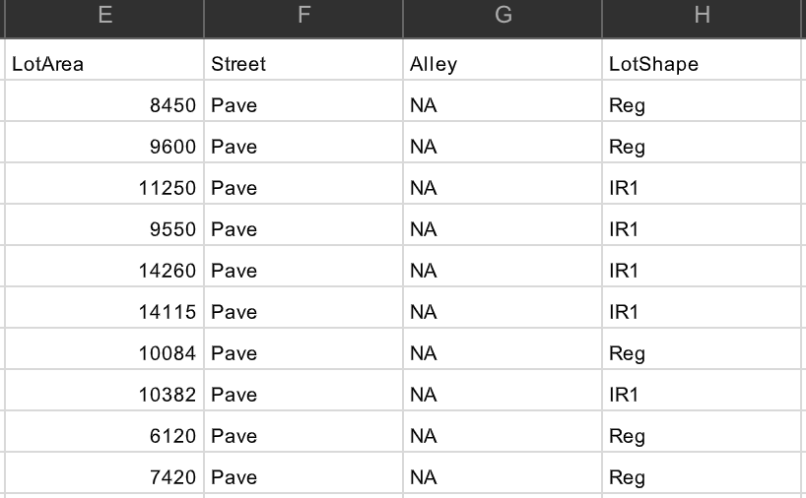
Data Cleaning
Below are some ways data may need to be cleaned
Remove redundant variables
Address null/missing values
Transform data
Convert data types
Restructure data

Slide 9
Exploratory Data Analysis
Exploratory Data Analysis (EDA) is used to do the following:
Understand your data
Generate summary statistics
Identify anomalies/outliers
Understand variables & their relationships
Help determine next steps in the analysis

Slide 10
Understand Your Data
Before performing any analysis, it’s important that you take the time to understand your data and the types of variables you will be dealing with. Some useful pandas methods are given below:
.shape - gives the dimensions of a dataset
.head() - gives the first n rows of a dataset. Default is n = 5.
.describe() - provides summary statistics of a dataset
.info() - gives information about the columns in your dataset including the datatype and the number of non-null values
.columns - returns a list of the column names
.unique() - returns the unique values of a column

Slide 11
Things to Look Out for In Visualizations
Trends
Patterns
Gaps
Relationships
Outliers
Message

Slide 12
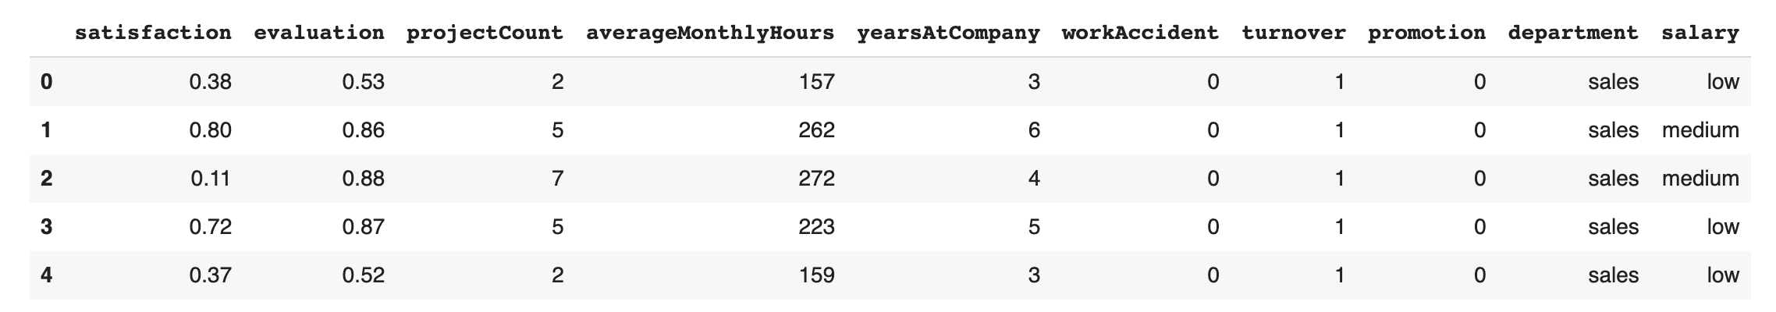
An Example Analysis – HR Retention
What is the business problem? What is the data science problem?
https://www.kaggle.com/randylaosat/predicting-employee-kernelover

Slide 13
HR Retention Problem Definition
Our company wants to understand what factors contribute most to employee turnover. We also want to be able to predict turnover for certain employees so we can focus our retention strategies on employees likely to turnover.
A quarterly HR report will be generated that lists employees that are predicted to turnover.
This is a supervised classification problem.

Slide 14
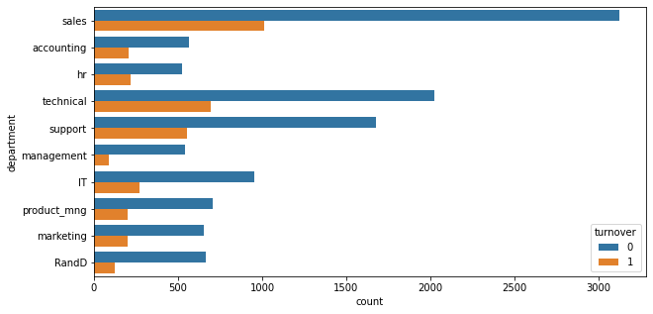
Department vs Turnover
Why might this not be a good way to represent this data?

Slide 15
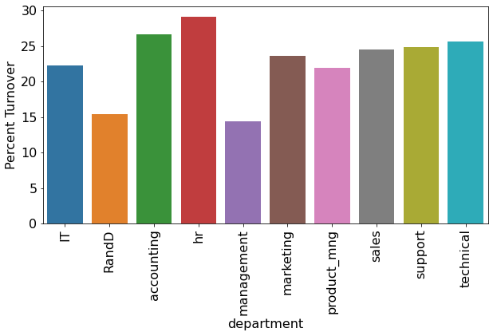
Department vs Percent Turnover
We can see that HR and accounting have the highest percent turnover. Management has the lowest turnover. Why might this be happening?

Slide 16
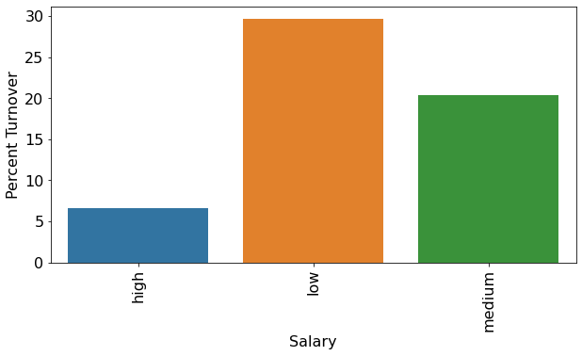
Salary vs Percent Turnover

Slide 17
Salary vs Percent Turnover
Unsurprisingly, most people who left had low or medium salaries.

Slide 18
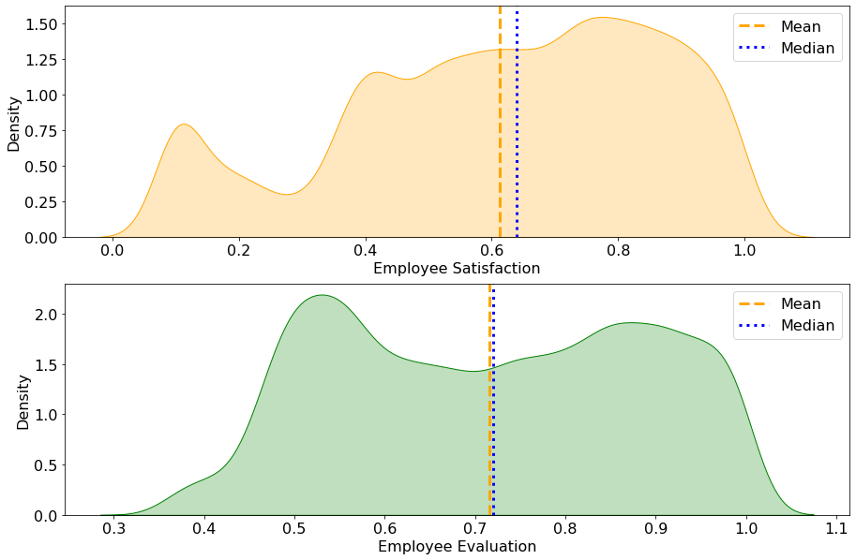
Employee Satisfaction & Evaluation

Slide 19
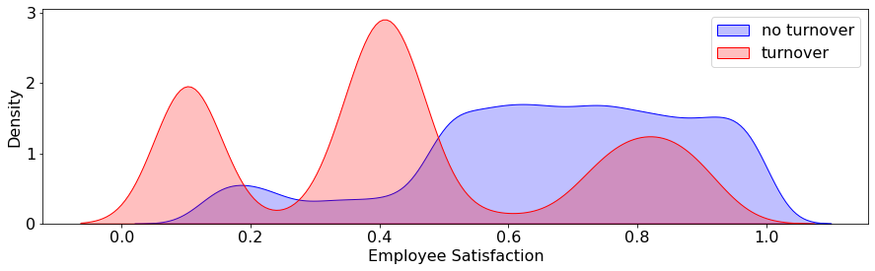
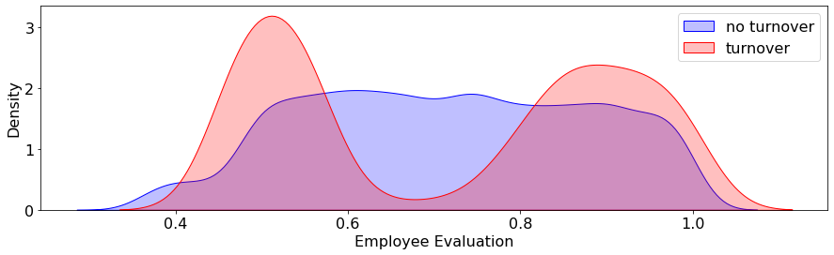
Satisfaction & Evaluation vs Turnover
The distributions for turnover vs no turnover are very different. We also see that the turnover group has multiple modes.

Slide 20
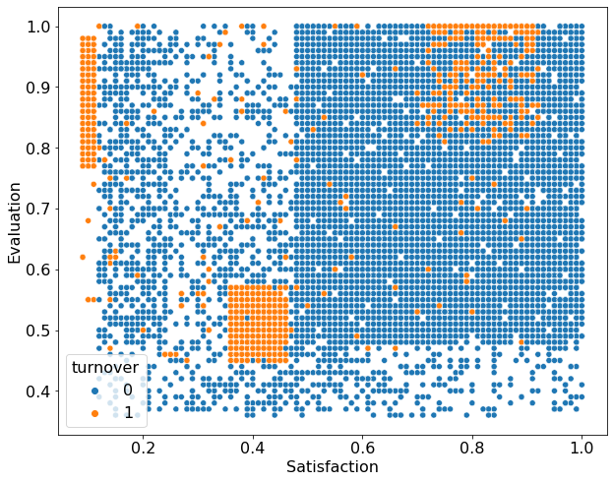
Satisfaction & Evaluation vs Turnover Pt 2

Slide 21
Satisfaction & Evaluation vs Turnover Pt 2
There appear to be three groups of employees who turnover:
1. Low satisfaction, high evaluation
2. Low satisfaction, low, evaluation
3. High satisfaction, high evaluation

Slide 22
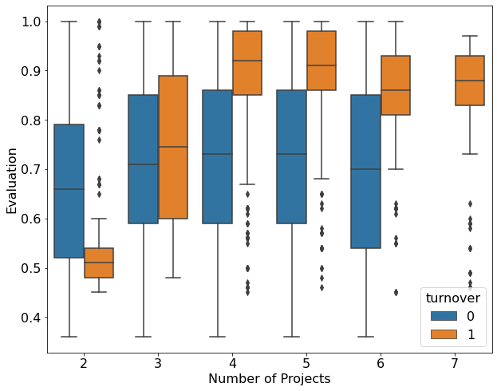
Project Count & Evaluation vs Turnover

Slide 23
Project Count & Evaluation vs Turnover
For > 3 projects, employees that have a higher evaluation tend to leave.

Slide 24
What Next?
Based on our EDA, we can see that there are likely complex relationships between our variables and turnover.
It's easy to understand why some employees are leaving (e.g., those with low satisfaction, low performance, low salary), but it is more challenging to understand why others are leaving (e.g., those with high satisfaction and high performance).
Building a model can help us understand these more complex relationships.

Slide 25

Recap
Think about the population of interest when collecting data.
Up to 80% of the analysis involves data cleaning - encourage your team to store their data in a tidy format when possible.
Exploratory data analysis (EDA) is a way to get an understanding of your data and potential relationships between variables.
This document is for the exclusive use of Deep Dive bootcamp participants during the bootcamp. This document may not be shared or duplicated

