Slide 1
Model Validation - Cross Validation & Model Validation w/ Categorical Response

Slide 2
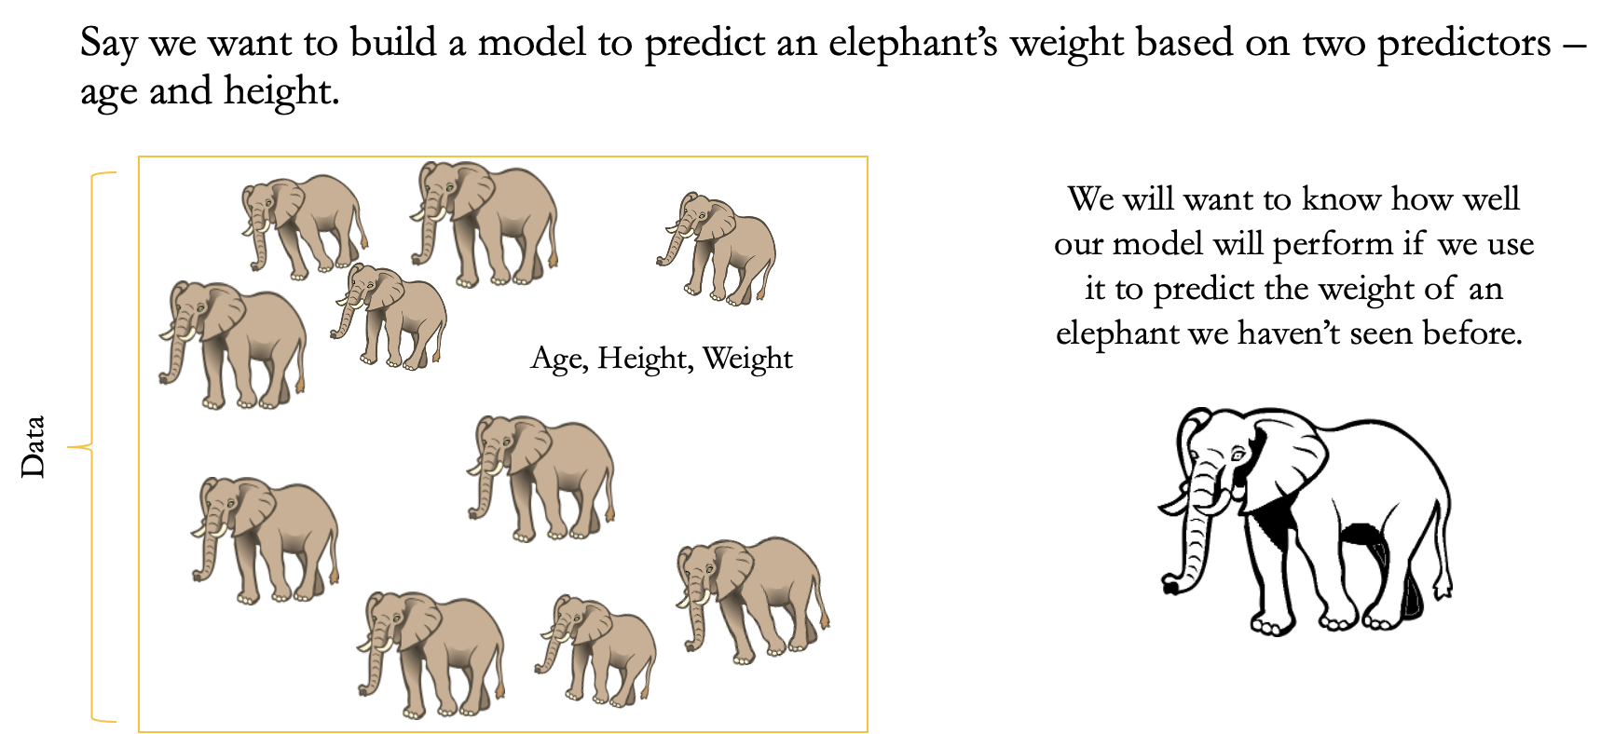
Cross Validation Motivation - Elephant Example

Slide 3
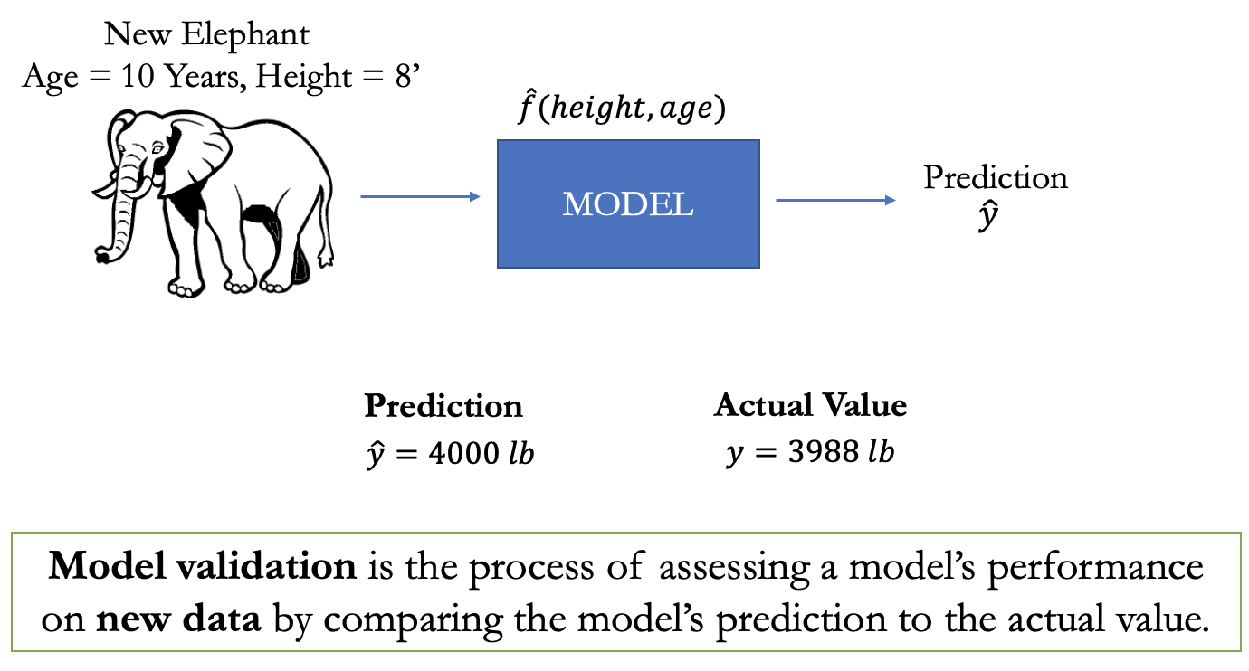
Model Validation

Slide 4
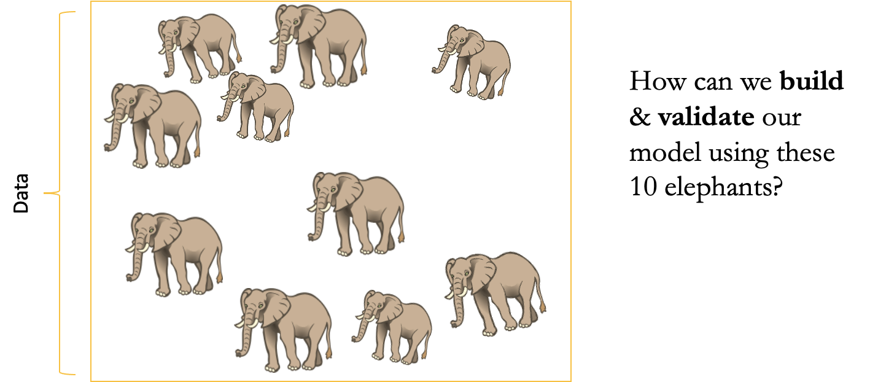
How Do We Validate Our Model?

Slide 5
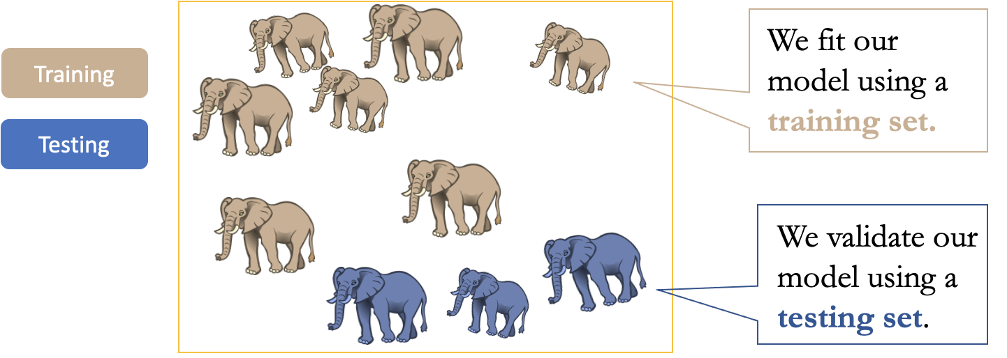
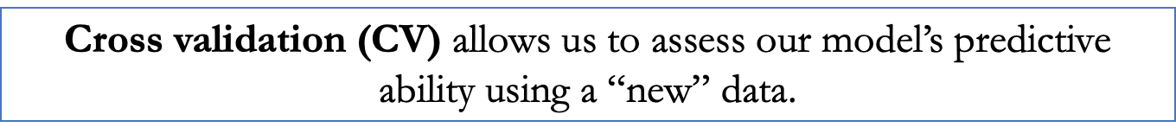
Cross Validation (CV)
To assess how our model will perform with new data, we can split our data into training and testing sets. This is a single-run cross validation.

Slide 6
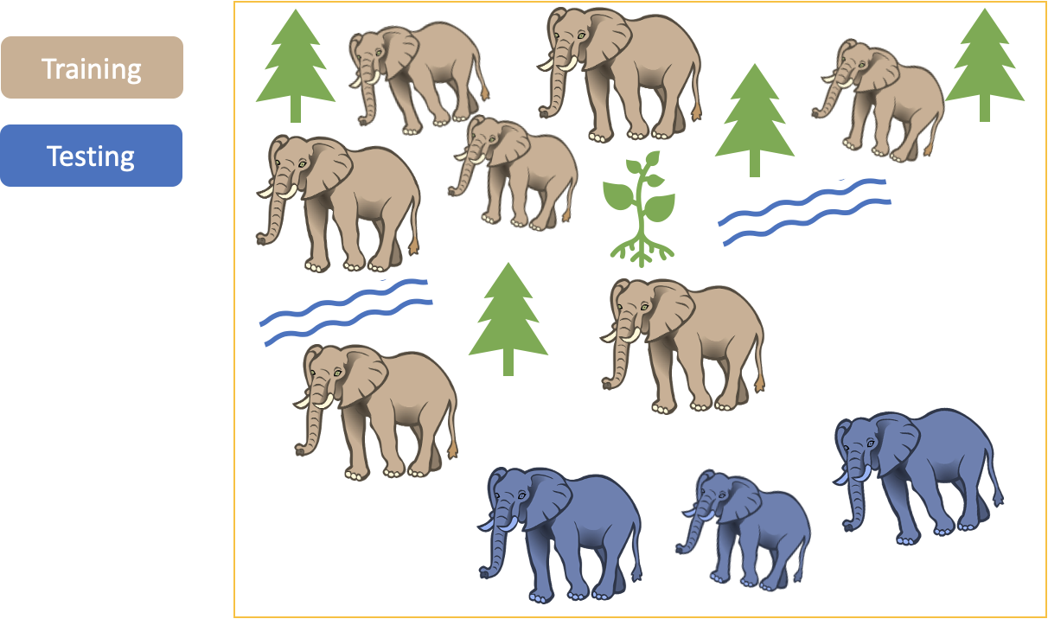
What Happens if We Only Run CV Once?

Slide 7
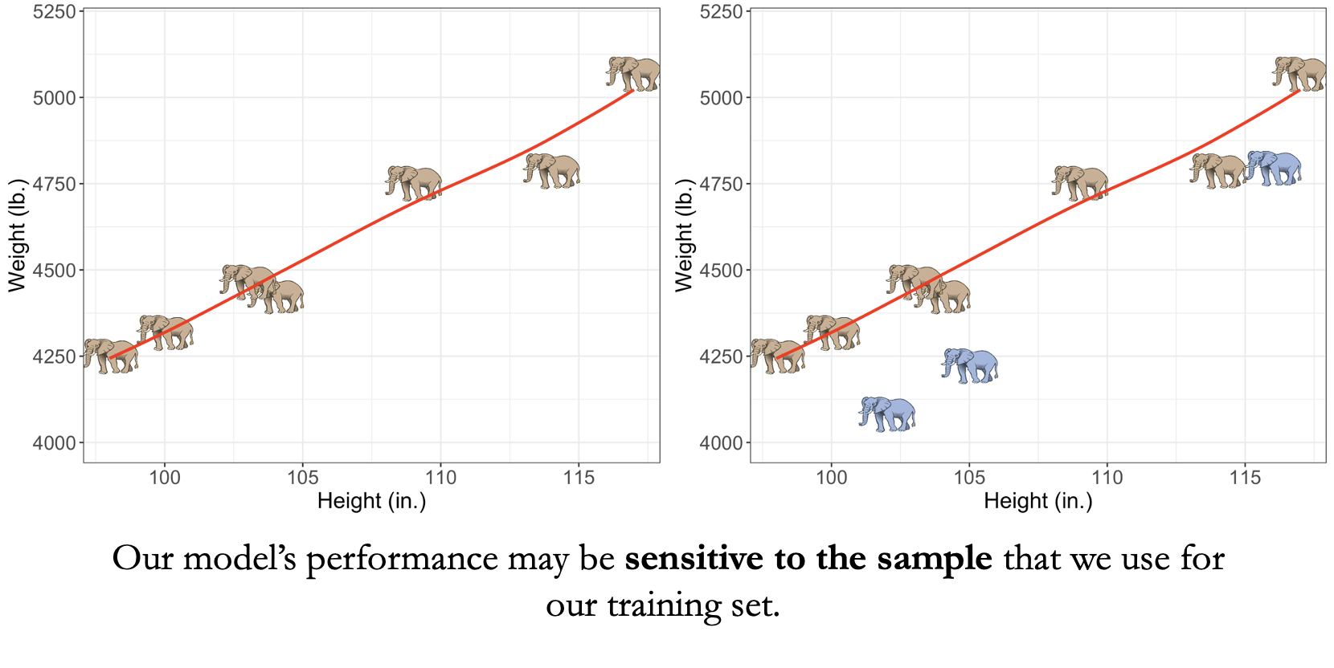
Single Run CV Limitation

Slide 8
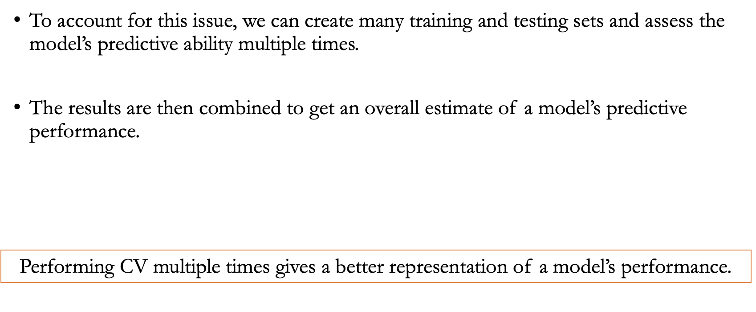
Solution? Perform CV Multiple Times!

Slide 9
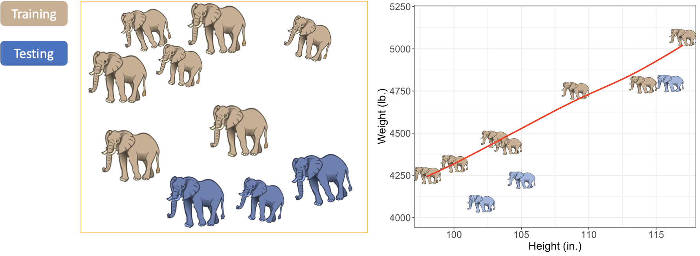
CV Example Set 1

Slide 10
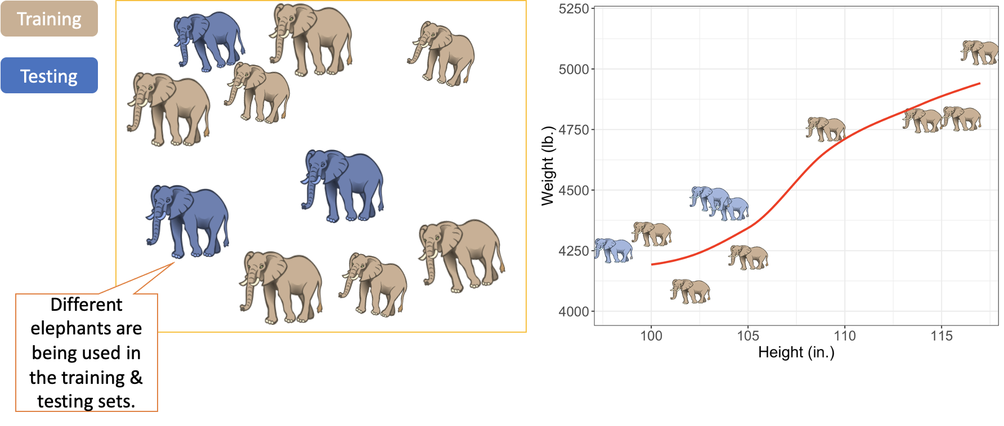
CV Example Set 2

Slide 11
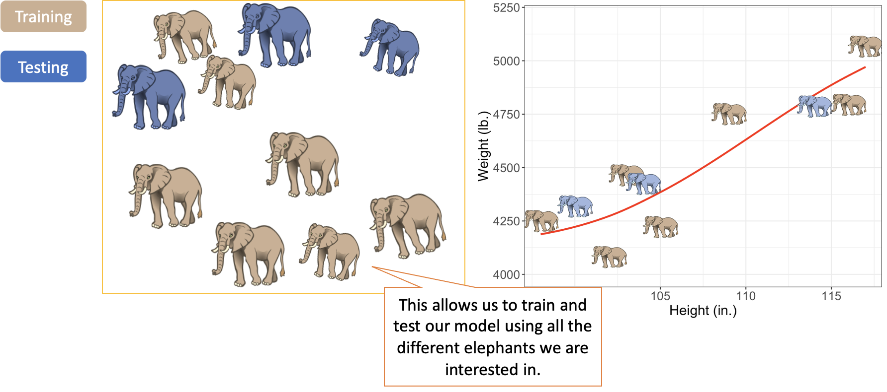
CV Example Set 3

Slide 12
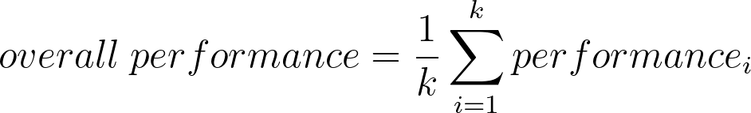
Cross Validation Overview
The cross validation process is generally split into the following steps:
1. Data is split into training and testing sets
2. A model is trained using the training data
3. The model is validated using the testing data. i.e. a performance metric is calculated between the values predicted by model and those in the sample data
4. This is repeated k times. Aggregate the performance metrics across k.
Training
Testing
Iteration 1
Performance Metric 1
Performance Metric 2
Iteration 2
Iteration k
Performance Metric k

Slide 13
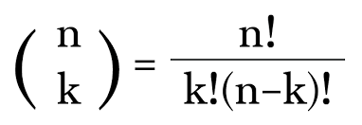
Given n, Choose k
Training
Testing
Given n=12 samples, how many different ways can we choose k=9 samples?
12! / ( 9! * (12-9)! ) = 12! / (9! * 3!) = 220
Iteration 1
Performance Metric 1
Performance Metric 2
Iteration 2
Iteration k
Performance Metric k

Slide 14
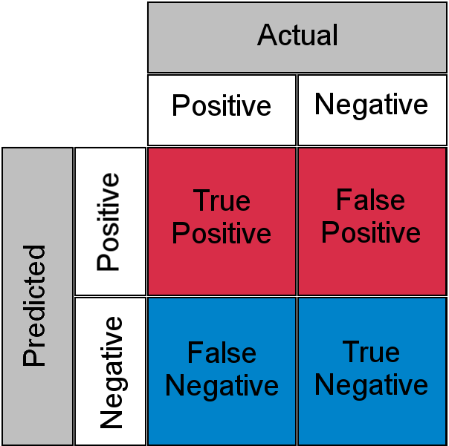
Error Metrics - Discrete Data*
Confusion Matrix
Can be used to calculate different error metrics that can be used to assess how well our model is performing.
* Binary Data

Slide 15
Confusion Matrix Example
Testing Data Response | 0 | 1 | 1 | 0 | 0 | 0 | 1 | 0 | 0 | 0 | 0
Predicted Response | 0 | 0 | 1 | 0 | 0 | 0 | 0 | 1 | 0 | 0 | 0
 |  | Actual
 |  | Positive (1) | Negative (0)
Predicted | Positive (1)
 | Negative (0)
TP =
TN =
FP =
FN =

Slide 16
Confusion Matrix Example
Testing Data Response | 0 | 1 | 1 | 0 | 0 | 0 | 1 | 0 | 0 | 0 | 0
Predicted Response | 0 | 0 | 1 | 0 | 0 | 0 | 0 | 1 | 0 | 0 | 0
 |  | Actual
 |  | Positive (1) | Negative (0)
Predicted | Positive (1) | 1 | 1
 | Negative (0) | 2 | 7
TP = 1
TN = 7
FP = 1
FN = 2

Slide 17
Accuracy, Precision, Recall, F1
Accuracy
Accuracy = (TP+TN)/(TP+FP+FN+TN)
(no. of correct predictions/total no. of predictions)
When to use: Accuracy is a good choice when classes are balanced and not skewed.
Precision
Precision = (TP)/(TP+FP)
Of our predicted positives, what proportion is truly positive?
When to use: When we want to be very sure in our positive predictions.
Recall
Recall = (TP)/(TP+FN)
Of the actual positives, what proportion were accurately classified?
When to use: When we want to classify as many positives as possible.
F1
F1 = 2*(precision*recall)/(precision+recall)
Number in [0,1]. A harmonic mean of precision and recall.
When to use: When you want to have high precision and recall.
 |  | Actual
 |  | Pos | Neg
Pred. | Pos | 1 (TP) | 1 (FP)
 | Neg | 2 (FN) | 7 (TN)
Accuracy =
Precision =
Recall =
F1 =

Slide 18
Accuracy, Precision, Recall, F1
Accuracy
Accuracy = (TP+TN)/(TP+FP+FN+TN)
(no. of correct predictions/total no. of predictions)
When to use: Accuracy is a good choice when classes are balanced and not skewed.
Precision
Precision = (TP)/(TP+FP)
Of our predicted positives, what proportion is truly positive?
When to use: When we want to be very sure in our positive predictions.
Recall
Recall = (TP)/(TP+FN)
Of the actual positives, what proportion were accurately classified?
When to use: When we want to classify as many positives as possible.
F1
F1 = 2*(precision*recall)/(precision+recall)
Number in [0,1]. A harmonic mean of precision and recall.
When to use: When you want to have high precision and recall.
 |  | Actual
 |  | Pos | Neg
Pred. | Pos | 1 (TP) | 1 (FP)
 | Neg | 2 (FN) | 7 (TN)
Accuracy = (1+7)/(1+1+2+7) = 8/11 = 73%
Precision = (1)/(1+1) = 1/2 = 50%
Recall = (1)/(1+2) = 1/3 = 33%
F1 = 2*(1/2)*(1/3)/(1/2+1/3) = 40%

Slide 19
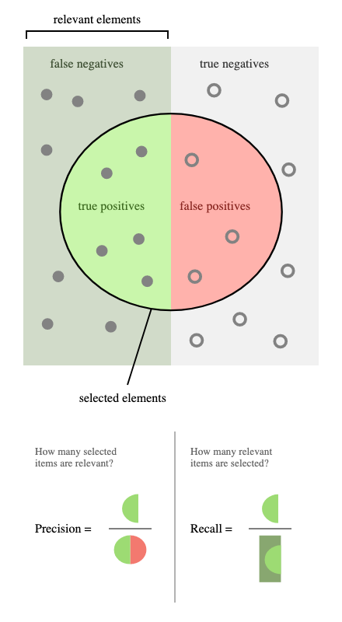
Many more metrics
source: wikipedia

