Slide 1
Naive Bayes Classification

Slide 2
Gaussian Naive Bayes
Gaussian Naive Bayes is a type of Naive Bayes classifier that assumes that your predictors follow a normal (Gaussian) distribution.
It can be used when your predictors are continuous.

Slide 3
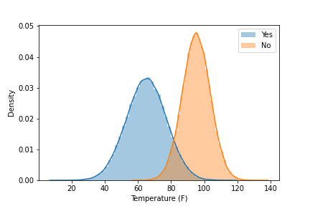
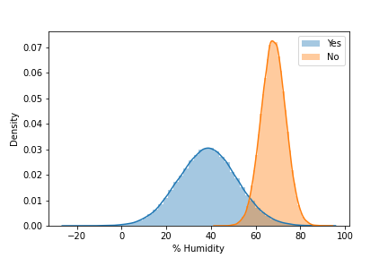
Temperature | Humidity | Play
54 | 40 | Yes
63 | 42 | Yes
81 | 60 | No
72 | 28 | Yes
68 | 70 | Yes
59 | 40 | Yes
83 | 43 | Yes
99 | 67 | No
66 | 20 | Yes
42 | 35 | Yes
103 | 70 | No
98 | 75 | No
80 | 30 | Yes
Will we play tennis if it is 100 degrees with 70% humidity?

Slide 4
Will we play tennis if it is 100 degrees with 70% humidity?

Slide 5
P(Yes|100,70) = P(100|Yes)*P(70|Yes)*P(Yes)
= 0.002*0.003*0.69
=4.15e^-6
P(No|100,70) = P(100|No)*P(70|No)*P(No)
=0.045*0.08*0.30
= 1080e^-6
Will we play tennis if it is 100 degrees with 70% humidity?

Slide 6
Naive Bayes Pros & Cons
Pros
Cons
Easy & fast
Can handle multi-class predictions
Performs well when assumption of independence holds
Is fairly robust even if independence assumption doesn’t hold
Works well with large datasets
Can run into issues if a category was not observed in training data set
Posterior probabilities are not true probabilities
May not perform as well as other more complex machine learning methods

