Slide 1
Bias/Variance Trade Off

Slide 2


ML Model
In ML, for some response Y and predictors X₁, X₂, …, X_{p} , there is a relationship of the form:
In prediction, we are trying to estimate the response:
Where
is the model we are trying to fit.

Slide 3
Variance & Bias
Variance is the amount
Bias is the error that is produced when trying to approximate a real-life problem using a simpler model.
would change if we used a different training set to fit the model.

Slide 4
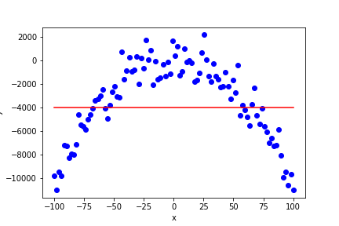
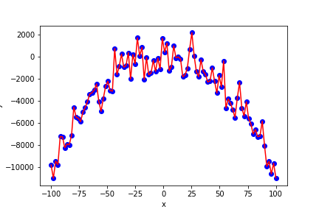
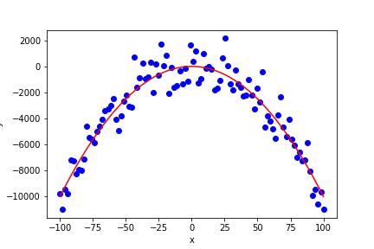
Underfitting vs Overfitting
Low Variance, High Bias
High Variance, Low Bias
Low Variance, Low Bias
Underfitting
Overfitting

Slide 5
Underfitting vs Overfitting
Underfitting
Model performs poorly on training data AND poorly on testing data
Model is unable to capture relationship between input data and target data (x and y) values
Model is not detailed enough - i.e. a straight line to model something that is exponential
Overfitting
Model performs well on training data but NOT on testing data
"Memorizing the training data"
Unable to generalize
Low Variance, High Bias
High Variance, Low Bias
Low Variance, Low Bias
Underfitting
Overfitting

Slide 6
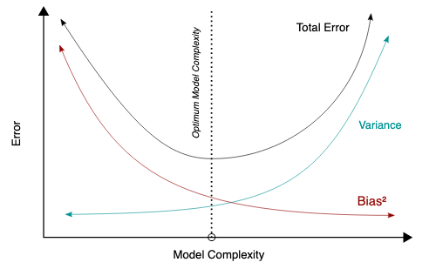
What Does This Mean For Us?
Generally, more flexible methods will have more variance and less bias.
However, at some point, the reduction in bias will slow down and the change in variance will increase rapidly.
Therefore, the goal in machine learning is to find a method for which both the variance and the bias are low.
Source: Wikimedia Commons

Slide 7
How Do We Address This in Practice?
It is generally not possible to explicitly compute the bias and variance for a method. However, it is important to keep these concepts in mind.
Flexible methods that reduce bias are not always the best solutions as they can have high variance (and they may not perform well when tested under a new data set).

