Slide 1
Probability Distributions

Slide 2
Random Variables
A random variable is a variable that can take on more than one value.
When dealing with random variables, it is often useful to think about the sample space for that variable.
Examples
Rolling a die
Height of men
A probability distribution is a function that provides the likelihood of seeing each value in a random variable’s sample space.

Slide 3
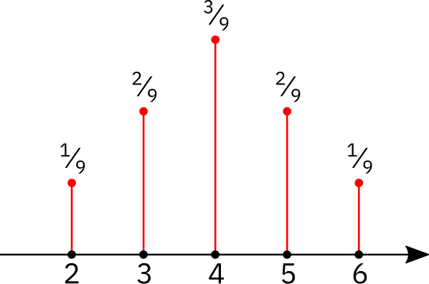
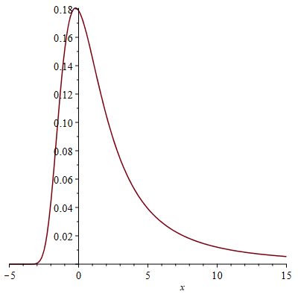
Discrete vs. Continuous Probabilities
Discrete random variables are defined by a probability mass function.
Continuous random variables are defined by a probability density function.

Slide 4
Why Are Probability Distributions Important in Data Science?
Probability lets us model uncertainties.
Probability lets us make statements about a population.
Many ML methods depend on distributional assumptions
Linear Regression assumes the residuals are normally distributed
Gaussian Naive Bayes assumes the predictors are normally distributed
Probability distributions can be useful to create ‘toy’ datasets to test out methods.

Slide 5
Common Probability Functions
Discrete
Bernoulli
Binomial
Poisson
Uniform
Continuous
Normal
Lognormal
Beta
Uniform
Probability functions have a functional form that is defined by a set of parameters.

Slide 6
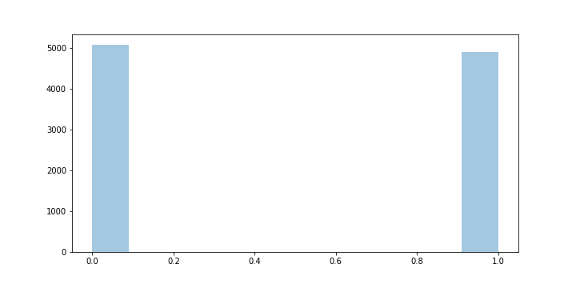

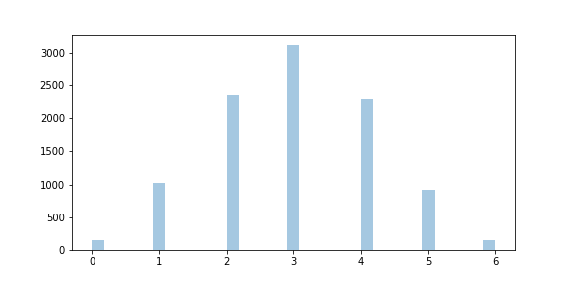
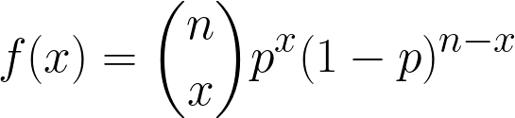
Discrete: Bernoulli & Binomial
Bernoulli distribution: probability of a random variable with two possible outcomes
Example: flipping a coin
Binomial distribution: probability of repeated trials of a random variable with two possible outcomes.
Example: number of heads when flipping a coin 6 times.

Slide 7
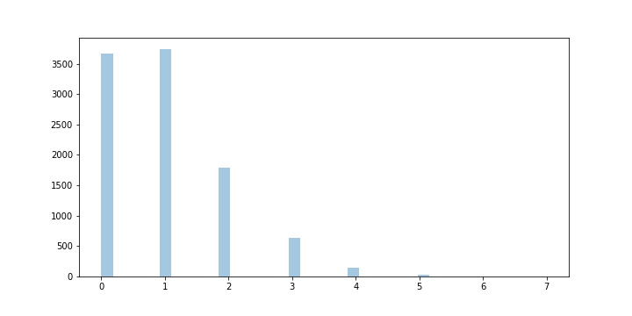
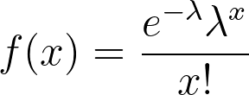
Discrete: Poisson
Poisson models the number of events in a given time period.
Example: the number of car accidents in a day.
Lambda is the average number of events in the given time period.

Slide 8
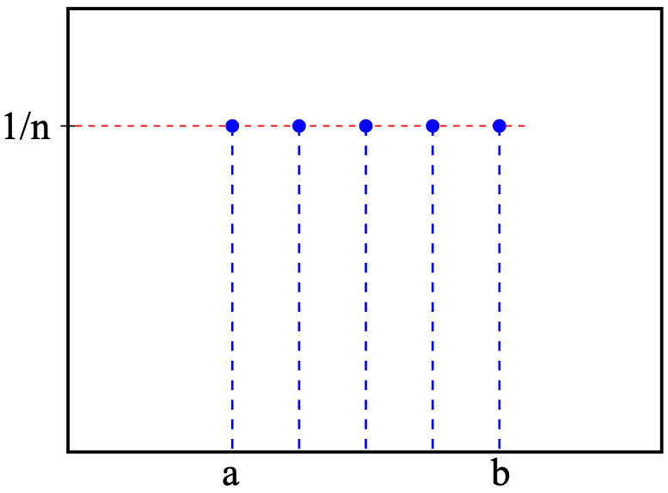
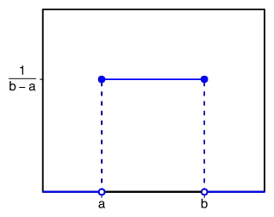
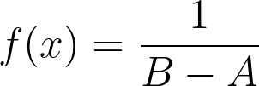
Discrete & Continuous: Uniform
Uniform models a random variable with equal probability across its sample space.
Can be continuous or discrete.
Example: drawing from a deck of cards

Slide 9
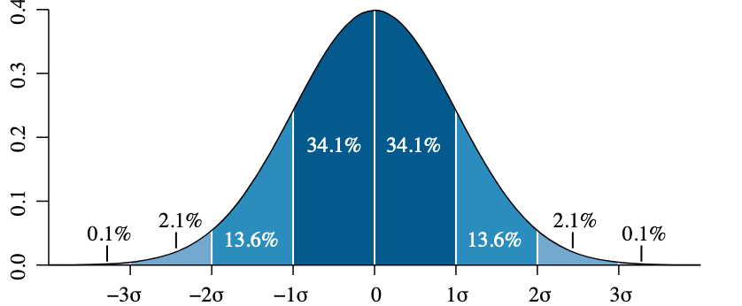
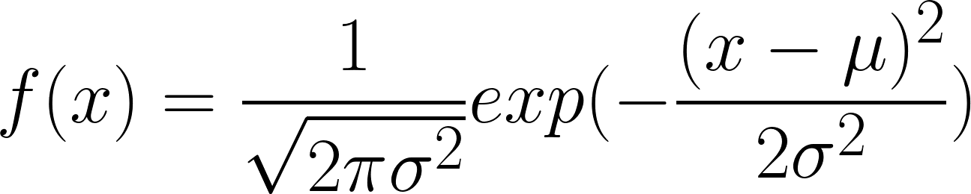
Continuous: Normal Distribution
Completely determined by mean and standard deviation
Also called Gaussian distribution
Mean, median and mode are the same
Unbounded
Symmetric
μ is the sample mean and
σ is the sample standard deviation
Normal (Gaussian) Distribution

Slide 10
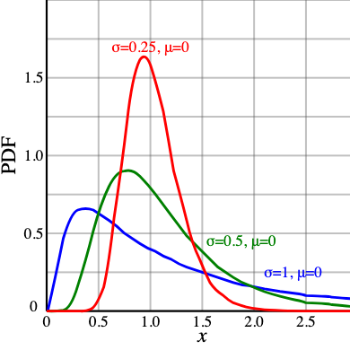
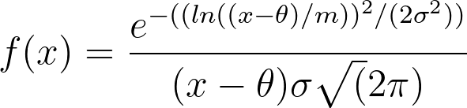
Continuous :Lognormal
Completely determined by mean and standard deviation
Used for positive, skewed data
Example: amount of rainfall, length of comments posted on internet forums

Slide 11
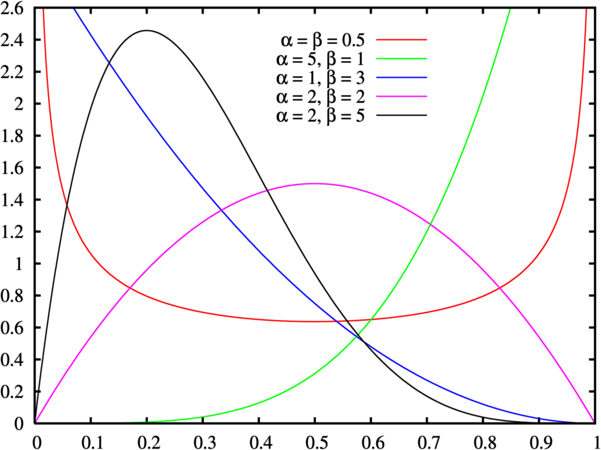
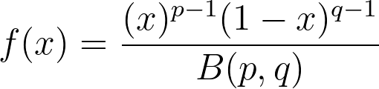
Continuous: Beta
Bounded by [0,1]
Very flexible in shape
Often used to model probabilities
p and q are shape parameters

Slide 12
How do you choose a probability distribution?
Ask yourself the following questions:
Is your data continuous vs discrete
Is your data symmetric or asymmetric?
Is your data bounded (aka finite support) or unbounded?
How likely are outliers?
Warning: The results of an analysis can depend heavily on the choice of probability distribution. Therefore, you should take care in choosing the distribution if the results are sensitive to the choice.

Slide 13
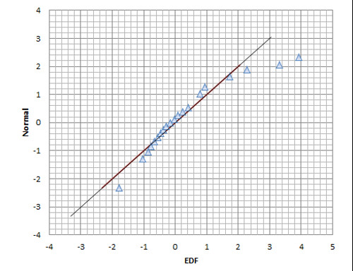
Assessing Distribution Fit to Data
At times, you may want to fit a probability distribution to your data. To assess the fit, you can use a Quantile-Quantile (QQ) Plot.

Slide 14
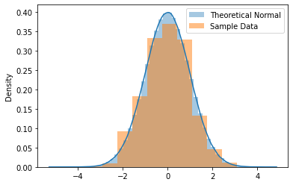
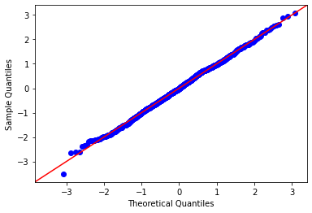
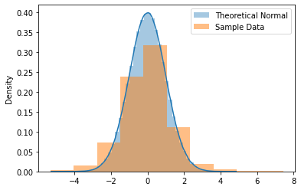
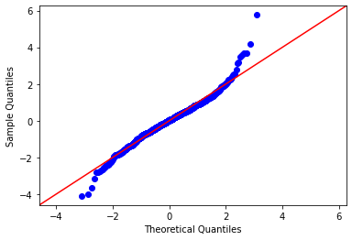
QQ Plots

