Slide 1
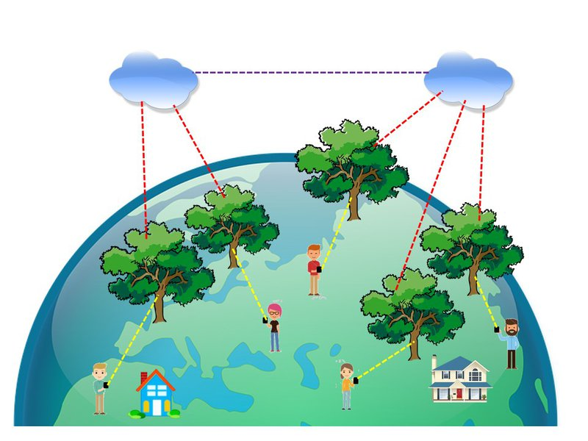
Feel like a tree
數樹:大樹據
Big Thinker
大思維
shoutw@gmail.com

Slide 2
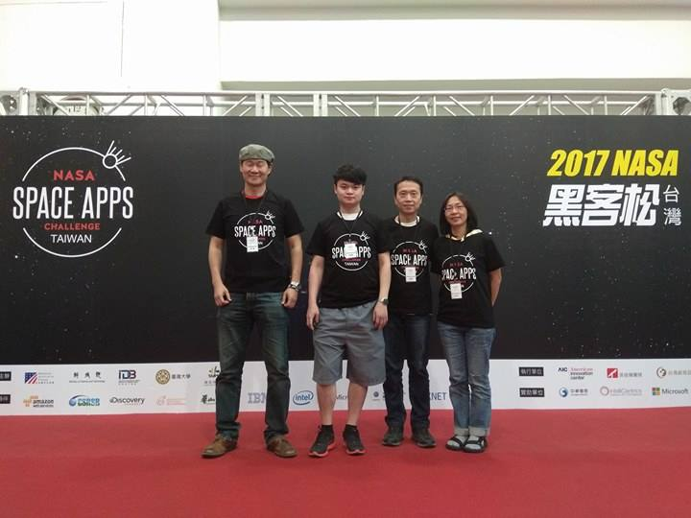
Back to Earth

Slide 3
Connect people to a number of trees then forest nature on earth.
One human being connects a tree.
Trees moved by the wind.
Sensors on a tree.
Tell cloud how the tree moved.
Cloud see how trees moved.
Tell APPs how them moved.
Smart phone shows people how,
How the trees shake and vibrate.

Slide 4
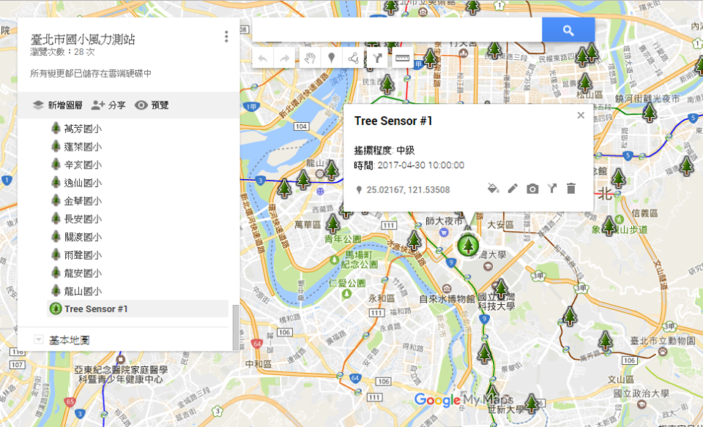
APPs UI

Slide 5
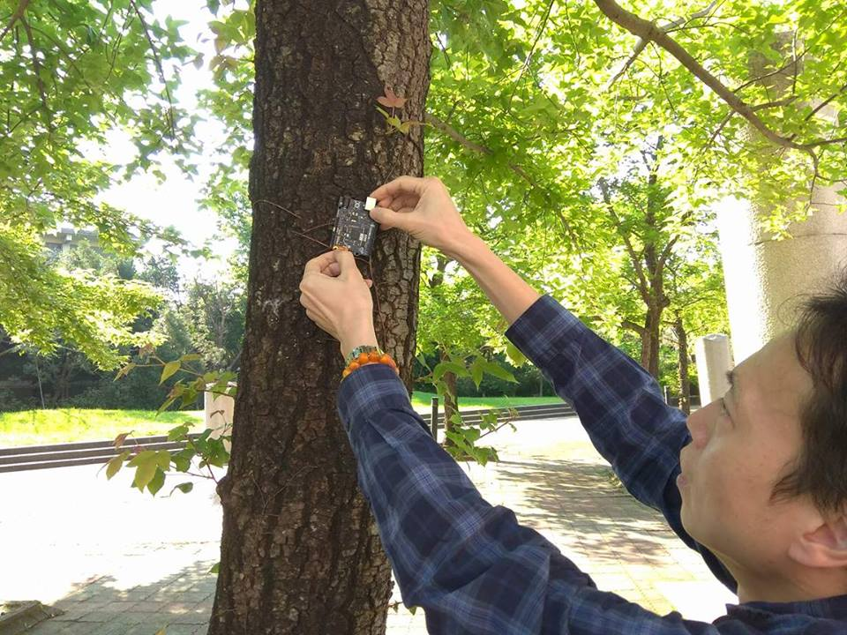
Attach a button IoT sensor device

Slide 6
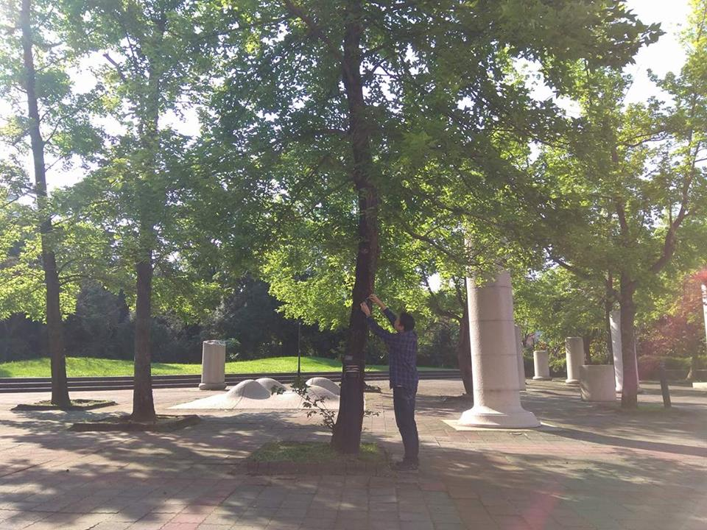
In forest

Slide 7
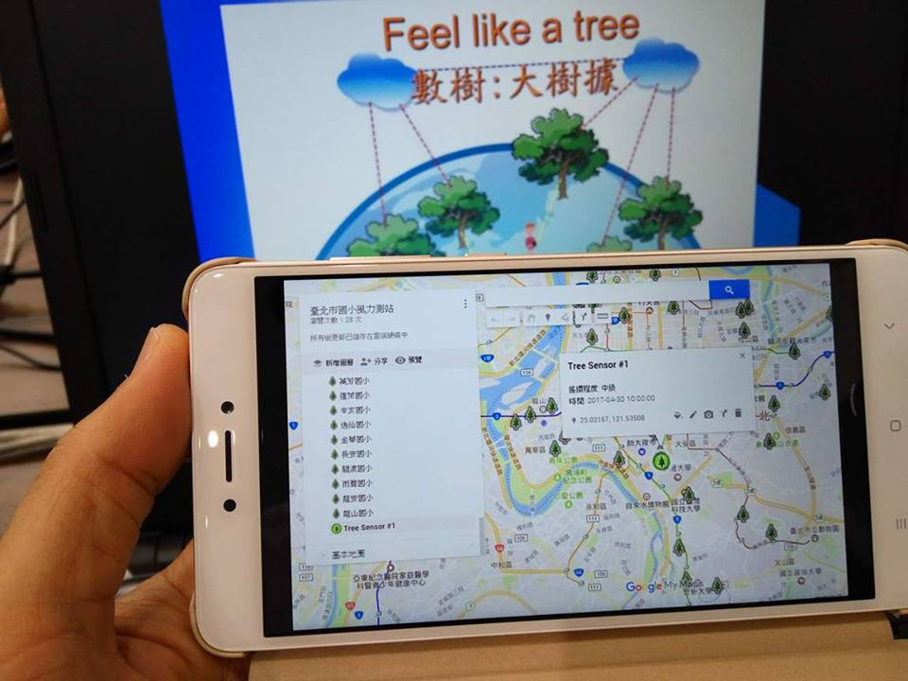
APPs UI

Slide 8
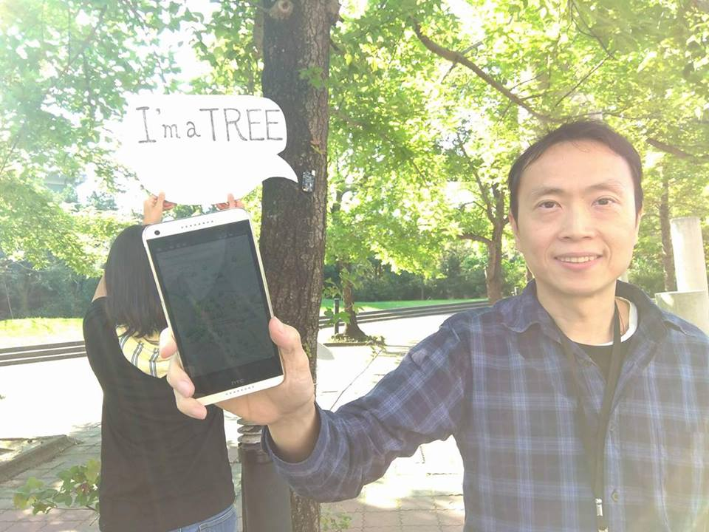
I shake, you vibate.

Slide 9
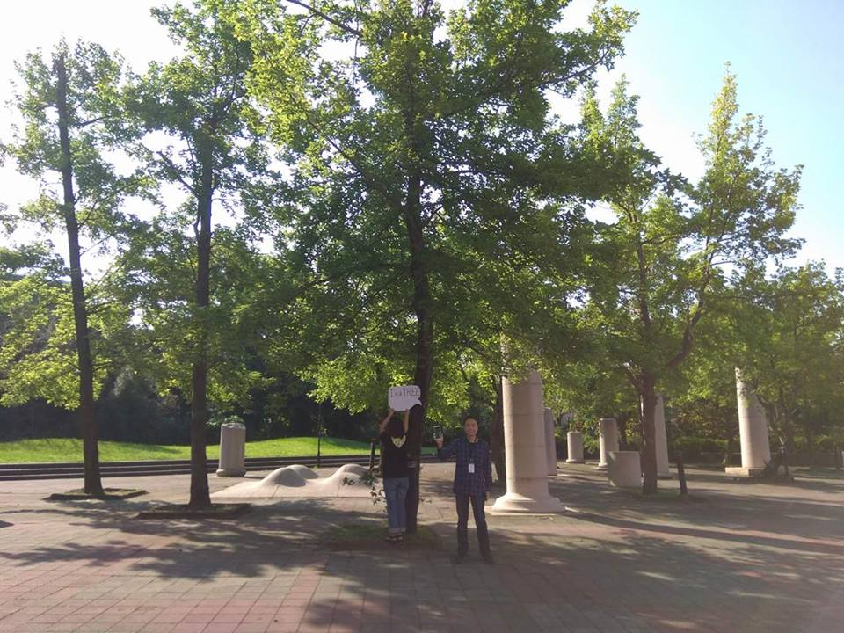
Feel like a tree

Slide 10
Impact
We connect people to trees and forest.
We see and feel how trees moved and vibrate.
Let go the distance and nation broad.
It comforts the people and become friends.
Pull people’s mind to the nature and outdoors.
The disaster will be less while we care.

Slide 11
Creativity
Through IOT smart phones to watch and feel a tree.
Connect people to plants outdoor in daily life especially for citizen.
Worldwide and easily accessable.
Yes. It is it.

Slide 12
Product
Emotional comfortable
Emotional Healthy
Wind, Trees and Earth
Cloud, APPs and Smart Phones.
Using IoT to promote the sense of sustainability.
Prove of Concepts. Prove of prototype.

Slide 13
Sustainability
YES. It can go direct to people and citizen.
YES. It can be extended and refined.
YES. It may be a popular APPs as well as activity cross cultures and nations, on earth.
NGO and Government will welcome it.

Slide 14
We invite you to have a tree in mind in smart phone
SEE You on Earth.

