Slide 1
Gradient Boosted Decision Trees
Min Chen
FEW 458

Slide 2
Game: Guess the Number
I have a secret target number between 1-100 – guess it!

Slide 3
Game: Guess the Number
I have a secret target number between 1-100 – guess it!
I will tell you the error

Slide 4
Core concept
learn from the mistakes

Slide 5
“Gradient”
Gradient Boosting uses gradient descent, a method from calculus, to decide how to improve. At each step, it calculates how the prediction can be changed to reduce the loss (i.e., the penalty for being wrong).
So you can think of it like this:
“I’m going down the hill of errors, step by step, guided by the slope (gradient), and each tree is a little push in the right direction.”

Slide 7
Basic concept of Gradient Boosting
In gradient boosting, an ensemble of weak learners is used to improve the performance of a machine learning model. The weak learners are usually decision trees.
Combined, their output results in better models.
In case of regression, the final result is generated from the average of all weak learners.
With classification, the final result can be computed as the class with the majority of votes from weak learners.

Slide 8
Boosting process
Build an initial model with the data
Run predictions
Calculate the error using the predictions and the actual values
Assign more weight to the incorrect predictions
Create another model that attempts to fix errors from the last model
Run predictions with the new model
Create several models with each model aiming at correcting the errors generated by the previous one
Obtain the final model by weighting the mean of all the models

Slide 9
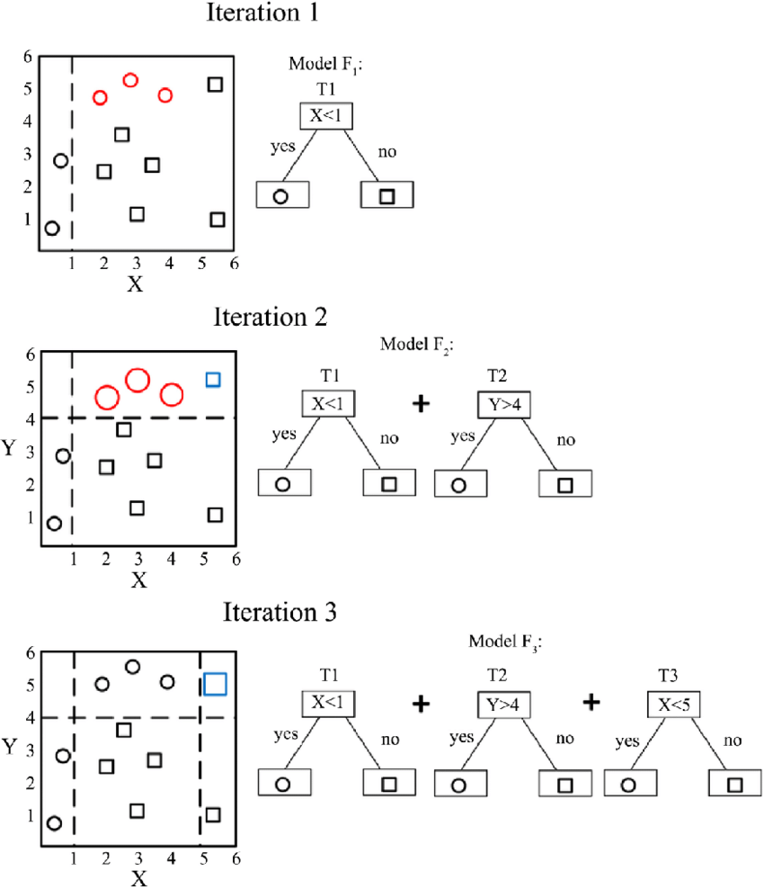

Slide 10
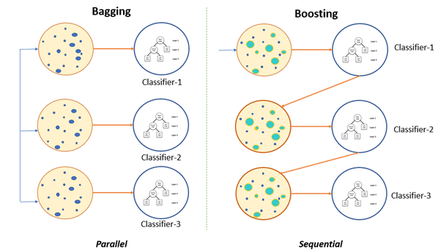
Basic concept of Gradient Boosting
In gradient boosting, weak learners work sequentially.
Each model tries to improve on the error from the previous model.

Slide 11
Major algorithms
XGBoost (Extreme Gradient Boosting)
LightGBM

Slide 12
Key Differences
Aspect | XGBoost | LightGBM
Tree Growth Strategy | Builds trees level-wise (depth-wise), expanding layer by layer. This allows for more pruning and regularization. | Uses a leaf-wise growth strategy, growing one node at a time. This often results in a shallower and more complex tree.
Handling Categorical Features | Requires one-hot encoding, which can increase the dimensionality and memory usage. | Natively supports categorical features, eliminating the need for one-hot encoding and saving memory.
Parallelism | Parallelizes tree construction vertically, using multiple CPU cores to process each level. | Uses a histogram-based method allowing efficient horizontal parallelization, often resulting in faster training.
Memory Usage | Generally higher due to depth-wise growth and full feature consideration at each split. | Typically more memory-efficient, especially on large/sparse datasets, due to leaf-wise growth and histograms.
Speed and Performance | Known for high accuracy and used in many competition-winning models. | Faster than XGBoost on large datasets due to histogram optimization and leaf-wise splits.

Slide 13
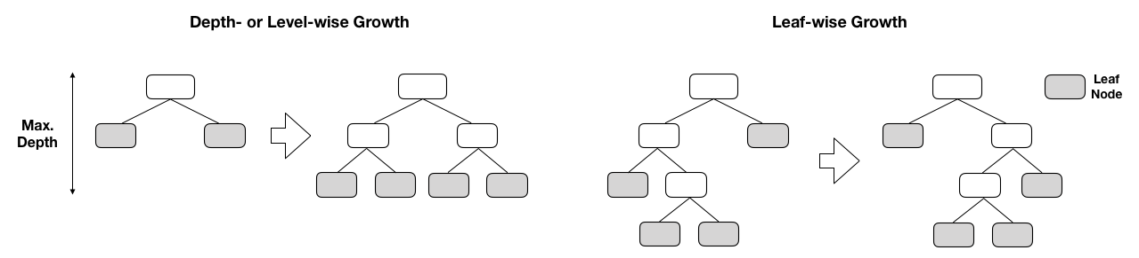
Level-wise vs. leaf-wise
Level-wise
Expands all the nodes at the same depth before going to the next level.
Builds the tree layer by layer (top-down, breadth-first).
At each level, all nodes are split, even if their splits don’t reduce the loss very much.
Leaf-wise
At each step, finds the leaf with the highest potential to reduce error, and splits only that one.
Builds the tree node by node (best-first strategy).
Prioritizes learning complex patterns in some branches while leaving others shallow.

