Slide 1
Principal Component Analysis (PCA)
35 mins for class, 35 mins for lab
https://towardsdatascience.com/principal-component-analysis-pca-explained-visually-with-zero-math-1cbf392b9e7d
Notes:
Welcome everyone. I am Hangkai, and today we’re diving into Principal Component Analysis, or PCA.
This session is split into two parts: 35 minutes of class and 35 minutes of hands-on lab.
Our goal is to understand what PCA does, why it’s useful, and how to interpret it—even without diving deep into the math.
The link on the slide is a great visual reference I recommend checking out after class.

Slide 2
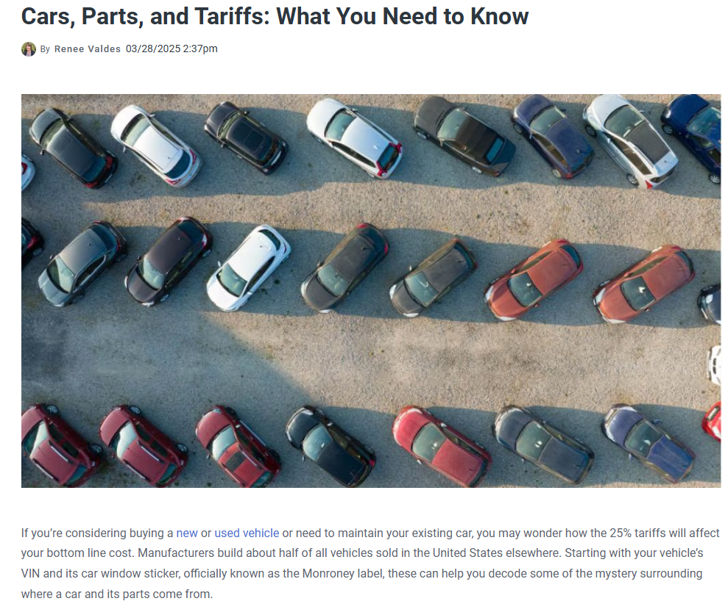
Notes:
"Before we get into PCA, I want to start with a real-life problem I’m facing..."
"I’m thinking about buying a car. But I just heard that new tariffs are coming—meaning prices for imported cars might shoot up soon."
So I have 2 choices: 1 is to ask Min to raise my salary sothat I am not afraid of the price raising. The other choice is to decide in a very short period if I want to save some money.

Slide 3

Screenshot from the internet
Notes:
So I opened the car selling website, but I got more worried!

Slide 4
So many information!
What is the most important thing when deciding to buy a car?
Screenshot from the internet
Notes:
There’s just so much information to consider.
(Pause and look around)
“Can anyone help me make a decision? What features would you focus on?”
Oh! Thanks for your suggestions, now it’s much clearer to see what is important in the car market and make it much easier to decide which car I want to buy.
"See? You’re already doing what PCA does—mentally filtering out less important variables and focusing on what really matters."
"Today, we’re going to learn how PCA helps machines do the same thing: take a complex dataset, and find what’s actually important."

Slide 5
A dimensionality reduction algorithm
Sometimes less is more!
It transforms high-dimensions data into lower-dimensions while retaining as much information as possible.
It is extremely useful when your dataset have a lot of features (more features means low efficiency!)
Notes:
So What is PCA?

Slide 6
An analogy
Finding the time to read a 1000-pages book is a luxury that few can afford.
Wouldn’t it be nice if we can summarize the most important points in just 2 or 3 pages so that the information is easily digestible even by the busiest person?
We may lose some information in the process, but hey, at least we get the big picture.

Slide 7
How does PCA work?
It’s a two-step process. We can’t write a book summary if we haven’t read or understood the content of the book.
PCA works the same way — understand, then summarize.
Human understands the meaning of a storybook through the use of expressive language. Unfortunately, PCA doesn’t speak English. It has to find meaning within our data through its preferred language, mathematics.
- Can PCA understand which part of our data is important?
- Can we mathematically quantify the amount of information embedded within the data?
Notes:
PCA has two steps:
Understand the data.
Summarize it by identifying what's important.
PCA doesn’t speak English—it finds patterns mathematically.
The key question PCA asks: “Where is the information in this dataset?”

Slide 8
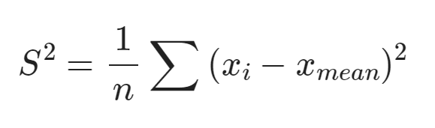
Variance
The answer is variance. The greater the variance, the more the information. Vice versa.
Notes:
The answer to the “what’s important” question is: variance.
Variance measures how much the data varies. More variance = more information.
In PCA’s view, high variance = useful signal; low variance = probably noise or redundancy.

Slide 9
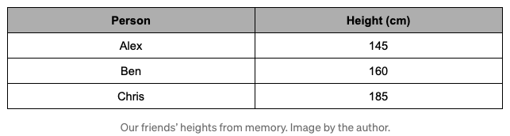
Suppose that we are playing a guessing game with our friends. The game is simple. Our friends would cover their faces and we need to guess who’s who based solely on their height. Being the good friends that we are, we remember how tall everyone is.

Slide 10
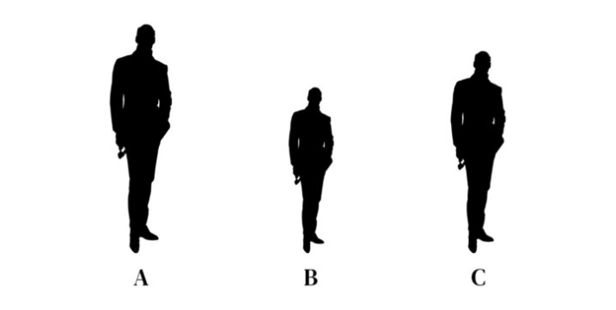
Who is who?
Notes:
Let’s say your friends are hiding, and you can only use their height to identify them.
If each person has a very different height (high variance), it’s easy to tell who’s who.
That’s PCA’s logic—it prioritizes features that help separate data.

Slide 11
Who is who?
Chris Alex Ben
Notes:
Let’s say your friends are hiding, and you can only use their height to identify them.
If each person has a very different height (high variance), it’s easy to tell who’s who.
That’s PCA’s logic—it prioritizes features that help separate data.

Slide 12
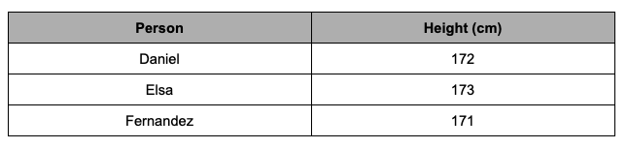
Now, let’s try and guess a different group of friends.

Slide 13
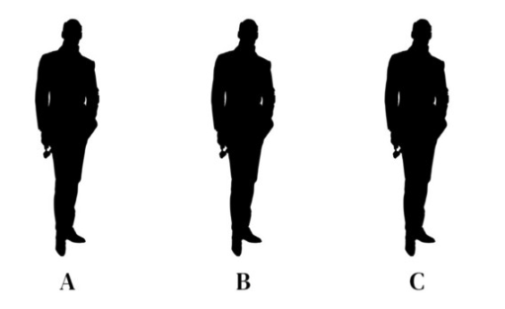
Who is who?

Slide 14
Importance of variance
When our data has a higher variance, it holds more information. This is why we keep hearing PCA and maximum variance in the same sentence.
From Wikipedia: PCA is defined as an orthogonal linear transformation that transforms the data to a new coordinate system such that the greatest variance by some scalar projection of the data comes to lie on the first coordinate (called the first principal component), the second greatest variance on the second coordinate, and so on.
In the eyes of PCA, variance is an objective and mathematical way to quantify the amount of information in our data.
Variance is information.

Slide 15
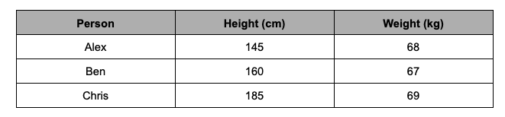
Game - Round 2
This time, we get to guess who’s who based on their height and weight.
Does the weight information help?

Slide 16
Useless features
The weight differences are so small (a.k.a small variance), it doesn’t help me differentiate our friends at all. I still had to rely mostly on height to make my guesses.
Intuitively, we have just reduced our data from 2-dimensions to 1-dimension. The idea is that we can selectively keep the variables with higher variances and then forget about the variables with lower variance.

Slide 17
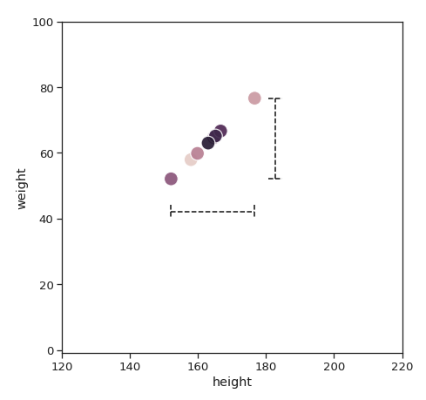
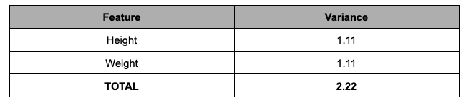
But what if-, just what if height and weight have the same variance? Does it mean we can no longer reduce the dimensionality of this data set?
In this case, it’s very difficult to choose the variables we want to delete. If I throw away either one of the variables, we are throwing away half of the information.

Slide 18
Can we keep both?
Perhaps, with a different perspective.
The best story books always have hidden themes that are not written but implied. Reading each chapter individually wouldn’t make sense. But if we read all of it, it gives us enough context to piece the puzzles together — the underlying plot emerges.
Up until now, we have only been looking at the variance of height and weight individually. Instead of limiting ourselves to choose just one or the other, why not combine them?

Slide 19
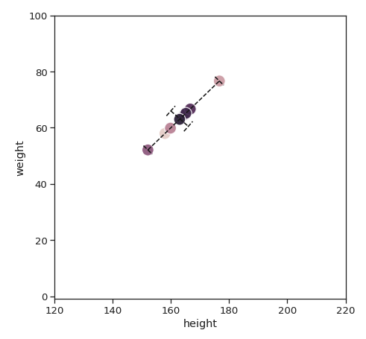
When we look closer at our data, the maximum amount of variance lies not in the x-axis, not in the y-axis, but a diagonal line across. The second-largest variance would be a line 90 degrees that cuts through the first.

Slide 20
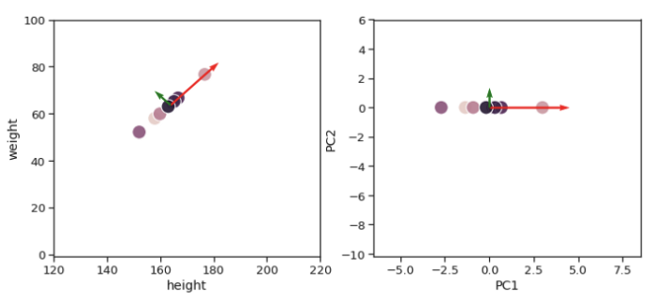
To represent these 2 lines, PCA combines both height and weight to create two brand new variables. It could be 30% height and 70% weight, or 87.2% height and 13.8% weight, or any other combinations depending on the data that we have.
These two new variables are called the first principal component (PC1) and the second principal component (PC2). Rather than using height and weight on the two axes, we can use PC1 and PC2 respectively.

Slide 21
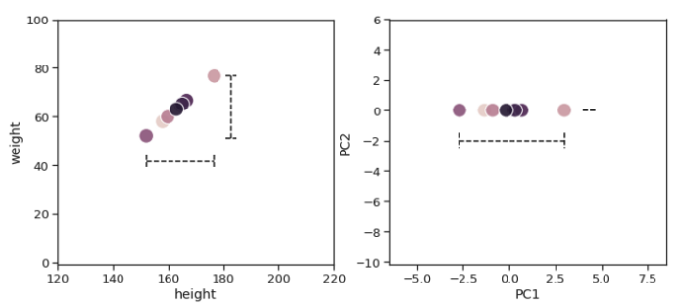
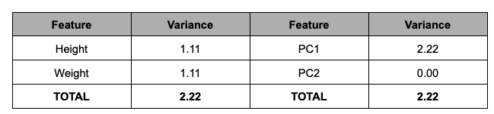
PC1 alone can capture the total variance of Height and Weight combined. Since PC1 has all the information, you already know the drill — we can be very comfortable in removing PC2 and know that our new data is still representative of the original data.

Slide 22
PCA
When it comes to real data, more often than not, we won’t get a principal component that captures 100% of the variances. Performing a PCA will give us N number of principal components, where N is equal to the dimensionality of our original data. From this list of principal components, we generally choose the least number of principal components that would explain the most amount of our original data.

Slide 23
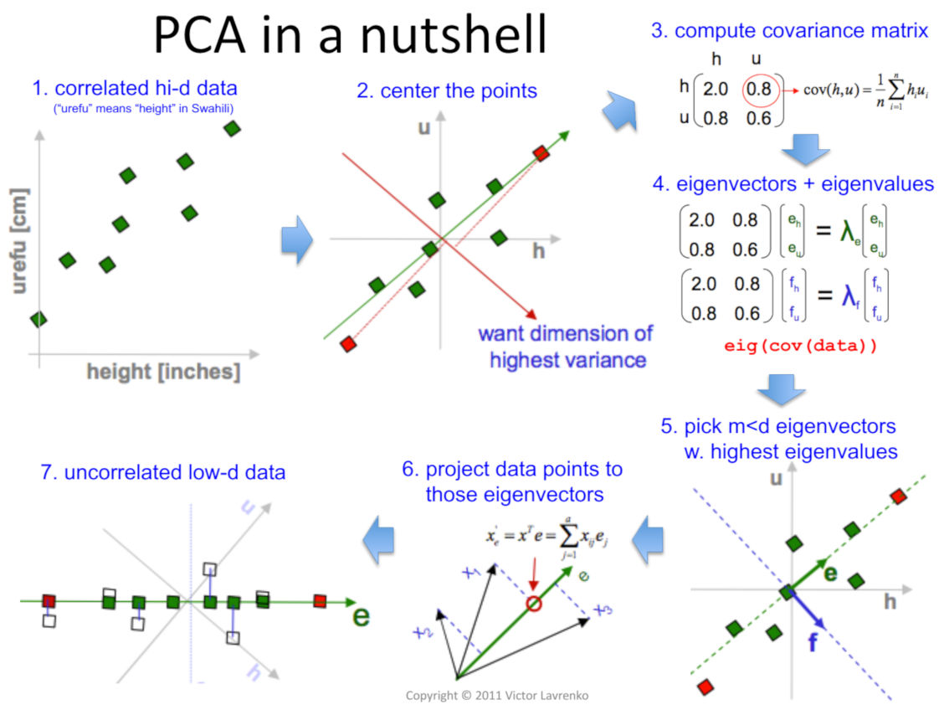

Slide 24
One more thing: Adding the "Prior Knowledge" Insight
When analyzing data, we might encounter variables that have large variations but are irrelevant to our specific goals.
For instance, if I'm buying a second-hand car, one variable could be how many times the previous driver sang in the car / the lucky number of previous owner. Now, that number might vary greatly between different cars—some drivers sing constantly, others rarely or never—but clearly, that's irrelevant to my decision about buying the car.
PCA helps us identify the most informative patterns, but we still need to bring our own understanding to know which variables truly matter.

