Slide 1
Decision Tree
Min Chen

Slide 2

Guess what’s in the envelope?
Ask me questions – I will answer yes or no
?

Slide 3
Decision Tree
A non-parametric supervised learning algorithm
a hierarchical tree structure
Root Node: This is the topmost node of the tree from where the population starts dividing according to various features.
Splitting: It is a process of dividing a node into two or more sub-nodes based on certain conditions.
Decision Node: When a sub-node splits into further sub-nodes, then it is called the decision node.
Leaf/Terminal Node: Nodes that do not split further are called leaf or terminal nodes.

Slide 4
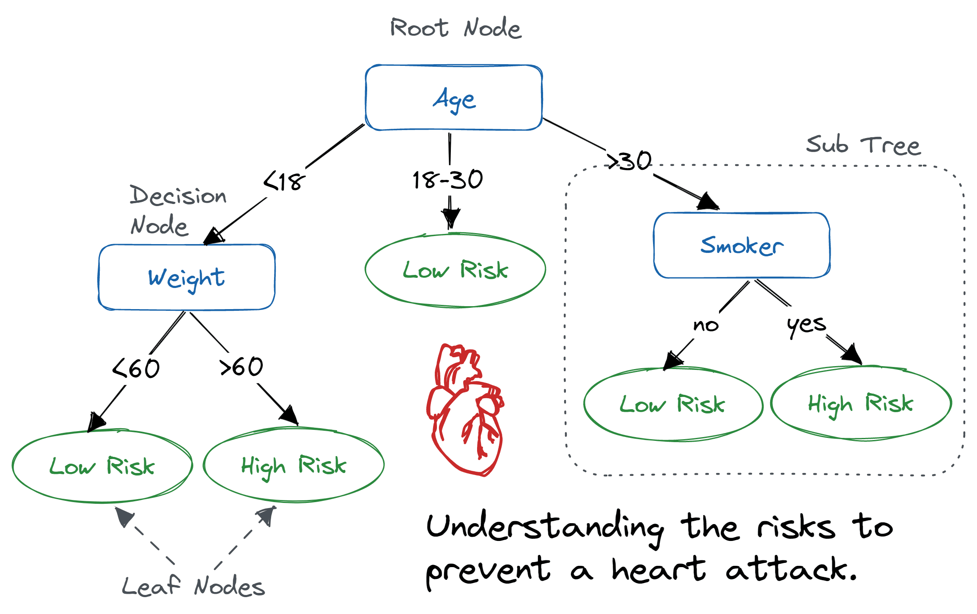
Decision Tree
https://www.datacamp.com/tutorial/decision-tree-classification-python

Slide 5
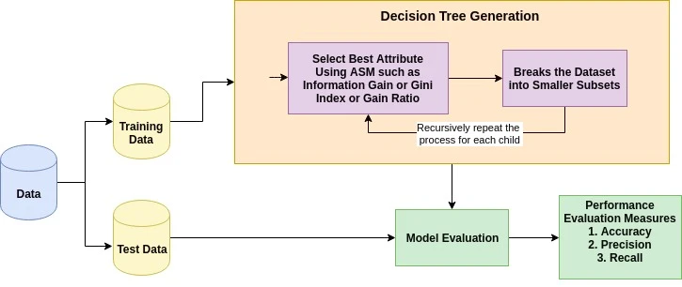
How does the Decision Tree algorithm work?
1. Choose the Best Attribute:
Start by selecting the attribute that best separates the data into classes. This selection is made using Attribute Selection Measures (ASM) such as Information Gain.
The attribute with the highest score under the chosen ASM is selected as the decision node to split the dataset.
2. Split the Data:
Split the dataset into subsets using the values of the selected attribute. Each subset should correspond to a possible value of the attribute.
This process divides the dataset in a way that similar data points end up in the same subset.
3. Recursion for Each Subset:
The algorithm then recurs on each subset, considering only attributes that have not been used. The steps are repeated for each subset.
A new decision node is found for each subset by choosing the best attribute according to ASM.
4. Termination Conditions:
The recursion is terminated under one of the following conditions:
All tuples in the subset belong to the same attribute value (pure).
There are no more attributes to split the data.
There are no more instances.

Slide 6
Attribute Selection Measures
Attribute Selection Measure (ASM): A heuristic technique for identifying the optimal criterion to split data effectively.
Functionality: Acts as splitting rules, aiding in determining precise breakpoints for records at each node.
Ranking System: Evaluates and assigns a rank to each feature or attribute, based on its capacity to clarify the dataset.
Selection of Attributes: Attributes with the highest scores are chosen as the nodes for splitting the data.
Continuous Attributes: For attributes with continuous values, ASM helps in defining exact split points for creating branches.
Popular ASMs:
Information Gain: Assesses how much information a feature provides about the class.
Gain Ratio: Modifies Information Gain to penalize attributes with more categories.
Gini Index: Measures the likelihood of incorrect classification if a random label is assigned based on the distribution seen in the subset.

Slide 7
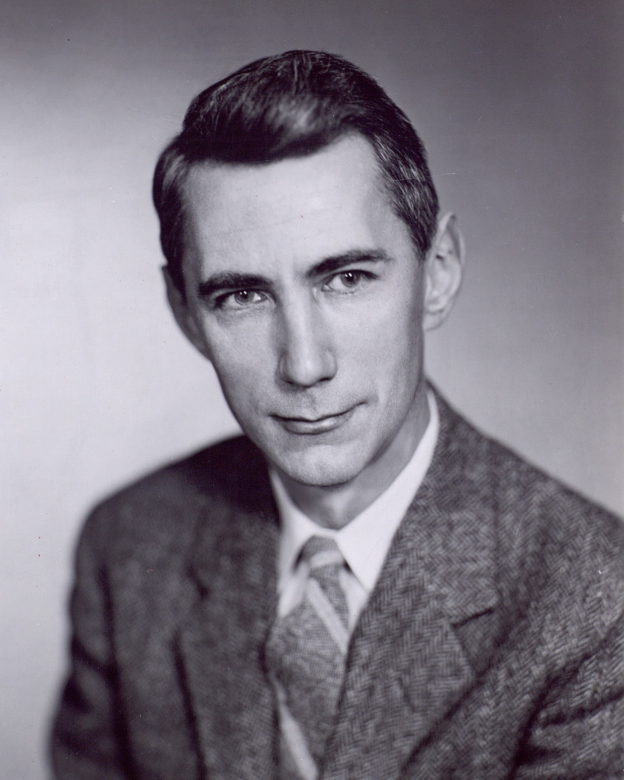
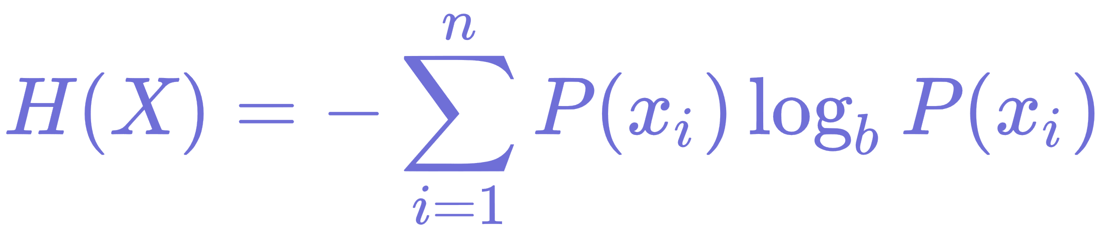
Information Gain
Information Gain is a concept derived from information theory, primarily used in decision tree algorithms to select the feature that best splits the dataset at each node. It measures the reduction in entropy or impurity in the dataset after it is divided on an attribute. Essentially, it quantifies the difference in entropy (or unpredictability) before and after the split. The attribute with the highest Information Gain is chosen for the split, as it provides the most significant increase in information (or the most significant decrease in uncertainty) about the target variable.
Entropy: Before calculating Information Gain, we first understand entropy, which measures the level of uncertainty or disorder within a dataset. A higher entropy value means more unpredictability and vice versa.
Calculation of Information Gain: Information Gain is calculated by subtracting the weighted entropies of the subsets produced by a split from the original entropy of the whole dataset before the split. The formula is given by:
where the summation is over all the subsets (children) created by the split.
Selection of the Best Attribute: The attribute with the highest Information Gain is selected for the split because it is considered to provide the most meaningful information about the target variable, thereby reducing uncertainty the most.
Goal: The primary goal of maximizing Information Gain is to build a decision tree that requires the fewest levels to accurately classify or predict the outcome, thus making the tree more efficient and easier to interpret.
Advantage: By using Information Gain, decision trees can focus on the most informative features, reducing the size and complexity of the tree and potentially improving prediction accuracy.
Claude Shannon
1916-2001

Slide 8

Gain ratio
Normalization of Information Gain: The Gain Ratio takes the Information Gain for an attribute and divides it by the intrinsic value of the dataset that the attribute splits. This intrinsic value is a measure of how broadly and evenly the split divides the dataset.
Formula: The Gain Ratio is calculated as:

Slide 9

Gini index
Definition: The Gini Index calculates the probability of a randomly chosen sample being incorrectly labeled if it was randomly labeled according to the distribution of labels in the subset. A Gini Index of 0 represents perfect purity, meaning all the elements in the subset belong to a single class.
Calculation: For a dataset with J classes, the Gini Index for a subset is calculated as:
where pj​ is the proportion of the samples that belong to class j.
Use in Splits: During the construction of a decision tree, the Gini Index is used to evaluate each possible split of the dataset, and the split that results in the lowest weighted Gini Index for the resulting partitions is chosen. This approach aims to increase the homogeneity of the child nodes.
Advantage: The Gini Index is simple to compute and does not require logarithmic calculations, unlike the Information Gain measure. It is particularly favored for datasets where speed is crucial, and it works well in practice for many classification tasks.
Goal: The ultimate goal of minimizing the Gini Index when building a decision tree is to increase the node purity. This means that after the split, the resultant nodes are more homogeneous (or less impure) with respect to the target variable, leading to a more accurate and efficient classification.

Slide 10
Pros and Cons of Decision Tree algorithm
Pros of Decision Trees
Interpretability: One of the biggest advantages of decision trees is their ease of interpretation and explanation. They mimic human decision-making closely, making their logic transparent and understandable even to non-experts.
Handles Both Types of Data: Decision trees can handle both numerical and categorical data, making them versatile for various types of datasets.
No Need for Data Preprocessing: Unlike many other algorithms, decision trees do not require data normalization or scaling, making them easier to implement without extensive data preprocessing steps.
Identifies Significant Variables: Through the process of building a decision tree, the most important variables are automatically highlighted, providing insights into the data.
Non-Parametric Method: As a non-parametric method, decision trees do not assume any distribution of the data, making them suitable for scenarios where such assumptions might not hold.
Cons of Decision Trees
Overfitting: Decision trees are prone to overfitting, especially with complex trees that have many branches. They can create models that are too specific to the training data and do not generalize well to unseen data.
Instability: Small variations in the data can result in a completely different tree being generated. This instability is reduced by using decision trees within an ensemble method like Random Forests.
Greedy Algorithms: Decision tree algorithms are considered "greedy" because they make the optimal choice at each node. However, this does not always lead to the global optimum.
Difficulty with Unbalanced Data: Decision trees can create biased trees if some classes dominate. It is often necessary to balance the dataset before training the tree.
Complexity with Large Data: For datasets with a large number of features and classes, the decision tree can become complex and inefficient, making it challenging to interpret and requiring more computational resources.

