Slide 1
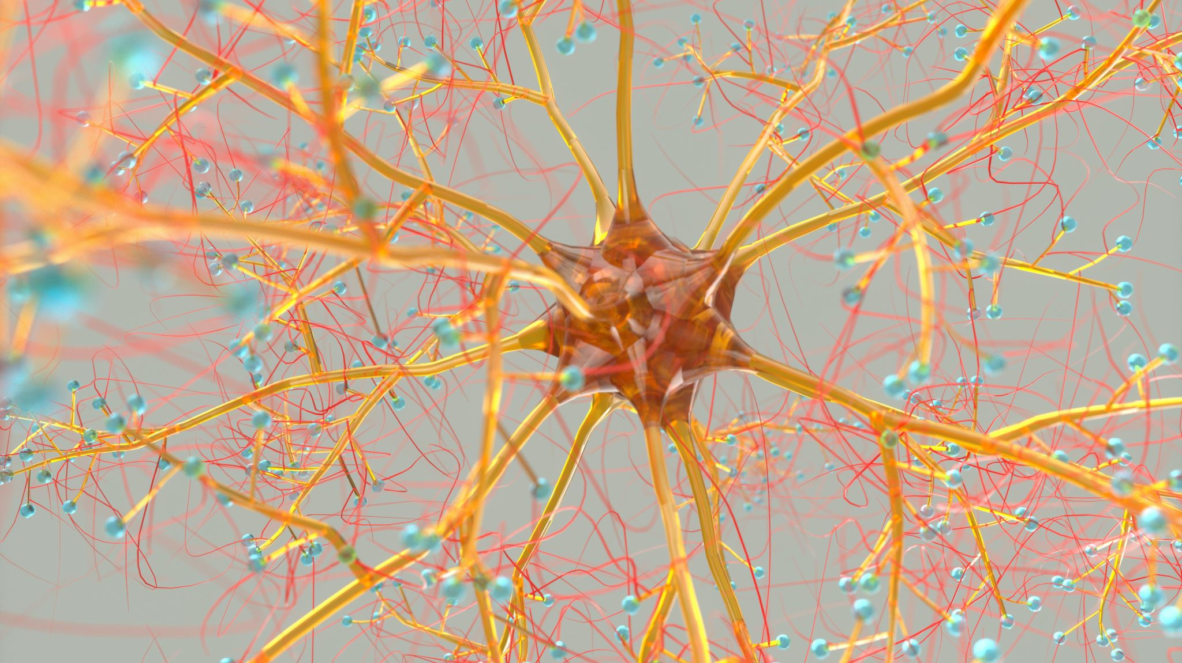
Artificial Neural Network (ANN)
Min Chen Spring 2024

Slide 2
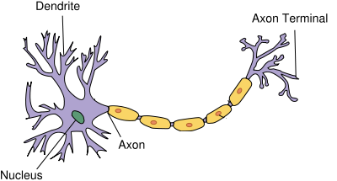
The Human Nervous System
Human nervous system consists of billions of neurons.
These neurons collectively process input received from sensory organs, process the information, and decides what to do in reaction to the input.
A typical neuron in the human nervous system has three main parts: dendrites, nucleus, and axons.
The information passed to a neuron is received by dendrites. The nucleus is responsible for processing this information. The output of a neuron is passed to other neurons via the axon, which is connected to the dendrites of other neurons further down the network.

Slide 3
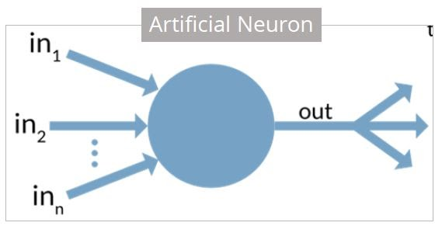
Artificial Neuron
Biological Neuron | Artificial Neuron
Cell Nucleus | Node
Dendrites | Input
Synapse | Weights or interconnections
Axon | Output

Slide 4
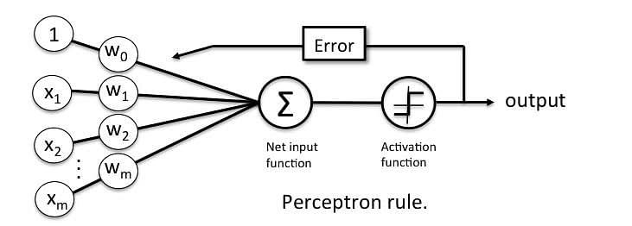
Perceptron
Perceptron was introduced by Frank Rosenblatt in 1957. He proposed a Perceptron learning rule based on the original MCP neuron. A Perceptron is an algorithm for supervised learning of binary classifiers.

Slide 5


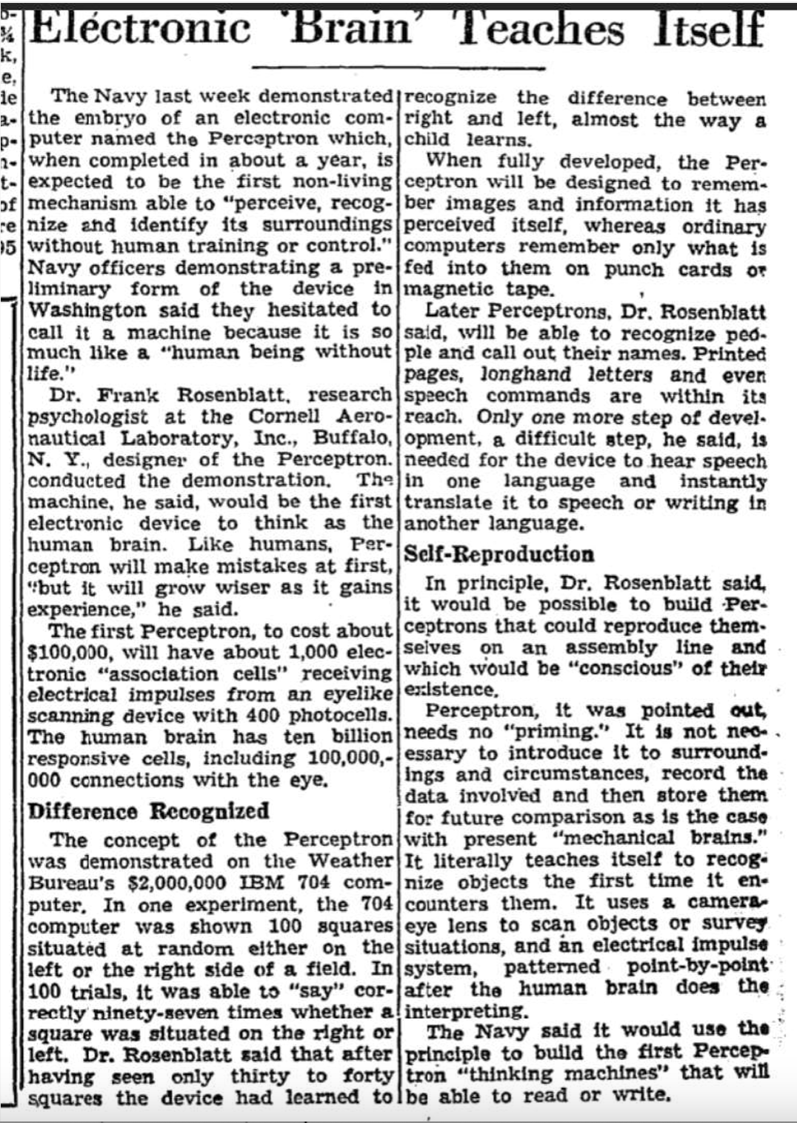
1958-07-13
Notes:
In 1958, Frank Rosenblatt introduced the Perceptron, the first ANN model. It was hyped up—even getting coverage in The New York Times—as a machine that would walk, talk, and self-learn.
But… it couldn’t even learn a simple XOR logic function.
Punchline: “It was like inventing a calculator that couldn’t subtract.”

Slide 6
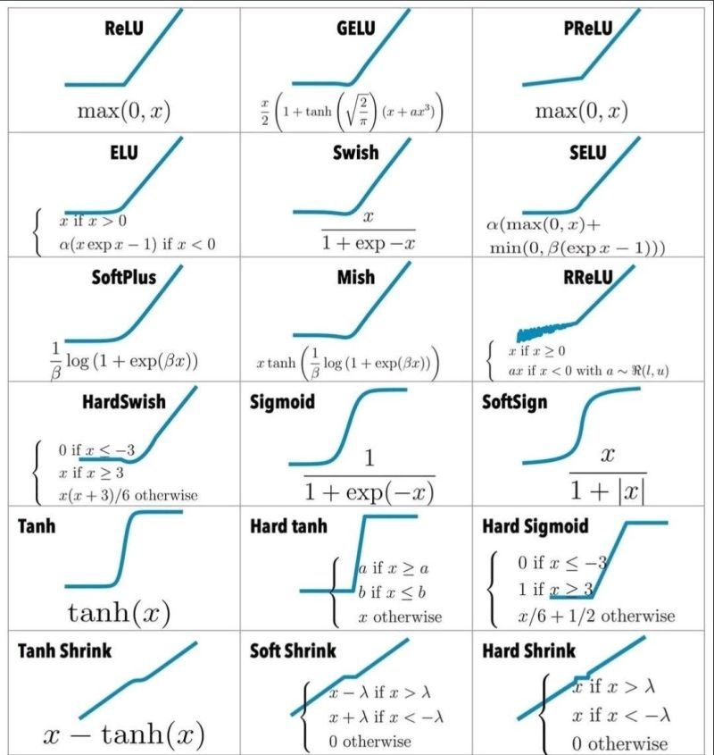
Activation Function
Purposes:
Decision Making
Introduction of Non-linearity
Control over output range
Enabling deep learning
Facilitate model training (differentiable is important)
https://ml-cheatsheet.readthedocs.io/en/latest/activation_functions.html

Slide 7
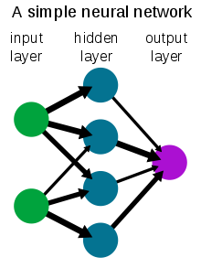
Artificial Neural Network (Multilayer Perceptron)
A single layer perceptron can solve simple problems where data is linearly separable in to 'n' dimensions, where 'n' is the number of features in the dataset. However, in case of non-linearly separable data, the accuracy of single layer perceptron decreases significantly. Multilayer perceptrons, on the other hand, can work efficiently with non-linearly separable data.

Slide 8
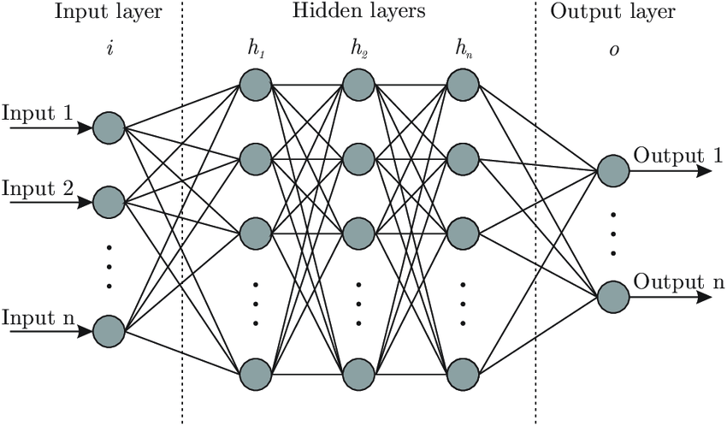
Or

Slide 9
Basic ANN Layers
Input Layer
Function: Receives the input data.
Characteristics: The number of neurons in this layer matches the number of features in the input dataset. It's the first point of contact for raw data entering the network.
Hidden Layers
Function: Perform computations and feature extractions.
Characteristics: ANNs can have one or multiple hidden layers. These layers are not directly exposed to the input or output and can be considered the "brain" of the network where most processing happens. The complexity and capacity of the model to learn from data are largely dependent on the number of hidden layers and neurons within them.
Output Layer
Function: Produces the final output of the network.
Characteristics: The configuration of the output layer depends on the specific task the network is designed to perform. For example, in a classification problem, the number of neurons might correspond to the number of classes, and the activation function might be a softmax to output probabilities of each class.

Slide 10
How ANN works
Iteration
Repetition
Convergence (achieve a satisfactory level of performance)
Backpropagation
Error calculation (loss function)
Error propagated back through the network, from the output layer towards the input layer (gradient of the loss function)
Weight update (optimization algorithm)
Forward Propagation
Input processing
Computation through layers
Output Generation
Initialization
Setting up the network (architecture)
Weight initialization
In the context of training artificial neural networks (ANNs) or any other machine learning models, an epoch refers to one complete pass through the entire training dataset. During an epoch, the model sees every sample in the dataset once, allowing it to learn from the data by adjusting its weights to minimize the loss function.

Slide 11
An ANN playground
https://playground.tensorflow.org/

Slide 12


Regularization
Regularization is a technique used to prevent overfitting in machine learning models, including Artificial Neural Networks (ANNs).
Regularization methods add a penalty on the size of the weights to the loss function, encouraging the model to learn simpler patterns that are more likely to generalize well.
L1 Regularization λ is the regularization strength or rate
some weights can become exactly zero
L2 Regularization
generally results in small weights and encourages the model to avoid fitting the noise in the training set

Slide 13
Learning rate
The learning rate in Artificial Neural Networks (ANNs) is a hyperparameter that controls how much we are adjusting the weights of our network with respect the loss gradient. Essentially, it determines the size of the steps that the model takes during the optimization process, specifically during gradient descent or its variants (e.g., SGD, Adam).
It's common to try out multiple learning rates and choose the one that leads to the best performance on a validation set.
The typical value of a learning rate can vary widely depending on the specific task, model architecture, and dataset. Values between 0.001 and 0.1 are common starting points, but the optimal range can be different based on the context.

Slide 14
Vanishing Gradient Problem
What Is It?
A phenomenon in deep neural networks where gradients shrink as they are backpropagated through layers.
This causes very small updates to weights in early layers — slowing or halting learning.
Why Does It Happen?
Common with sigmoid and tanh activation functions.
These functions saturate at extreme input values (very positive or very negative).
Their derivatives become very small → gradient ≈ 0
Why It Matters:
Early layers stop learning
Slows convergence or leads to poor performance
Especially problematic in deep networks

Slide 15
Function | Output Range | Use Case | Nonlinearity | Gradient Problems?
Sigmoid | (0, 1) | Binary classification | Yes | Yes (vanishing)
Tanh | (−1, 1) | Hidden layers (early) | Yes | Yes (less severe)
ReLU | [0, ∞) | Most hidden layers | Yes | Yes (dying ReLU)
Leaky ReLU | (−∞, ∞) | Hidden layers (alternative) | Yes | No
ELU | (−α, ∞) | Deep networks | Yes | No
Softmax | (0, 1) | Multiclass output layer | Yes | No

Slide 16
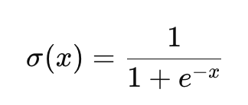
Sigmoid (Logistic Function)
Formula:
Used for: Binary classification (e.g., logistic regression)
Pros:
Smooth, bounded output.
Interpretable as probability.
Cons:
Vanishing gradient problem for large positive/negative values.
Slower convergence.
Analogy: Like a dimmer switch — it smoothly decides how much signal passes.

Slide 17
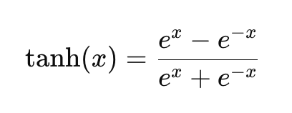
Tanh (Hyperbolic Tangent)
Range: (−1, 1)
Used for: Hidden layers in early networks
Pros:
Zero-centered output → often better than sigmoid
Smooth gradient
Cons:
Still suffers from vanishing gradient, but less than sigmoid
Analogy: Like a thermostat — it can push signal positive or negative based on conditions.

Slide 18
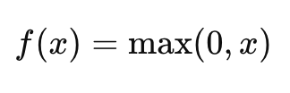
ReLU (Rectified Linear Unit)
Range: [0, ∞)
Used for: Most modern deep networks (hidden layers)
Pros:
Simple and fast to compute
Solves vanishing gradient problem for positive inputs
Cons:
Dying ReLU: Neurons can “die” (output always 0) if they receive only negative input during training
Analogy: Like a switch — either ON (x > 0) or OFF (x ≤ 0)

Slide 19
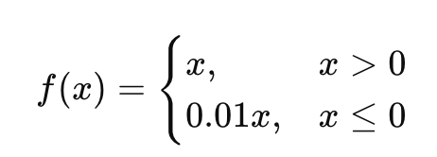
Leaky ReLU
Used for: Solves ReLU's "dying neuron" issue
Pros:
Keeps small gradient for x < 0
Still fast and simple
Cons:
The leak factor (e.g., 0.01) is a hyperparameter
Analogy: Like a leaky pipe — even when off, a trickle of signal comes through.

Slide 20
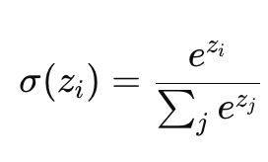
Softmax
Used for: Multiclass classification (output layer)
Pros:
Outputs sum to 1 → interpretable as probabilities
Picks the "most likely class"
Cons:
Computationally expensive
Sensitive to outliers (due to exponentials)
Analogy: Like a voting system — distributes probabilities across classes.

Slide 21
Tips
Use ReLU as your default for hidden layers.
Use Sigmoid or Softmax only in the output layer, depending on whether it’s binary or multiclass classification.
Try Leaky ReLU or ELU if your model struggles to train (e.g., dead neurons or poor convergence).

