Slide 1
Overfitting in Machine Learning

Slide 2
The problem: You trained a model that 'perfectly' fits your training data, but you found a poor performance when you apply it to another dataset.

Slide 3
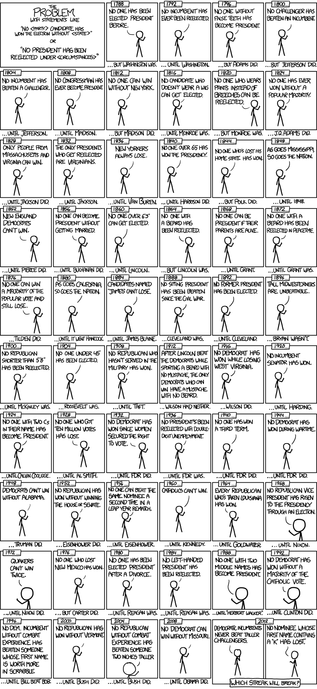
https://xkcd.com/1122/

Slide 4
Your model captured some 'wrong' or 'not useful' features (noises), but might lose some key underlying information (signals)!
In predictive modeling, you can think of the “signal” as the true underlying pattern that you wish to learn from the data.
“Noise,” on the other hand, refers to the irrelevant information or randomness in a dataset.

Slide 5
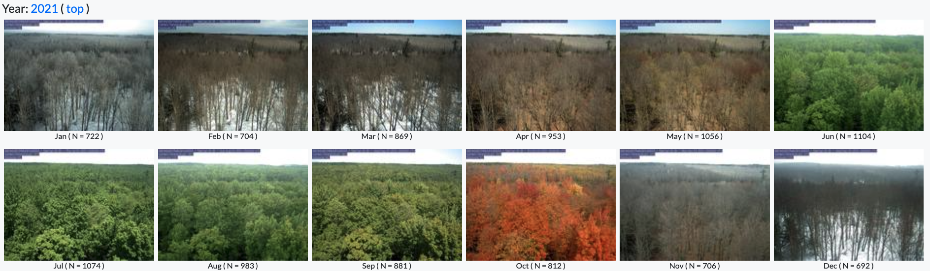
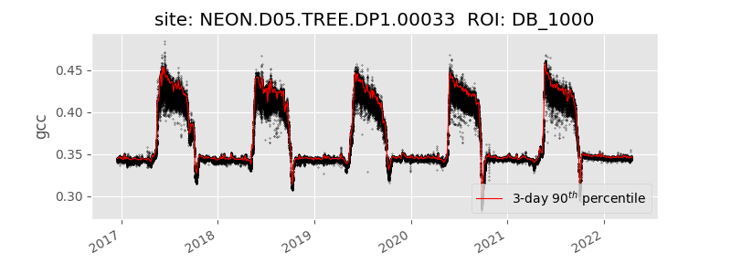
Green chromatic coordinates (GCC) of this PhenoCam site.
GCC measures the greeness of vegetation and is not expected to vary too much in a short time period (signal). But looking at the real data, we see a lot of variations. Part of them is due to the change of the illumination condition, but a lot of them are due to measurement noises.

Slide 6
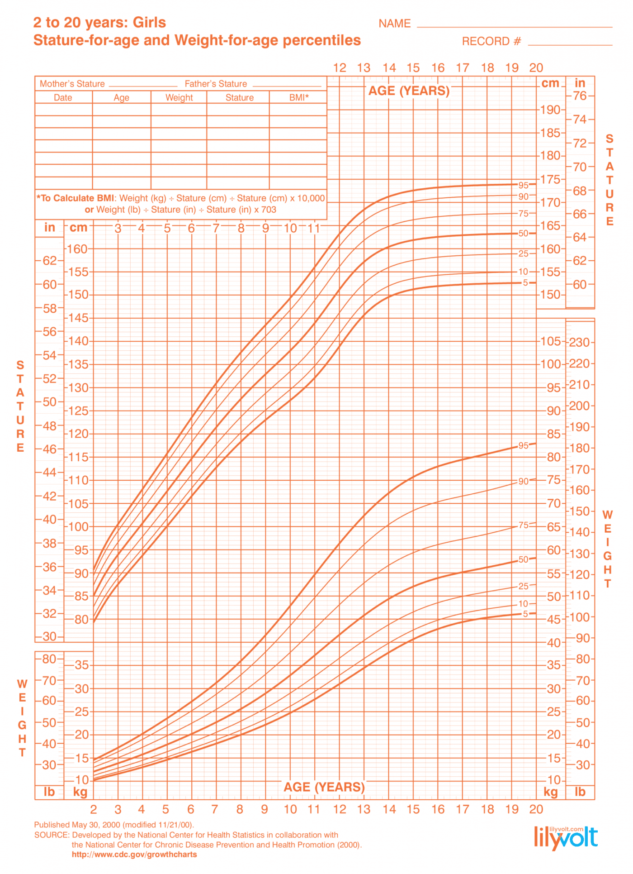
CDC growth chart for girls
This chart is the signal.
However, if you could only sample one local school, the relationship might be muddier. It would be affected by outliers (e.g. kid whose dad is an NBA player) and randomness (e.g. kids who hit puberty at different ages).

Slide 7
A well functioning ML algorithm will separate the signal from the noise.
If the algorithm is too complex or flexible (e.g. it has too many input features or it’s not properly regularized), it can end up “memorizing the noise” instead of finding the signal. This overfit model will then make predictions based on that noise. It will perform unusually well on its training data, yet very poorly on new, unseen data.

Slide 8
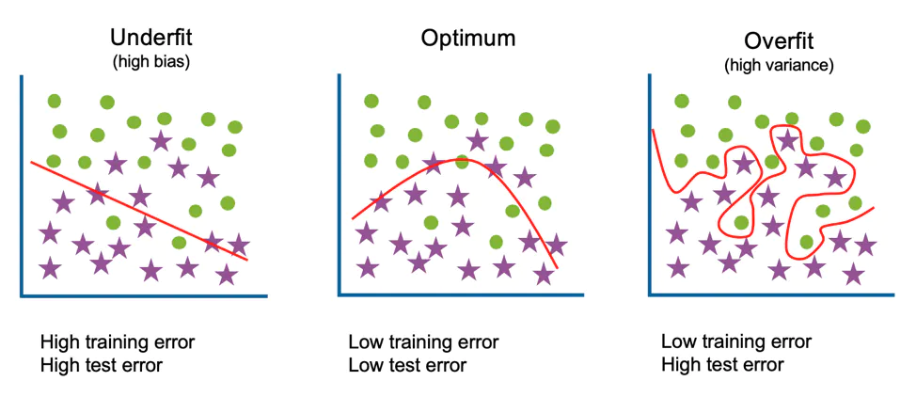
Underfit, optimum fit and overfit
Underfitting occurs when a model is too simple – informed by too few features or regularized too much – which makes it inflexible in learning from the dataset.

Slide 9
Underfit, optimum fit and overfit
Underfitting occurs when a model is too simple – informed by too few features or regularized too much – which makes it inflexible in learning from the dataset.

Slide 10
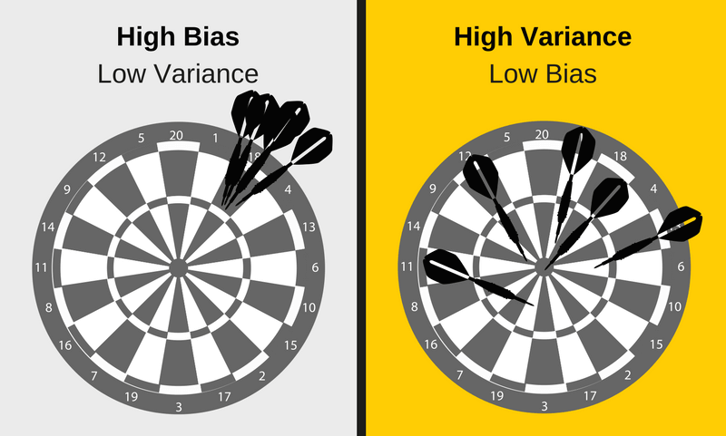
Bias vs. Variance
Simple learners tend to have less variance in their predictions but more bias towards wrong outcomes.
On the other hand, complex learners tend to have more variance in their predictions.
Both bias and variance are forms of prediction error in machine learning.
Typically, we can reduce error from bias but might increase error from variance as a result, or vice versa.
This trade-off between too simple (high bias) vs. too complex (high variance) is a key concept in statistics and machine learning, and one that affects all supervised learning algorithms.
https://elitedatascience.com/bias-variance-tradeoff

Slide 11
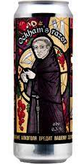
How to Detect Overfitting
Split our initial dataset into separate training and test subsets.
This method can approximate of how well our model will perform on new data.
If our model does much better on the training set than on the test set, then we’re likely overfitting.
For example, it would be a big red flag if our model saw 99% accuracy on the training set but only 55% accuracy on the test set.
Another tip is to start with a very simple model to serve as a benchmark.
Then, as you try more complex algorithms, you’ll have a reference point to see if the additional complexity is worth it.
This is the Occam’s razor test. If two models have comparable performance, then you should usually pick the simpler one.

Slide 12
Occam’s Razor
The idea comes from a 14th-century Franciscan friar named William of Ockham (or Occam). He was a philosopher and theologian — and a bit of a minimalist, at least in thought.
At a time when people were explaining things with angels, aether, and complex divine mechanisms, William stepped in with a bold idea:
“Don’t make things more complicated than they need to be.”
In other words: if two explanations work, pick the simpler one.

Slide 13
Examples
1. Flat Tire or Alien Vandalism?
Your bike tire is flat.
Simple explanation: You ran over a nail.
Complex explanation: Aliens came at night and slashed your tire.
→ Occam’s Razor says: Go with the nail.

Slide 14
Examples
2. Car Won’t Start
Simple: Battery’s dead.
Complex: Someone hacked your car remotely and disabled the starter.
→ Occam’s Razor picks: Dead battery.

Slide 15
I wasn’t able to find my phone last week
Maybe I left it at home. Reasonable.
Maybe it slipped between the couch cushions. Also plausible.
Maybe I dropped it in the parking lot. Possible.
Maybe someone cloned me, stole my phone, and is using it to teach a competing ML course across campus. 😱
Or… what if it teleported into an alternate dimension? Multiverse problems.
The simplest explanation that fits the facts is usually the right one. Don’t build a 300-layer neural net to solve a problem a linear model could’ve handled.

Slide 16
How to Prevent Overfitting
Cross Validation
Train with more data
Remove features
Early stopping
Regularization
Ensembling
…

Slide 17
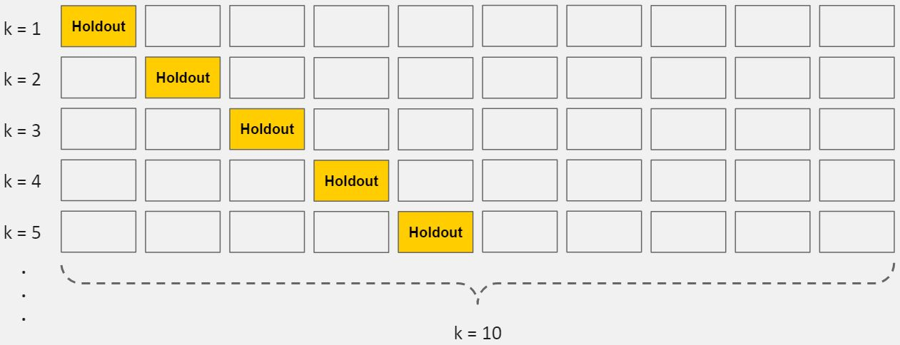
Cross-validation
Cross-validation is a powerful preventative measure against overfitting.
The idea is clever: Use your initial training data to generate multiple mini train-test splits. Use these splits to tune your model.
In standard k-fold cross-validation, we partition the data into k subsets, called folds. Then, we iteratively train the algorithm on k-1 folds while using the remaining fold as the test set (called the “holdout fold”).
Cross-validation allows you to tune hyperparameters with only your original training set. This allows you to keep your test set as a truly unseen dataset for selecting your final model.

Slide 18
Train with more data
It won’t work every time, but training with more data can help algorithms detect the signal better. In the earlier example of modeling height vs. age in children, it’s clear how sampling more schools will help your model.
Of course, that’s not always the case. If we just add more noisy data, this technique won’t help. That’s why you should always ensure your data is clean and relevant.

Slide 19
Remove features/Dimensionality Reduction
Goal: Pick the most relevant features (variables) and remove the irrelevant or redundant ones.
Why it's important:
Too many features = more chance for the model to memorize noise (overfit).
Redundant features can confuse the model.
Makes the model simpler, faster, and easier to interpret.
Imagine you're predicting house prices, and you have these features:
square_footage, number_of_rooms, zip_code, color_of_front_door, owner’s_favorite_ice_cream_flavor.
Clearly, some features like owner’s_favorite_ice_cream_flavor or even color_of_front_door are irrelevant—they add noise, not signal.
Some algorithms have built-in feature selection; for those that don’t, you can manually improve their generalizability by removing irrelevant input features.

Slide 20
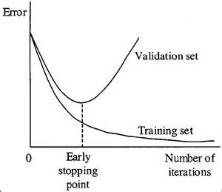
Early Stopping
Stopping the training before the model starts to overfit
When you’re training a learning algorithm iteratively, you can measure how well each iteration of the model performs.
Up until a certain number of iterations, new iterations improve the model. After that point, however, the model’s ability to generalize can weaken as it begins to overfit the training data.
Today, this technique is mostly used in deep learning

Slide 21
Regularization
Regularization refers to a broad range of techniques for artificially forcing your model to be simpler.
The method will depend on the type of learner you’re using. For example, you could prune a decision tree, use dropout on a neural network, or add a penalty parameter to the cost function in regression.
L1 and L2 regularizations
Oftentimes, the regularization method is a hyperparameter as well, which means it can be tuned through cross-validation.

Slide 22
Ensembling
Ensembles are machine learning methods for combining predictions from multiple separate models. Think of it like asking multiple experts and taking a consensus—you often get better results than relying on just one.
Main types of Ensemble methods:
Bagging (Bootstrap Aggregating)
How: Train the same algorithm on different bootstrap samples (random subsets with replacement) and average their predictions (for regression) or vote (for classification).
Radom Forest
Boosting:
How: Models are trained sequentially, with each model trying to correct the errors of the previous one.
Gradient Boosting, XGBoost, LightGBM
Stacking – combine strength of different models
How: Train several base models (e.g., logistic regression, decision trees, SVM), then train a meta-model on their outputs.
Example:
Train 3 models: Random Forest, XGBoost, and SVM.
Use their predictions as inputs to train a final model (e.g., logistic regression).
You’re like a judge combining inputs from multiple specialists to make a final decision.

Slide 23
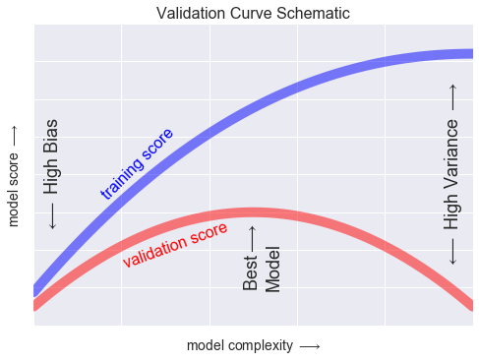
Validation curve
For high-bias models, the performance of the model on the validation set is similar to the performance on the training set.
For high-variance models, the performance of the model on the validation set is far worse than the performance on the training set.
The training score is everywhere higher than the validation score. This is generally the case: the model will be a better fit to data it has seen than to data it has not seen.
For very low model complexity (a high-bias model), the training data is under-fit, which means that the model is a poor predictor both for the training data and for any previously unseen data.
For very high model complexity (a high-variance model), the training data is over-fit, which means that the model predicts the training data very well, but fails for any previously unseen data.
For some intermediate value, the validation curve has a maximum. This level of complexity indicates a suitable trade-off between bias and variance.

Slide 24
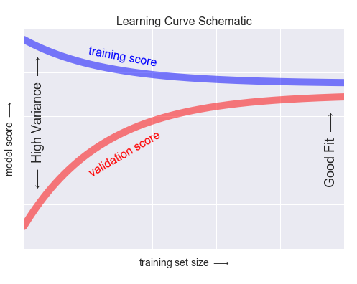
Learning curve
The behavior of the validation curve has not one but two important inputs: the model complexity and the number of training points. It is often useful to explore the behavior of the model as a function of the number of training points, which we can do by using increasingly larger subsets of the data to fit our model. A plot of the training/validation score with respect to the size of the training set is known as a learning curve.
The general behavior we would expect from a learning curve is this:
A model of a given complexity will overfit a small dataset: this means the training score will be relatively high, while the validation score will be relatively low.
A model of a given complexity will underfit a large dataset: this means that the training score will decrease, but the validation score will increase.
A model will never, except by chance, give a better score to the validation set than the training set: this means the curves should keep getting closer together but never cross.
We expect to see learning curve like this

Slide 25
Validation in Practice: Grid Search
The preceding discussion is meant to give you some intuition into the trade-off between bias and variance, and its dependence on model complexity and training set size. In practice, models generally have more than one knob to turn, and thus plots of validation and learning curves change from lines to multi-dimensional surfaces. In these cases, such visualizations are difficult and we would rather simply find the particular model that maximizes the validation score.
Scikit-Learn provides automated tools to do this in the grid search module. Here is an example of using grid search to find the optimal polynomial model. We will explore a three-dimensional grid of model features; namely the polynomial degree, the flag telling us whether to fit the intercept, and the flag telling us whether to normalize the problem. This can be set up using Scikit-Learn's GridSearchCV meta-estimator.

