Slide 1
Random Forest
Min Chen

Slide 2
Game
1 | Red | Smooth | Small | Yes
2 | Yellow | Rough | Medium | No
3 | Red | Rough | Small | No
4 | Green | Smooth | Large | Yes
5 | Yellow | Smooth | Medium | Yes
6 | Red | Smooth | Large | Yes
7 | Green | Rough | Small | No
8 | Yellow | Rough | Small | No
9 | Red | Smooth | Medium | Yes
10 | Green | Smooth | Small | Yes
Write a simple classification rule. Examples:
“If Color is Red, then Edible = Yes.”
“If Texture is Rough and Size is Small, then Edible = No.”
Rules - just 1 or 2 conditions.

Slide 3
Color: Red, Size: Medium, Texture: Smooth
What’s your prediction?
1 | Red | Smooth | Small | Yes
2 | Yellow | Rough | Medium | No
3 | Red | Rough | Small | No
4 | Green | Smooth | Large | Yes
5 | Yellow | Smooth | Medium | Yes
6 | Red | Smooth | Large | Yes
7 | Green | Rough | Small | No
8 | Yellow | Rough | Small | No
9 | Red | Smooth | Medium | Yes
10 | Green | Smooth | Small | Yes

Slide 4
Discussion
Were individual rules always correct?
How did the ensemble compare?
What happened if you had a poor sample? Did the group still predict well?

Slide 5
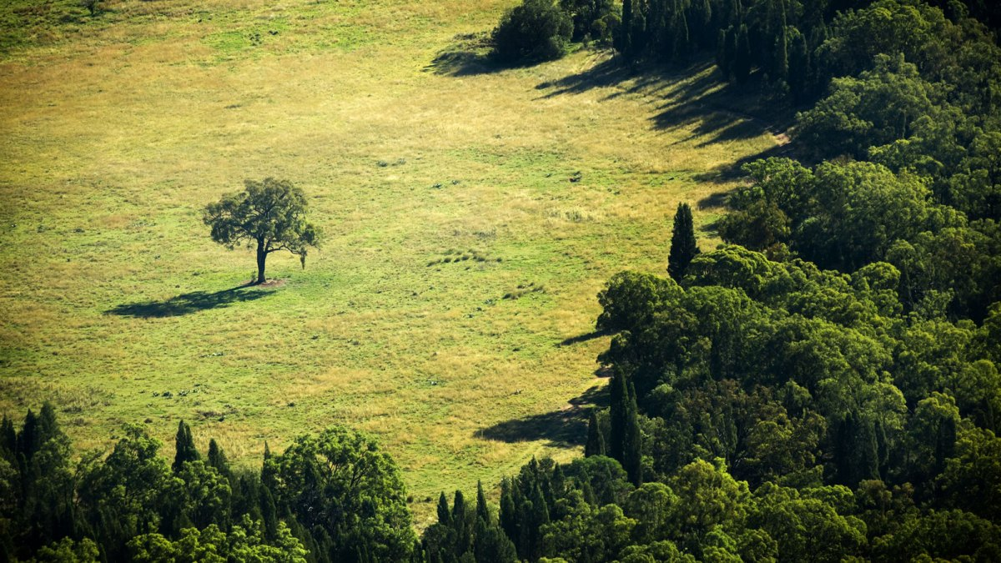
Tree
Forest

Slide 6
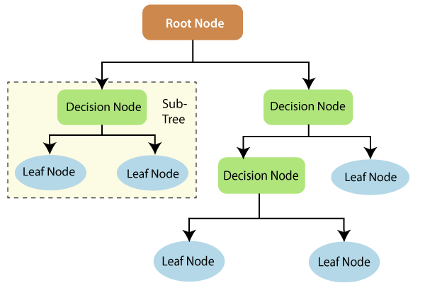
Recap: Decision tree
Tree Building Process:
Training data is split into branches based on features.
Branching continues until leaf nodes (indivisible outcomes) are reached.
Role of Nodes:
Each node represents a feature/attribute used to predict the outcome.
Leaf nodes contain the final decision
Key Concepts in Information Theory:
Entropy: Measures uncertainty or impurity in the data.
Information Gain: Reduction in entropy when a feature is used to split the data.
Higher information gain indicates a better feature for splitting.
Decision Tree Training:
At each node, the algorithm chooses the feature with the highest information gain.
This helps reduce uncertainty and improves model accuracy.

Slide 7
Limitations of Decision Trees
Overfitting
Deep trees tend to memorize training data, leading to poor generalization on unseen data.
High Variance
Small changes in the data can result in a completely different tree structure, making decision trees unstable.
Greedy Splits
Trees make locally optimal decisions at each node, which may not lead to the best global tree.
Bias Toward Dominant Features
Features with more categories or continuous values may dominate splits, even if they're not most relevant.

Slide 8
From decision tree to random forest
Randomness in Node Selection:
Unlike decision trees, Random Forest selects root and split nodes randomly to build diverse trees.
Bagging (Bootstrap Aggregation):
Random Forest uses multiple samples of the training data (via sampling with replacement) to build multiple trees.
This increases diversity and reduces overfitting.
Notes:
In Random Forest, the choice of root and internal nodes is not fixed like in a single decision tree. Instead, features are chosen randomly at each split to create diverse decision trees.
Example: Imagine you're building different “if-then” logic trees to decide which phone to buy. In one tree, the first question is “Is it under $500?”, while another tree starts with “Does it have 128GB storage?”. By varying the first and intermediate questions (nodes), you get different perspectives on the same decision.
Random Forest trains each tree on a random subset of the data, sampled with replacement. This is called bagging, and it ensures that each tree sees a slightly different version of the training data.
Example: Suppose 100 people give their opinions on what makes a good phone. You randomly ask 70 of them (with repeats allowed) for their opinion, and build one decision tree. Then you randomly ask another group (again with repeats) for another tree. Different people → different perspectives → diverse trees.

Slide 9
From decision tree to random forest
Multiple Decision Trees:
A forest of decision trees is created instead of relying on a single tree.
Each tree is trained on a different subset of the data.
Random Feature Selection:
At each split, a random subset of features is considered to split the node, improving robustness and reducing correlation between trees.
Notes:
Instead of using one decision tree, Random Forest uses many trees, each making its own prediction.
Example: If one friend tells you to buy a phone based on price, and another says buy based on camera quality, and another says based on battery life—you get many decision trees. Each tree has its own criteria, and you combine their opinions for a better-informed decision.
At each decision point in the tree, only a random subset of features is considered. This introduces more variation and prevents dominant features from biasing the model.
Example: Say you're choosing a phone based on 10 features (price, camera, RAM, battery, etc.). When building one tree, you only allow it to choose splits from 3 randomly selected features at each level. It forces the tree to look at different aspects of the phones rather than always starting with price.

Slide 10
From decision tree to random forest
Majority Voting for Classification:
Each tree gives a prediction.
The final output is based on majority vote among the trees (e.g., 3 out of 4 trees say “buy” → prediction is “buy”).
Final Output from Leaf Nodes:
Each decision tree ends at a leaf node representing its individual prediction.
Random Forest aggregates these for a final decision.
Ensemble Approach:
Combines predictions from multiple independent decision trees to achieve better accuracy and generalization than a single tree.
Notes:
Each tree gives a classification result, and the final output is chosen by majority vote.
Example: Suppose 4 friends (trees) give their opinion:
3 say “Buy this phone”
1 says “Don’t buy” Since 3 out of 4 say “Buy,” the Random Forest final decision is “Buy.”
Each decision tree ends in a leaf node, which represents the tree’s final output for a given input.
Example: You follow a decision tree path like:
Is price < $500? → Yes
RAM ≥ 6GB? → Yes
Has fast charging? → No → Leaf node = “Do Not Buy” You repeat this across multiple trees and combine the results.
Random Forest is an ensemble method: it combines the “wisdom of crowds.” Even if individual trees make mistakes, their combined decision is usually much more accurate.
Example: If you ask one friend for advice on buying a phone, they might be biased. But if you ask 100 friends and most recommend the same phone, you’re more confident. This is the essence of an ensemble: more opinions, less error.

Slide 11
What is Bootstrapping?
Bootstrapping is a statistical method where we sample with replacement from a dataset to create multiple new datasets of the same size.
Intuition:
Suppose you have a class of 100 students.
You want to create new “mock classes” of 100 students each by randomly selecting students with replacement.
That means some students might appear multiple times in a mock class, while others may be left out.
Key Characteristics:
Same size as the original dataset.
With replacement → duplicates allowed.
On average, about 63% of the original data points appear in each bootstrap sample (some multiple times).

Slide 12
What is Bagging (Bootstrap Aggregating)?
Bagging = Bootstrap Sampling + Aggregation
It’s a technique to improve model stability and accuracy by combining predictions from multiple models trained on different bootstrap samples.
Intuition:
Think of bagging as asking multiple different groups (each with slightly different opinions) the same question, and then aggregating their answers.
Steps in Bagging:
Generate multiple bootstrap samples from the training data.
Train a model (e.g., decision tree) on each sample.
Aggregate the predictions:
Classification → majority vote
Regression → average

Slide 13
Relate the game to Random Forest:
Each of you = a decision tree
Your bootstrap sample = training data for that tree
Your rule = the tree’s output
The class = the forest
The vote = final ensemble prediction

